Slide 1
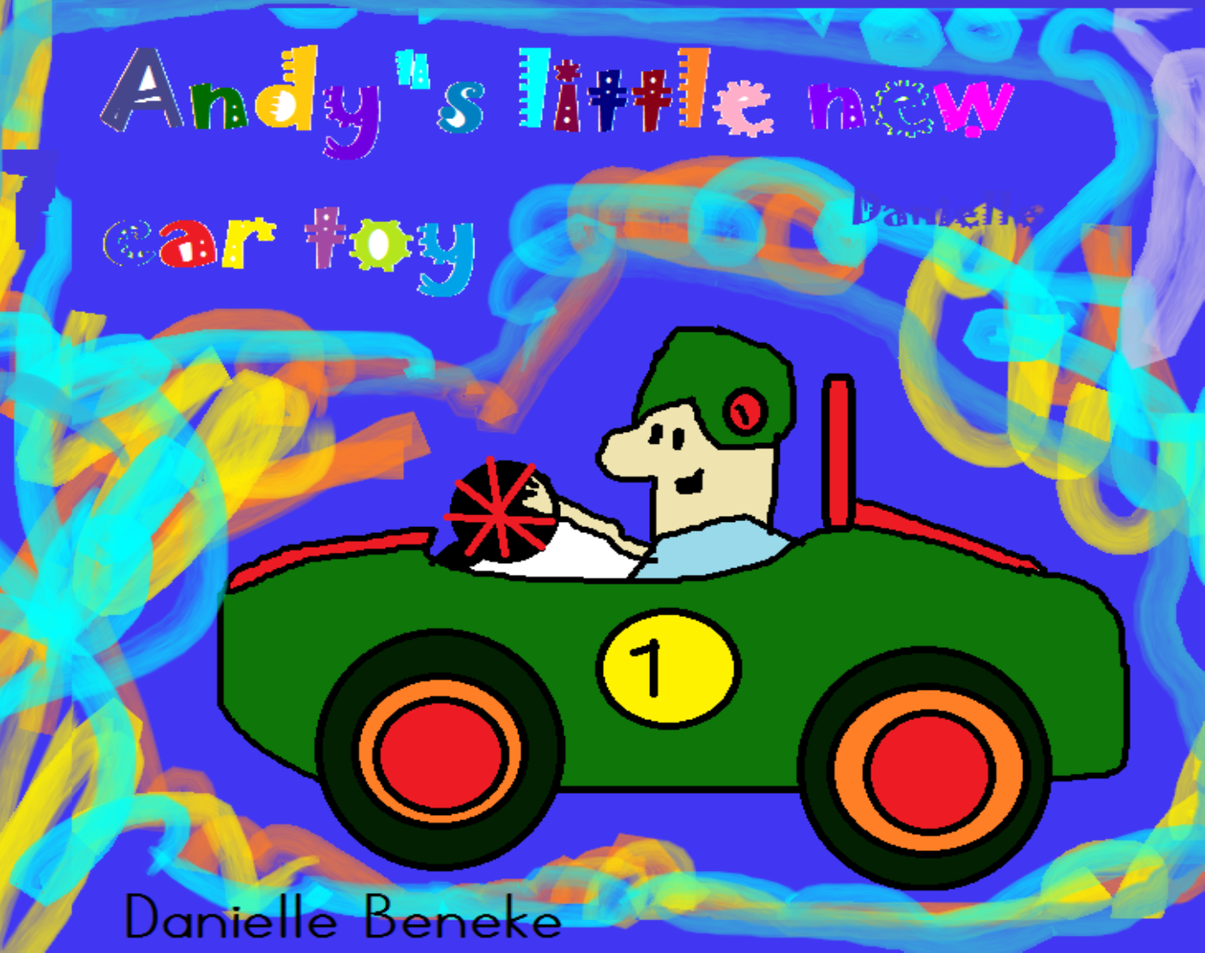

Written and illustrated by

Slide 2
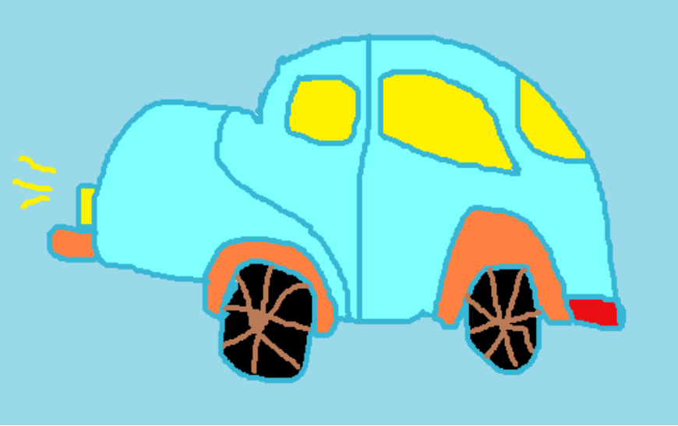
One day there was a little boy, his name was Andy.

Slide 3
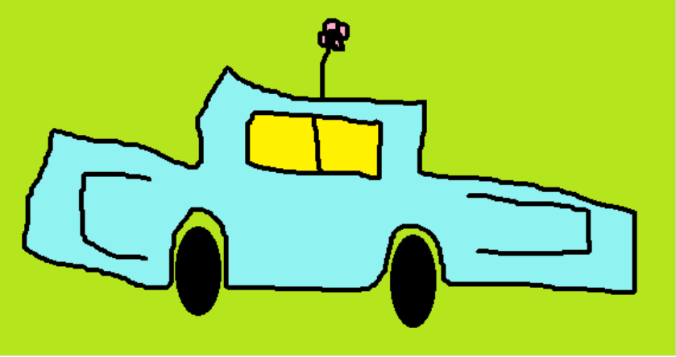
Andy was a very selfish boy, especially with his toys.
He was finally old enough to go to kindergarten.

Slide 4
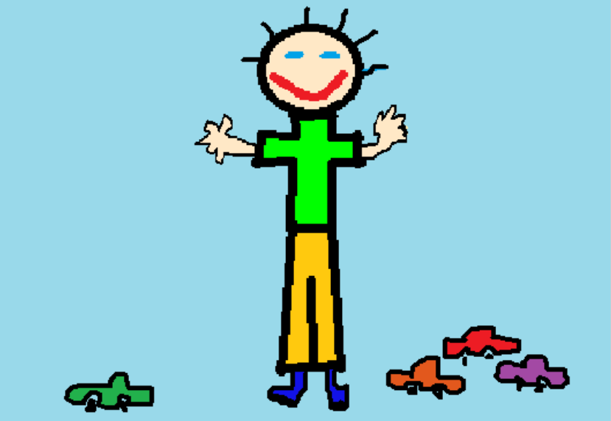
When he got to kindergarten, all the children wanted to play with him and his toys.

Slide 5
Andy was not very happy, because he wanted to play alone with his toys. He hated sharing his toys!

Slide 6
He ran away and said he wanted to play by himself.

Slide 7
He did not know why he didn’t have any friends.

Slide 8
All the children hated him, because every time they wanted to play with him, he said no!!!

Slide 9
Andy was all alone. When he got home, he asked his mom why all the children don’t want to play with him.

Slide 10
Mom said, “Don’t be sad, I think I know why nobody wants to play with you, if the children asks you to play, don’t chase them away, say yes. Let the children play with you and with your toys.”

Slide 11
The next day Andy shared all of his toys. Andy learned that to be selfish makes you lonely.
Andy made a lot of friends when he became less selfish.

Slide 12
Mom was so proud of Andy and bought him some new toys. Andy was so excited, he called all of his friends and asked them to come play with him at his home. Everyone came and enjoyed playing together!

Slide 13
Andy, a very selfish boy didn’t want children to play with his toys. He had no friends and was very lonely. His mom helped him to realize that in order to have friends, he had to be less selfish.
Illustrated by :Danielle Beneke

