Slide 1
LIASA 2014
Celebrating libraries in 20 years of democracy
Johannesburg, South Africa
20 – 25 September 2014

Slide 2
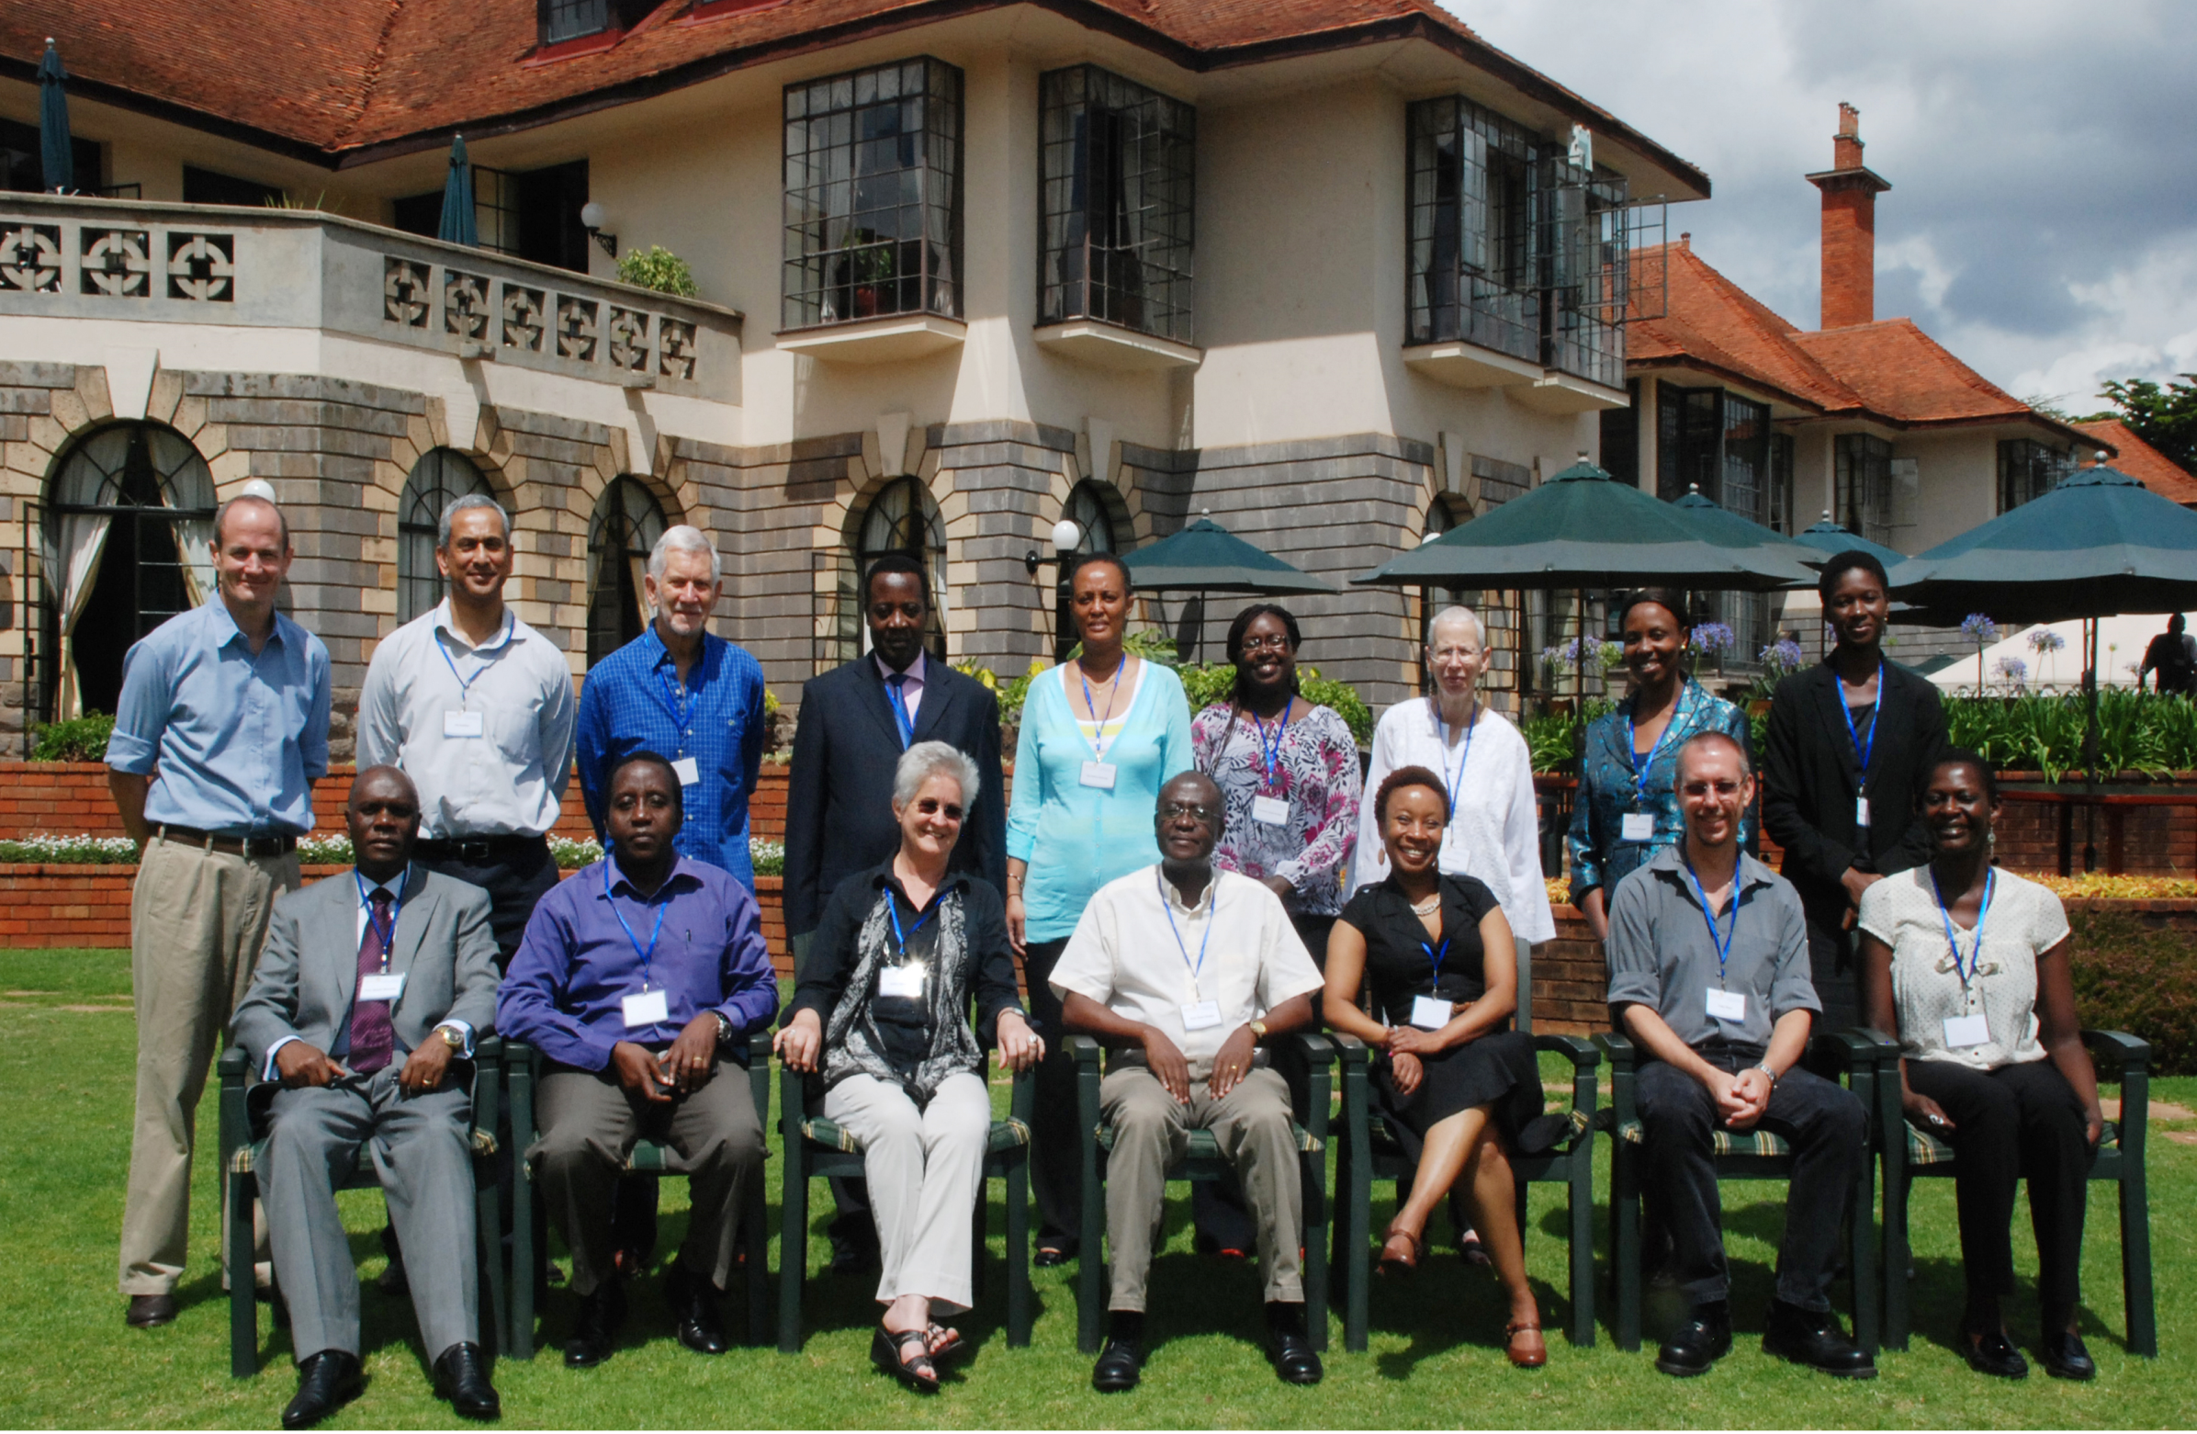
Open Educational resources for the African Context: Investing in the Future
A presentation by OER Africa – 24th September 2014

Slide 3
OER Definition
Open Educational Resources (OERs) are any type of educational materials that are in the public domain or introduced with an open license.
The nature of these open materials means that anyone can legally and freely copy, use, adapt and re-share them.
OERs range from textbooks to curricula, syllabi, lecture notes, assignments, tests, projects, audio, video and animation.
UNESCO

Slide 4
… undergraduate education is not just about discipline specific knowledge or cognitive skills;
instead, dispositions and cognitive skills that enable graduates to be effective citizens are also valued outcomes for students completing a bachelor’s degree.
Chan et al (2013)
Notes:
Chan et al (2013) See Roy Y. Chan Boston College; Gavin T. L. Brown, The University of Auckland; Larry H. Ludlow, Boston College., “What is the purpose of higher education?: A comparison of institutional and student perspectives on the goals and purposes of completing a bachelor’s degree in the 21st century.” Paper presented at the annual Association for the Study of Higher Education (ASHE) conference. St. Louis, MO: November 15, 2013. Downloaded from: https://www.academia.edu/2626994/What_is_the_purpose_of_higher_education_Comparing_student_and_institutional_perspectives_for_completing_a_bachelors_degree_in_the_21st_century on December 16th 2013

Slide 5
Africa’s HE Context
Changing student profiles
Continuing students, mature students, part-time, professional…
New demands from learners
Ubiquitous access (VLEs, VLs, Open Access Journals, etc.)
New pressures on HE systems
Delivery: face to face, distance, blended mode
Content: relevant, interactive, appropriate
New pressures on governments
Funding, connectivity, reliable power
Notes:
Image: http://wp.vcu.edu/medcgsa/wp-content/uploads/sites/2847/2013/05/graduation-cap-and-diploma.jpg

Slide 6
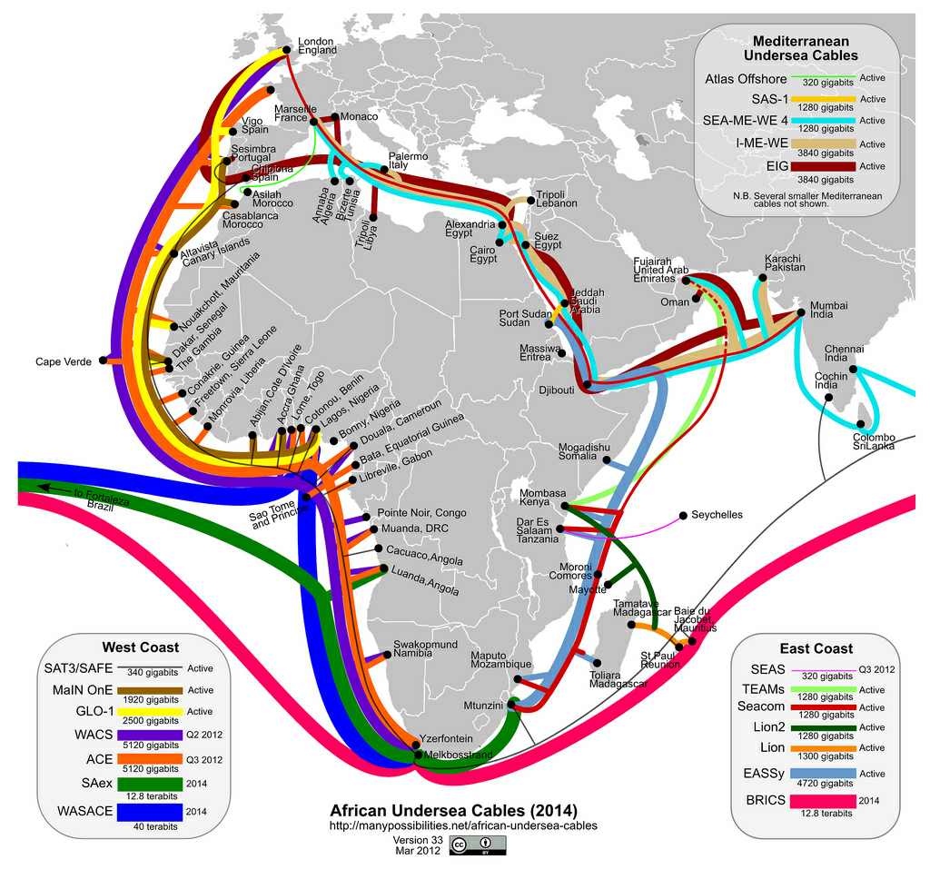
Notes:
http://jellyfishcoolman.files.wordpress.com/2009/07/african-submarine-fibre-optic-cables.jpg
Spinal Image: http://www.murrelektronik.com

Slide 7
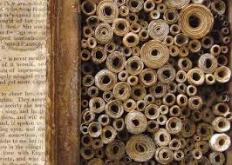
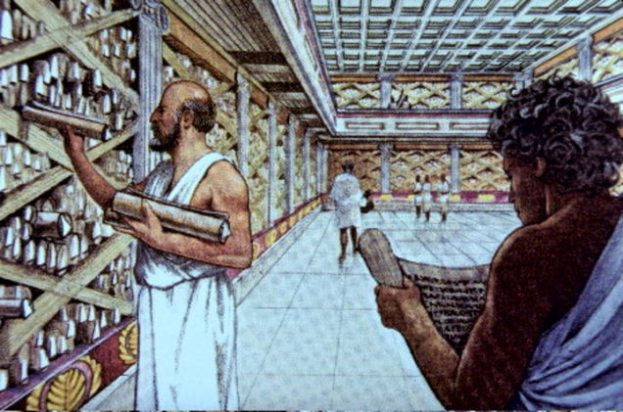
Yesterday’s Librarian
 | Provided Content | Space | Services | Skills
Used to be print-based: | Books Access to secure resources | Library buildings: used for work for collection for storage | how to find those books | Subject expertise Customer - relations
Notes:
Library at Alexandra (scrolls): http://www.crystalinks.com/libraryofalexandria.html and https://encrypted-tbn2.gstatic.com/images?q=tbn:ANd9GcRenwrMH7SbvwlbB3nt2mQI1FxPxgg6axV9tvaaebRLAy6cgw6HyA

Slide 8
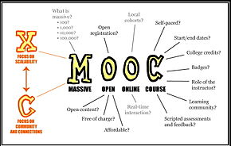
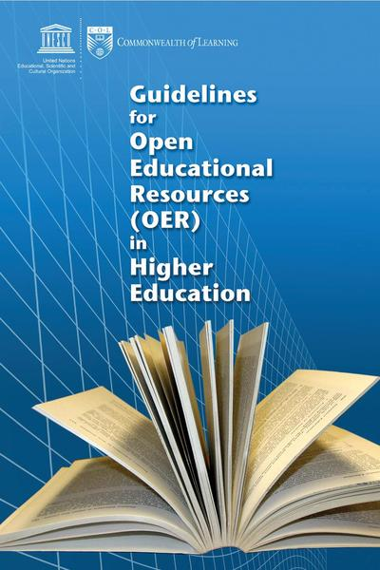
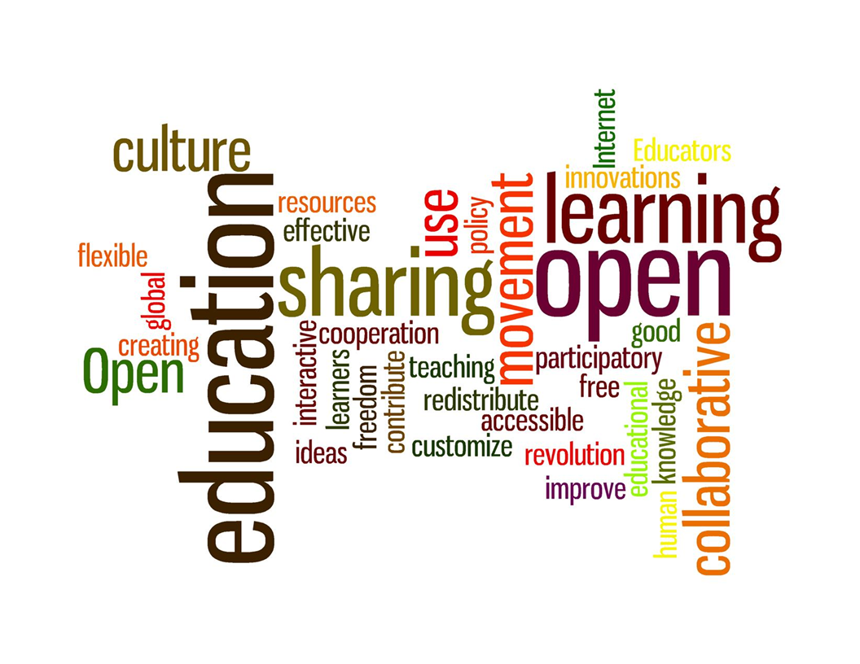
Notes:
Open Education sign… http://ctlt.ubc.ca/programs/communities-of-practice/open-education/
Come in.. http://learningcatalyst.org/welcome/?p=79
MOOC… http://en.wikipedia.org/wiki/Massive_open_online_course
Guidelines… http://commons.wikimedia.org/wiki/File:Guidelines_for_Open_Educational_Resources_%28OER%29_in_Higher_Education.pdf
The Open Classroom… http://beyondthescores.wordpress.com/2012/10/14/the-open-classroom/
Creative Commons… http://www.scribemedia.org/2009/01/23/commons-commons-whats-non-commercial-anyway/

Slide 9
Why institutionalize OER?
Open licensing provides a cost-effective means to increase investment in creating more effective teaching and learning environments using resource-based learning.
Notes:
Need to keep up with the new roles and ways of working:
Team-based curriculum design and materials development including students
E-tutoring Saide Supporting distance learners.docx
Ongoing CPD, LLL: e.g. AfriVip

Slide 11
Use of OER in African HEIs
Openly share skills-based relevant OER across institutions and thus:
Encourage the development of 21st century skills amongst students in-school and potential out-of-school students / life-long learners to new
Ways of thinking: Creativity, critical thinking, problem-solving, decision-making and learning
Ways of working: Communication and collaboration
Tools for working: Information and communications technology (ICT) and information literacy
Skills for living in the world: Citizenship, life and career, and personal and social responsibility

Slide 13
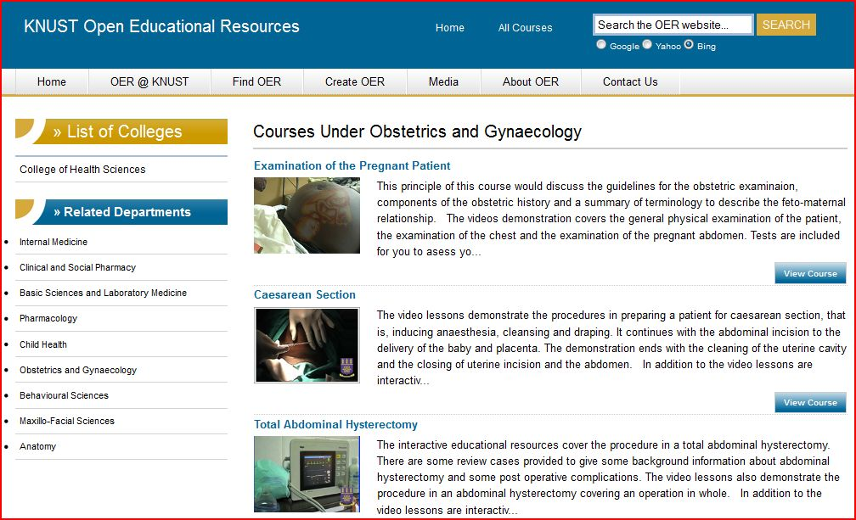
Notes:
http://web.knust.edu.gh/oer/pages/
Rationale for Health OER
African health sector aware of the need to develop socially relevant and culturally appropriate training materials and experiences:
Need to find new ways of delivering health education content in a format that will enable students to have increased access to the material, e.g.
case based studies using video or print;
recorded demonstrations by clinical experts of techniques in history taking, physical examination, and clinical procedures made available to students for review and practice in their own time. (Clinical Skills Demonstration)

Slide 15
Resource Details
Resource Name : | University Certificate in Midwifery
Resource Description : | This CD ROM has been developed to support the UCM and upgrading midwifery programmes. It combines a number of new strategies that are being piloted by MCH department to respond to the national needs within the Health sector. These include reducing maternal and neonatal morbidity and mortality in relation to Millennium Development Goals 4, 5 & 6. Consequently this course embraces the latest methodology (Problem Based Learning) and technologies (Computer based education) in an attempt to be relevant and effective in preparing new midwifes. The materials on the CD ROM have been authored by both University of Malawi - Kamuzu College of Nursing and foreign experts.
Resource Author : | University of Malawi, Kamuzu College of Nursing
Resource Source : | University of Malawi, Kamuzu College of Nursing
Resource Tags : | nursing, Problem Based Learning, maternal and neonatal morbidity, Computer based education,
Resource Type : | Modules, Training Notes/Materials/Tutorials
Resource Year : | 2009
Resource Licensing Condition : | Creative Commons: Attribution-Non Commercial Share Alike 2.5
Resource Media Type : | Text/HTML
Resource Language : | English

Slide 16
OER Adaptation
Adaptation of a learning module on Episiotomy
2009: University of Ghana and University of Michigan create a teaching module on Episiotomy and Repair, which they share through the African Health OER Network.
2013: module is adapted for use by physicians at St. Paul Millennium Medical Hospital in Ethiopia to train Obstetrics and Gynaecology residents.
Adaptation contains the same surgical video and many of the same self-assessment questions as the original version.
The adaptation includes audio commentary and additional text by an Ethiopian physician with additional questions for his students in Addis Ababa, noting the similarities and differences in how the procedure is performed in Ghana.

Slide 17
http://www.tessafrica.net/
Notes:
Teacher Education – customised by language, by country, etc.

Slide 18
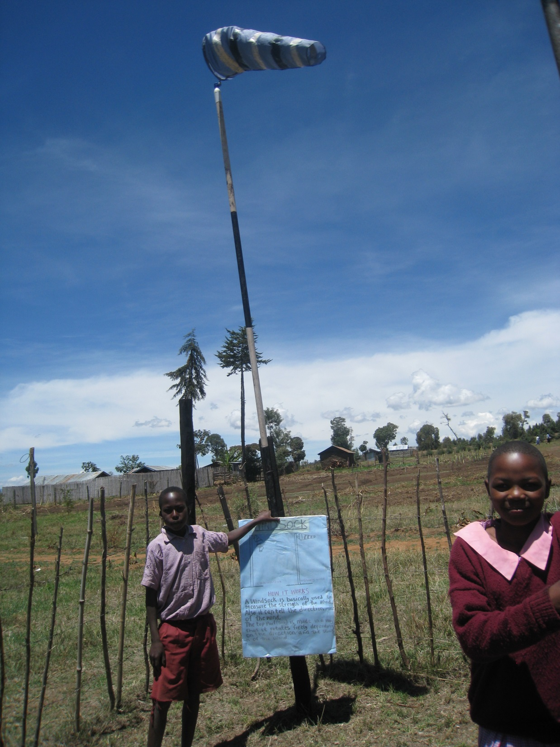
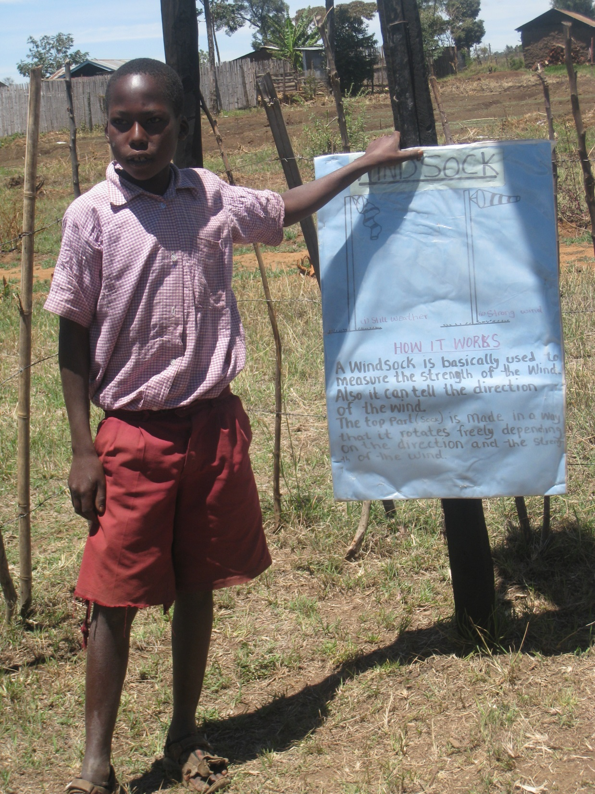
HOW IT WORKS

Slide 19
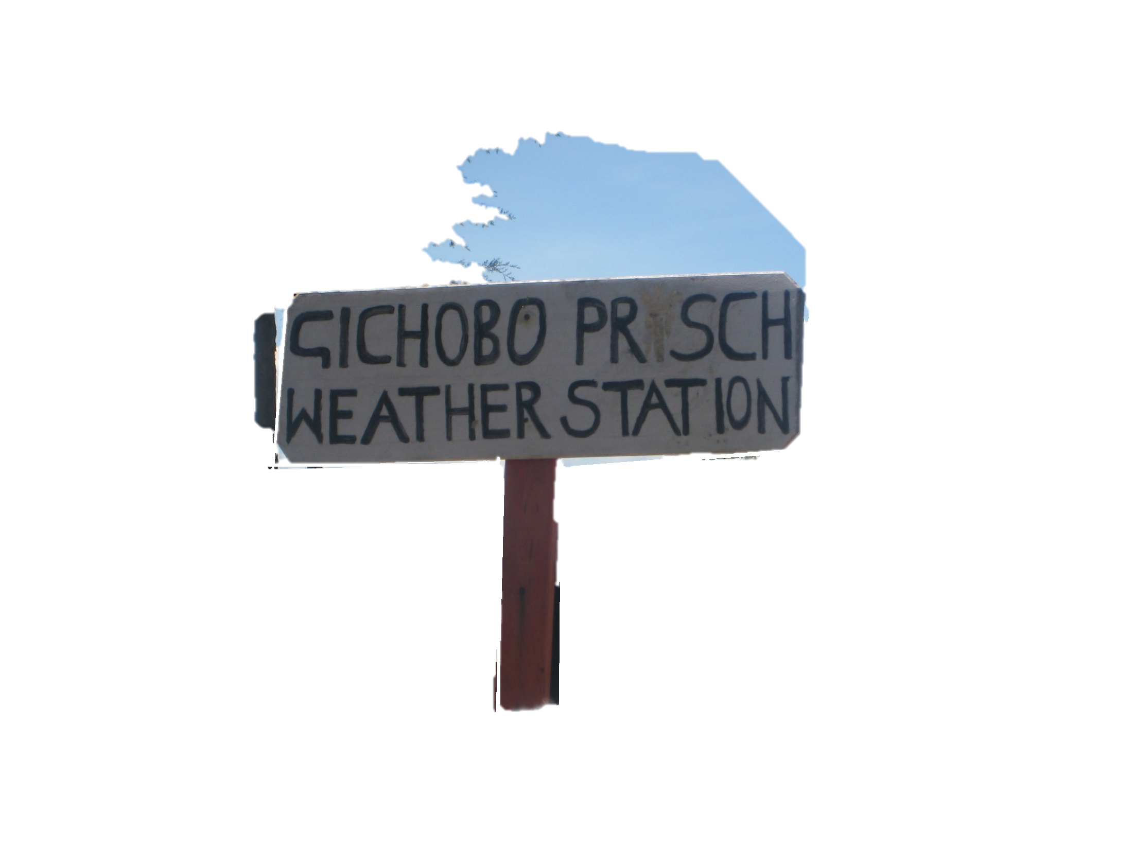
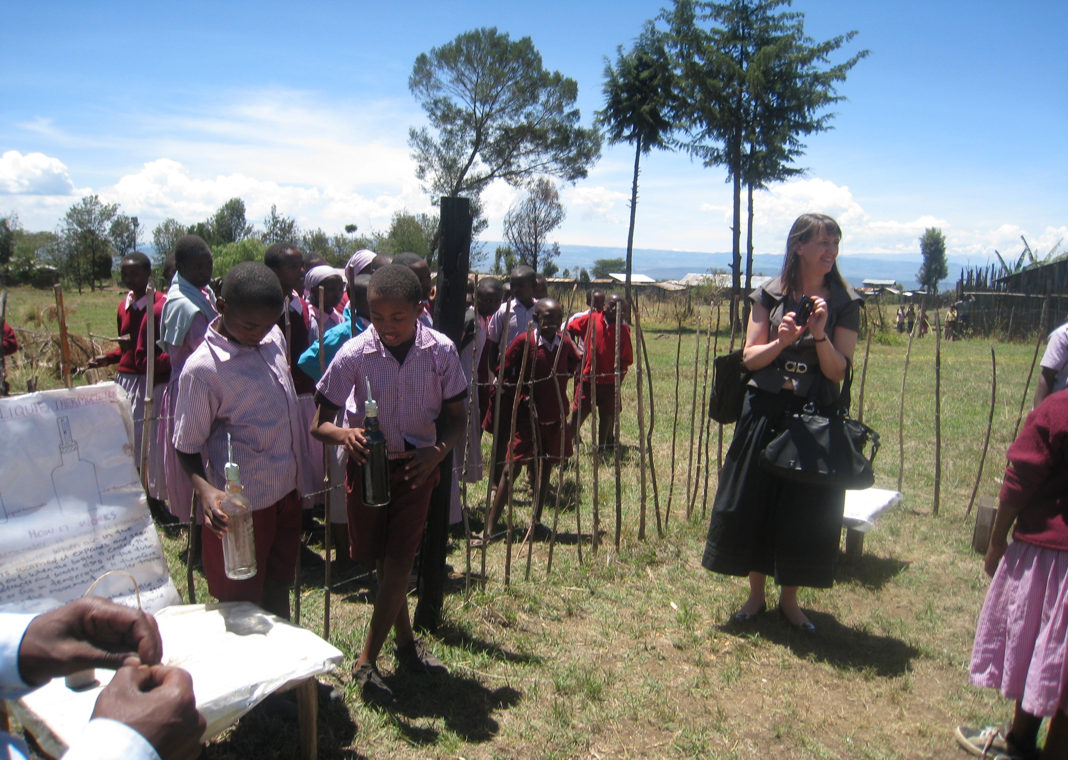
LIQUID THERMOMETRE

Slide 20
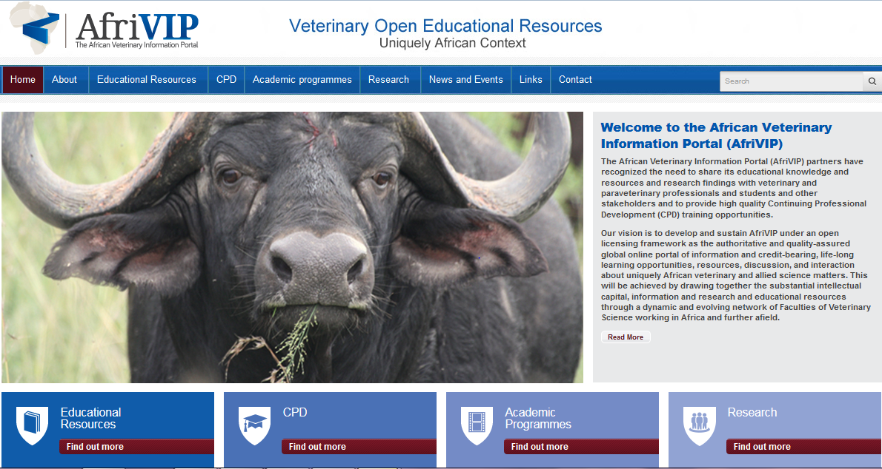
Notes:
Welcome to the African Veterinary Information Portal (AfriVIP)
The African Veterinary Information Portal (AfriVIP) will be positioned as the authoritative, global online portal of information and credit-bearing, life-long learning opportunities, resources, discussion, and interaction about African veterinary and allied sciences matters. All the resources are Open Education Resources (OER) and therefore carry an open license (Creative Commons), allowing it to be freely copied, distributed, and adapted without asking copyright permission.
The Faculty of Veterinary Science, University of Pretoria, and its partners, has recognized the need to provide high quality Continuing Professional Development (CPD) training for veterinarians and allied professions including para-veterinary professionals. This has initiated the development of the African Veterinary Information Portal (AfriVIP), for veterinary training and information and a training platform of the OIE Collaborating Centre for Training in Integrated Livestock and Wildlife Health and Management.

Slide 21
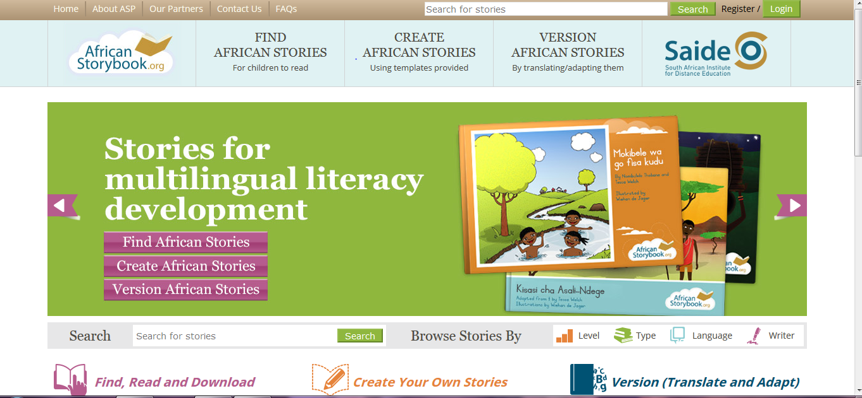

Slide 22
e-books, journals and databases,
hybrid of both print and digital resources
Digital content, remote content, 24 hour accessibility to content
physical & digital space:
access to content
managing and preserving content created by institutions
preserving the nation's cultural heritage
zoned study environments:
traditionally silent areas
open access
multi-media equipment
Content
Space
training and teaching people to use and access information
network services and digitalised content
up to date with latest web-based technology
Services
Skills
Subject, customer and leadership
Higher level IT skills, e.g. digital preservation
Presenting relevant digital information & digital materials to users in a customised way
Teaching:
Information Literacy
Appraisal skills
Marketing the library

Slide 23
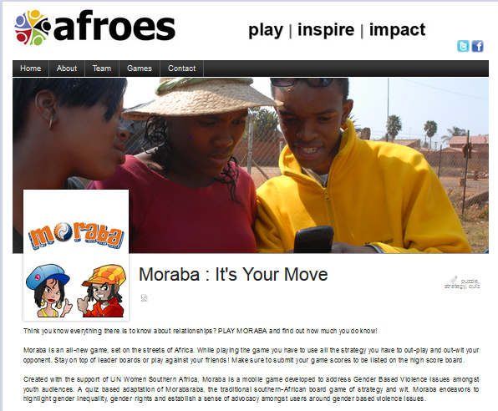

Slide 24
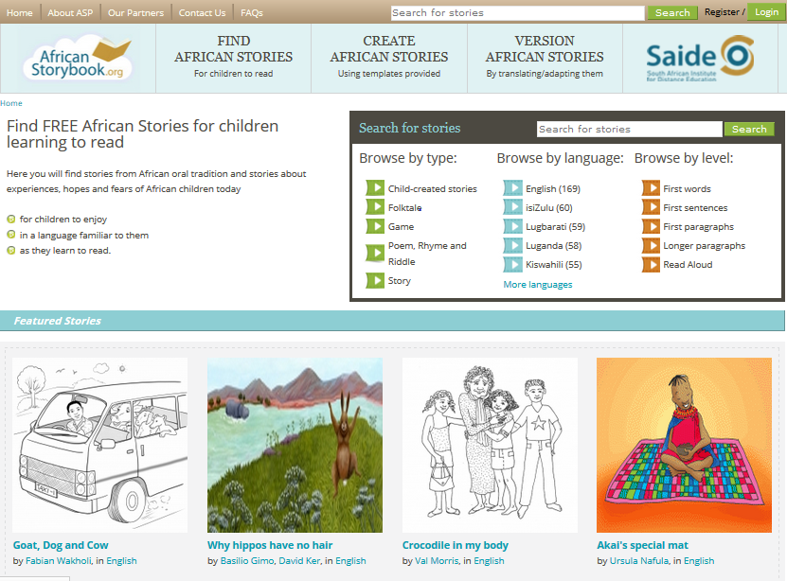

Slide 25
Some African Contributions to…
Medicine
1979 Nobel Prize for the CT Scan - South African physicist Allan Cormack and British electrical engineer Godfrey Hounsfield.
Literature
1986 Nobel Prize in Literature – Wole Soyinka of Nigeria
Disaster Relief
USHAHIDI – founders Erik Hersman, Ory Okolloh, Juliana Rotich, David Kobia of Kenya - develop free and open source software for information collection, visualisation, and interactive mapping.
Environment
Wangari Maathai - Kenyan environmental and political activist. Awarded the Nobel peace prize 2004.

Slide 26
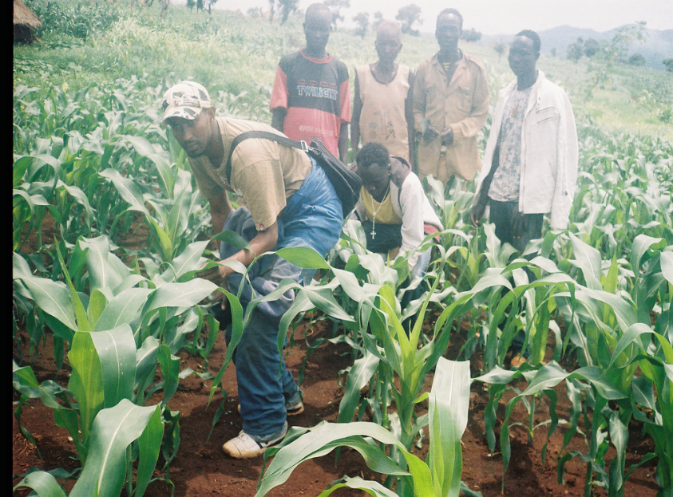
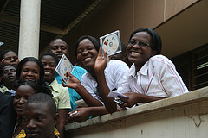
OER for Africa – and the world
Freely available
No royalties
Allows contextualisation of existing quality resources
Facilitates conversations about institutional and national policy necessary to support quality teaching, learning and research
Choose how to share
OER show-cases African intellectual capital – yes we can and yes we do generate knowledge!

Slide 27
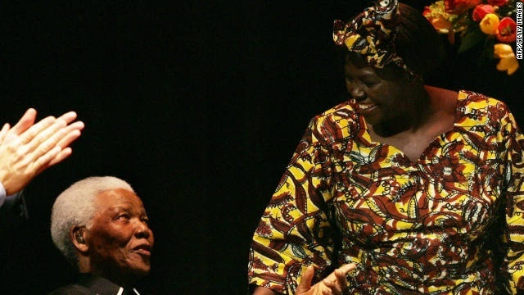
African Nobel Peace Laureates
Madiba with Prof. Wangari Maathai
Notes:
http://www.zimbio.com/Wangari+Maathai/articles/zb2JBAZSqNU/Wangari+Maathai+life+pictures
OER is one tool on our journey towards achieving
Vibrant, sustainable African higher education institutions that play a critical role in building and sustaining African societies and economies, by producing the continent’s future intellectual leaders through free and open development and sharing of common intellectual capital.

Slide 28
Thank you
This work is licensed under a Creative Commons Attribution 4.0 License
Catherine Ngugi
OER Africa Project Director
catherine.ngugi@oerafrica.org

