Slide 1
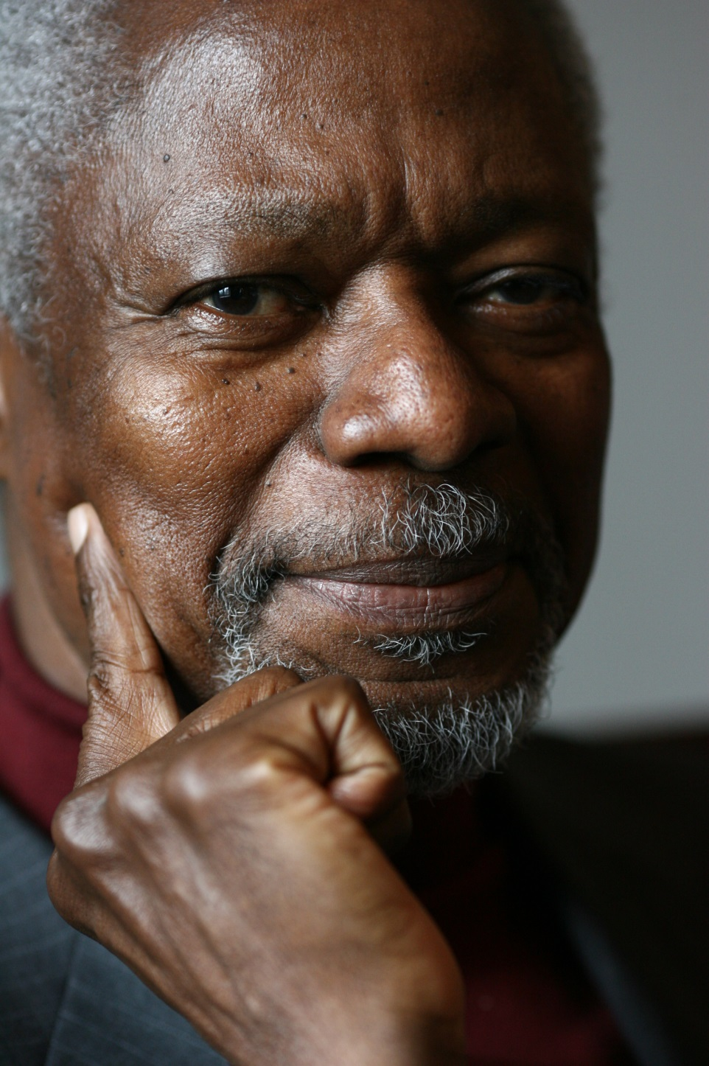
Kofi Anan Nobel Laureate, 2001
“Education is a human right with immense power to transform. On its foundation rest the cornerstones of freedom, democracy and sustainable human development.”
Notes:
OER is a powerful tool towards transforming higher education in Africa. This is a transformation that will see Africa take its rightful place as a major actor in the transformation of our societies, livelihoods, economies, politics, the practice of science and the performance of the arts. Africa’s contribution to the global knowledge economy is vital.
Picture: http://static.goal.com/100000/100084.jpg
Quote from : http://www.unicef.org/sowc99/sowc99a.pdf – The State of the World’s Children (1999) [downloaded Sept 20th 2014)
Kofi Annan was awarded the Peace Prize for having revitalized the UN and for having given priority to human rights. The Nobel Committee also recognized his commitment to the struggle to contain the spreading of the HIV virus in Africa and his declared opposition to international terrorism.
(http://www.nobelprize.org/nobel_prizes/peace/laureates/2001/annan-facts.html)
He served as the seventh Secretary-General of the United Nations from January 1997 to December 2006.

Slide 2
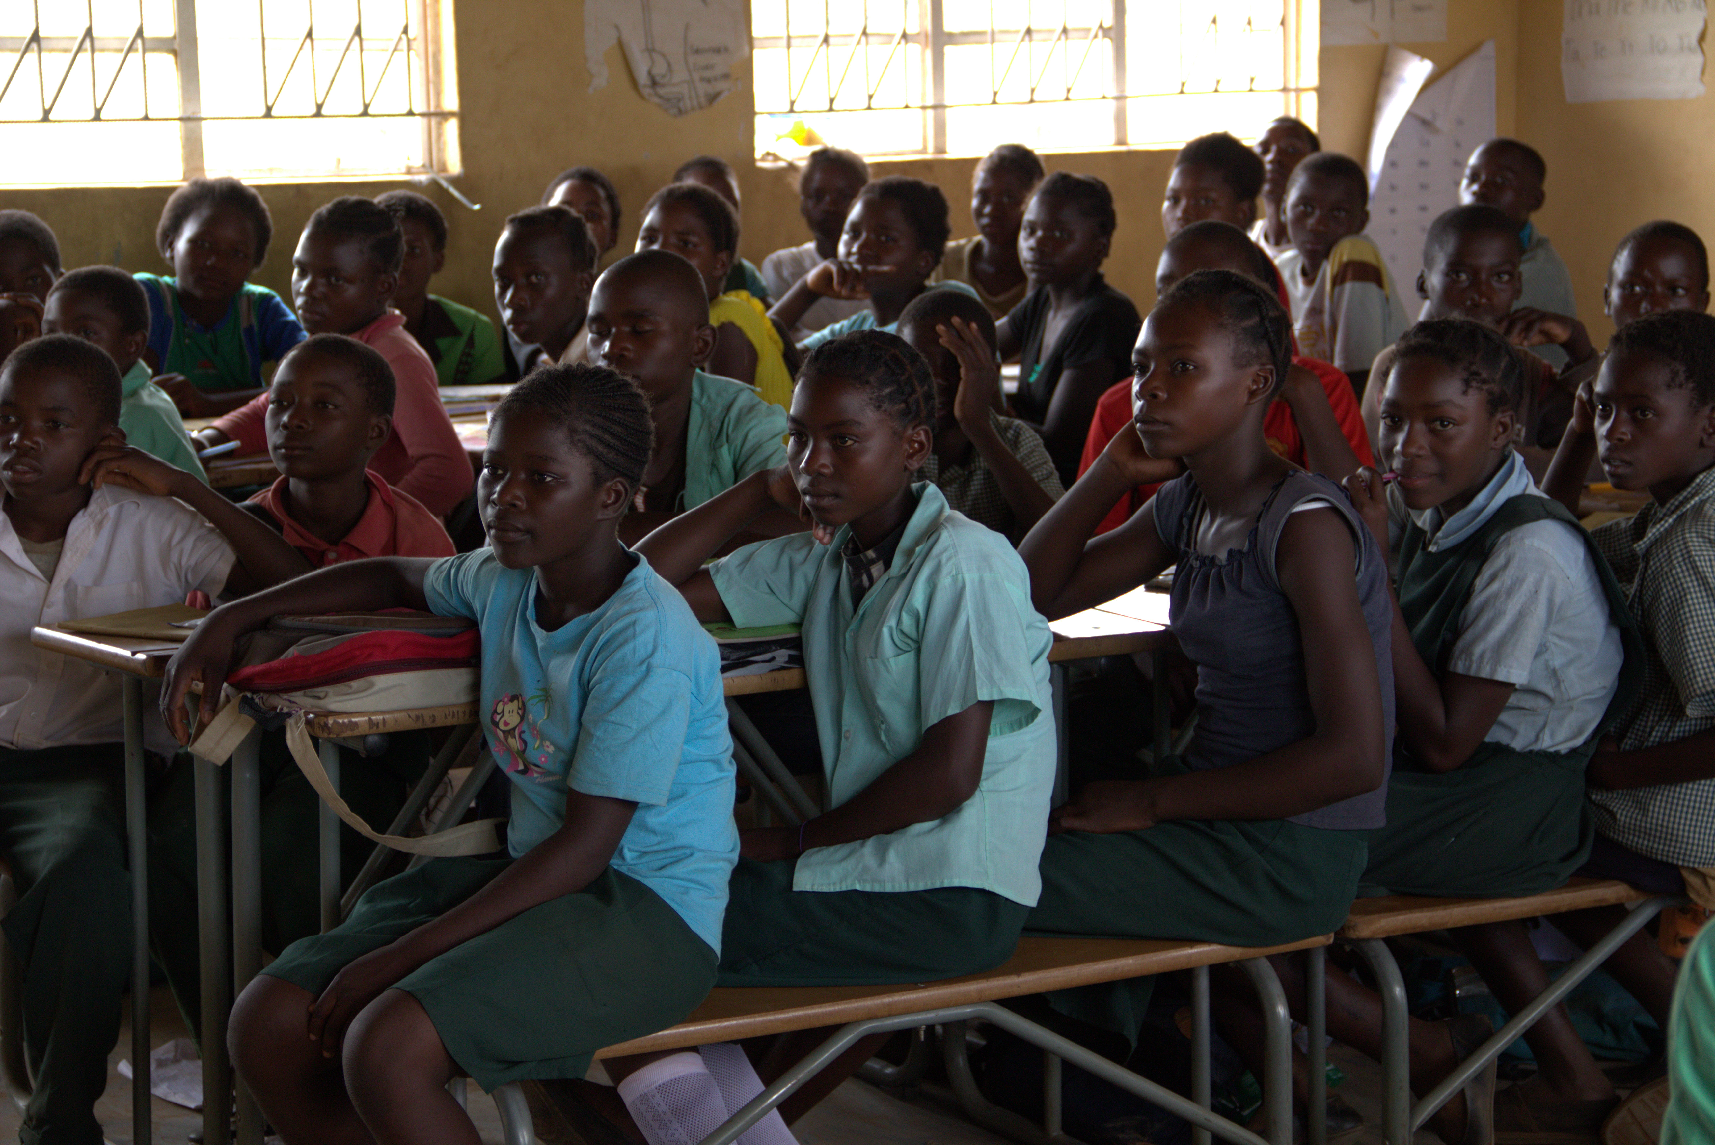
Notes:
SDG 4 is a wide ranging and, as we have heard, ambitious

Slide 3
5th ACDE conference and General Assembly
Open University of Sudan
6 – 9 March 2017
Dr Ephraim Mhlanga

Slide 4
Embracing OER and Technology

Slide 5
Why all this?
Changes in higher education over past decade leading to challenges
Increasing access
GER still lowest compared to other regions of the world
The challenge of relevance
High rates of unemployment in economies starved of HR skills
The challenge of lack of learning resources
Does not only limit access through modes of delivery, also compromises quality of learning

Slide 6
Why all this?
The challenge of inadequate research and knowledge generation and sharing
Africa contributes a paltry 2% of the commonwealth of research
Diminishing critical mass of experienced university professoriate
Increasing use of “green sticks” to sustain university programmes

Slide 7
Universities are overwhelmed !!
In most cases universities have struggled for years to achieve mandate effectively. Evidenced in:
a continuing state of decline in physical infrastructure,
inadequate state funding,
lower standards of teaching and learning,
under-equipped libraries and science laboratories,
reduced research and publication output, and
a reduction in real value of wages for faculty resulting in moribund faculty morale.⁹
Notes:
⁹ This has also necessitated faculties seeking out other sources of income that they need to support themselves and their families. The result is a less focused commitment to quality teaching and research in many cases.

Slide 8
Context
All these challenges faced in an environment characterised by:
Advent of ICTs
Increasing influence of Open Education Movement and OER
Increasing need for life long education.

Slide 9
Responsiveness
In order to address the challenges, universities cannot have business as usual.
Doing more of what we have always been doing no answer.
These developments call for universities to be more responsive and faster in embracing change.

Slide 10
An Important Quote
“The university must become a primary tool for Africa’s development in the new century. Universities can help develop African expertise; they can enhance the analysis of African problems; strengthen domestic institutions; serve as a model environment for the practice of good governance, conflict resolution and respect for human rights, and enable African academics to play an active part in the global community of scholars.”
Source: United Nations Information Service: Press Release No: UNIS/SG/2625. August 3, 2000.

Slide 11
International Developments
World Open Educational Resources Congress (2012), organised by the Commonwealth of Learning (COL) and UNESCO with the generous support of William and Flora Hewlett Foundation, attracted over 400 participants from 70 countries.
Congress adopted the Paris OER Declaration which encouraged governments to openly license educational materials developed with public funds.
Since then, COL and UNESCO been working closely to cooperate in the field of OER for advocacy, capacity building and policy development for implementation of the Paris OER Declaration.

Slide 12
International Developments
Saide, through its initiative, OER Africa and with support from Hewlett and Bill and Melinda Gates Foundations also supporting implementation of a number of projects in various universities in Sub-Saharan Africa.

Slide 13
International Developments
The 2012 World OER Congress focused on securing governmental support for OER.
On 18 – 20 Sept 2017, the 2nd World OER Congress going to be hosted by the Government of Slovenia in Ljubjana, Slovenia.
Aim is to make the transition from commitment to action.
At this conference, global community will identify strategies to harness the potential of OER for achieving inclusive and equitable quality education and lifelong learning for all by 2030.
Notes:
SDG 4: Ensure inclusive and equitable quality education and promote lifelong learning opportunities for all

Slide 14
International Developments
As preparation for the 2nd Conference, COL in partnership with UNESCO holding regional consultation meetings.
Theme: “OER for Inclusive and Equitable Quality Education:
From Commitment to Action”

Slide 15
But what are Open Educational Resources?
http://wikieducator.org/Open_content_licensing_for_educators/Home

Slide 16
But what are Open Educational Resources?
Open Educational Resources (OERs) are any type of educational materials that are in the public domain or introduced with an open license.
Anyone can legally and freely copy, use, adapt and re-share them without any need to pay royalties or licence fees.
OERs range from textbooks to curricula, syllabi, lecture notes, assignments, tests, projects, audio, video and animation.

Slide 17
Value of OER
The fundamental principle underlying the definition of OER is the freedom to share knowledge, and that knowledge should be legally, socially, and technologically open (Torres, 2013).
This ensures greater access to more people than a similar commercial product that is not free. It also increases flexibility of use, which in turn creates opportunity for greater access (Smith, 2013).
Open licensing provides a cost-effective means to increase investment in creating more effective teaching and learning environments using resource-based learning.

Slide 18
OER Africa Experience in African Higher Education
OER Africa

Slide 19
Resource Details
Resource Name : | University Certificate in Midwifery
Resource Description : | This CD ROM has been developed to support the UCM and upgrading midwifery programmes. It combines a number of new strategies that are being piloted by MCH department to respond to the national needs within the Health sector. These include reducing maternal and neonatal morbidity and mortality in relation to Millennium Development Goals 4, 5 & 6. Consequently this course embraces the latest methodology (Problem Based Learning) and technologies (Computer based education) in an attempt to be relevant and effective in preparing new midwifes. The materials on the CD ROM have been authored by both University of Malawi - Kamuzu College of Nursing and foreign experts.
Resource Author : | University of Malawi, Kamuzu College of Nursing
Resource Source : | University of Malawi, Kamuzu College of Nursing
Resource Tags : | nursing, Problem Based Learning, maternal and neonatal morbidity, Computer based education,
Resource Type : | Modules, Training Notes/Materials/Tutorials
Resource Year : | 2009
Resource Licensing Condition : | Creative Commons: Attribution-Non Commercial Share Alike 2.5
Resource Media Type : | Text/HTML
Resource Language : | English
Notes:
We have supported faculty in creating health OER specifically for their students, based on pre-existing, openly licensed high quality relevant content

Slide 20
Notes:
In Malawi, Ethiopia, Uganda, Kenya and Tanzania, we have worked with faculty to narrow the divide between the agricultural knowledge produced in the academy and the agricultural know-how generated by farmers on the ground. This is one step towards improved food-security in Africa; one step towards ensuring that drought and climate change do not inevitably result in famine on our continent.

Slide 21
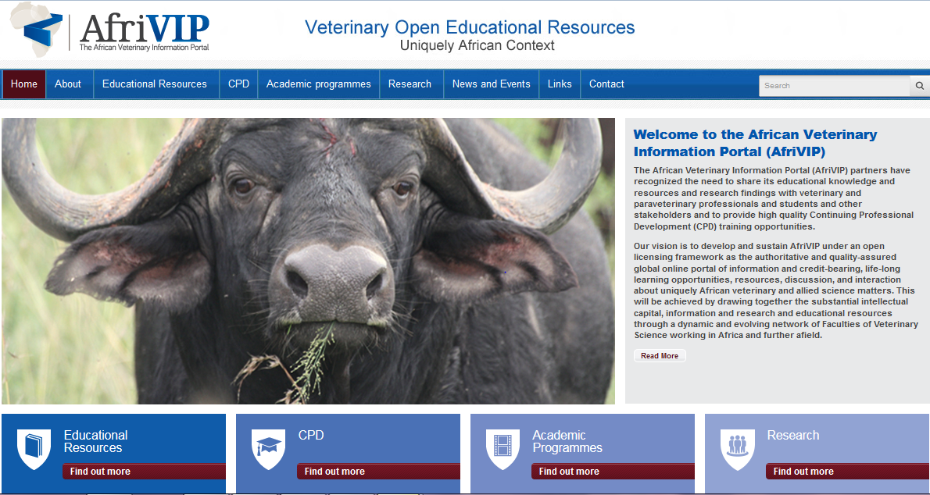
Notes:
We are working with the Faculty of Veterinary Science at the University of Pretoria, and its partners, in other Faculties of Vet Science across the continent, who have recognized the need to provide high quality Continuing Professional Development (CPD) training for veterinarians and allied professions including para-veterinary professionals. This has initiated the development of the African Veterinary Information Portal (AfriVIP), for veterinary training and information and a training platform of the OIE Collaborating Centre for Training in Integrated Livestock and Wildlife Health and Management.

Slide 22
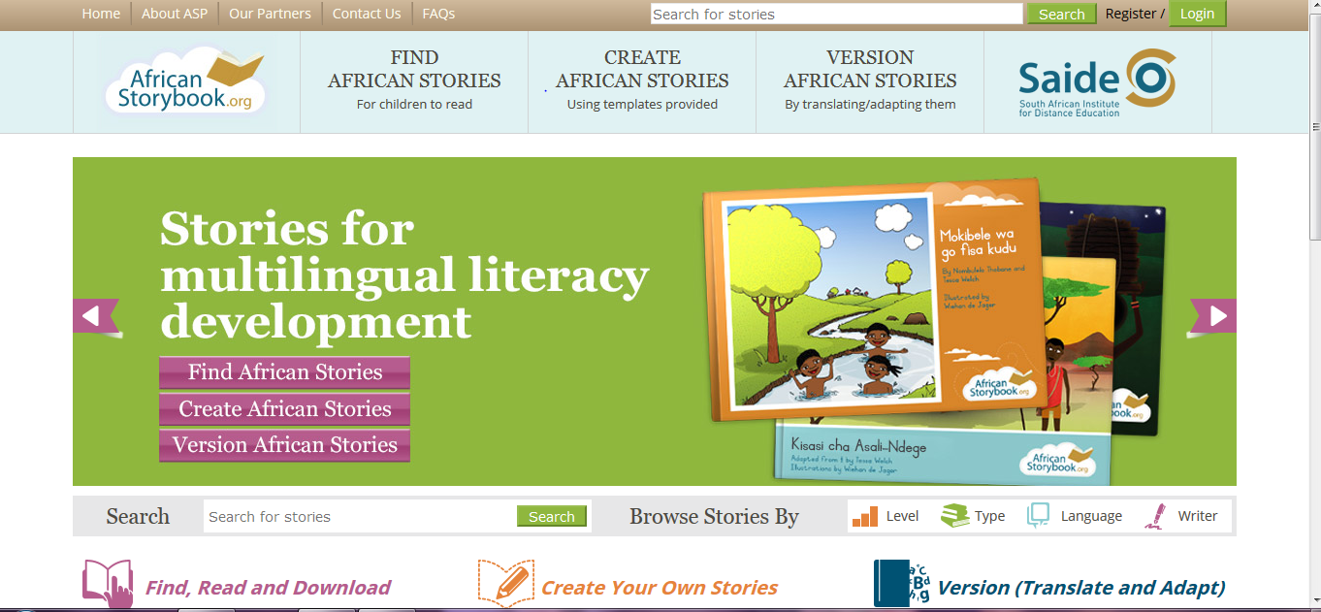
Notes:
The African Story Book aims to generate a plethora of stories in languages familiar to Africa’s children. The more stories children read (write, perform, listen to) the more likely they are to enjoy reading.
The African Story Book is a practical application of technology to share and generate openly licensed stories and thereby improve Early Childhood Literacy.

Slide 23
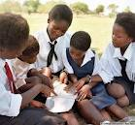
OER for Africa… and the world
OER show-cases African intellectual capital – allowing us our rightful participation as contributors to the global knowledge economy.
Notes:
Because OER allows flexibility in module and course design and in the long-term, cuts costs
No Royalties; Choose how to share; Freely available
Allows contextualisation of existing quality resources
Facilitates conversations about institutional and national policy necessary to support quality teaching, learning and research
OER is a tool that enables Africa to share with the rest of the world its wealth of knowledge!

Slide 24
OER Enablers
Critical mass of universities with basic understanding of OER now exists.
Improving bandwidth and technological infrastructure in African institutions.
Increasing priority placed on teaching and learning.

Slide 25
What are the Barriers?
Slow change in approaches to teaching resulting in continued use of traditional methods of teaching which require learners to be largely consumers of information. This makes sustained integration of OER into academic activities difficult to achieve.

Slide 26
What are the Barriers?
High rate of Staff turn-over.
Staff workloads and the time needed to search for OER.
Lack of sufficient skills to search for OER.
Generalized negative perceptions of OER as ‘poor quality’.
Poor understanding of IP issues amongst academics & inadequate support from relevant university offices.

Slide 27
Preliminary Learnings
Whilst OER have been well received by academics in institutions where we have worked, sustainability of initiatives beyond projects has not been evident.
Commitment Action Impact

Slide 28
Preliminary Learnings
Integration of OER more effective where there is commitment to design processes.
Initiatives succeed where there is local leadership.

Slide 29
ICTs Important
Integration of OER enhanced by use of educational technology.
Harvard Business School professor Clayton M. Christensen coined the term disruptive technology¹
Technology provides a wide range of possibilities for accessing, sharing and disseminating information.
Notes:
Christensen, C . M. (1997) The Innovator's Dilemma

Slide 30
Blended Learning
Also called hybrid learning or mixed-mode learning, blended learning takes various forms

Slide 31
Interplay of Distance and ICT Support
1.
2.
Increasing resource-based (independent) learning in face-to-face programmes, and
Increasing face-to-face interaction in distance education programmes.
Mixture of online and offline modes of delivery used (blend)
Use of digital forms of technology that do not require internet

Slide 32
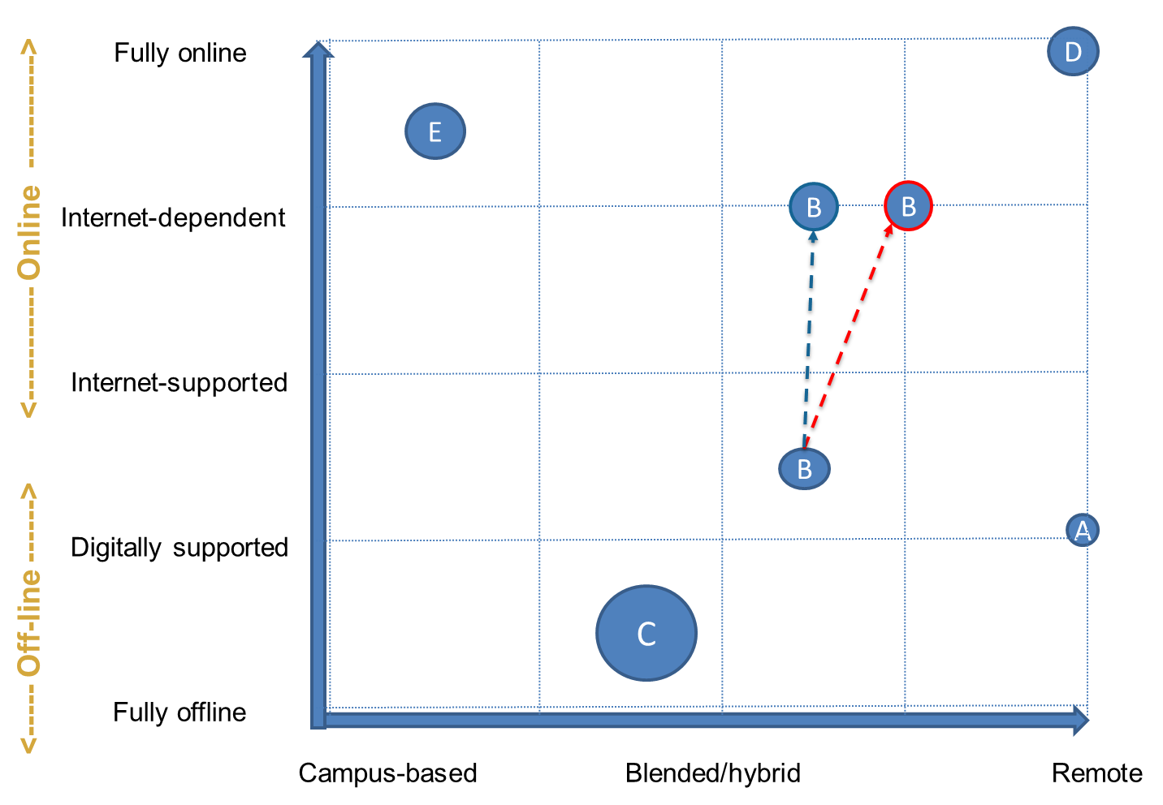
Grid illustrating different dimensions influencing mode of provision

Slide 33
In Higher Education
Too few higher education programmes capture local knowledge, reflect local contexts and have relevance.
Too few higher education courses engage the student in a meaningful way. Too many focus on the transmission of content.
Textbooks to support the courses are too expensive for students and for institutions
Too often learning outcomes are not met

Slide 34
But developing courses that respond to these challenges takes time …
Can we work together across institutions or even countries to develop such courses, drawing wherever possible on existing OER, adapting them and developing new materials as necessary ensuring that students easily access them to maximise learning benefits.

Slide 35
My own garden is my own garden’, said the Giant. ‘Anyone can understand that, and I will allow nobody to play in it but myself’. So he built a high wall all round it and put up a notice-board saying: Trespassers will be prosecuted.
Oscar Wilde: The Selfish Giant

Slide 36
Breaking down the walls to share our gardens

Slide 37
THANK YOU
Ephraim Mhlanga
Saide/OER Africa
ephraimm@saide.org.za

