Slide 1
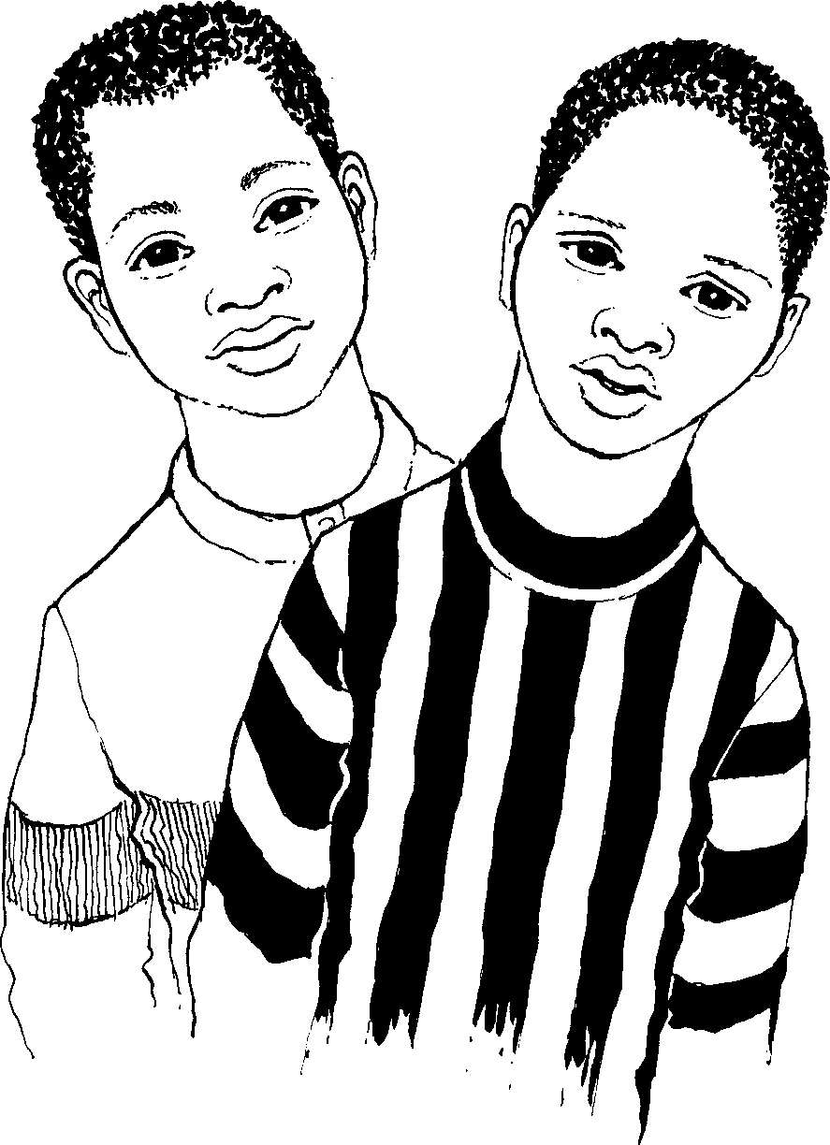
Abafana ababili abalambile Two hungry boys
Story in isiZulu by Clare Verbeek, Thembani Dladla, Zanele Buthelezi
Illustrated by Jinny Heath

Slide 2
UBen no Thabo abafana ababili abalambile.
Ben and Thabo are two hungry boys.

Slide 3
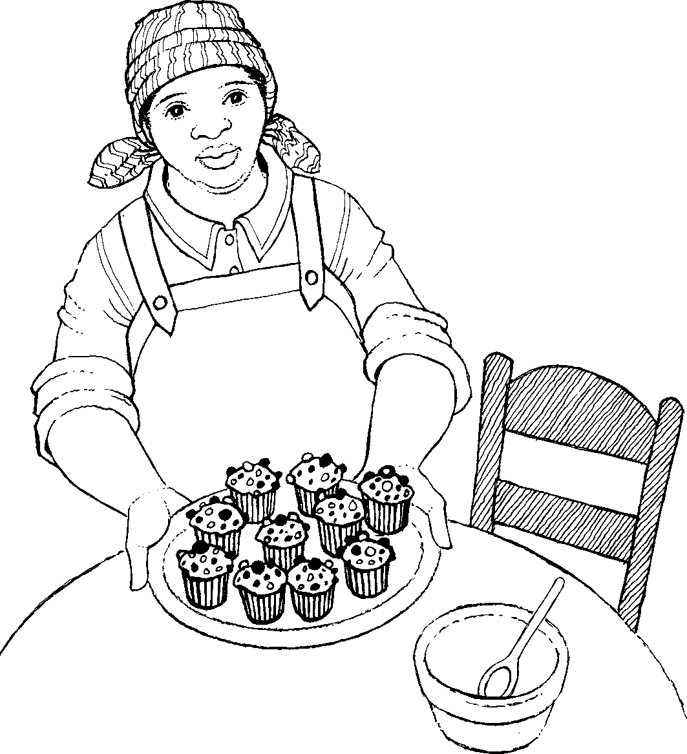
Ugogo wenza amakhekhe amancane alishumi. Uwabeka epuletini.
Granny is making ten cupcakes. She puts them on a plate.

Slide 4
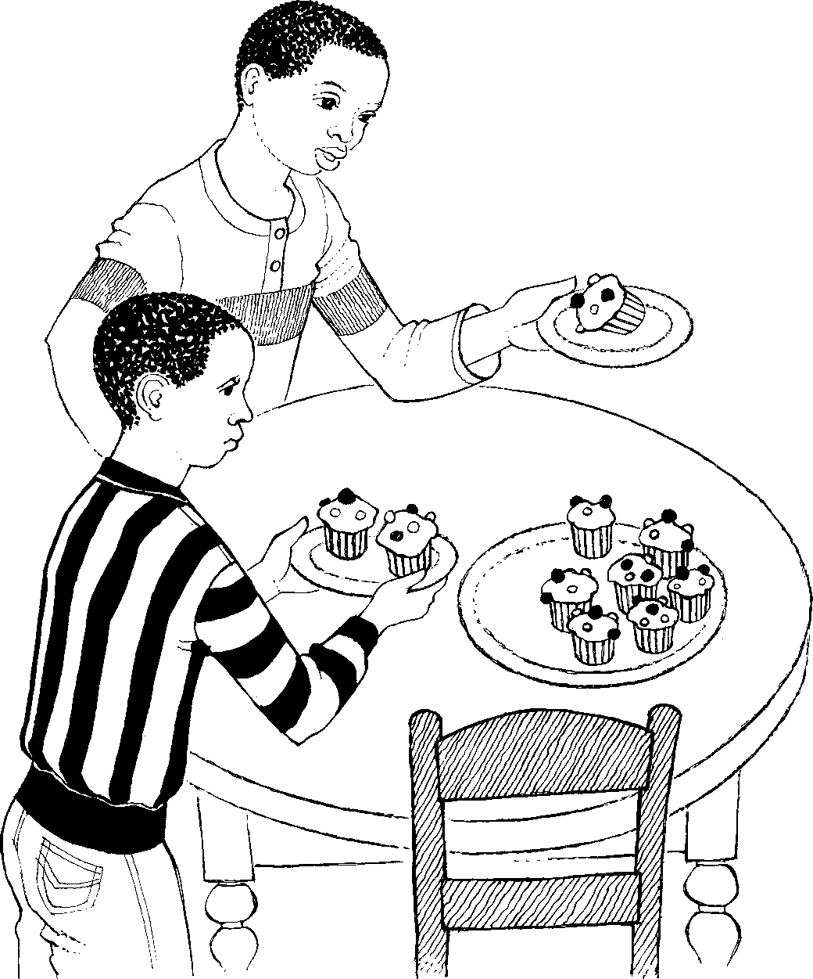
UBen uthatha ikhekhe elilodwa.
UThabo uthatha amakhekhe amabili.
Ben takes one cupcake.
Thabo takes two cupcakes.

Slide 5
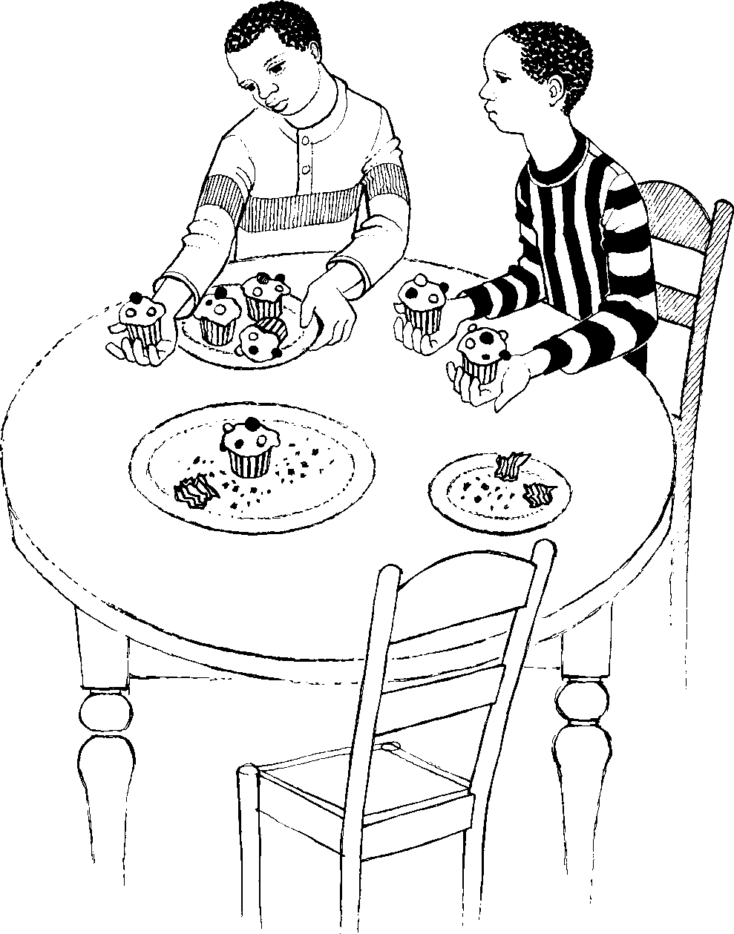
UBen uthatha amakhekhe amane.
UThabo uthatha amakhekhe amabili.
Ben takes four cupcakes.
Thabo takes two cupcakes.

Slide 6
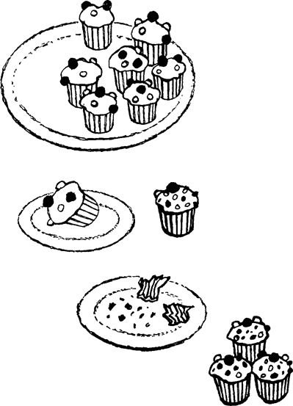
Mangaki amakhekhe adliwe uBen?
Mangaki amakhekhe adliwe uThabo?
Mangaki amakhekhe asalele ugogo?
How many cupcakes did Ben eat?
How many cupcakes did Thabo eat?
How many cupcakes are left for granny?

Slide 7
Abafana ababili abalambile Two hungry boys
© 2007 School of Education and
Development (Centre for Adult Education), University of KwaZulu-Natal.
This book may be copied, and used for teaching and learning free of charge.
It may not be sold for profit.
Story in isiZulu by Clare Verbeek, Thembani Dladla, Zanele Buthelezi
Illustrated by Jinny Heath

