Slide 1
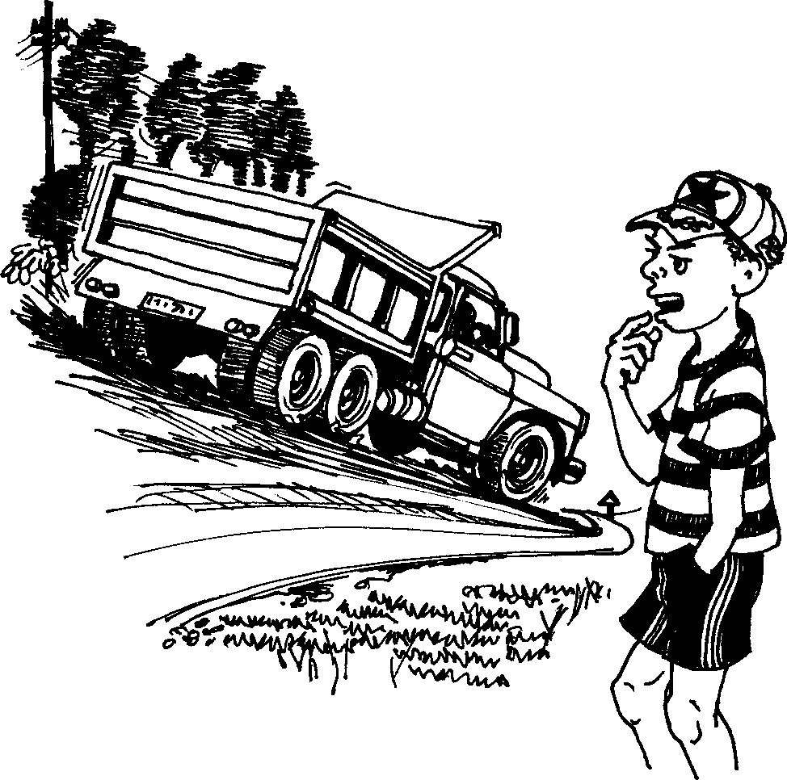
Ingozi Accident
Story in isiZulu by Clare Verbeek, Thembani Dladla, Zanele Buthelezi
Illustrated by Cathy Feek

Slide 2
Ngibone iloli elikhulu ligijima phansi le emgwaqeni.
I saw a big truck driving down the road.

Slide 3
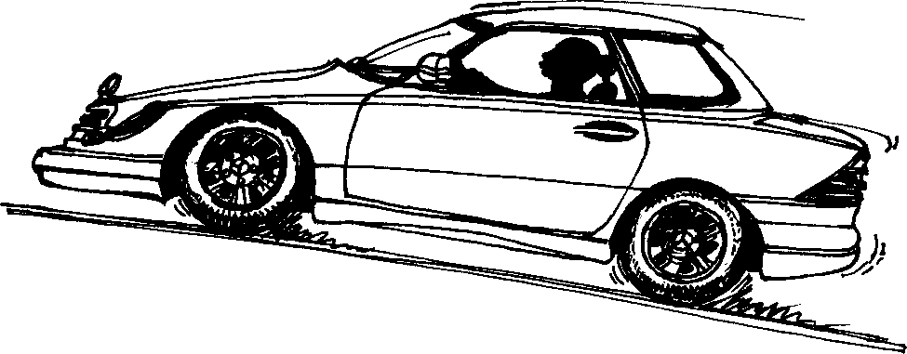
Imoto engu-Mercedes yayiza ikhuphuka ngomgwaqo.
A Mercedes came driving up the road.

Slide 4
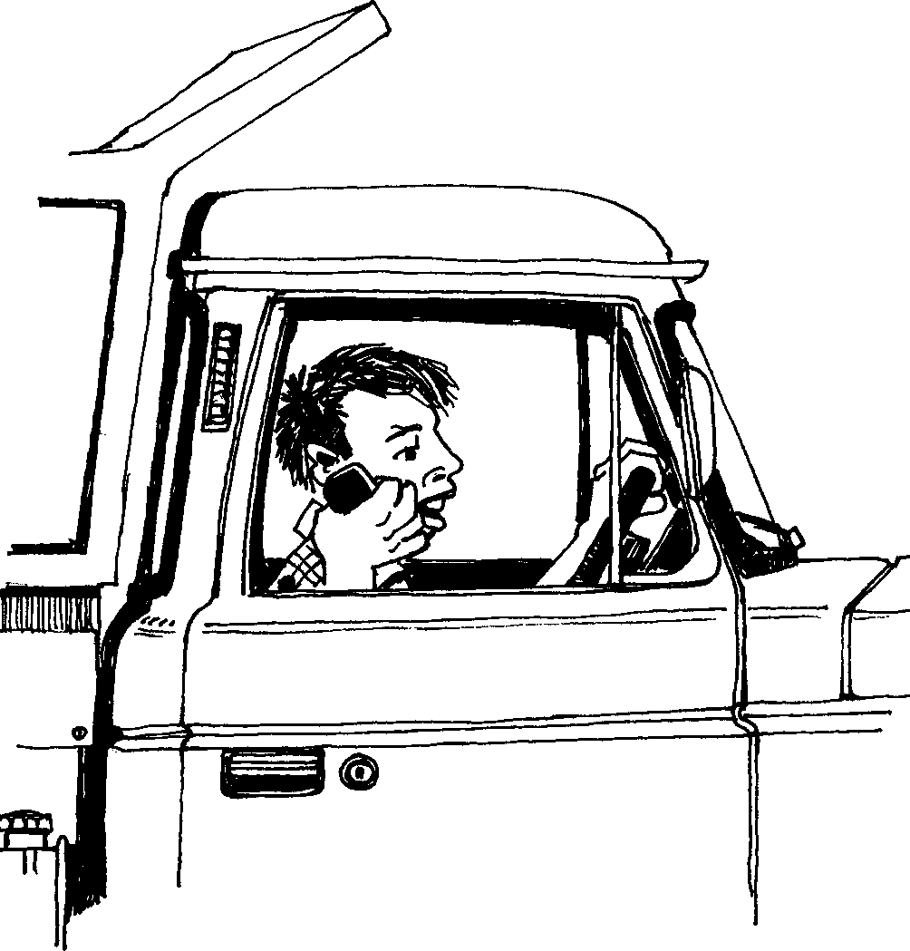
Umshayeli weloli wayekhuluma
kumakhalekhukhwini.
The truck driver was talking on his cellphone.

Slide 5
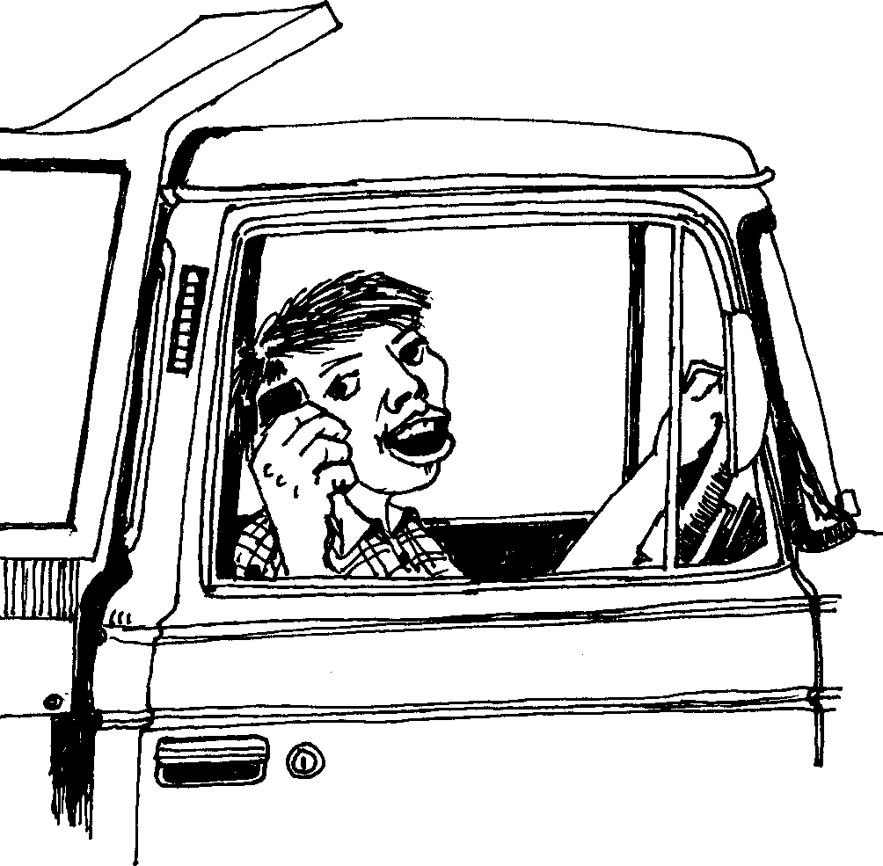
Wayengabhekile
emgwaqeni.
He was not looking at the road.

Slide 6
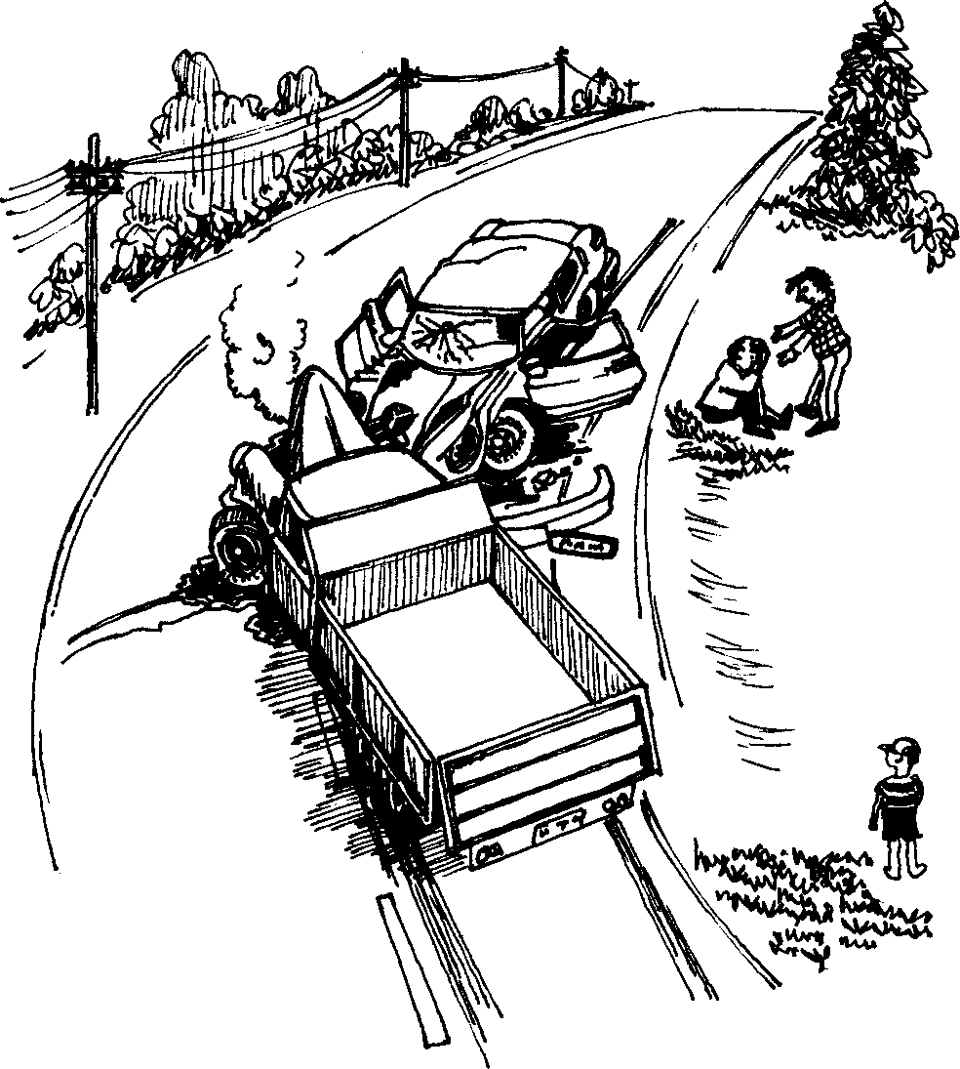
Kwaba khona okukhulu
ukushayisana.
There was a big accident.

Slide 7
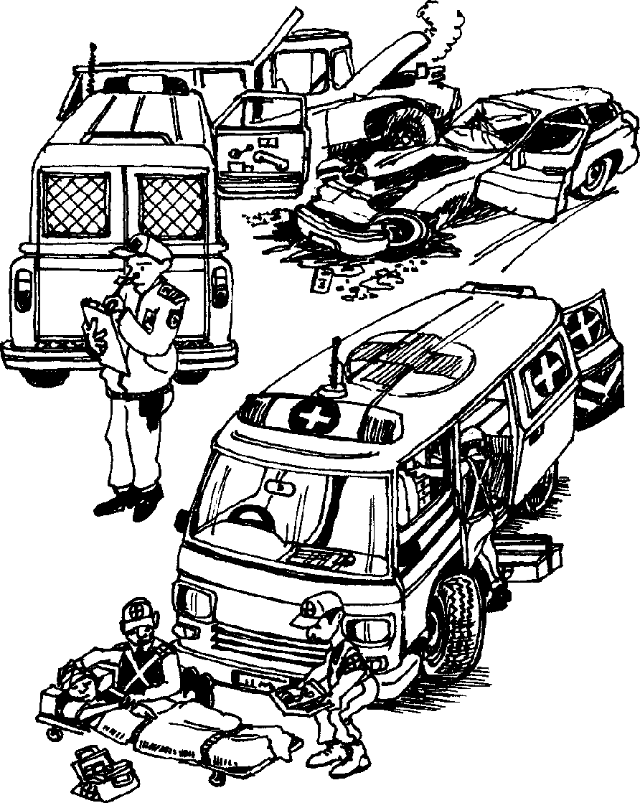
I-ambulensi namaphoyisa
beza ukuzosiza.
An ambulance and the police came to help.

Slide 8
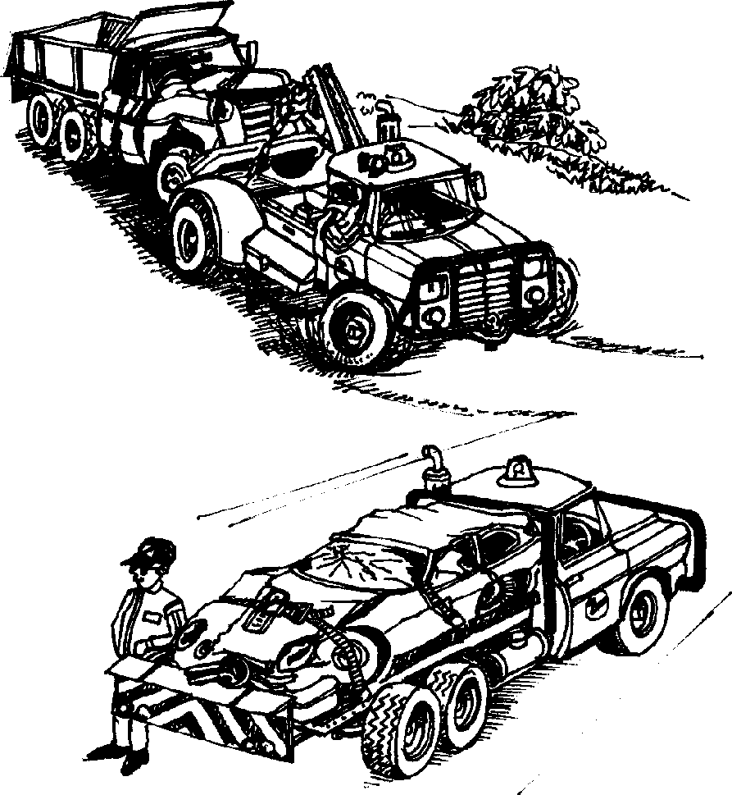
Kwafika amaloli amabili adonsa izimoto. Adonsa kokubili imoto encane neloli.
Two tow trucks came. They towed the truck and the car.

Slide 9
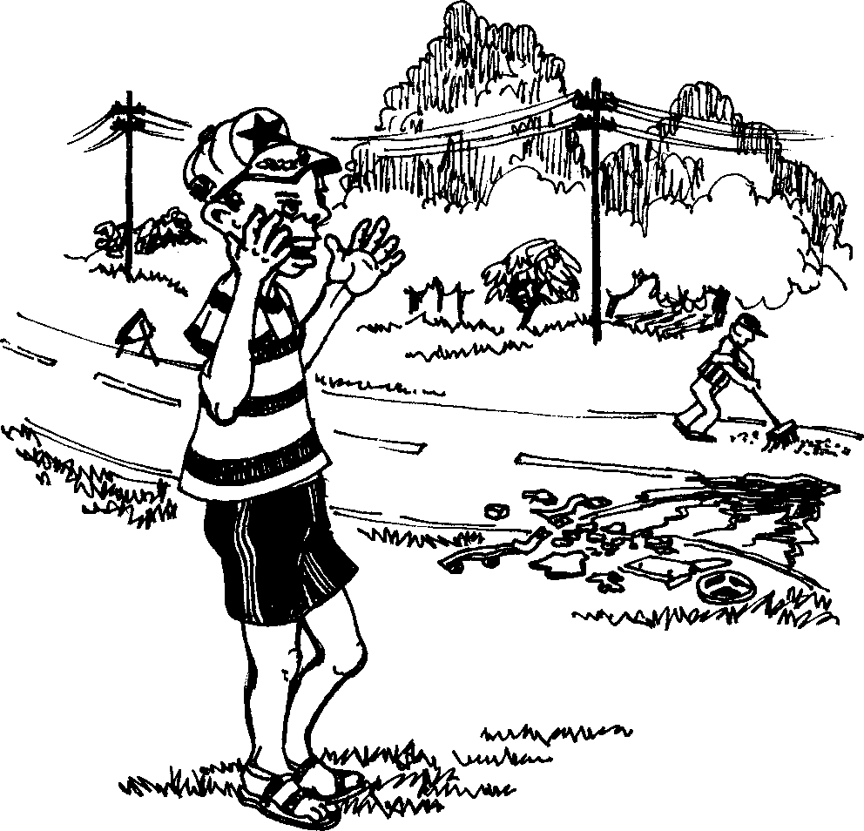
Ngethuka.
I was shocked.

Slide 10
Ingozi Accident
Story in isiZulu by Clare Verbeek, Thembani Dladla, Zanele Buthelezi
Cathy Feek

