Slide 1
Antoni, Ke bo mang Bale
A Skipping Song
From: My Drum
(Johannesburg, Abecedarius Books, 1991)
Illustration: Tamsyn Mortimer

Slide 2
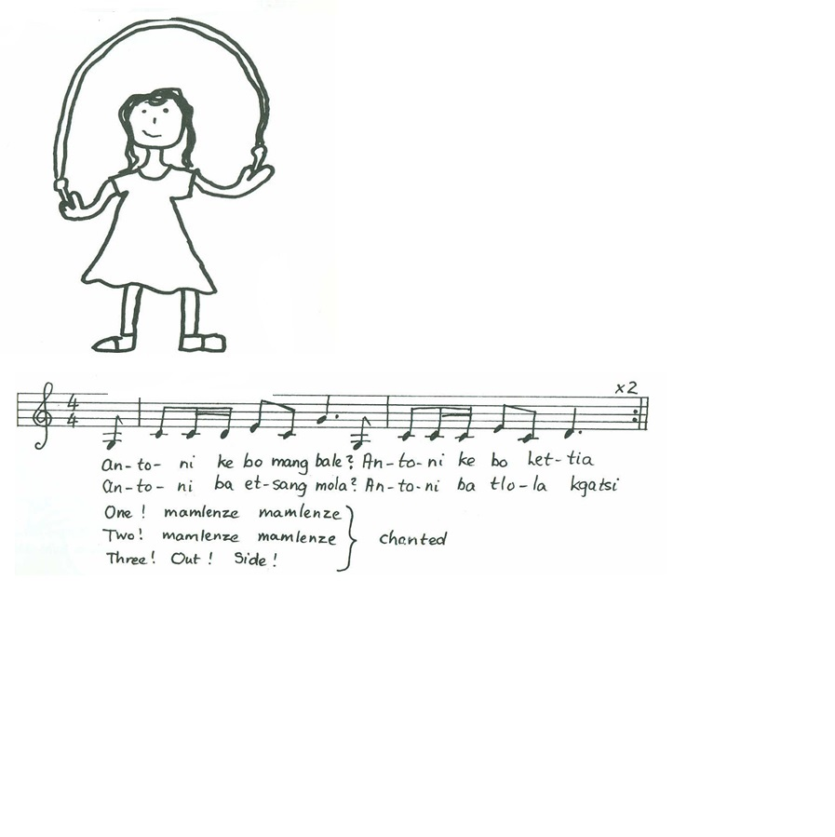
Antoni, Ke bo mang Bale
Traditional Song

Slide 3
Sesotho/ Zulu
Antoni, ke bo mang bale?
Antoni, ke bo Lettia
Antoni, ba etsang mola? Antoni, ba tlola kgatsi.
One! Mamlenze mamlenze
Two! Mamlenze mamlenze
Three! Out! Side!
Sesotho/ Zulu
Antoni, ke bo mang bale?
Antoni, ke bo Lettia
Antoni, ba etsang mola? Antoni, ba tlola kgatsi.
One! Mamlenze mamlenze
Two! Mamlenze mamlenze
Three! Out! Side!
English
Antoni, who is that?
Antoni, that’s Lettia
Antoni, what is she doing? Antoni, she is skipping.
One! Mamlenze mamlenze
Two! Mamlenze mamleze
Three! You’re out!
You can listen to children singing this song here …

Slide 4
Antoni, Ke bo mang Bale
© Meyerowitz B, Copans J, and Welch T
For an Afrikaans version of this song, see ‘My naam is Galiema hoe’

