Slide 1
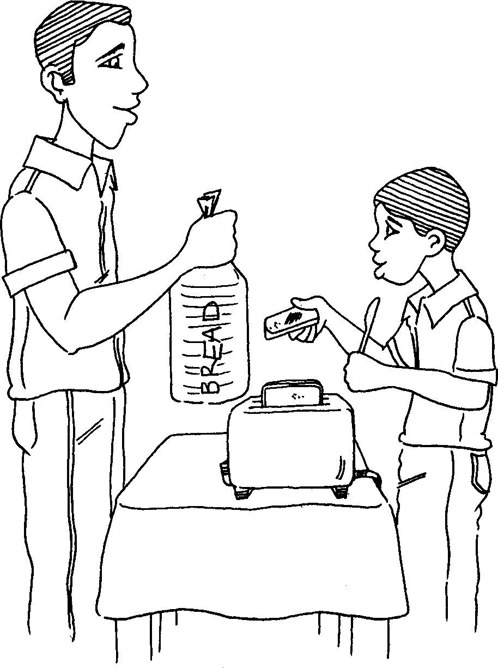
Ukudla kwasekuseni Breakfast
Story in isiZulu by Clare Verbeek, Thembani Dladla, Zanele Buthelezi
Illustrated by Cathy Feek

Slide 2
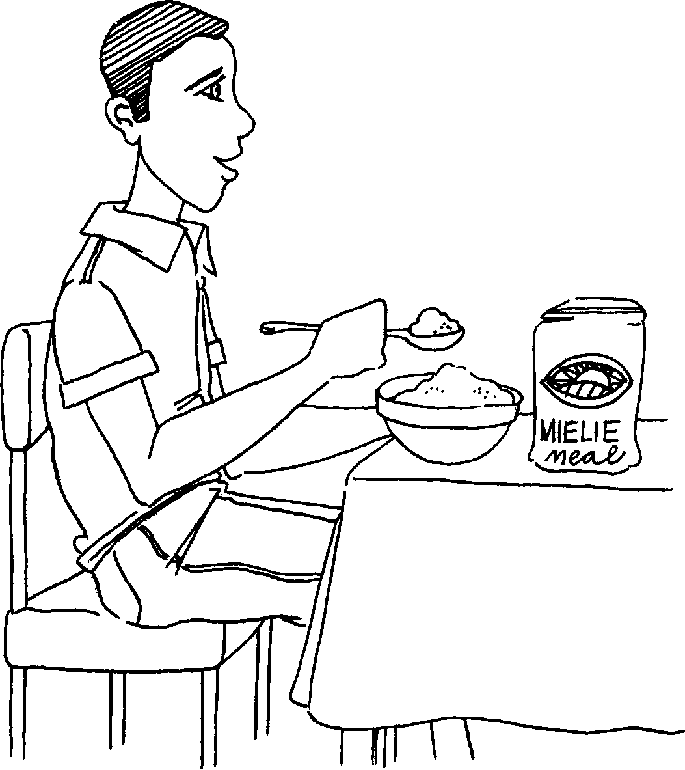
Ubaba uthanda iphalishi lempuphu.
Dad loves porridge.

Slide 3
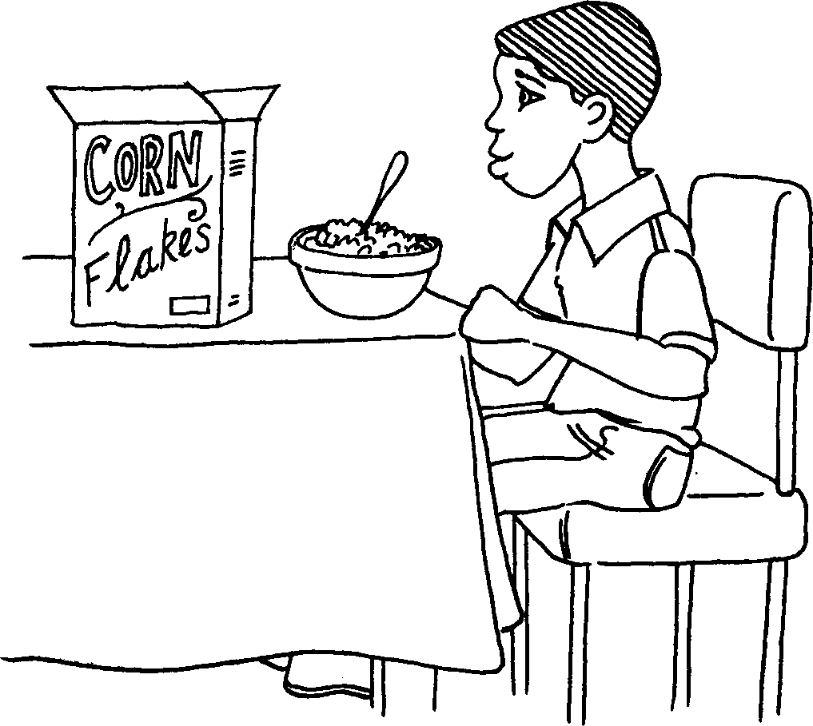
Mina ngithanda ama-cornflakes.
I love cornflakes.

Slide 4
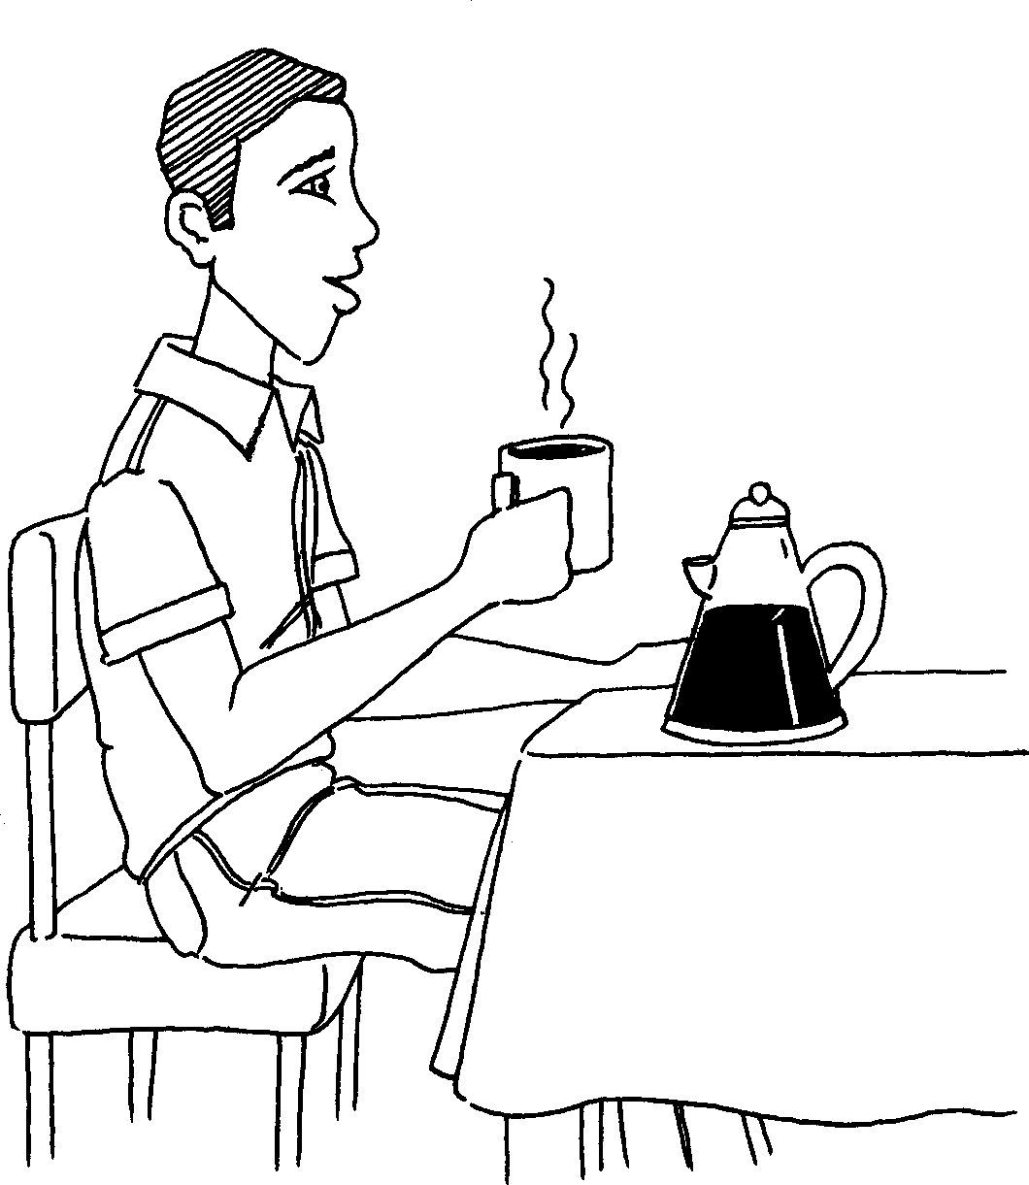
Ubaba uthanda ikofi.
Dad loves coffee.

Slide 5
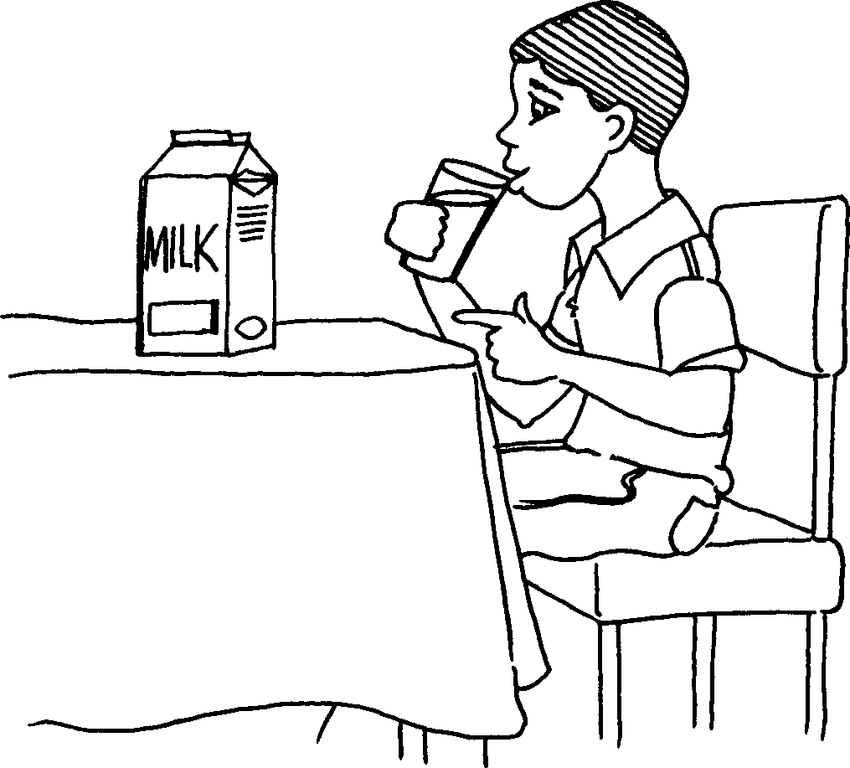
Mina ngithanda ubisi.
I love milk.

Slide 6
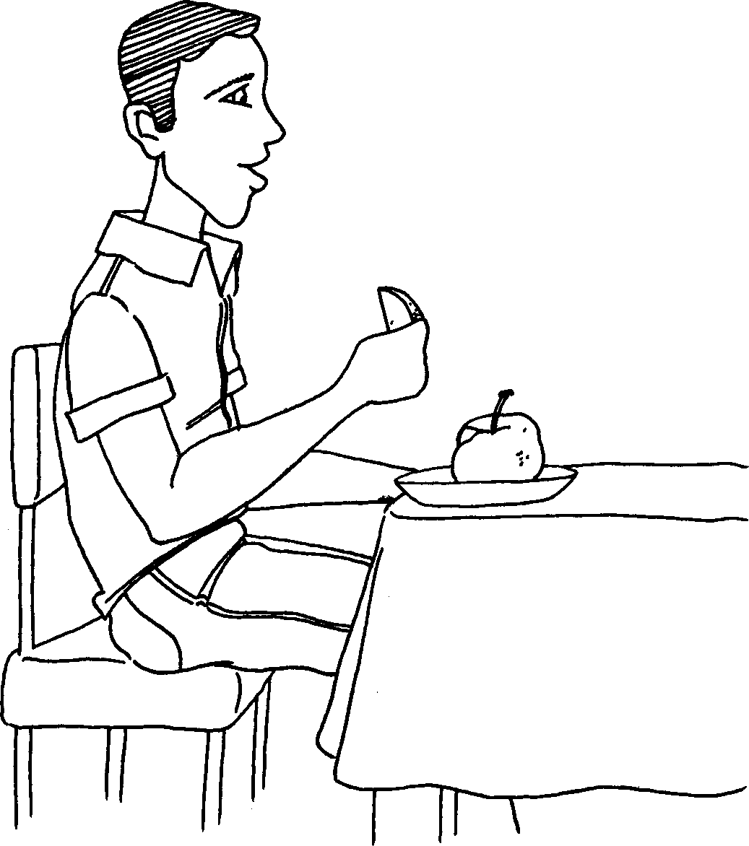
Ubaba uthanda ama-apula.
Dad loves apples.

Slide 7
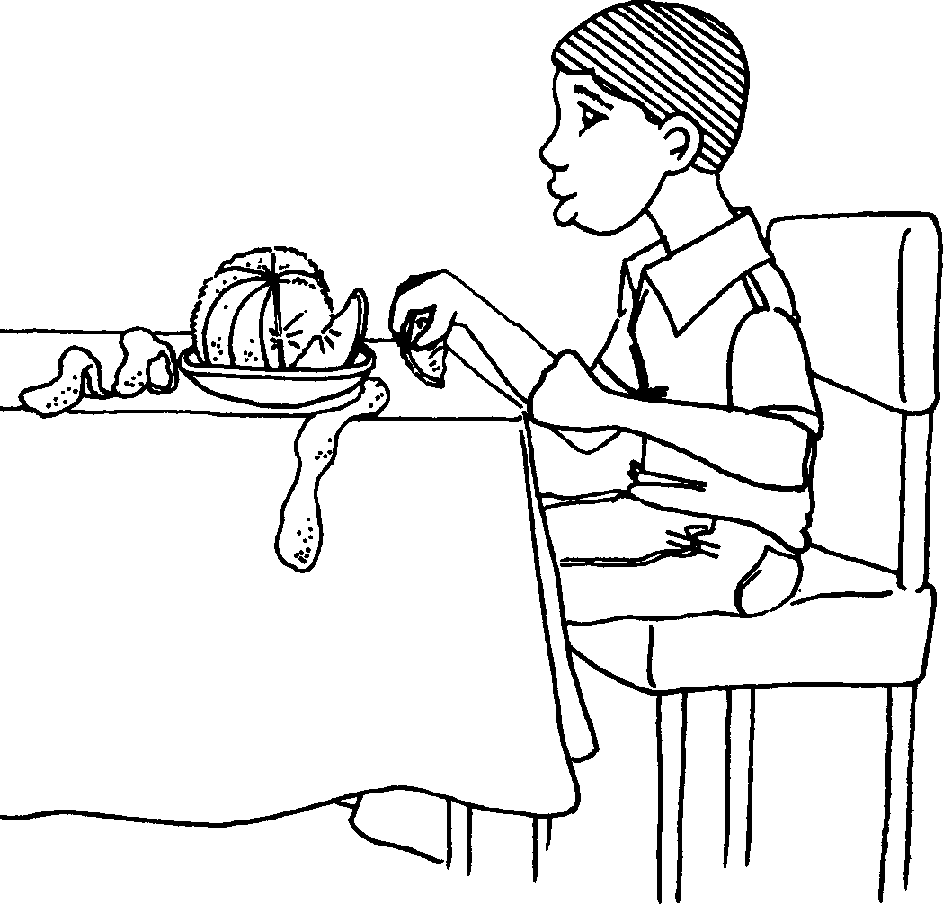
Ngithanda amawolintshi.
I love oranges.

Slide 8
Ubaba uthanda isinkwa kanti mina ngithanda isinkwa esigazingiwe.
Dad loves bread. I love toasted bread.

Slide 9
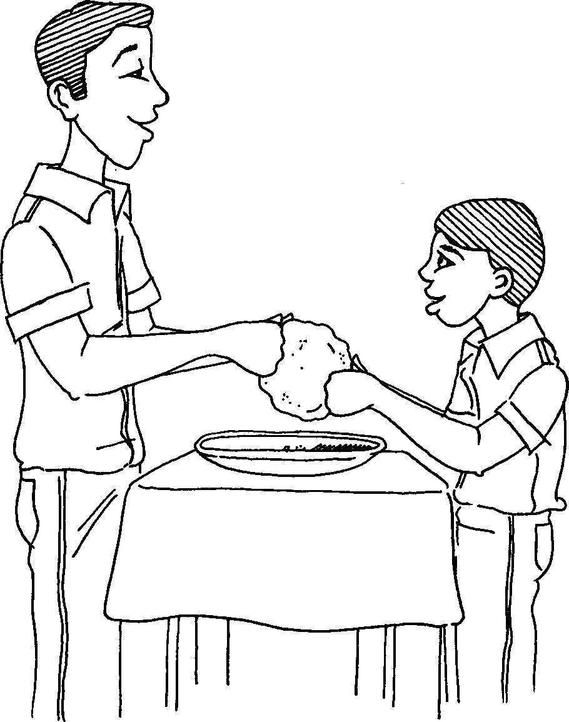
Kodwa sobabili nobaba
sithanda amagwinya.
We both love fat cakes (vetkoek).

Slide 10
Ukudla kwasekuseni Breakfast
Story in isiZulu by Clare Verbeek, Thembani Dladla, Zanele Buthelezi
Cathy Feek

