Slide 1
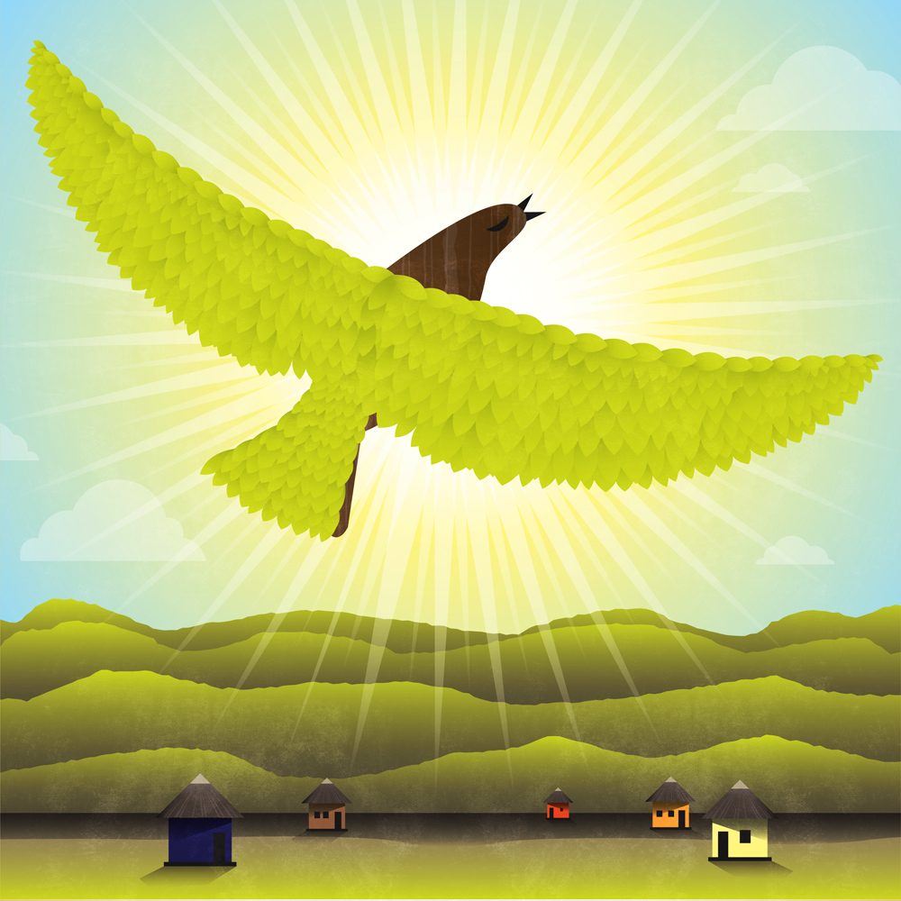
Bana ba kerese
Children of wax
Adapted from a Zimbabwean folktale by Tessa Welch and Lorato Trok
Illustrated by Wiehan de Jager

Slide 2
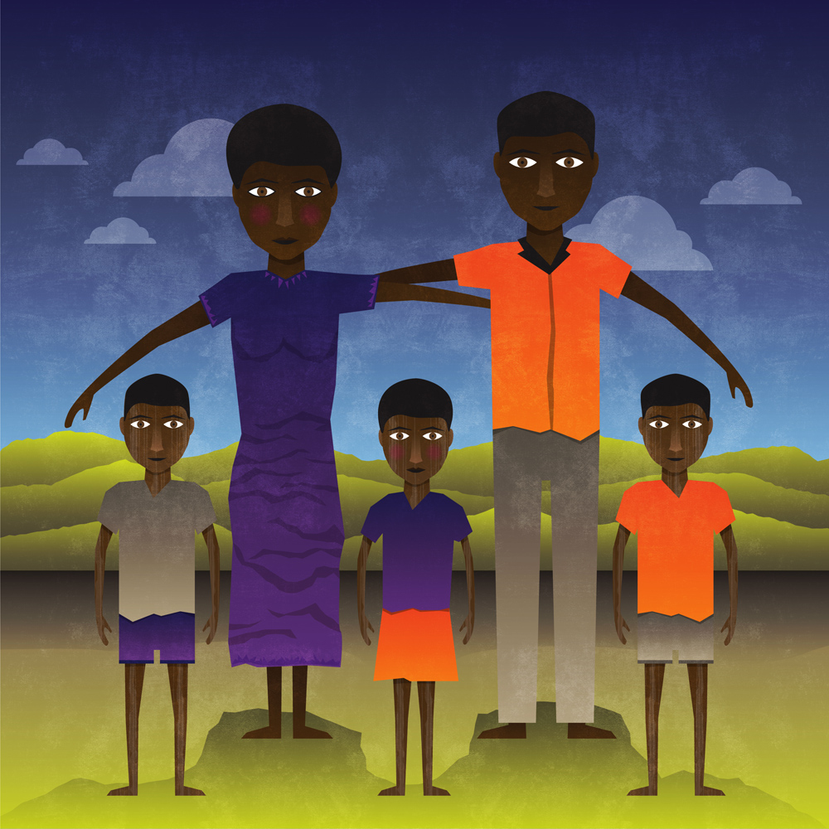
Bogologolo tala go kile ga nna lelapa lengwe le le itumetseng.
Once upon a time, there lived a happy family.

Slide 3
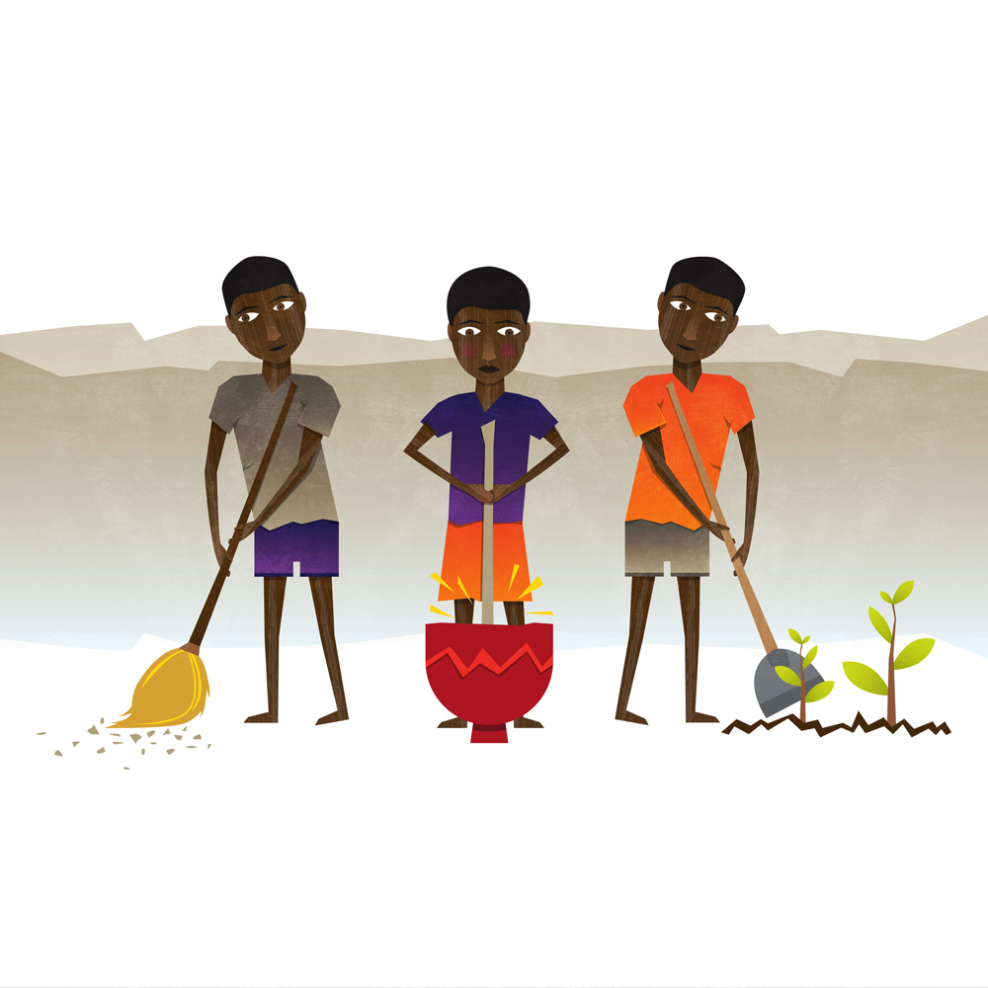
Ba ne ba sa rate ntwa mme ba ne ba thusa batsadi ba bona kwa gae le kwa masimong.
They never fought with each other. They helped their parents at home and in the fields.

Slide 4
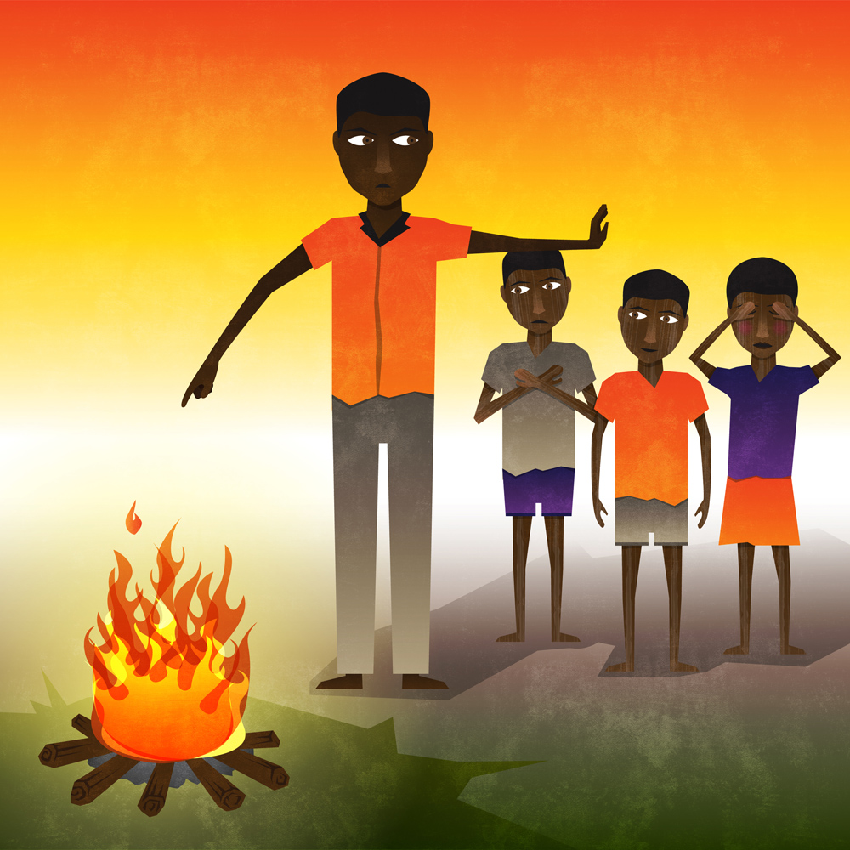
Mme ba ne ba sa letlelelwa go atamela fa thoko ga molelo.
But they were not allowed to go near a fire.

Slide 5
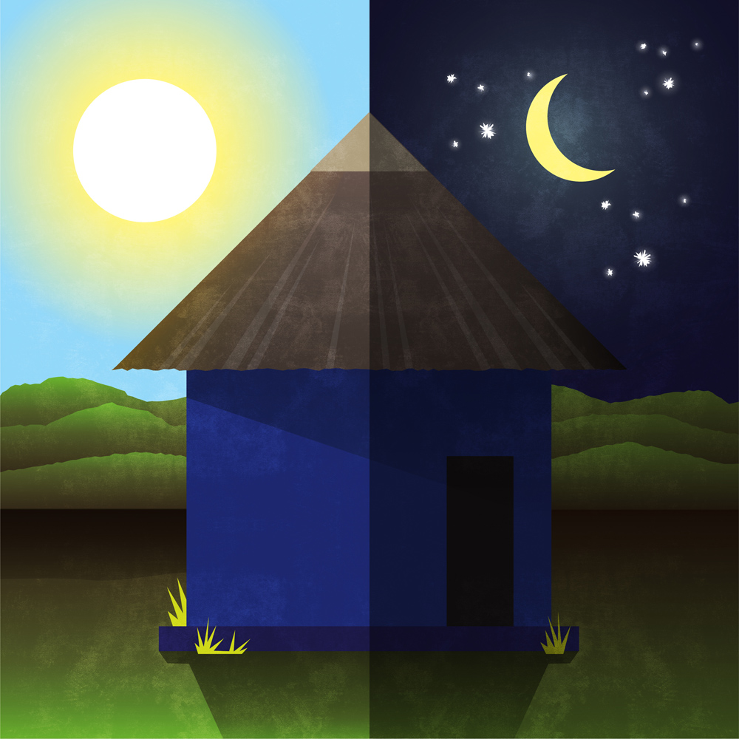
Ba ne ba letlelelwa fela go dira ditiro tsa bona bosigo.
They had to do all their work during the night.

Slide 6
Ka gonne ba ne ba bopilwe ka kerese!
Because they were made of wax!

Slide 7
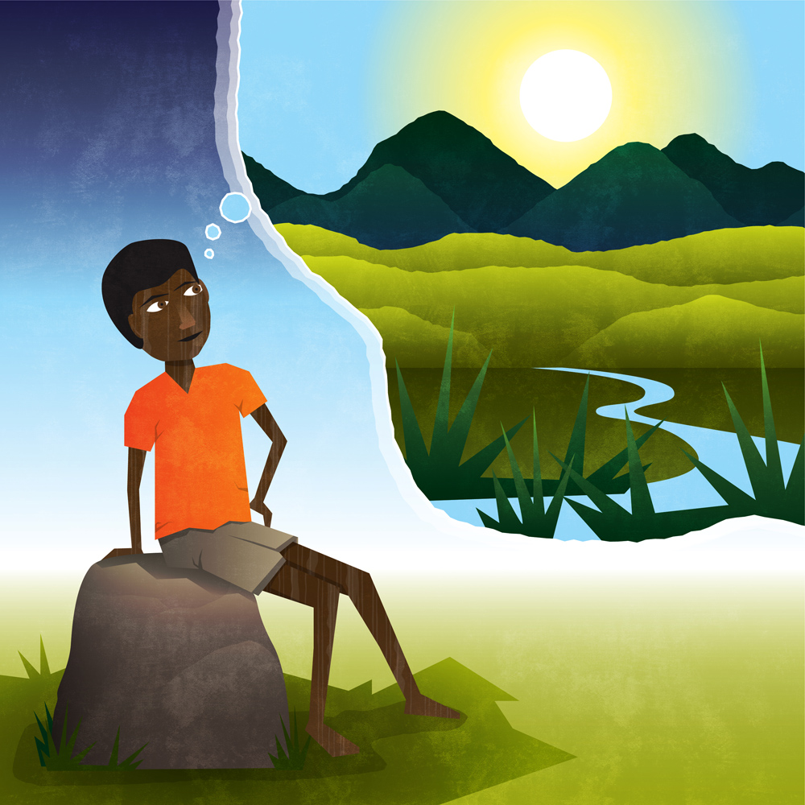
Mme mongwe wa basimane o ne a eletsa go bona letsatsi.
But one of the boys longed to go out in the sunlight.

Slide 8
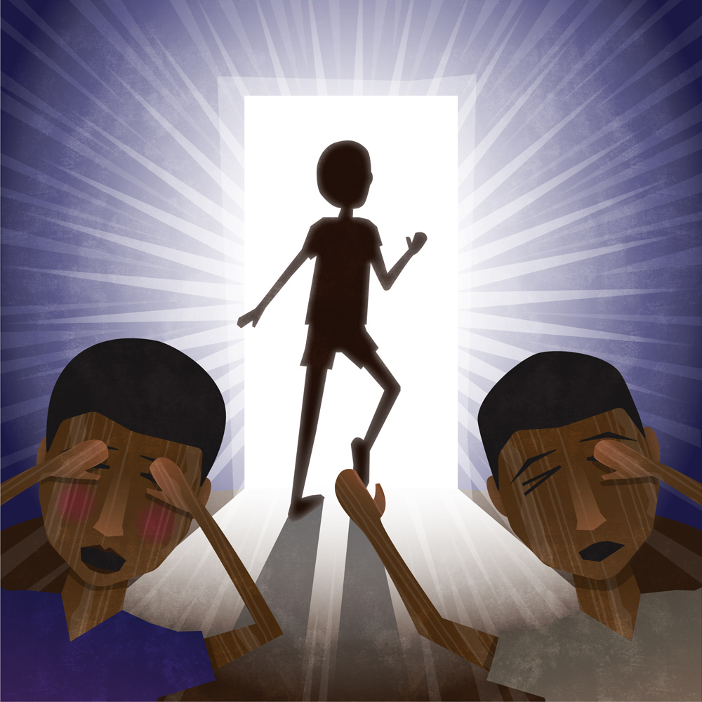
Ka letsatsi lengwe keletso ya gagwe e ne ya oketsega.
Basimane ba bangwe ba ne ba mo kgalema …
One day the longing was too strong. His brothers warned him …

Slide 9
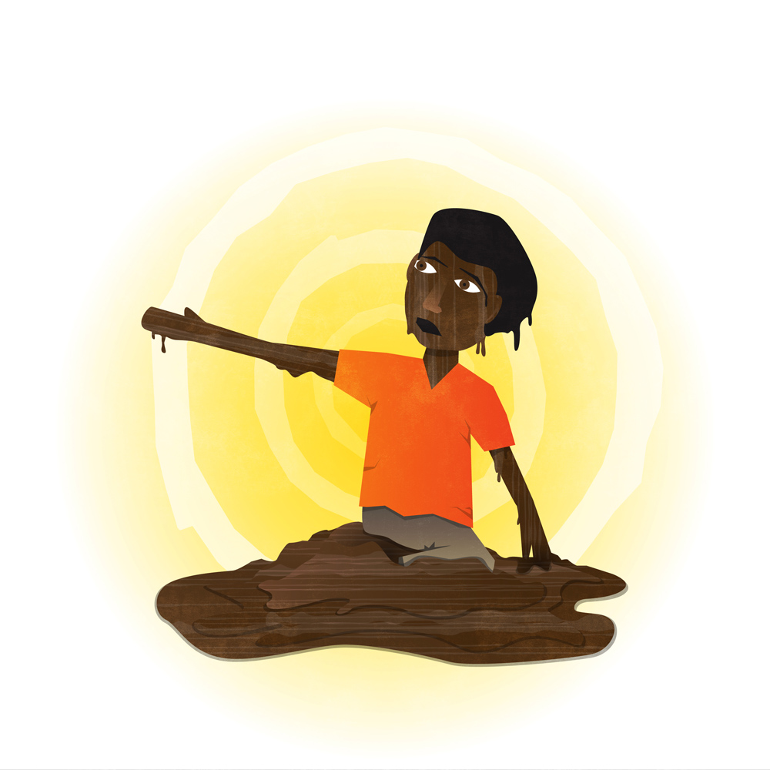
Mme go ne so setse go le thari!
O ne a tlhapologa mo letsatsing.
But it was too late!
He melted in the hot sun.

Slide 10
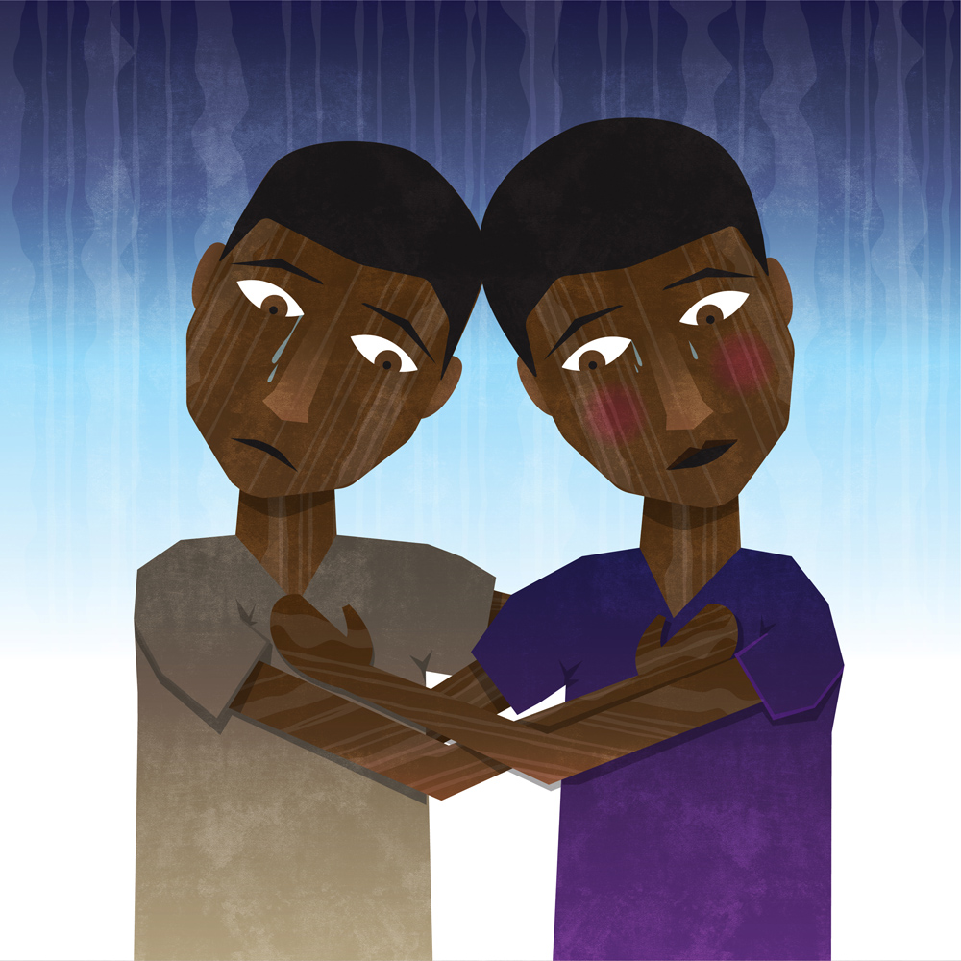
Bana ba kerese ba ne ba utlwa botlhoko go bona o mongwe a tlhapologa.
The wax children were so sad to see their brother melting away.

Slide 11
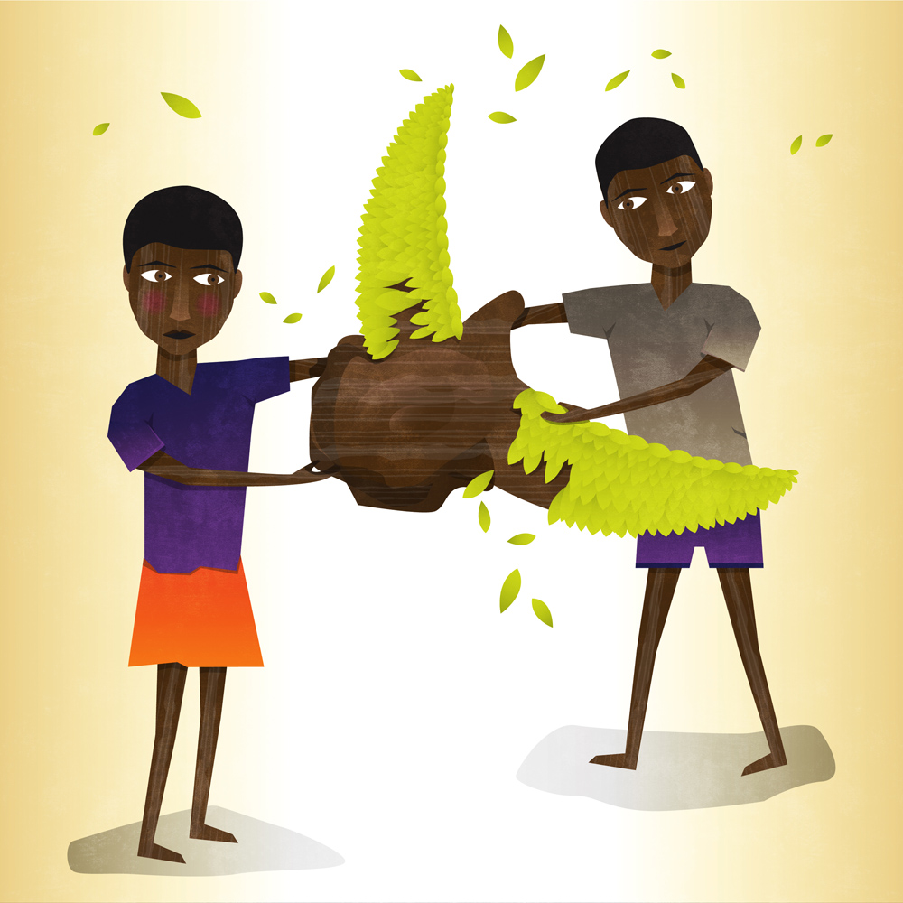
Mme ba ne ba dira leano. Ba ne ba tsaya kerese eo ba e aga go nna nonyane.
But they made a plan. They shaped the lump of melted wax into a bird.

Slide 12
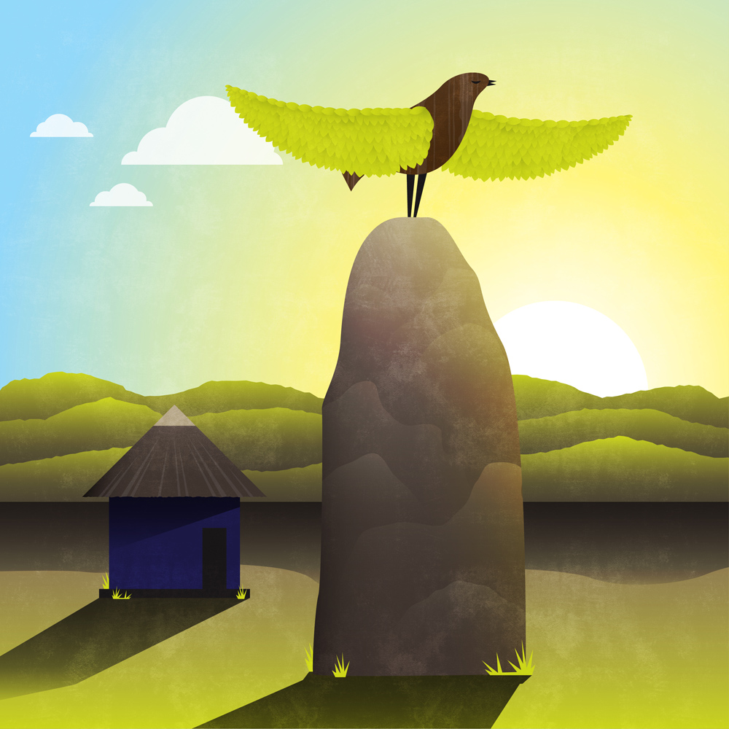
Ba ile ba tsaya nonyane e ba e isa kwa godimo ga thaba.
They took their bird brother up to a high mountain.

Slide 13
Fa letsatsi le tlhaba, o ile a fofela godima a opela a itumetse.
And as the sun rose, he flew away singing into the morning light.

Slide 14


Bana ba kerese
Children of wax
A Setswana/English version of a Zimbabwean tale for young readers by Tessa Welch and Lorato Trok
Illustrated by Wiehan de Jager
An excellent version to read aloud to children is the story Children of Wax in Alexander McCall Smith’s book of folktales: The Baboons Who Went This Way and That
© African Storybook Initiative, 2013

