Slide 1
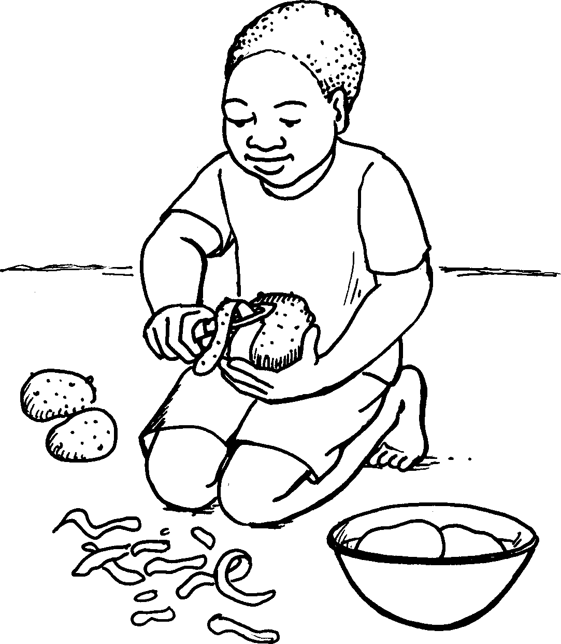
Ukupheka Cooking
Story in isiZulu by Clare Verbeek, Thembani Dladla, Zanele Buthelezi
Illustrated by Kathy Arbuckle

Slide 2
Ngicwecwa amazambane.
I peel the potatoes.

Slide 3
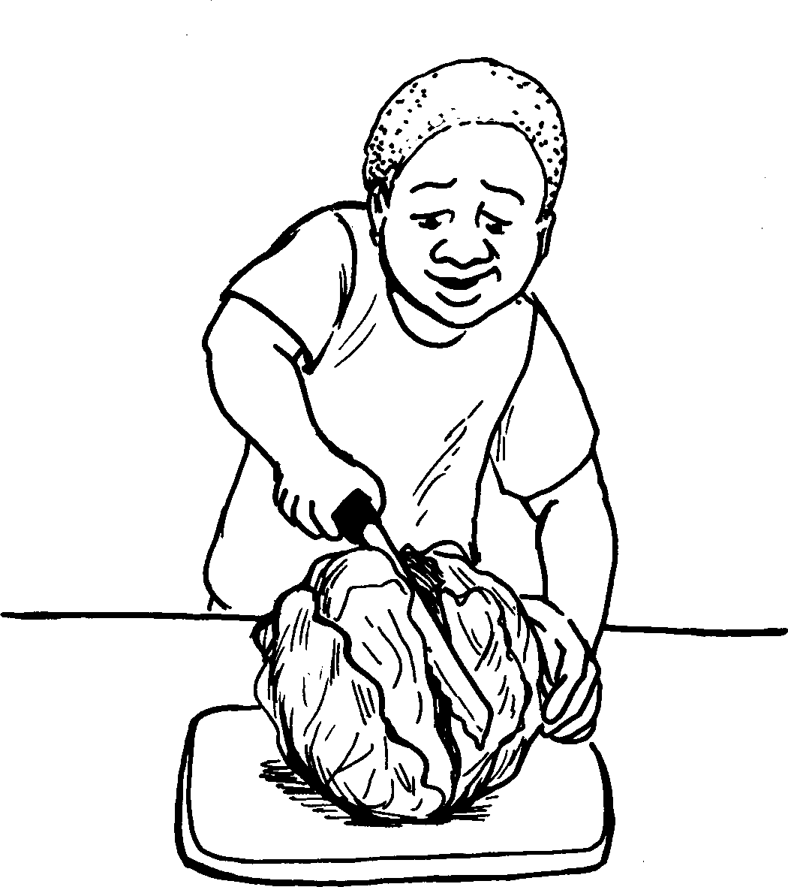
Ngiqoba iklabishi.
I chop a cabbage.

Slide 4
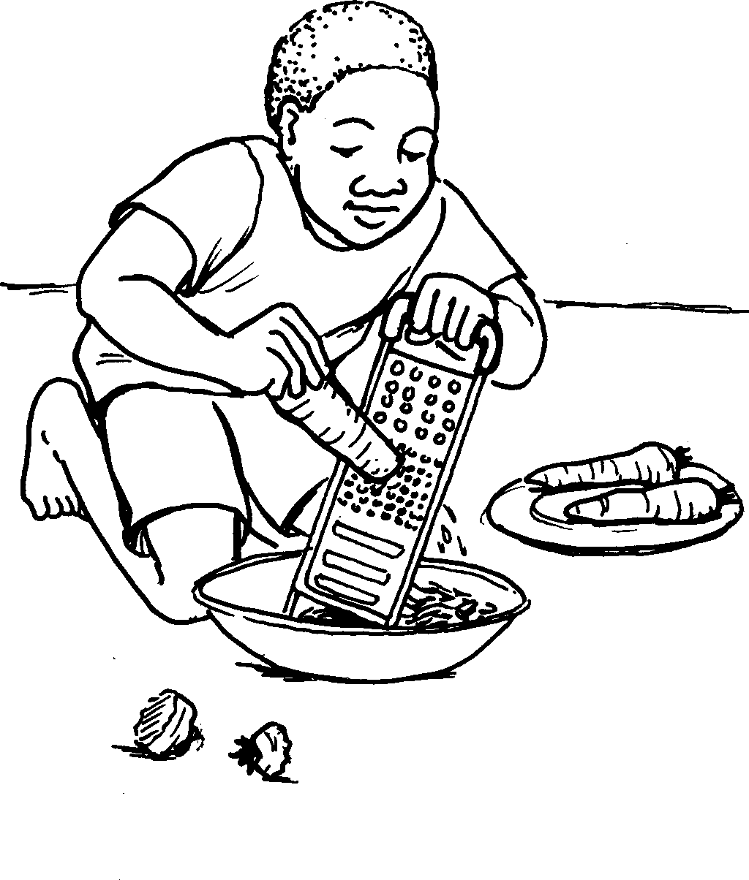
Ngilungisa iziqathi.
I grate the carrots.

Slide 5
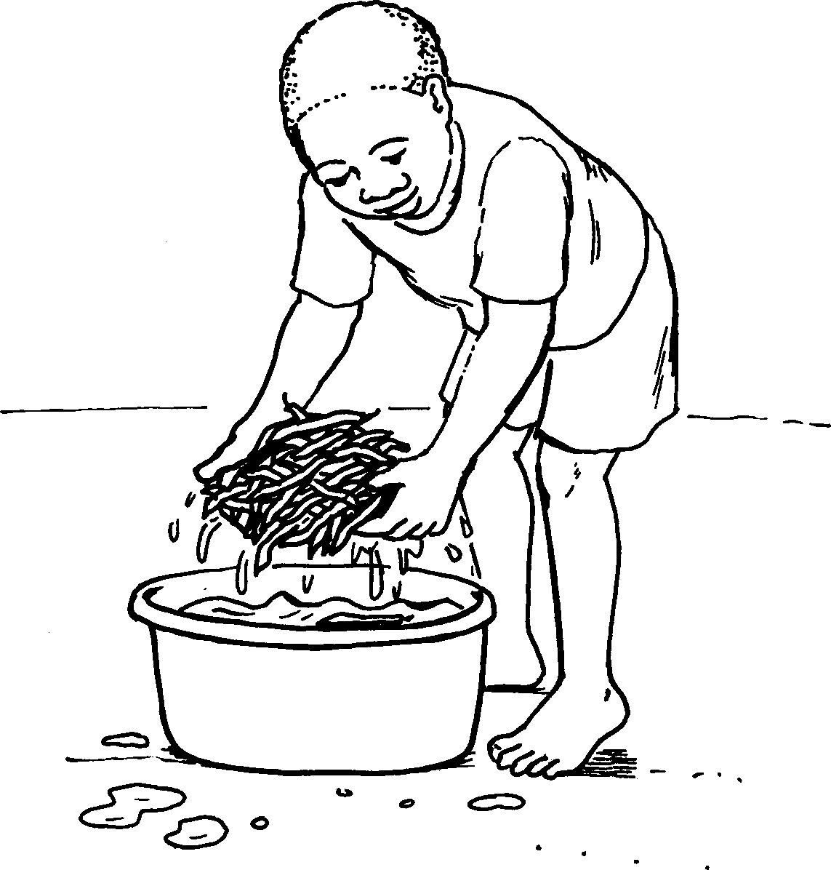
Ngigeza ubhontshisi.
I wash the beans.

Slide 6
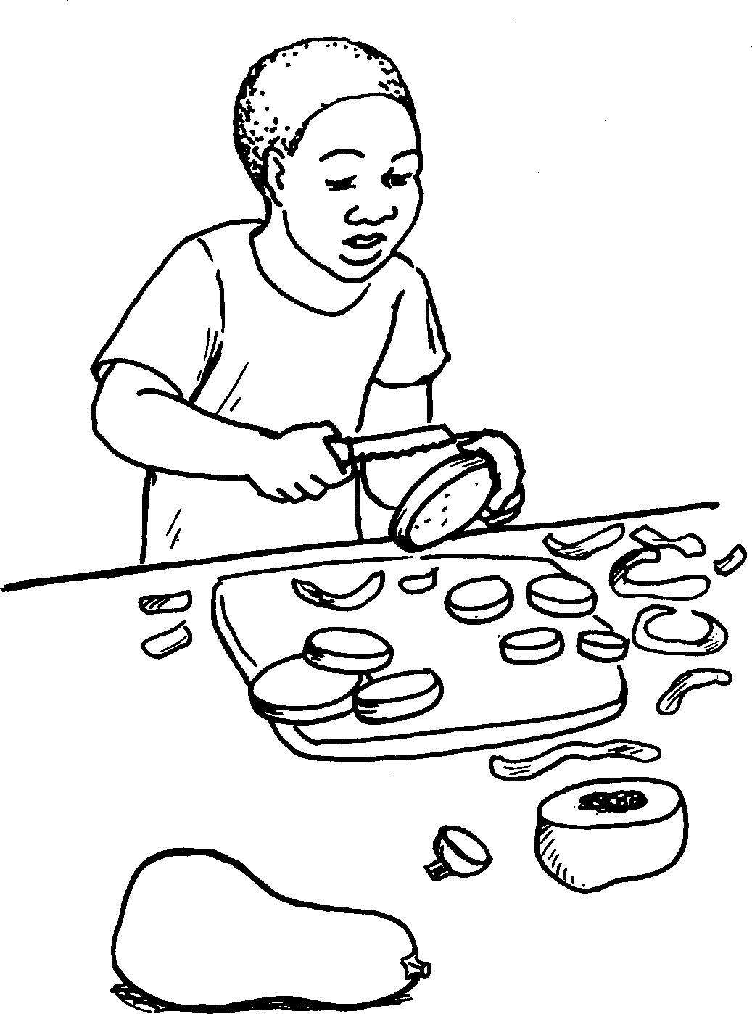
Ngicwecwa ithanga.
I cut the butternut.

Slide 7
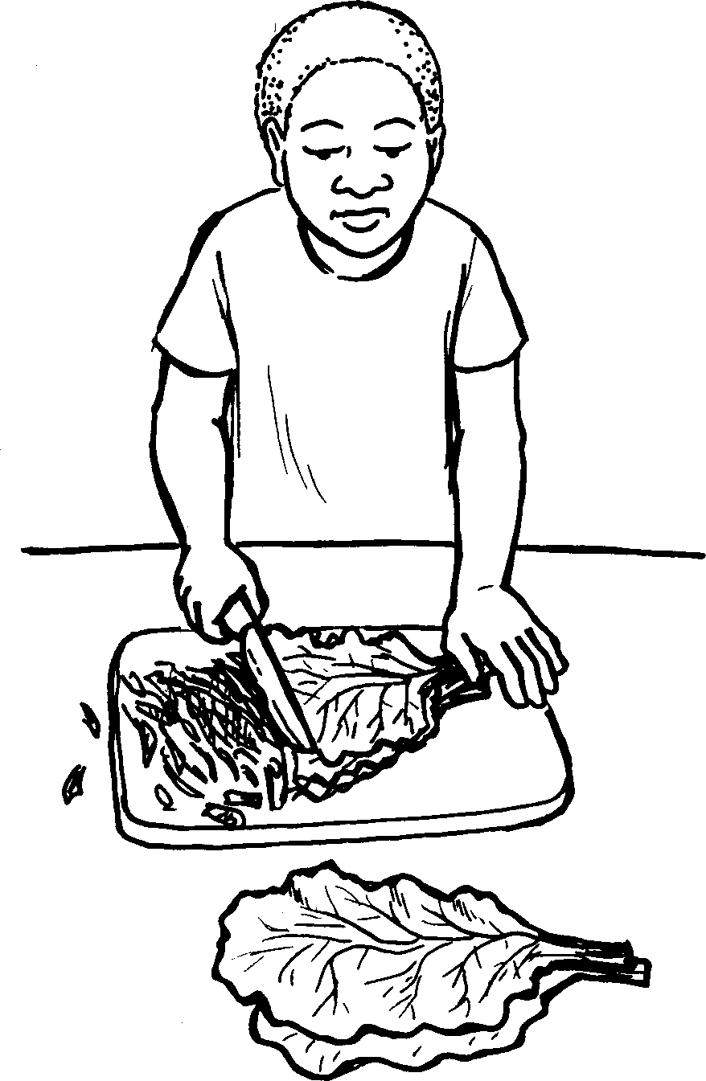
Ngiqoba imifino.
I chop the spinach.

Slide 8
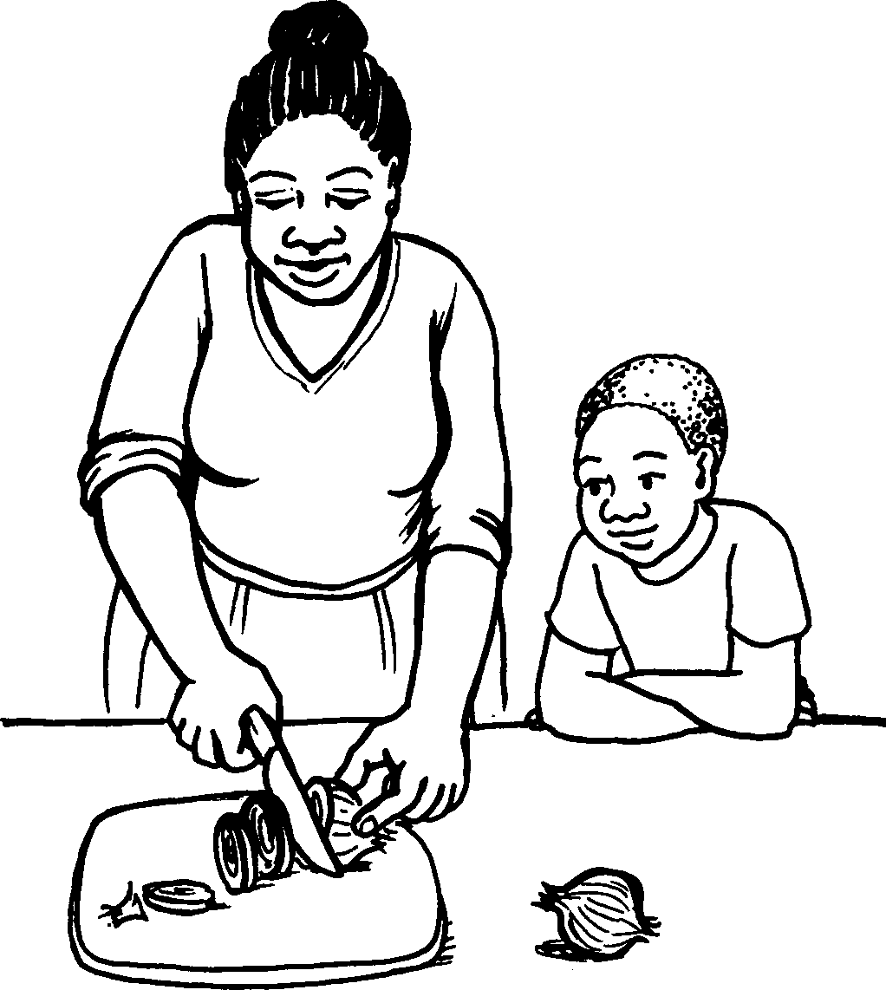
Kepha umama uqoba u-anyanisi.
My mom chops the onions.

Slide 9
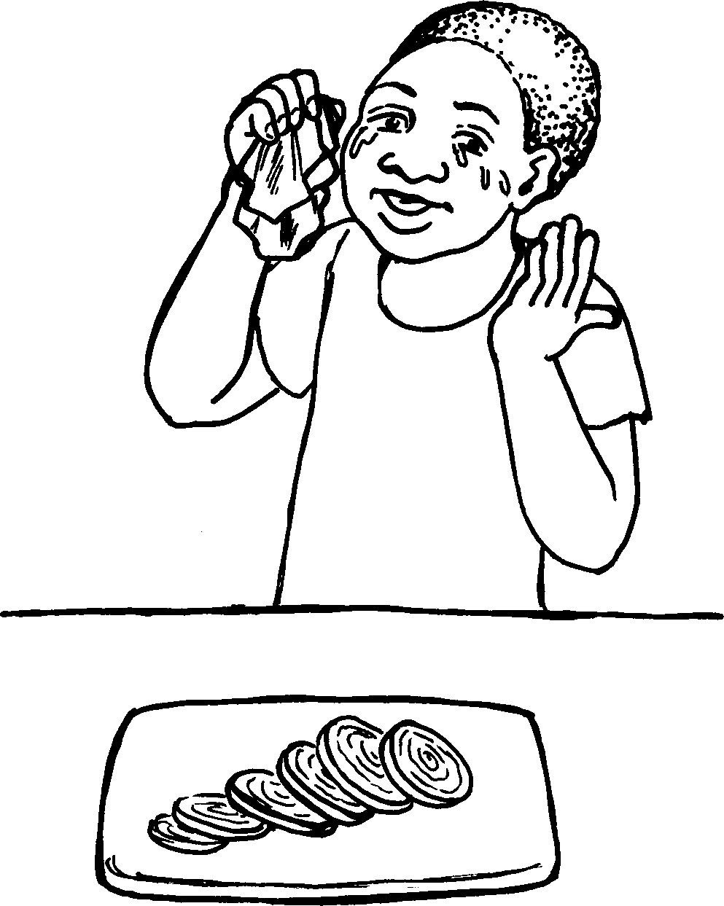
Mina ungenza ngikhale
u-anyanisi uma uqotshwa.
Onions make me cry when they are chopped.

Slide 10
Ukupheka Cooking
Story in isiZulu by Clare Verbeek, Thembani Dladla, Zanele Buthelezi
Kathy Arbuckle

