Slide 1
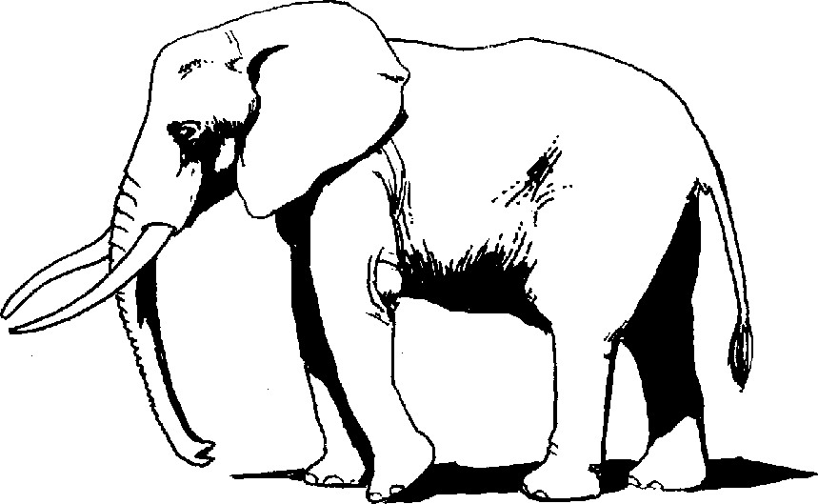
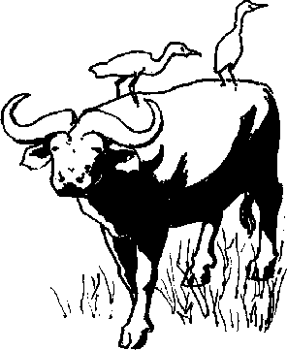
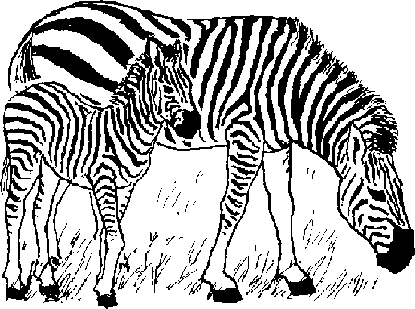
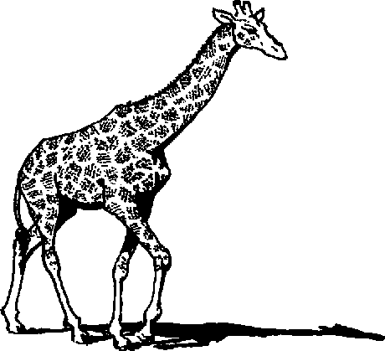
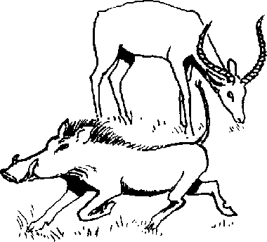
Ukubala Counting
Story in isiZulu by Clare Verbeek, Thembani Dladla, Zanele Buthelezi
Illustrated by Gay Galsworthy

Slide 2
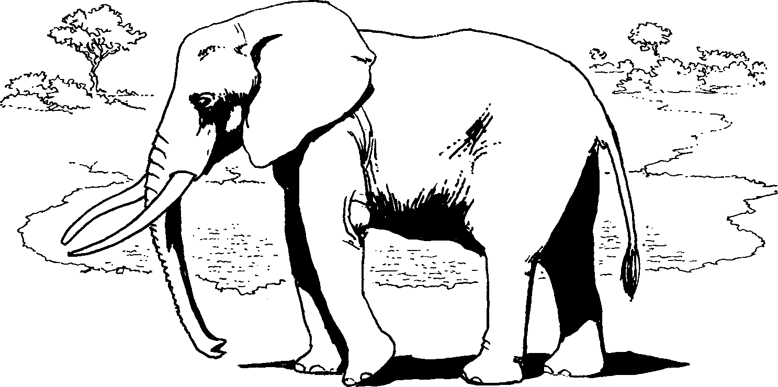
Indlovu eyodwa iya kophuza.
One elephant went to drink water.

Slide 3
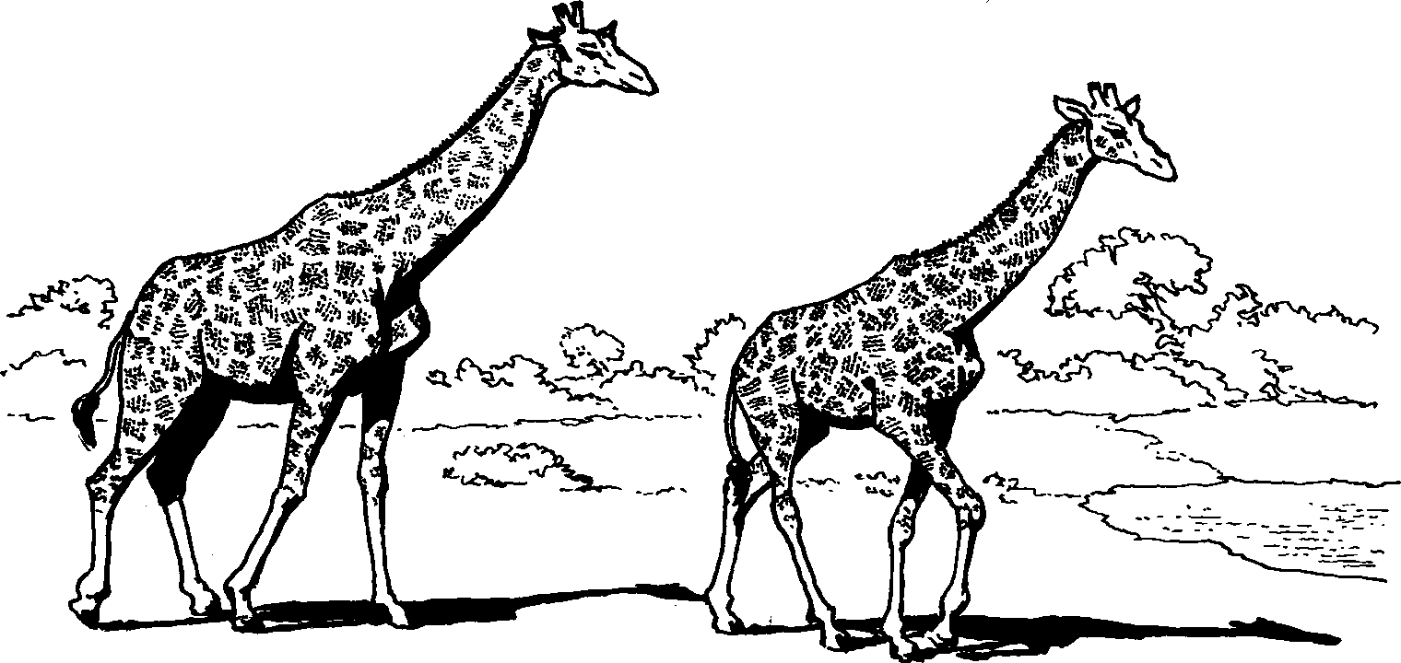
Izindlulamithi ezimbili ziya kophuza.
Two giraffes went to drink water.

Slide 4
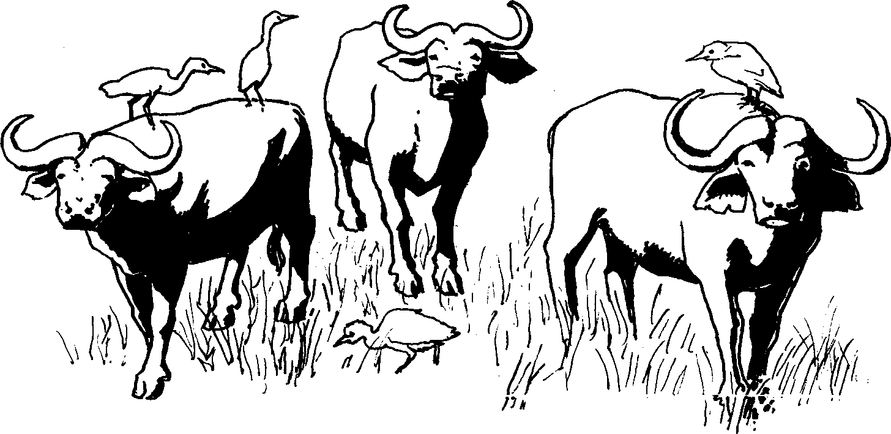
Izinyathi ezintathu namalanda amane.
Zonke ziya kophuza.
There are four buffalos and four birds. They are all going to drink water.

Slide 5
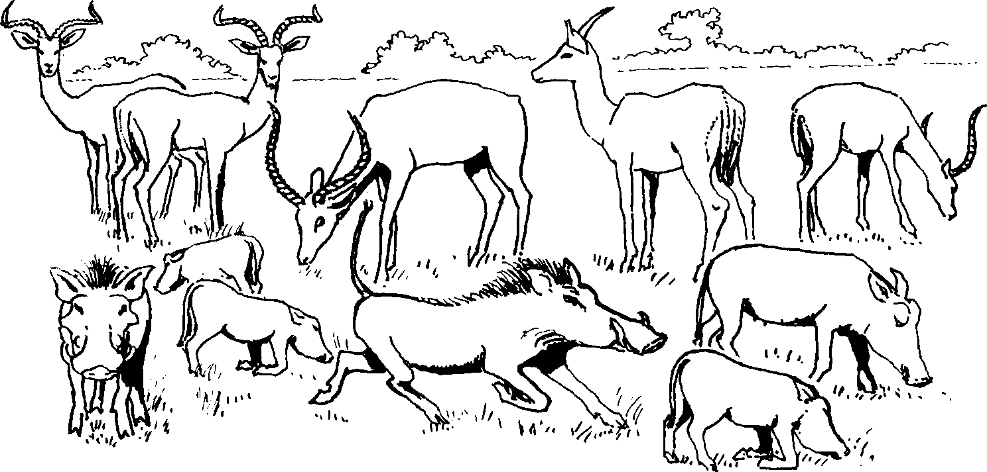
Izimpala ezinhlanu nezintibane
eziyisithupha ziya kophuza.
Five impalas and six wild hogs are going to drink water.

Slide 6
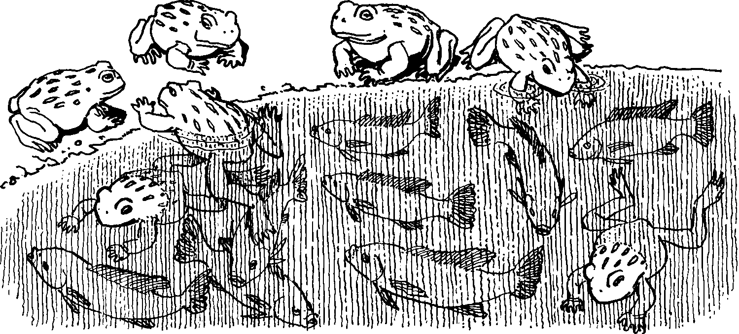
Amaxoxo ayisikhombisa nezinhlanzi
eziyisishiyagalombili. Zihlezi emanzini.
Seven frogs and eight fish are in the water.

Slide 7
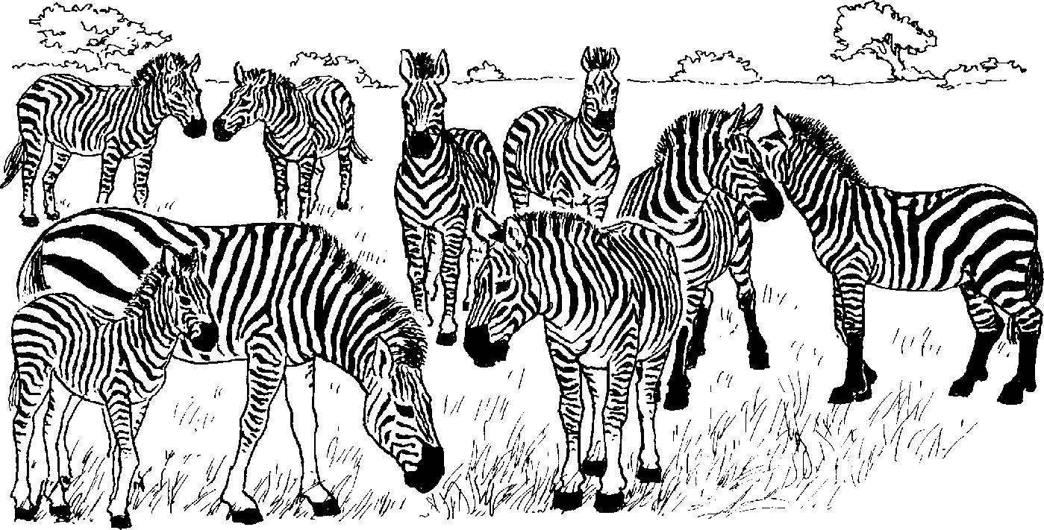
Amadube ayisishiyagalolunye aya kophuza.
Nine zebras are going to drink water.

Slide 8
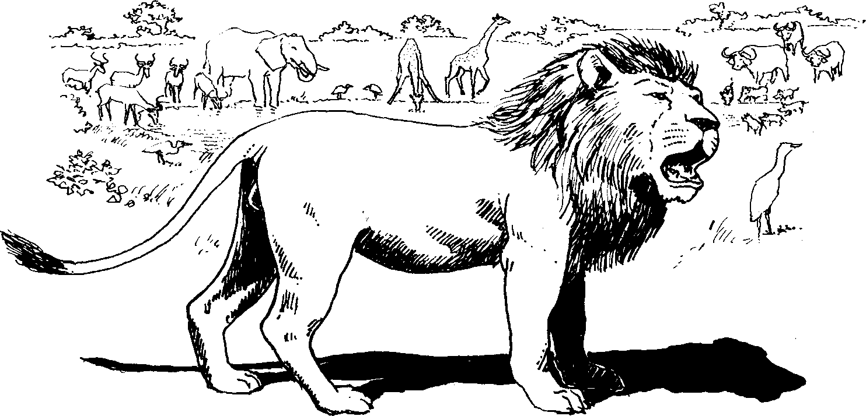
Kwafika ibhubesi elilodwa lizophuza.
One lion came to drink water.

Slide 9
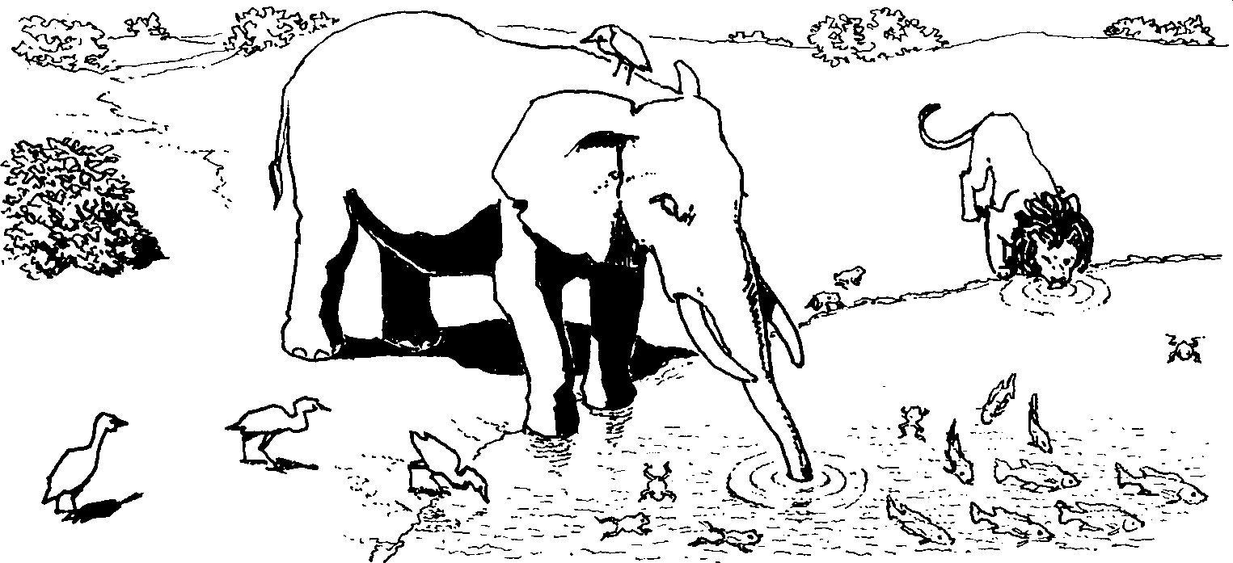
Ubani onesibindi sokuqhubeka ahlale aphuze?
Who is brave enough to continue drinking?

Slide 10
Ukubala Counting
Story in isiZulu by Clare Verbeek, Thembani Dladla, Zanele Buthelezi
Gay Galsworthy

