Slide 1
Goso the Teacher
Adapted from one of George W Bateman’s Zanzibar Tales
Illustrated by Jemma Kahn

Slide 2
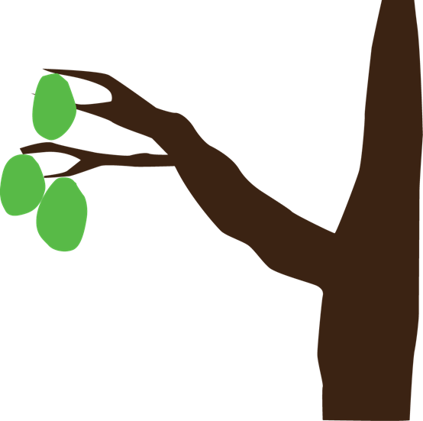
Once there was a man named Goso.
He taught children to read, not in a schoolhouse
but under a calabash tree.

Slide 3
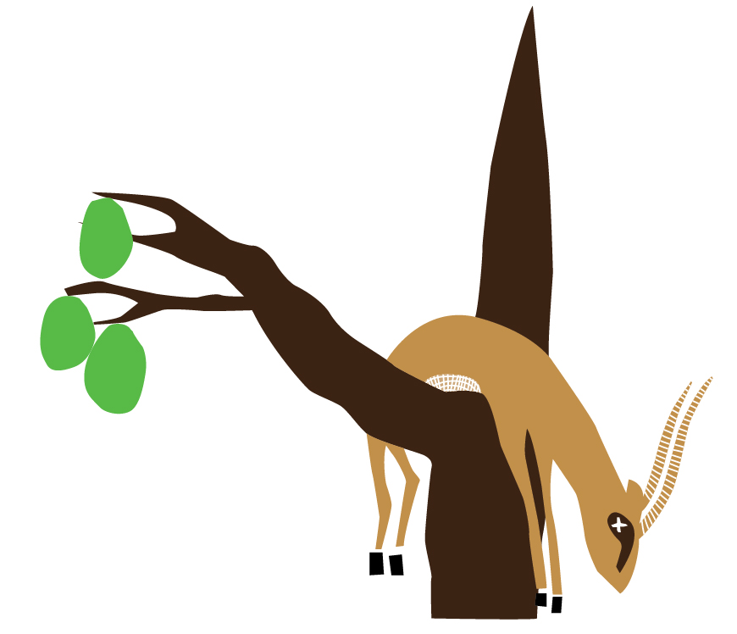
One evening, Paa, the gazelle, climbed up the tree to steal some fruit.
He shook off a calabash
and it hit Goso on the head and killed him.

Slide 4
When the children found their teacher lying dead on the ground, they were very sad.
They wanted to find the one who had killed Goso.

Slide 5
So they caught South Wind.
“It was you that threw down the calabash that hit our teacher Goso. You should not have done it.”
But South Wind said, “If I were so powerful would I be stopped by a mud wall?”

Slide 6
So they went to the mud wall.
“It was you that stopped South Wind, that threw down the calabash that hit our teacher Goso. You should not have done it.”
But Mud Wall said, “If I were so powerful how could a rat gnaw through me?”

Slide 7
So they found the rat.
“It was you that gnawed through Mud Wall, that stopped South Wind, that threw down the calabash that hit our teacher Goso. You should not have done it.”
But Rat said, “If I were so powerful would I be eaten by a cat?”

Slide 8
So they found the cat.
“It is you that eats Rat, that gnaws through Mud Wall, that stops South Wind, that threw down the calabash that hit our teacher Goso. You should not have done it.”
But Cat said, “If I were so powerful would I be tied by a rope?”

Slide 9
So they went to rope.
“It is you that ties Cat, that eats Rat, that gnaws through Mud Wall, that stops South Wind, that threw down the calabash that hit our teacher Goso. You should not have done it.”
But Rope said, “If I were so powerful would I be cut by a knife?”

Slide 10
So they found Knife.
“It is you that cuts Rope, that ties Cat, that eats Rat, that gnaws through Mud Wall, that stops South Wind, that threw down the calabash that hit our teacher Goso. You should not have done it.”
But Knife said, “If I were so powerful would I be burned by a fire?”

Slide 11
So they looked for the fire.
“It is you that burns Knife, that cuts Rope, that ties Cat, that eats Rat, that gnaws through Mud Wall, that stops South Wind, that threw down the calabash that hit our teacher Goso. You should not have done it.”
But Fire said, “If I were so powerful would I be put out by water?”

Slide 12
So they went to Water.
“It is you that puts out Fire, that burns Knife, that cuts Rope, that ties Cat, that eats Rat, that gnaws through Mud Wall, that stops South Wind, that threw down the calabash that hit our teacher Goso. You should not have done it.”
But Water said, “If I were so powerful would I be drunk by the ox?”

Slide 13
So they found Ox.
“It is you that drinks Water, that puts out Fire, that burns Knife, that cuts Rope, that ties Cat, that eats Rat, that gnaws through Mud Wall, that stops South Wind, that threw down the calabash that hit our teacher Goso. You should not have done it.”
But Ox said, “If I were so powerful would I be stung by a fly?”

Slide 14
So they found Fly.
“It is you that stings Ox, that drinks Water, that puts out Fire, that burns Knife, that cuts Rope, that ties Cat, that eats Rat, that gnaws through Mud Wall, that stops South Wind, that threw down the calabash that hit our teacher Goso. You should not have done it.”
But Fly said, “If I were so powerful, would I be eaten by the gazelle?”

Slide 15
So they found Paa, the gazelle.
“It is you that eats Fly, that stings Ox, that drinks Water, that puts out Fire, that burns Knife, that cuts Rope, that ties Cat, that eats Rat, that gnaws through Mud Wall, that stops South Wind, that threw down the calabash that hit our teacher Goso. You should not have done it.”

Slide 16
Paa was so surprised at being found out, that he had nothing to say.
Then the children said: “You are the one that threw down the calabash that hit our teacher Goso. You are the one that must be punished!”

Slide 17
Goso the Teacher
Adapted by Tessa Welch from one of George W Bateman’s Zanzibar Tales
Jemma Kahn
© African Storybook Initiative, 2013

