Slide 1
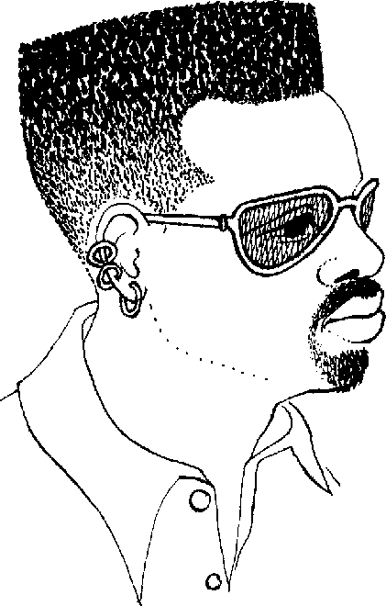
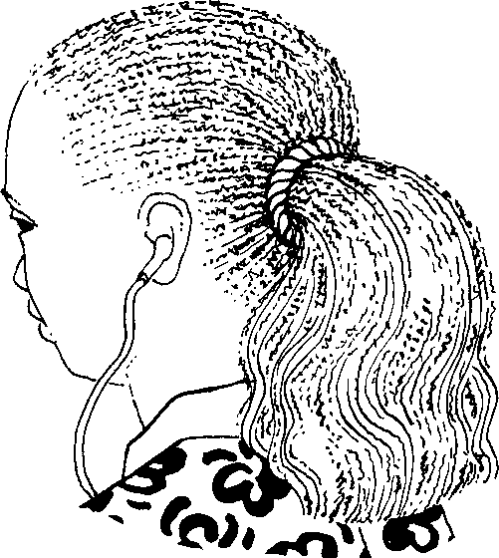
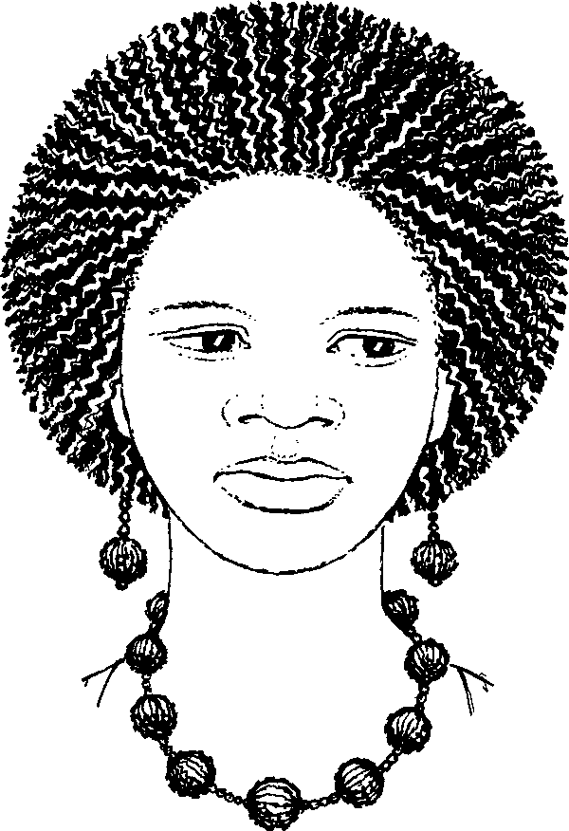
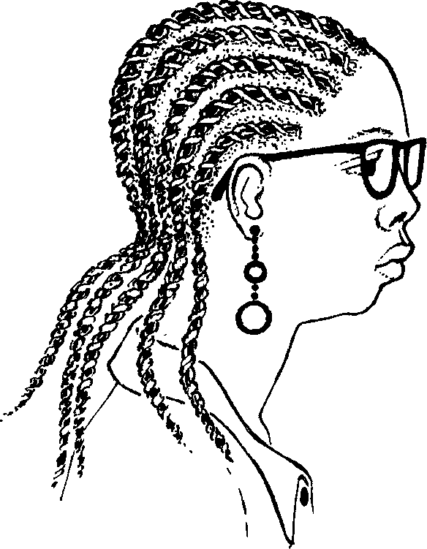
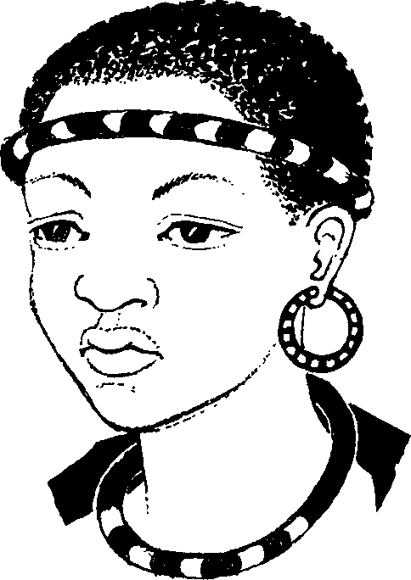
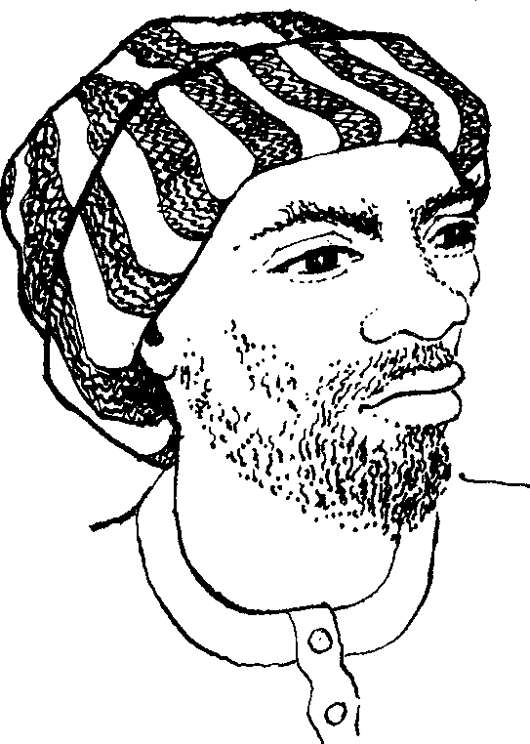
Izinwele Hair
Story in isiZulu by Clare Verbeek, Thembani Dladla, Zanele Buthelezi
Illustrated by Jinny Heath

Slide 2
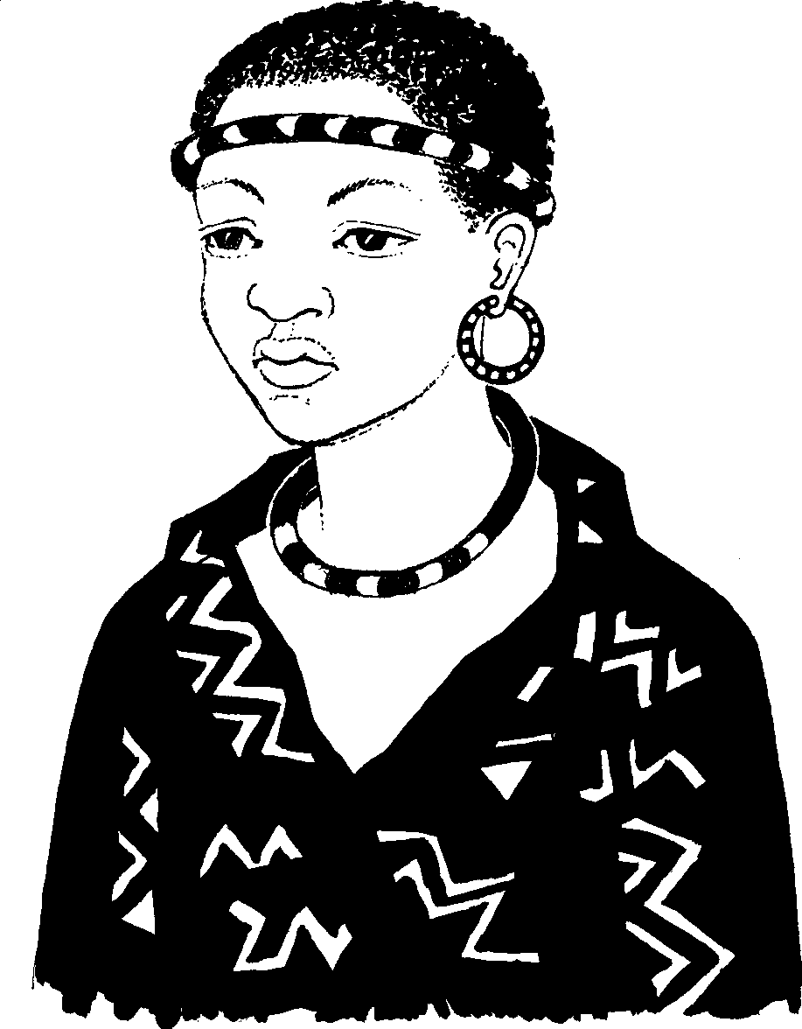
UThuli unezinwele ezimfishane.
Thuli has short hair.

Slide 3
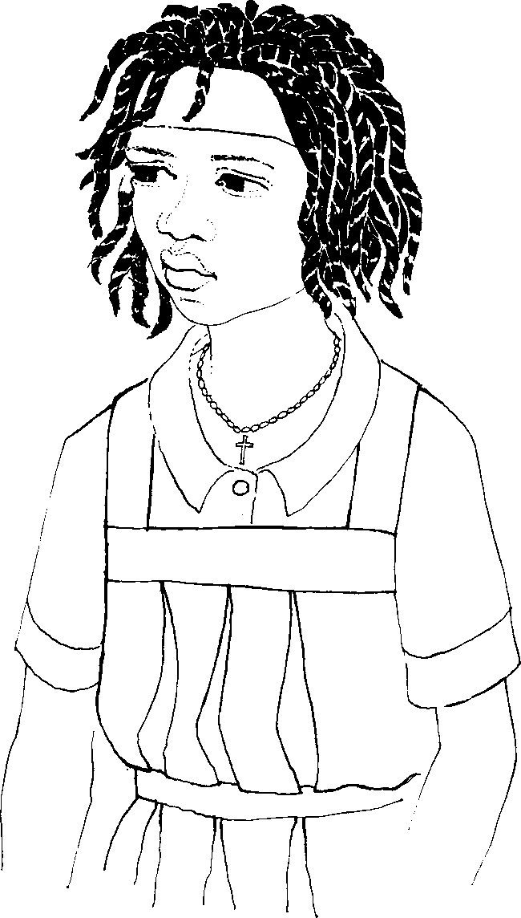
U-Anna yena unezinwele ezinde.
Anna has long hair.

Slide 4
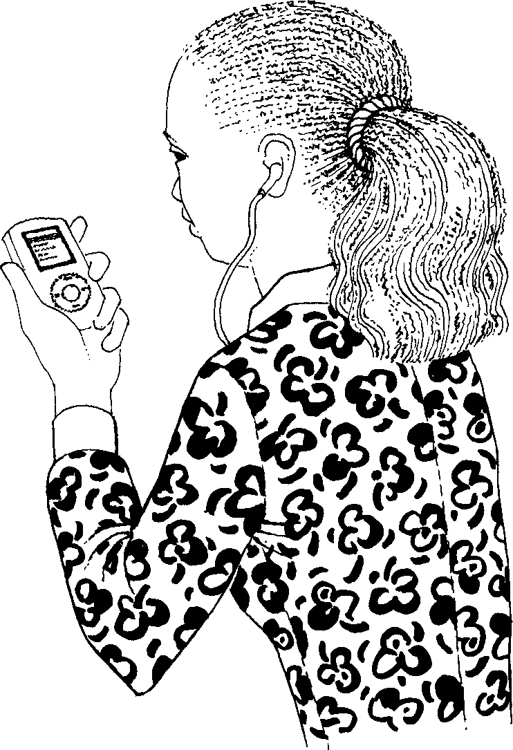
EzikaKathy zona zinde
kunazo zonke.
Kathy has the longest hair.

Slide 5
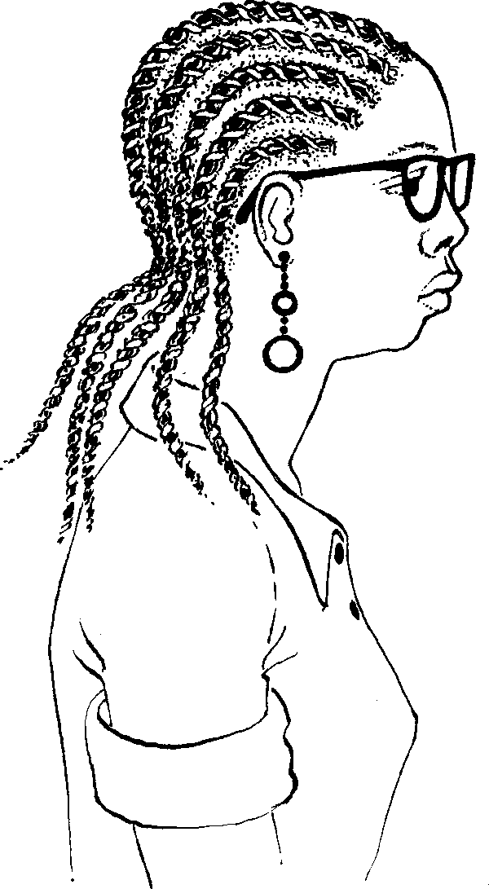
UZama yena uzilukile
ezakhe izinwele.
Zama has plaited her hair.

Slide 6
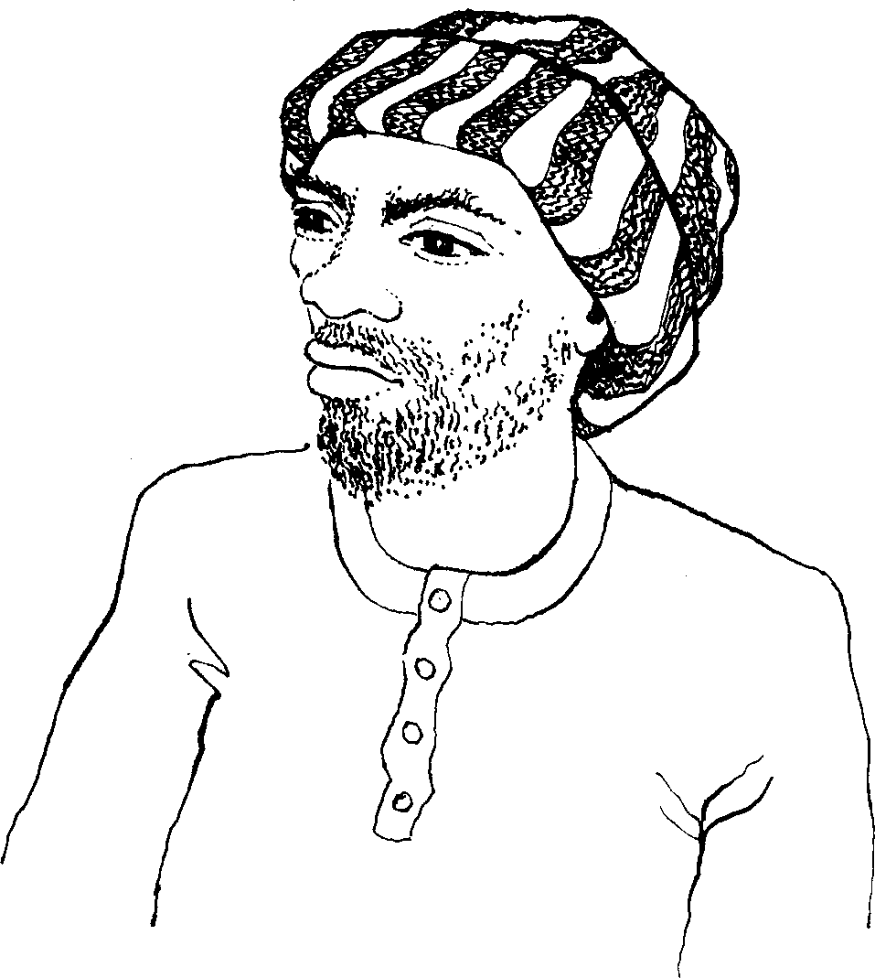
Ezikababa izinwele zona
zisesilevini.
Baba has a beard.

Slide 7
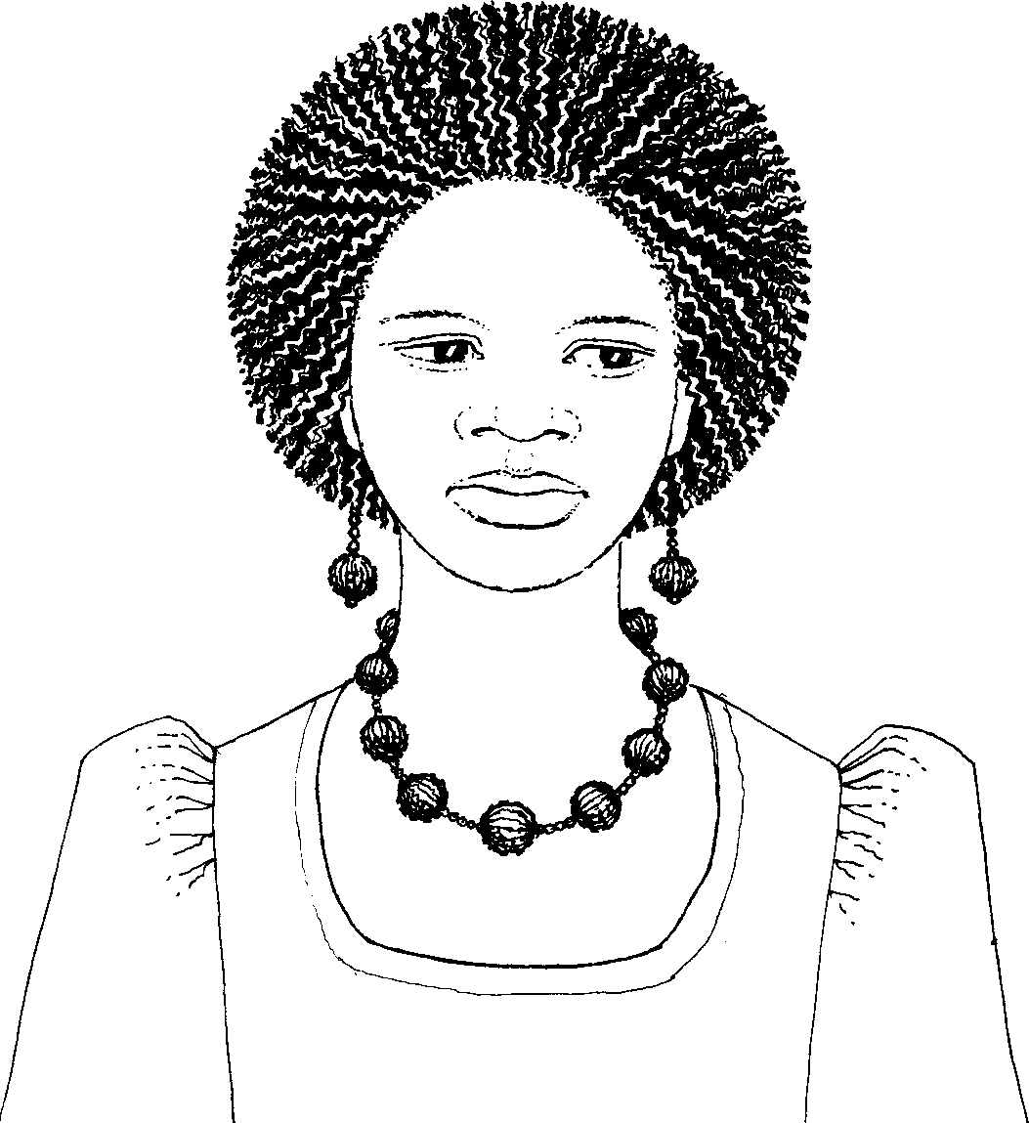
UZanele yena uzicwalile
ezakhe izinwele.
Zanele has combed her hair.

Slide 8
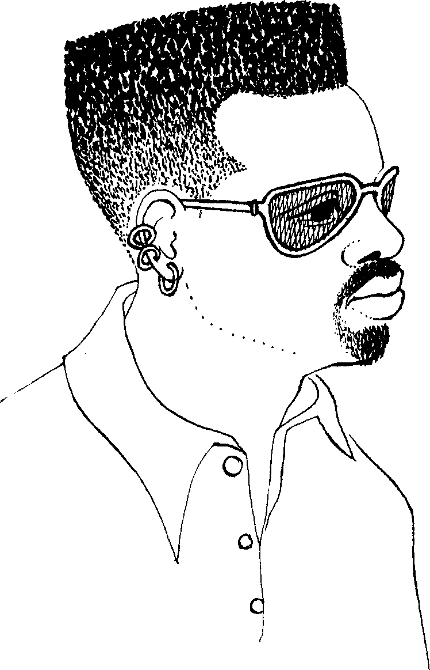
UThabo yena ugunde wazishiya phambili.
Thabo has cut his hair.

Slide 9
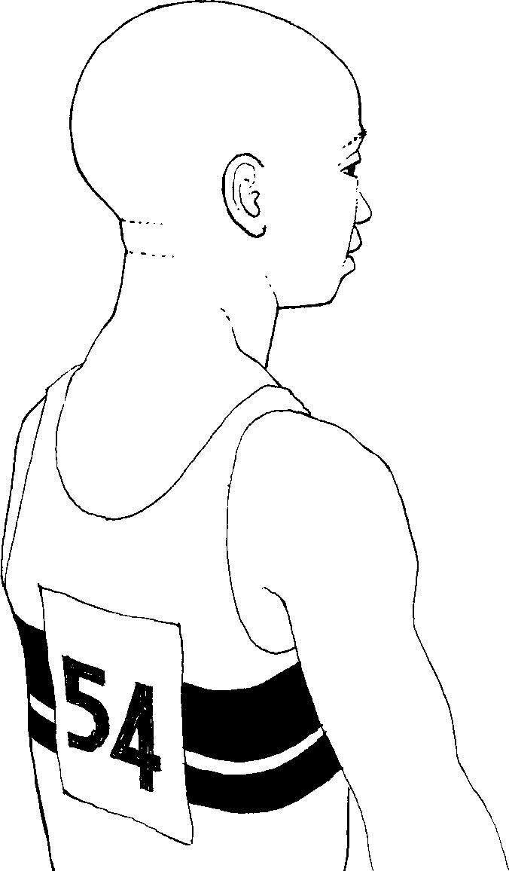
UThemba yena ugunde imbungculu.
Themba has shaved his hair.

Slide 10
Izinwele Hair
Story in isiZulu by Clare Verbeek, Thembani Dladla, Zanele Buthelezi
Jinny Heath

