Slide 1
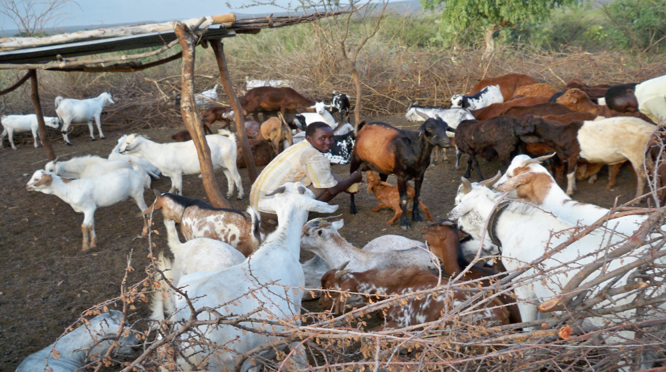
Ilchamus counting game
Collected with photographs by Caroline Lentupuru

Slide 2
Lekeek isiet! Kakwa kulo isiet?
Lekweny isiet! Kakwa kulo isiet?
Lekichu isiet! Kakwa kulo isiet?
The children compete to name the different types of trees, birds and cows.
One child says, “Eight trees! “ [or birds, or cows, or anything in sight that is countable]
The rest ask “Which are these eight?”
Then first child has to say the colours or names of the eight trees or birds or cows.
Eight trees! Which are these eight?
Eight birds! Which are these eight?
Eight cows! Which are these eight?

Slide 3
The Il Chamus are the second smallest community in Kenya. The community lives around the shores of Lake Baringo in Baringo County and number less than 50,000 members.
They regard themselves as one of the indigenous communities pushed to the area by Maasai clan wars. In fact, Il Chamus is a Maasai name meaning people who can see into the future. They were later renamed the Njemps by the Europeans that is why today the Il Chamus are often referred to as the Njemps. They are part of the larger Nilotic group.
They are a pastoralist community. As a minority, they suffer marginalization and lag behind in education. Most affected are the girls whom community has not invested much in.
Due to the nature of their lifestyle, the Il Chamus’ vocabulary revolves a lot around livestock and trees. Livestock is the main source of livelihood and trees are important for constructing shelter and for pasture for their animals. For this reason, children are introduced to colour and number of animals as well as different types of trees found in their environment. This is done through a combination of short stories and games. These stories also serve to sharpen children’s wit and foster attentiveness to detail.

Slide 4
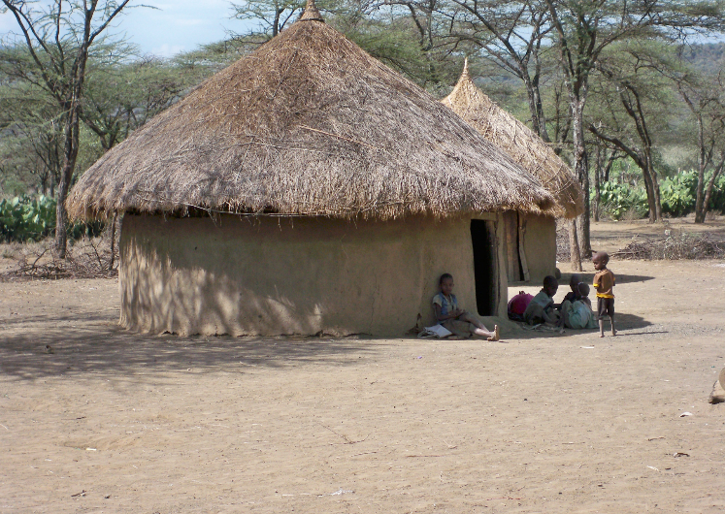
Ilchamus counting game
Collected with photographs by Caroline Lentupuru
© African Storybook Initiative, 2013

