Slide 1
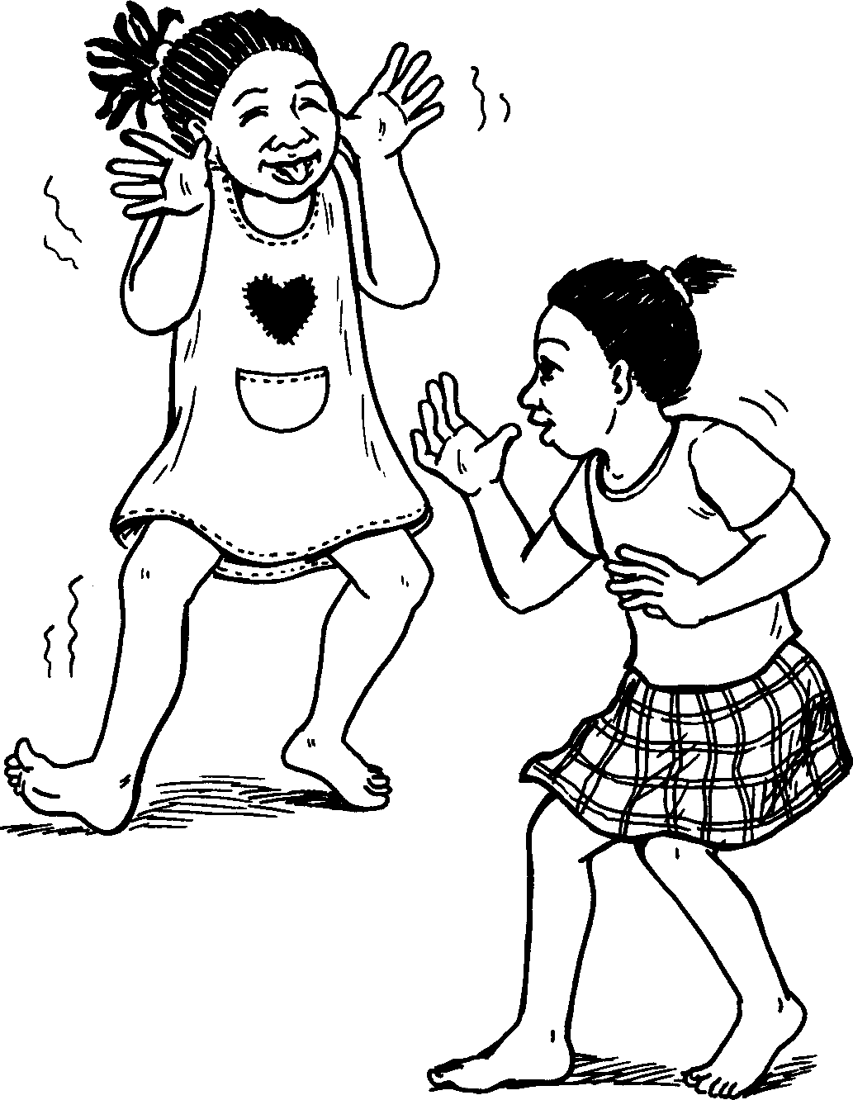
Imizwa Feelings
A story I isiZulu by Clare Verbeek, Thembani Dladla, Zanele Buthelezi
Illustrated by Kathy Arbuckle

Slide 2
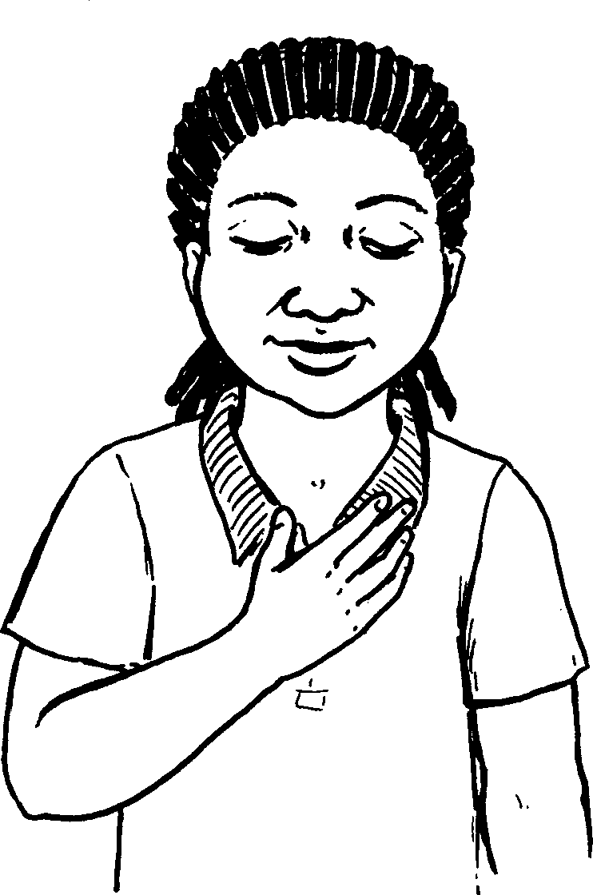
Inhliziyo yami inemizwa eminingi.
My heart feels a lot of things.

Slide 3
Ngiye ngijabule uma ugogo esixoxela izindaba ebusuku.
I feel happy when my granny tells us stories in the evening.

Slide 4
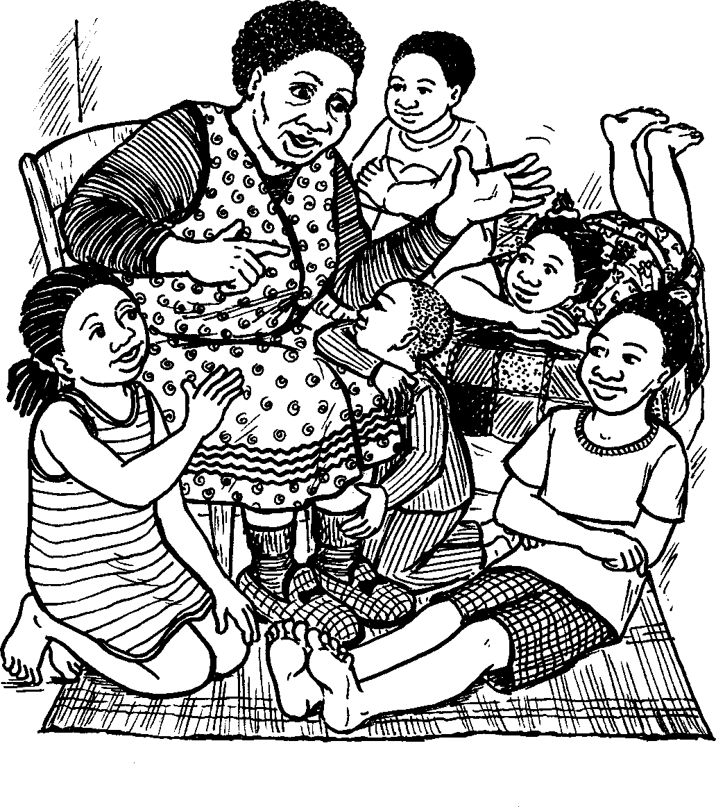

Slide 5
Ngiye ngizizwe ngiyisilima uma ngidlala nomngani wami.
I feel stupid when I play with my friend.

Slide 7
Ngiphatheka kabi uma ubaba ethi akanayo imali.
I feel bad when my dad says he does not have money.

Slide 8
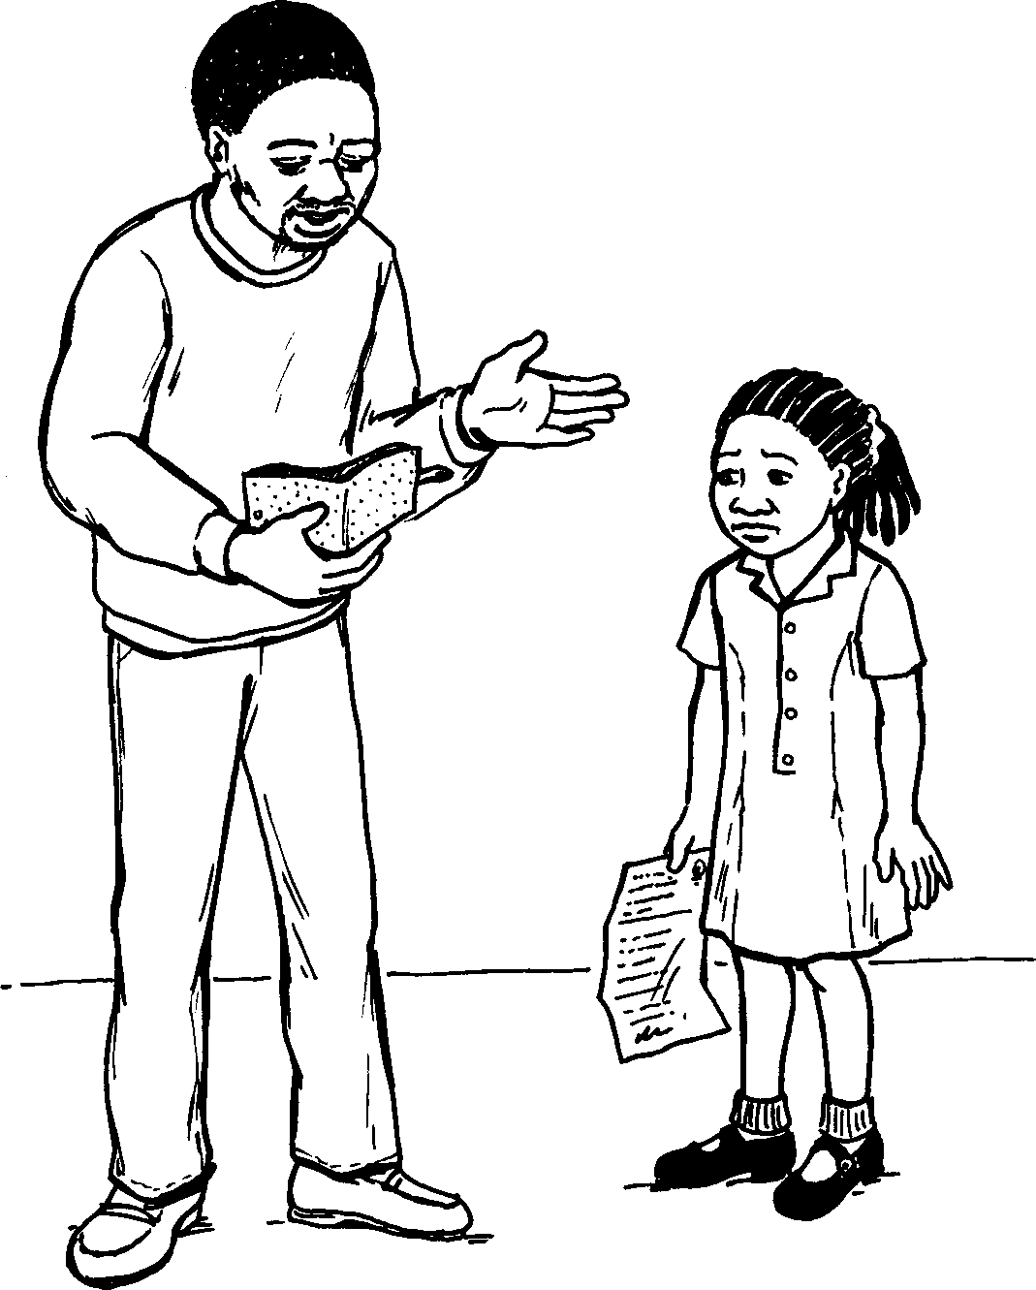

Slide 9
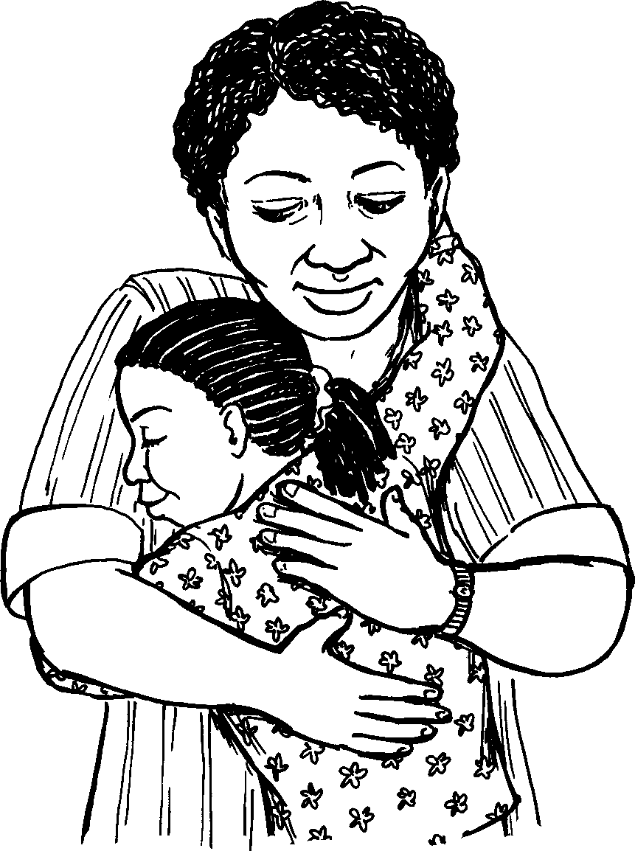
Ngizizwa ngithandwa uma umama engigona.
I feel loves when my mom gives me a hug.

Slide 10
Imizwa Feelings
Story in isiZulu by Clare Verbeek, Thembani Dladla, Zanele Buthelezi
Kathy Arbuckle

