Slide 1
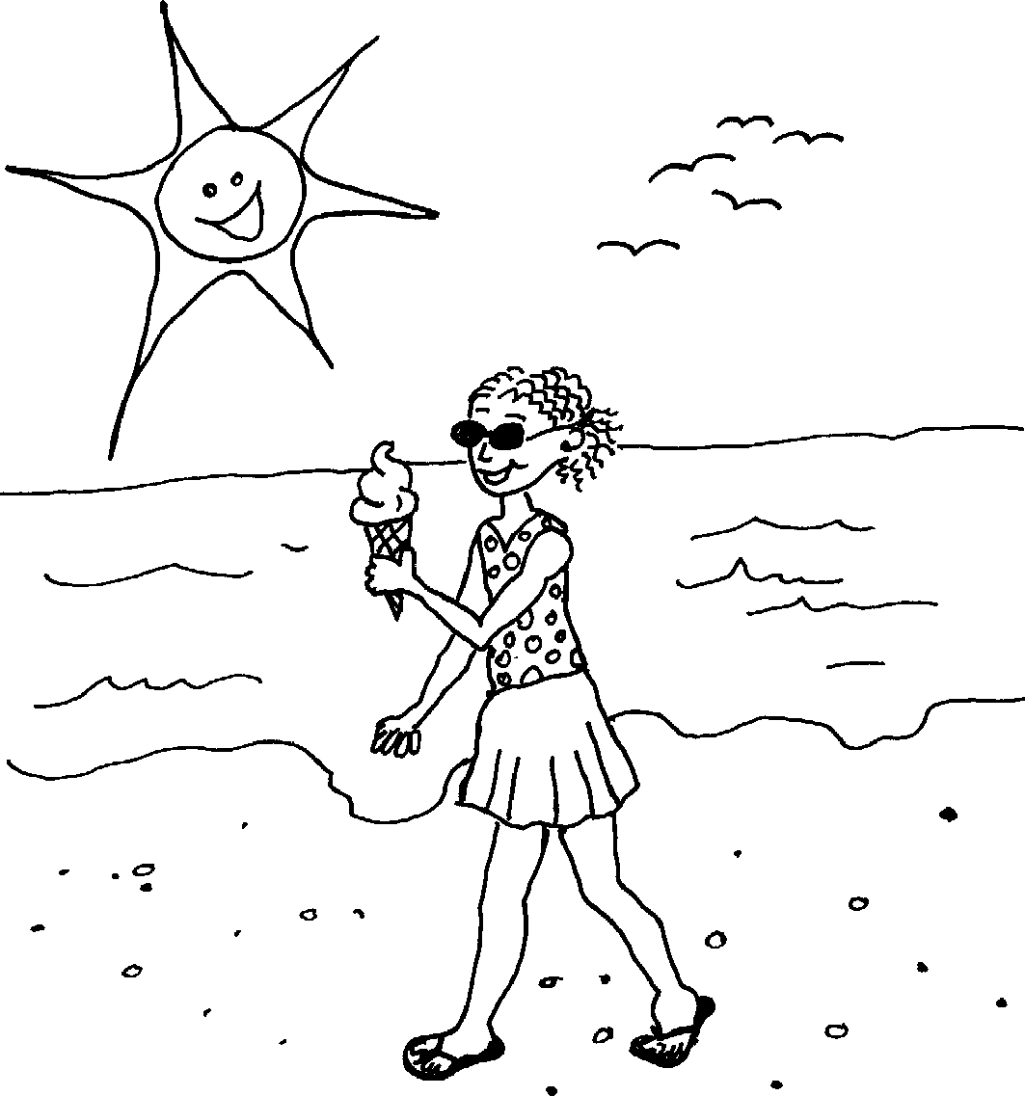
Incwadi ehlahla isimo sezulu Weather book
Story in isiZulu by Clare Verbeek, Thembani Dladla, Zanele Buthelezi
Illustrated by Sandra McDougall

Slide 2
Libalele.
It is dry ??

Slide 3
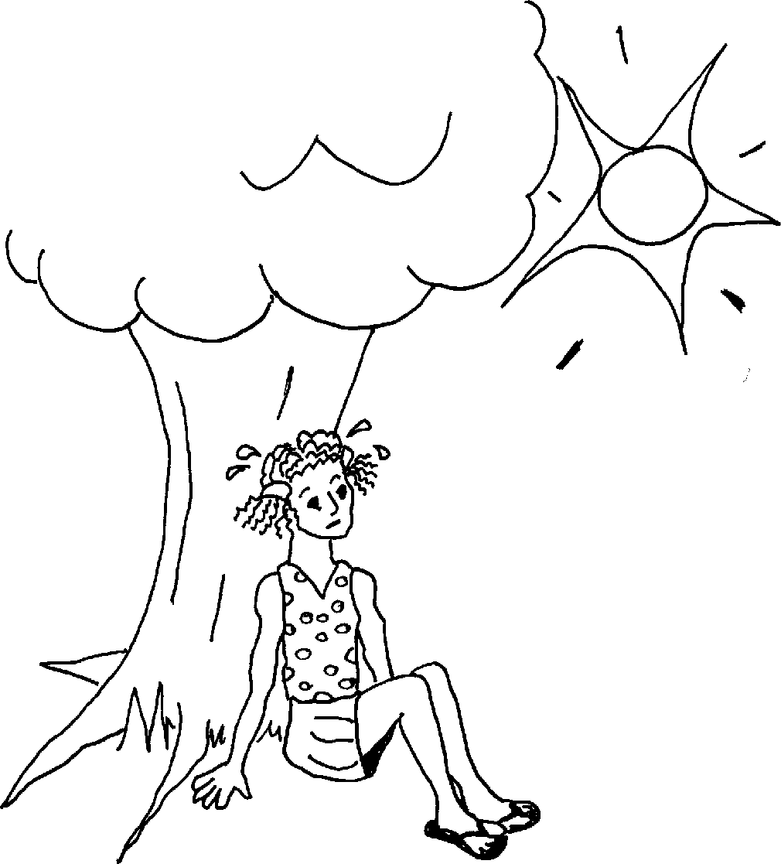
Liyashisa.
The sun is hot.

Slide 4
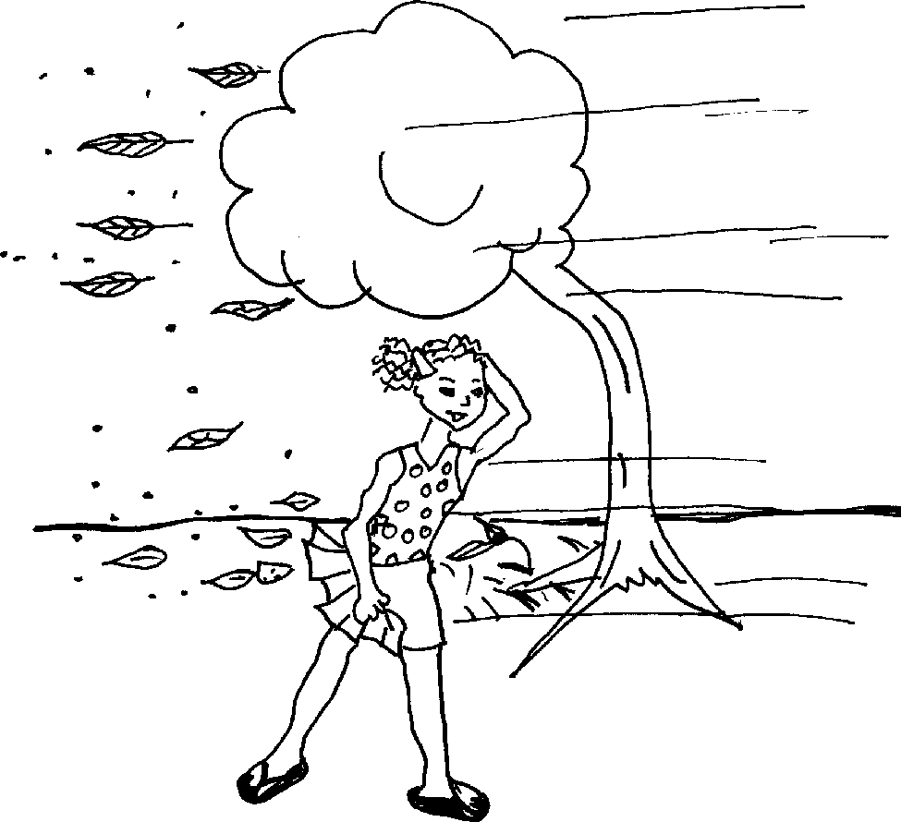
Linomoya.
It is windy.

Slide 5
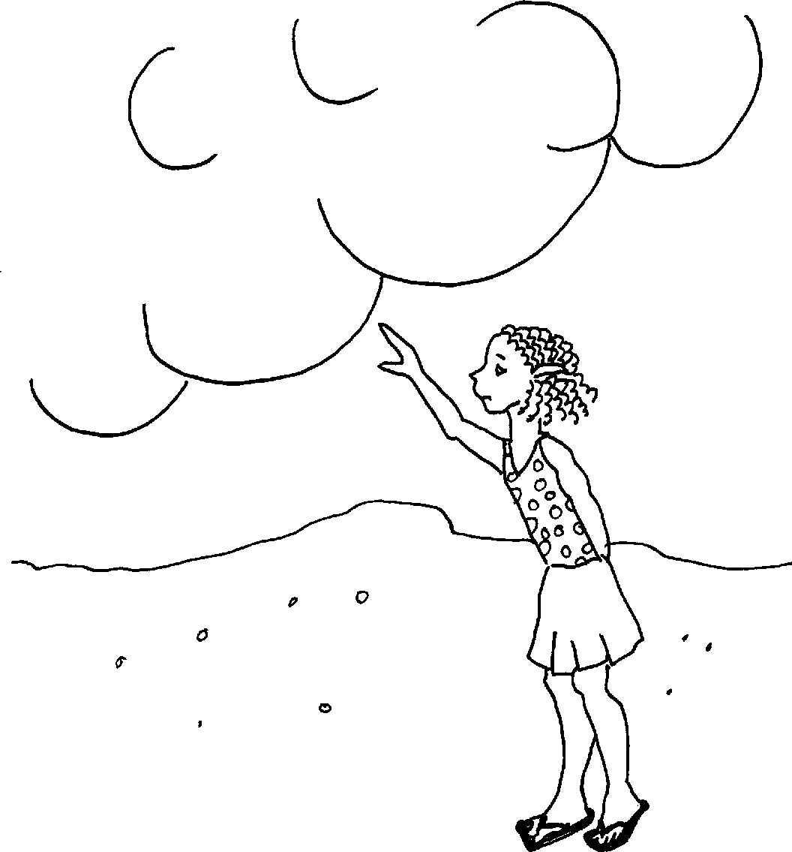
Liguqubele.
It is cloudy.

Slide 6
Liyabanda.
It is cold.

Slide 7
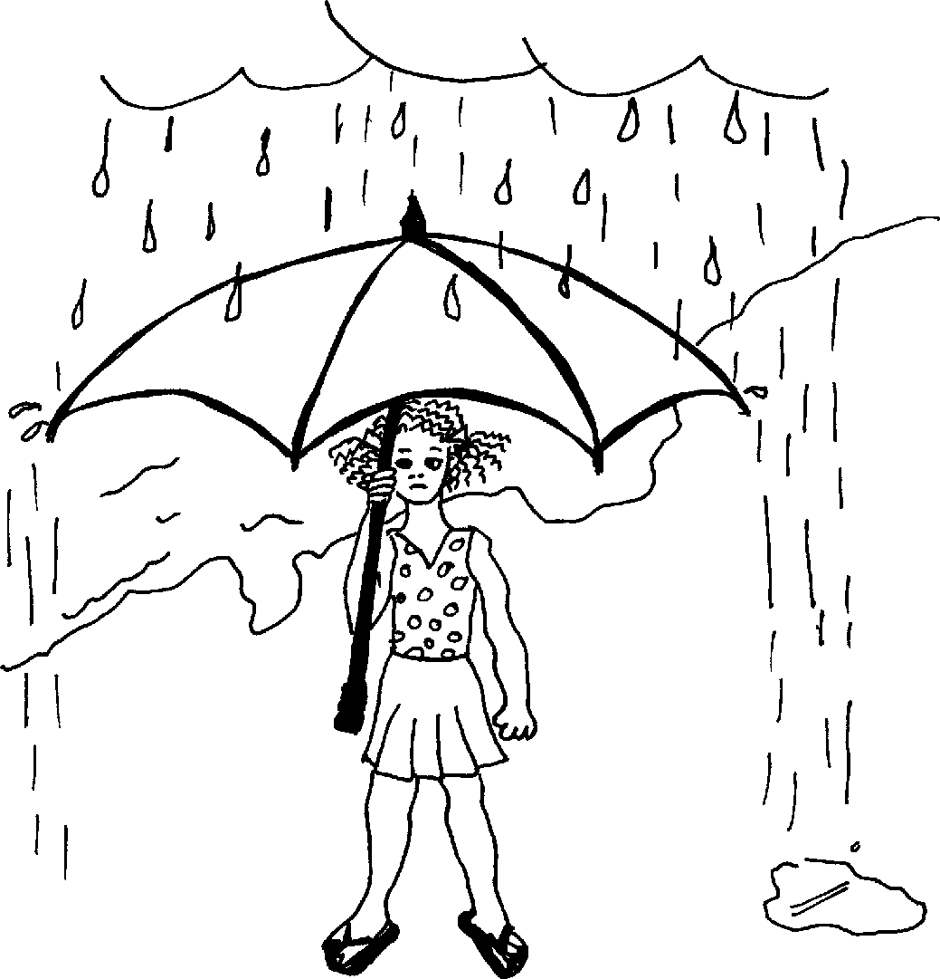
Liyana.
It is raining.

Slide 8
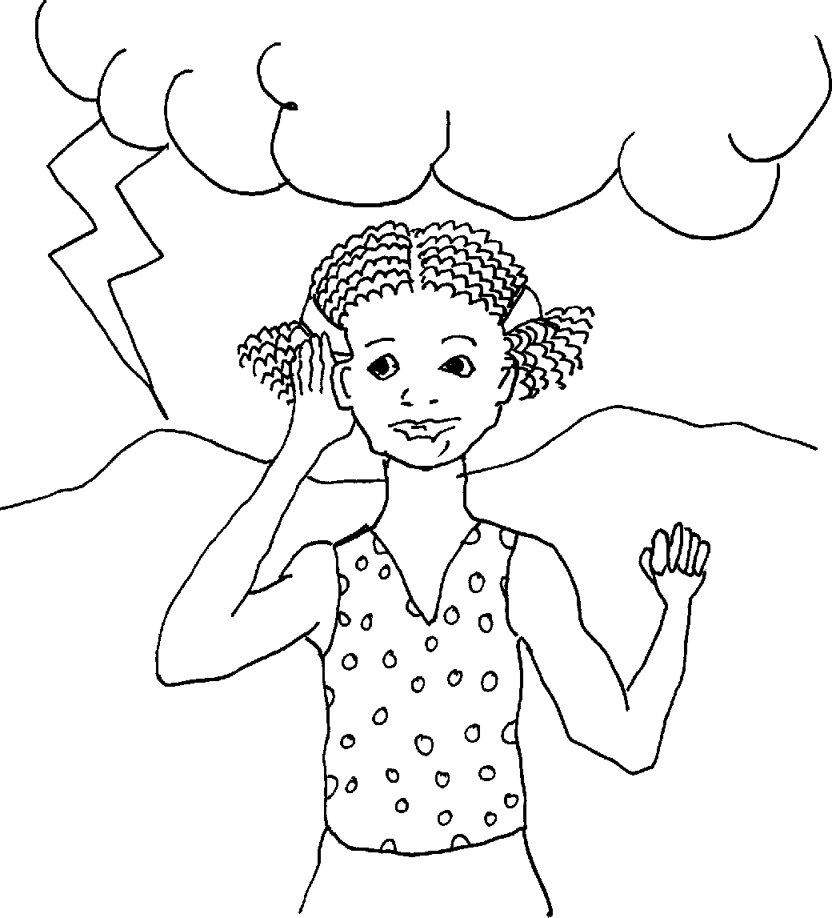
Liyaduma.
There is thunder.

Slide 9
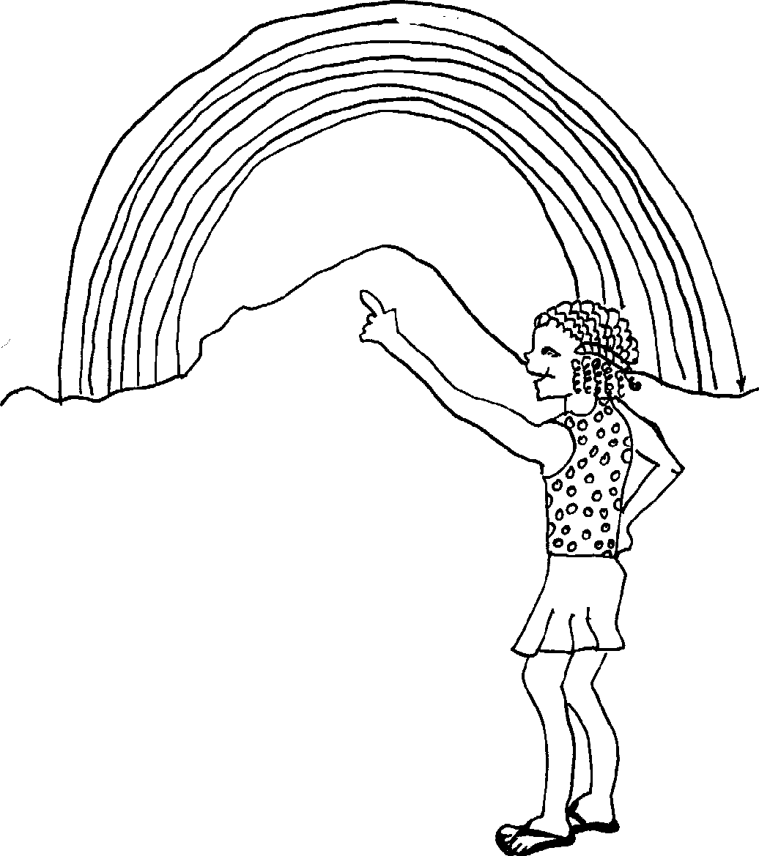
Ngibona uthingo lwenkosazana.
I see a rainbow.

Slide 10
Incwadi ehlahla isimo sezulu Weather book
A story in isiZulu by Clare Verbeek, Thembani Dladla, Zanele Buthelezi
Sandra Mc Dougall

