Slide 1
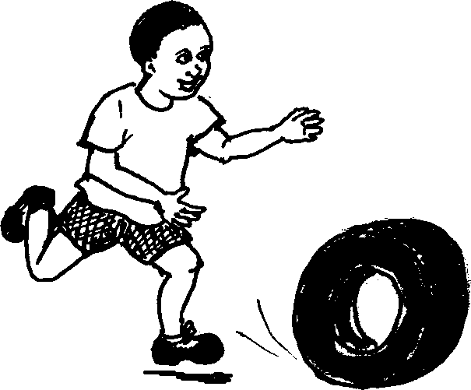
Umfowethu olivila Lazy little brother
A story in isiZulu by Clare Verbeek, Thembani Dladla, Zanele Buthelezi
Illustrated by Mlungisi Dlamini

Slide 2
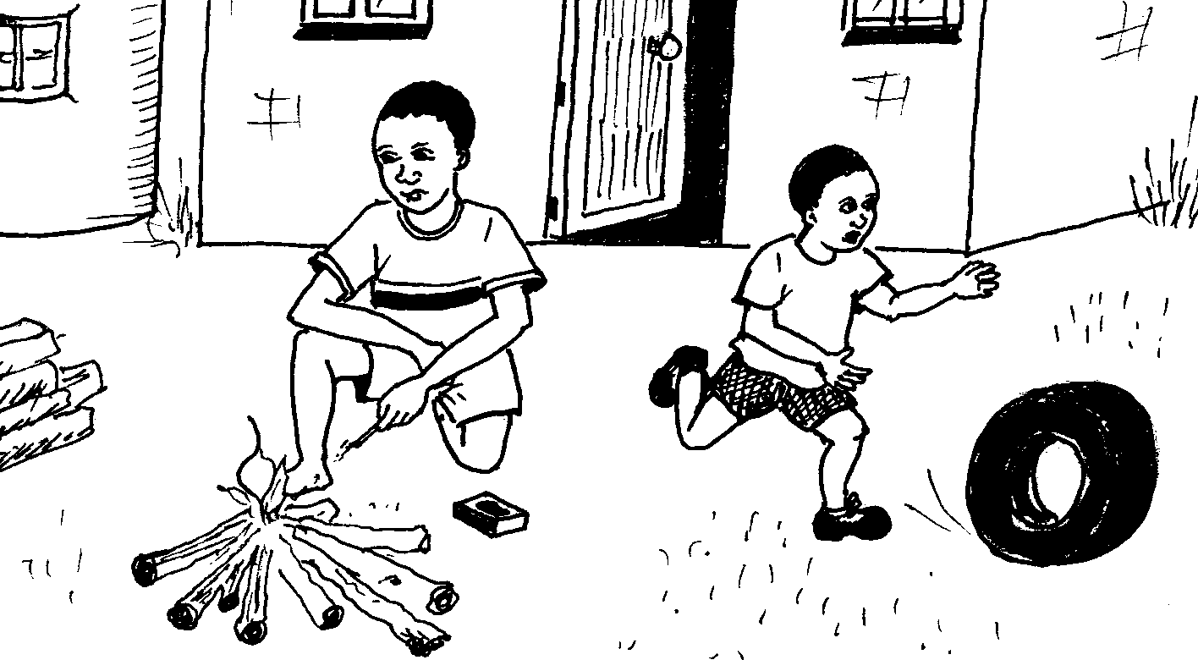
Ngivuka ngibase umlilo.
I wake up and make fire.

Slide 3
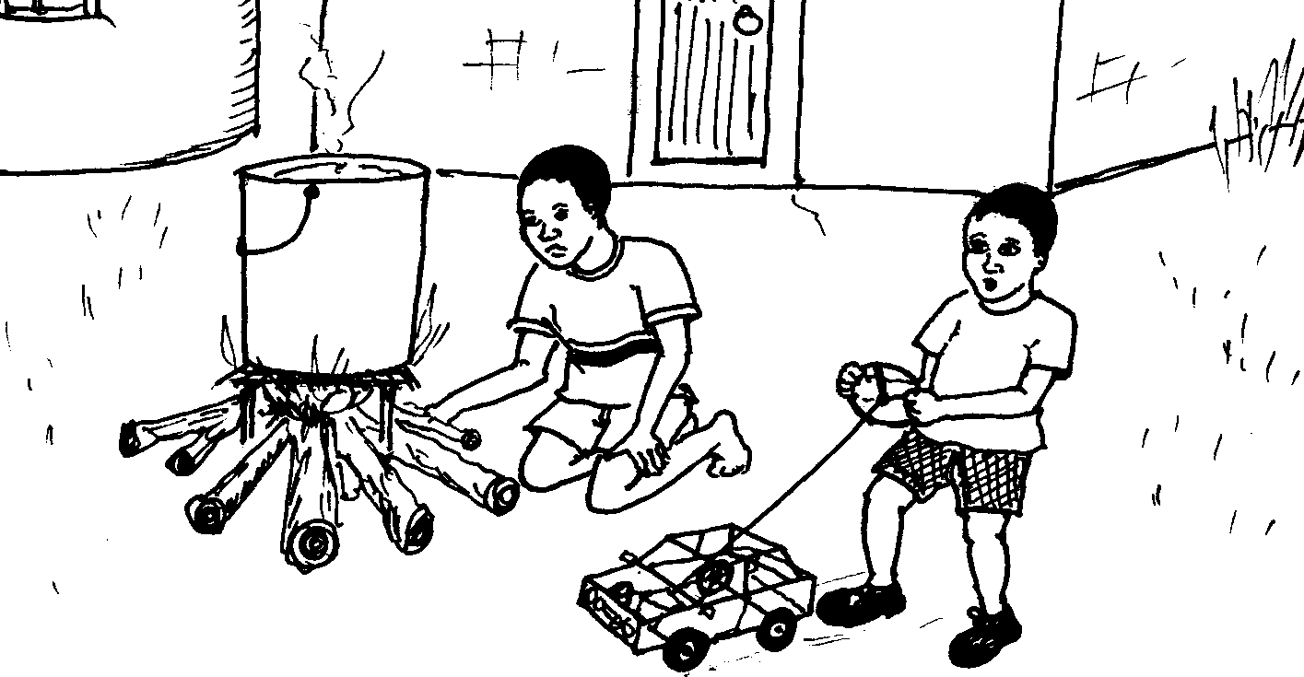
Ngibilise amanzi.
I boil some water.

Slide 4
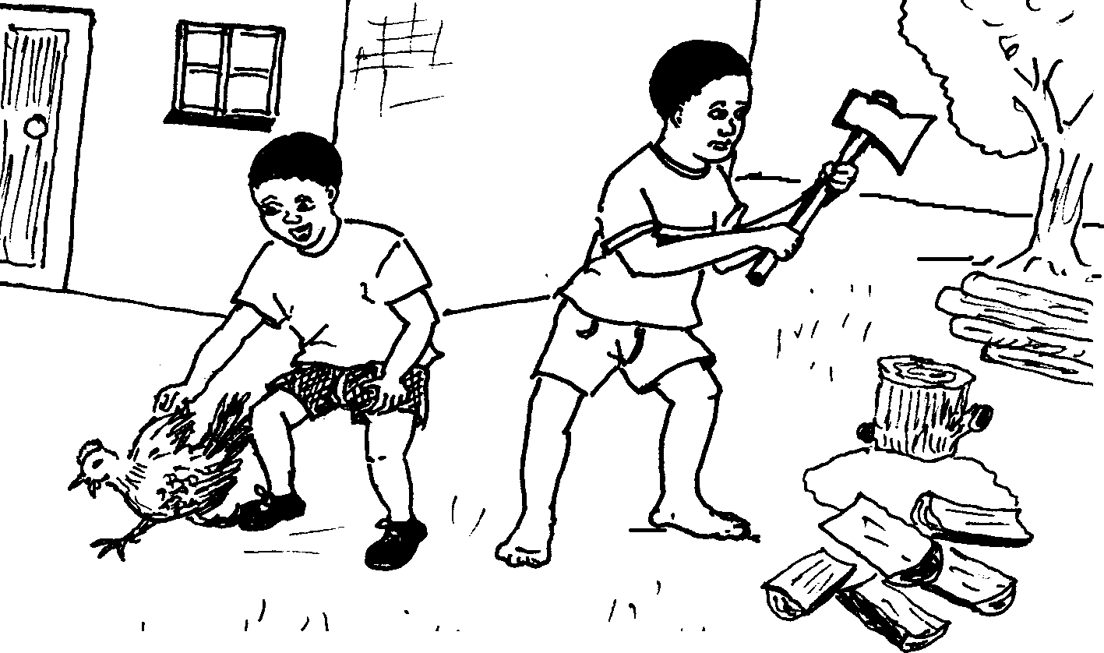
Nginqume ugodo.
I chop the firewood.

Slide 5
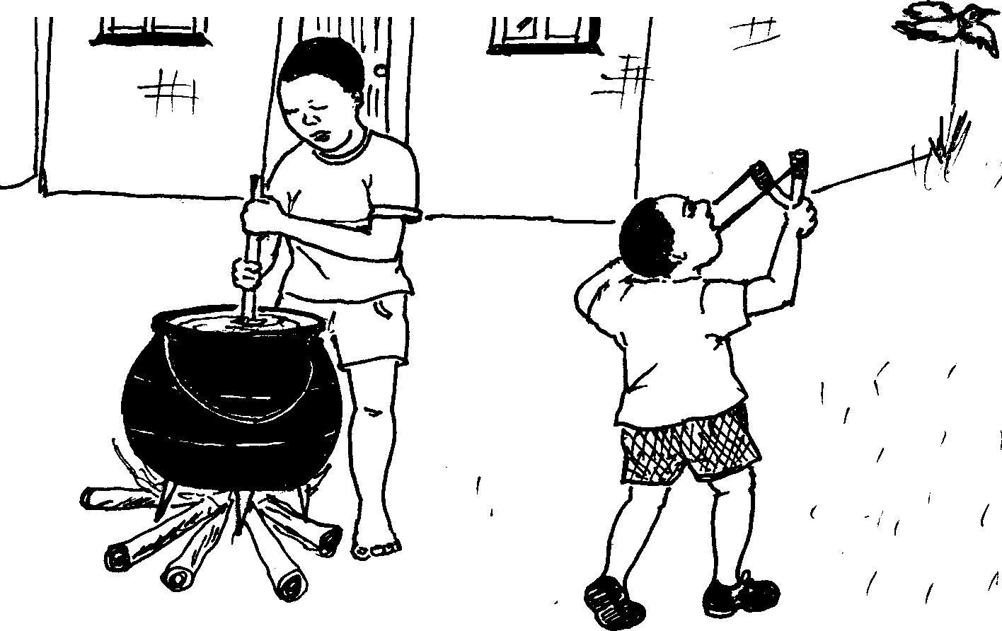
Ngigovuze ibhodwe.
I stir the pot.

Slide 6
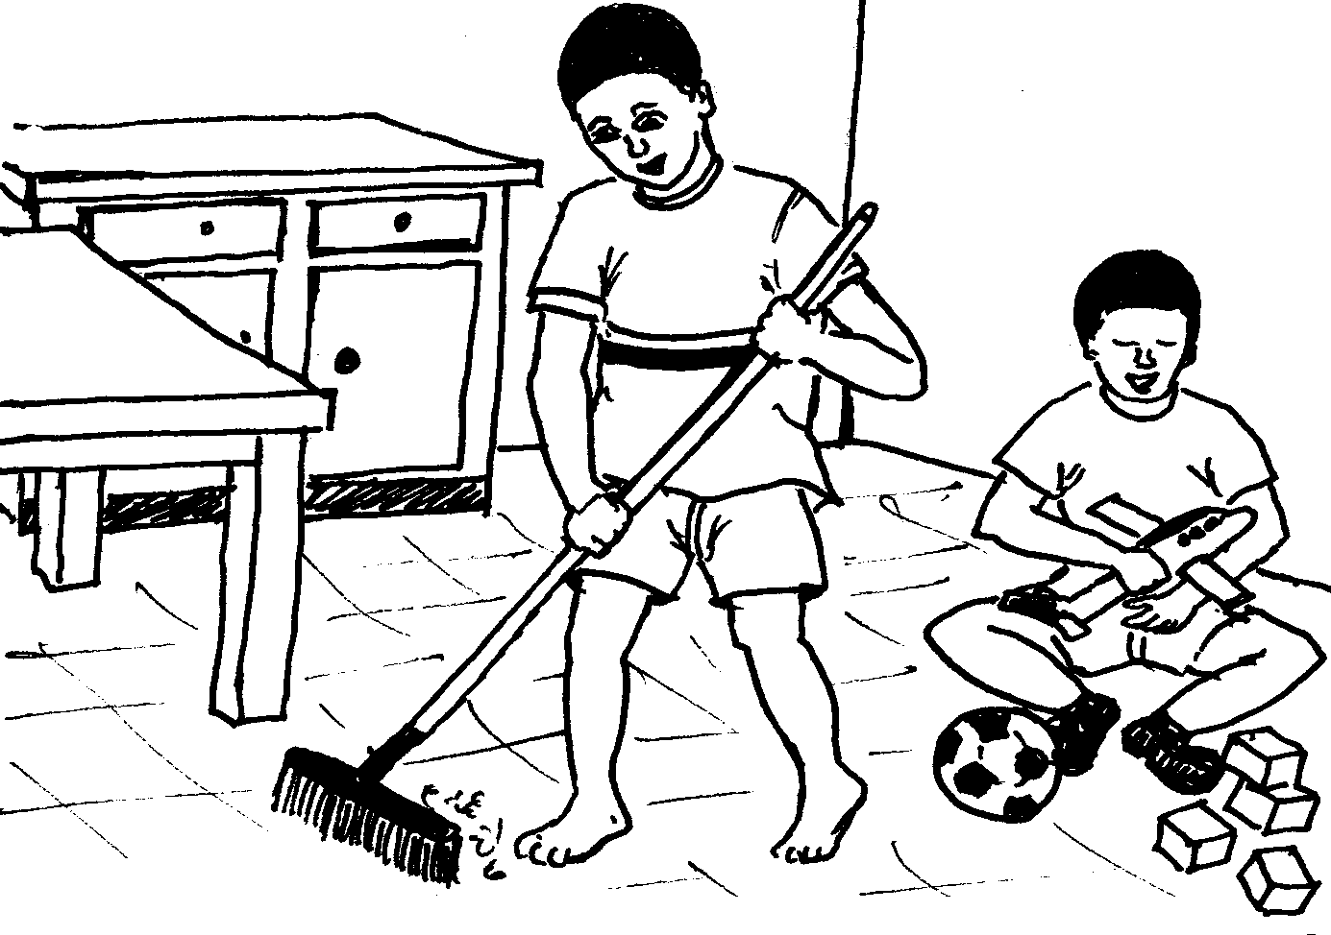
Ngishanele phansi.
I sweep the floor.

Slide 7
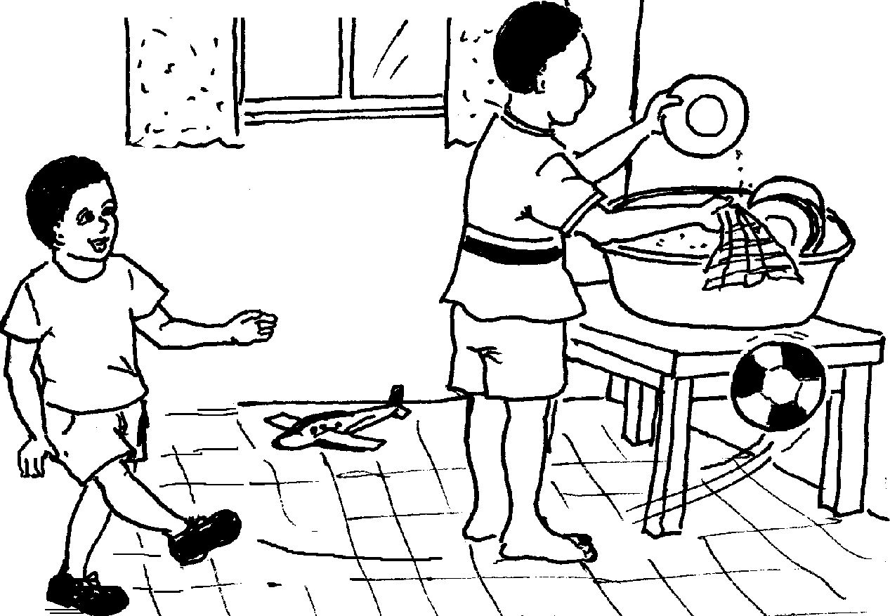
Ngigeze izitsha.
I wash the dishes.

Slide 8
Kungani ngisebeza kanzima kangaka. . .
Why do I work so hard. . .

Slide 9
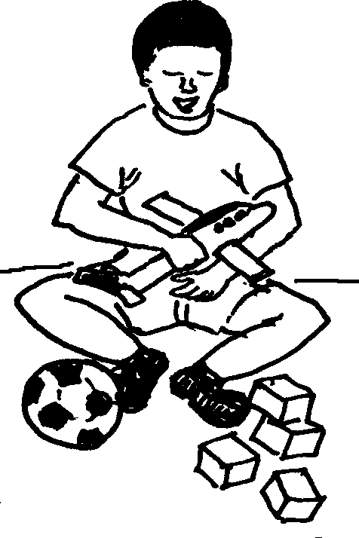
…kepha umfowethu elibele ukudlala.
…when my brother is busy playing.

Slide 10
Umfowethu olivila Lazy little brother
© 2007 School of Education and
Development (Centre for Adult Education), University of KwaZulu-Natal.
This book may be copied, and used for teaching and learning free of charge.
It may not be sold for profit.
A story in isiZulu by Clare Verbeek, Thembani Dladla, Zanele Buthelezi
Mlungisi Dlamini

