Slide 1
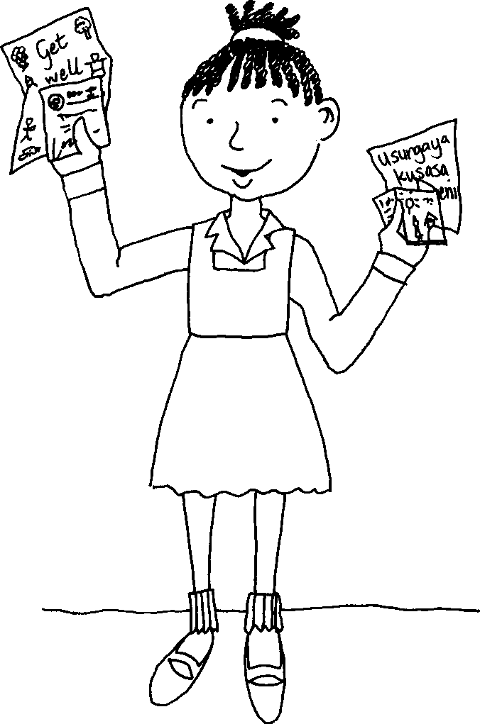
Izincwadi Letters
A story in isiZulu by Clare Verbeek, Thembani Dladla, Zanele Buthelezi
Illustrated by Cathy Feek

Slide 2
Ngesonto eledlule ngithole izincwadi ezingini.
Last week I received a lot of letters.

Slide 3
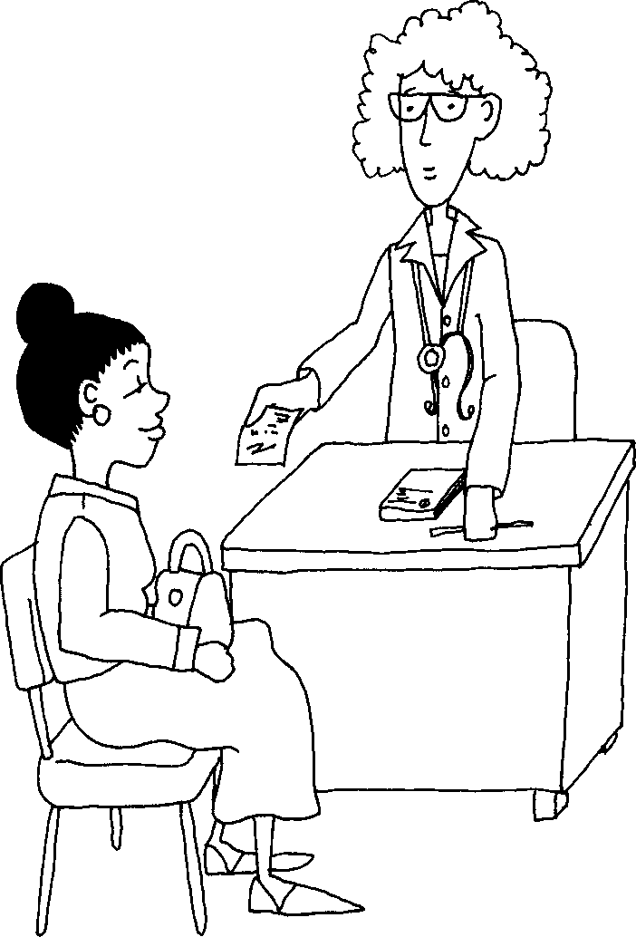
NgoMsombuluko udokotela wami wabhala incwadi eya kuthisha wami.
On Monday my doctor wrote a letter to my teacher.

Slide 4
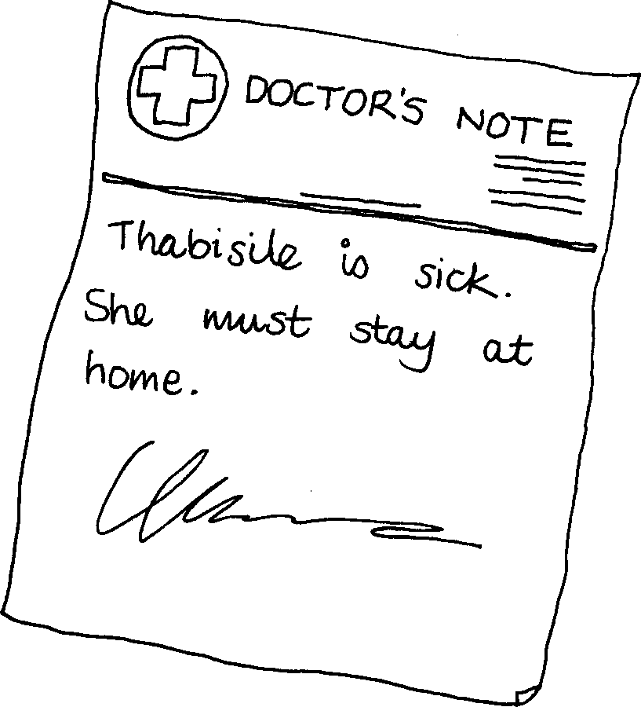
UThabisile uyagula. Kumele
ahlale ekhaya.
Thabisile is sick. She must stay at home.

Slide 5
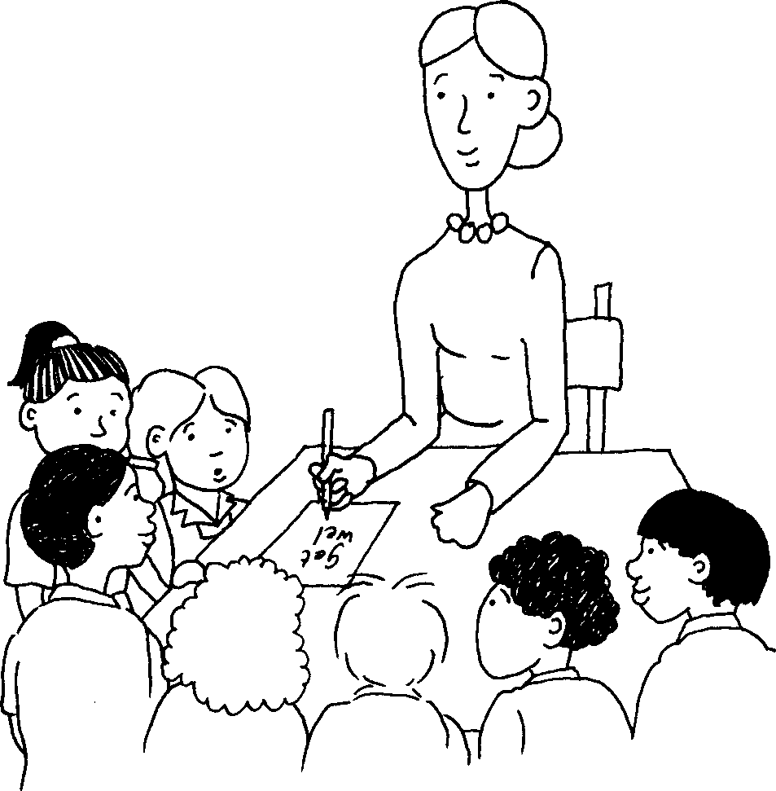
NgoLwesibili ngathola
incwadi evela ekilasini.
On Tuesday I got a letter from my class.

Slide 6
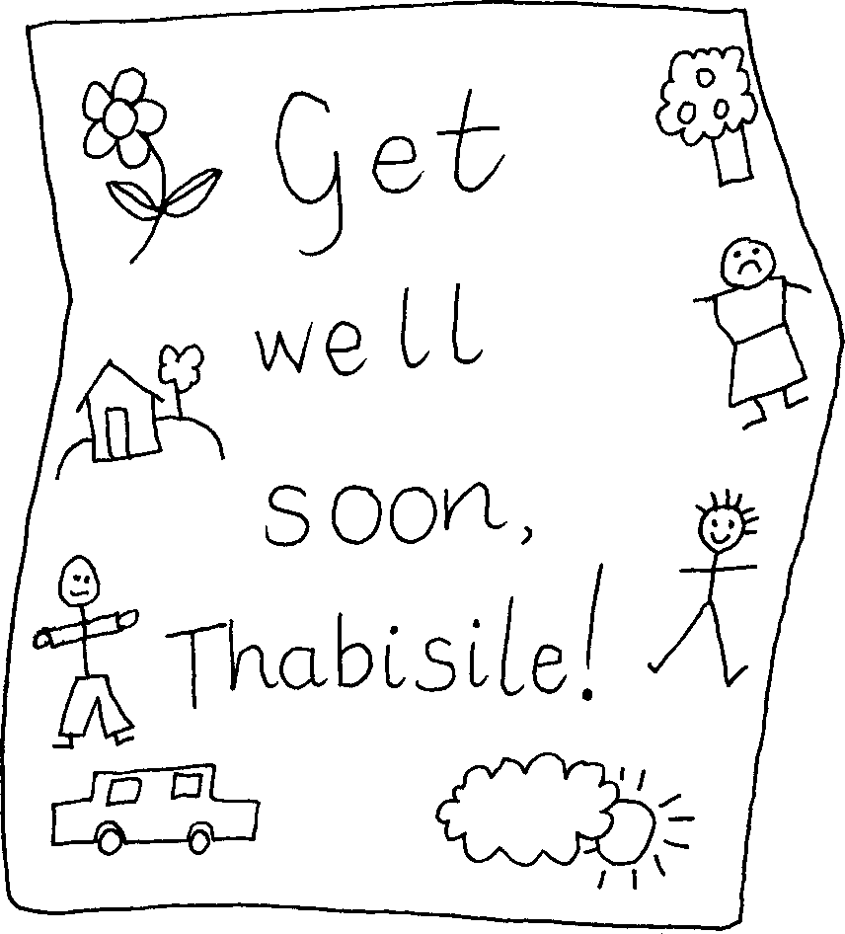
Yiba ngcono ngokushesha
Thabisile!
Get well soon, Thabisile!

Slide 7
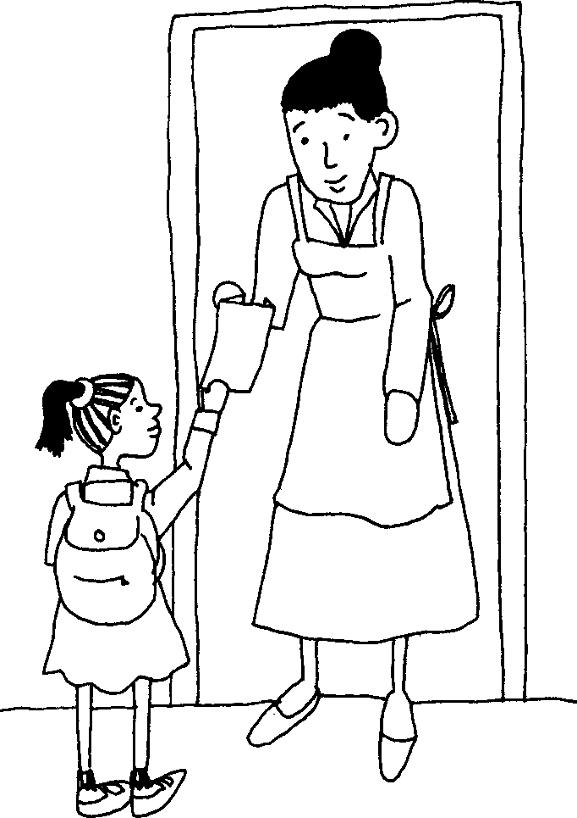
NgoLwesithathu ngabe
sengithola incwadi evela kumngani wami omkhulu.
On Wednesday I got a letter from my best friend.

Slide 8
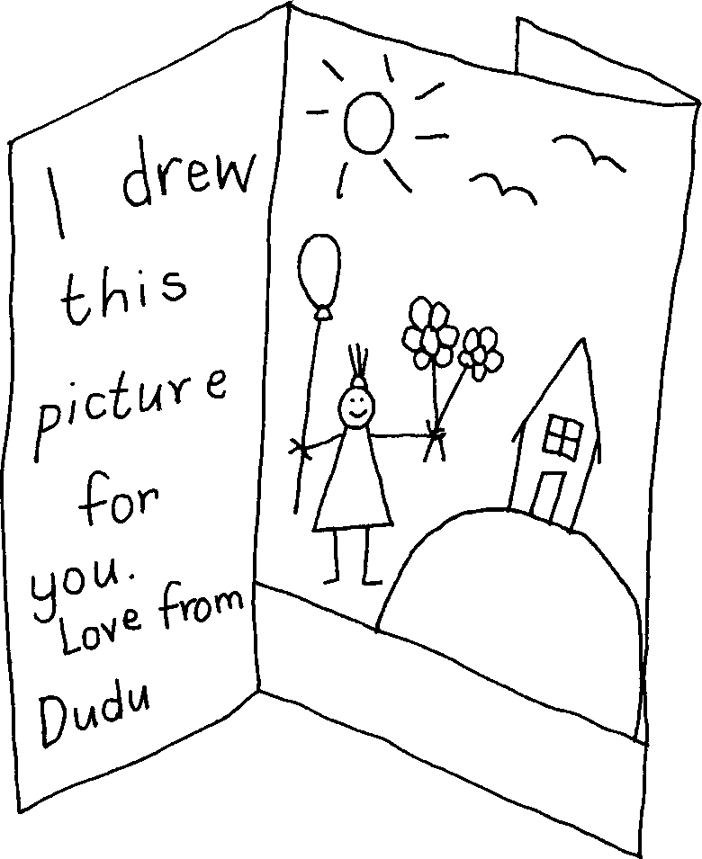
Ngikudwebele lesi sithombe. Ngothando ivela kuDudu
I drew this picture for you. Love from Dudu

Slide 9
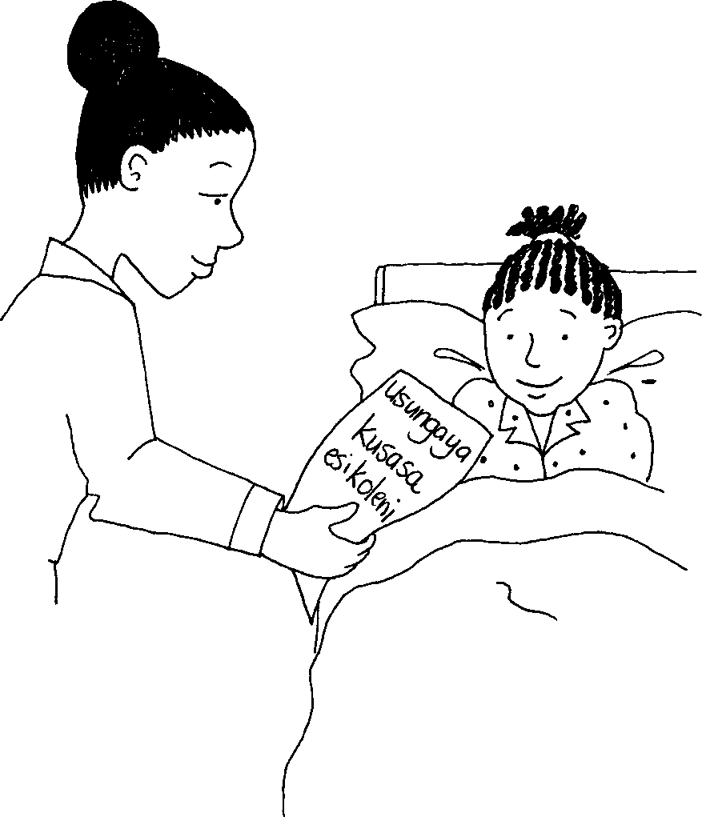
NgoLwesine ngathola incwajana evela kumama.
On Thursday I got a letter from my mother.

Slide 10
Izincwadi Letters
A story in isiZulu by Clare Verbeek, Thembani Dladla, Zanele Buthelezi
Cathy Feek

