Slide 1
Liphi ikati lami? Where is my cat?
Story in isiZulu by Clare Verbeek, Thembani Dladla, Zanele Buthelezi
Illustrated by Jinny Heath

Slide 2
Likuphi ikati lami?
Where is my cat?

Slide 3
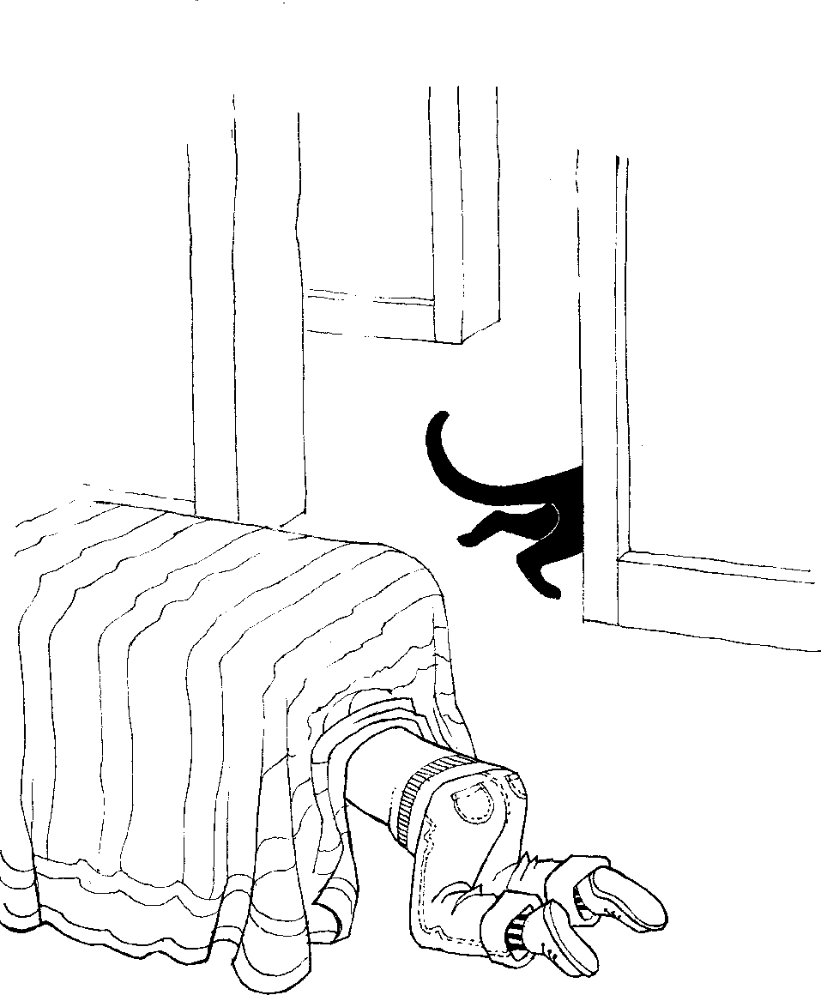
Kungabe lingaphansi kombhede?
Is it under the bed?

Slide 4
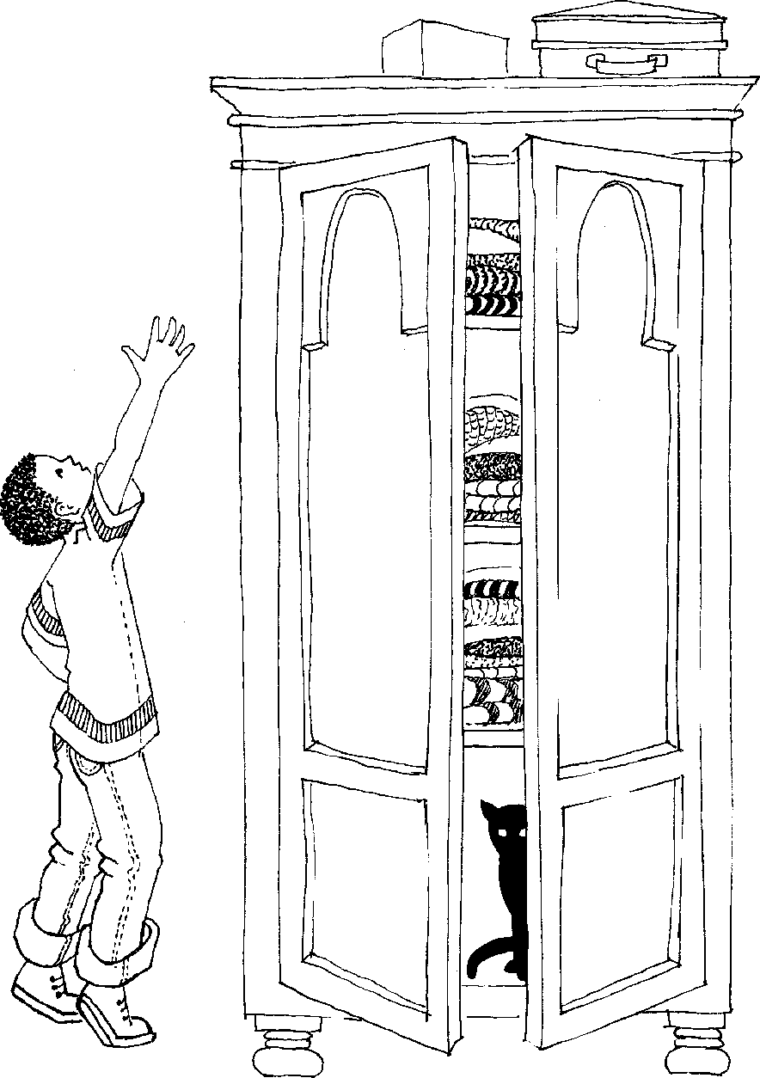
Kungabe lingaphezu
kwekhabethe?
Is it on top of the cupboard?

Slide 5
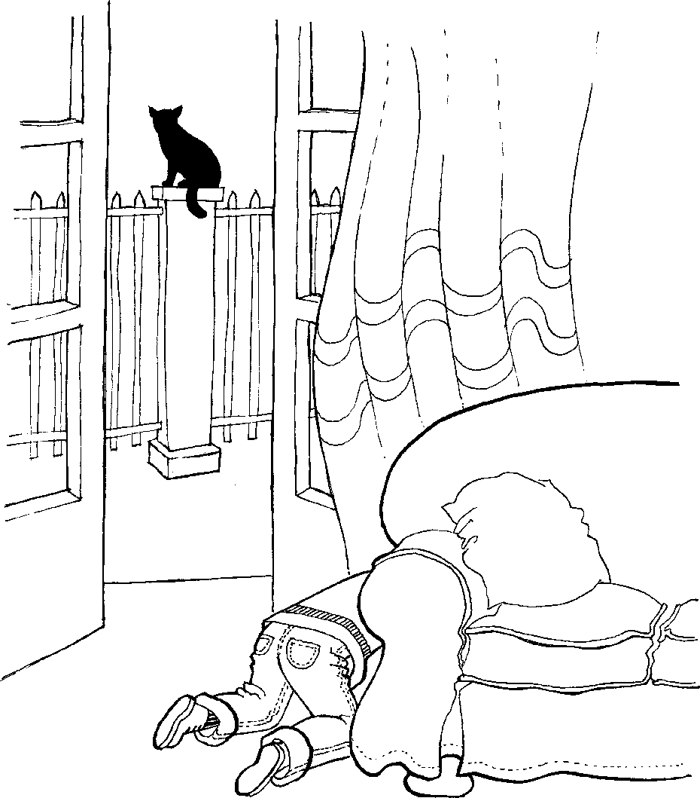
Kungabe lingemuva
kukasofa?
Is it behind the couch?

Slide 6
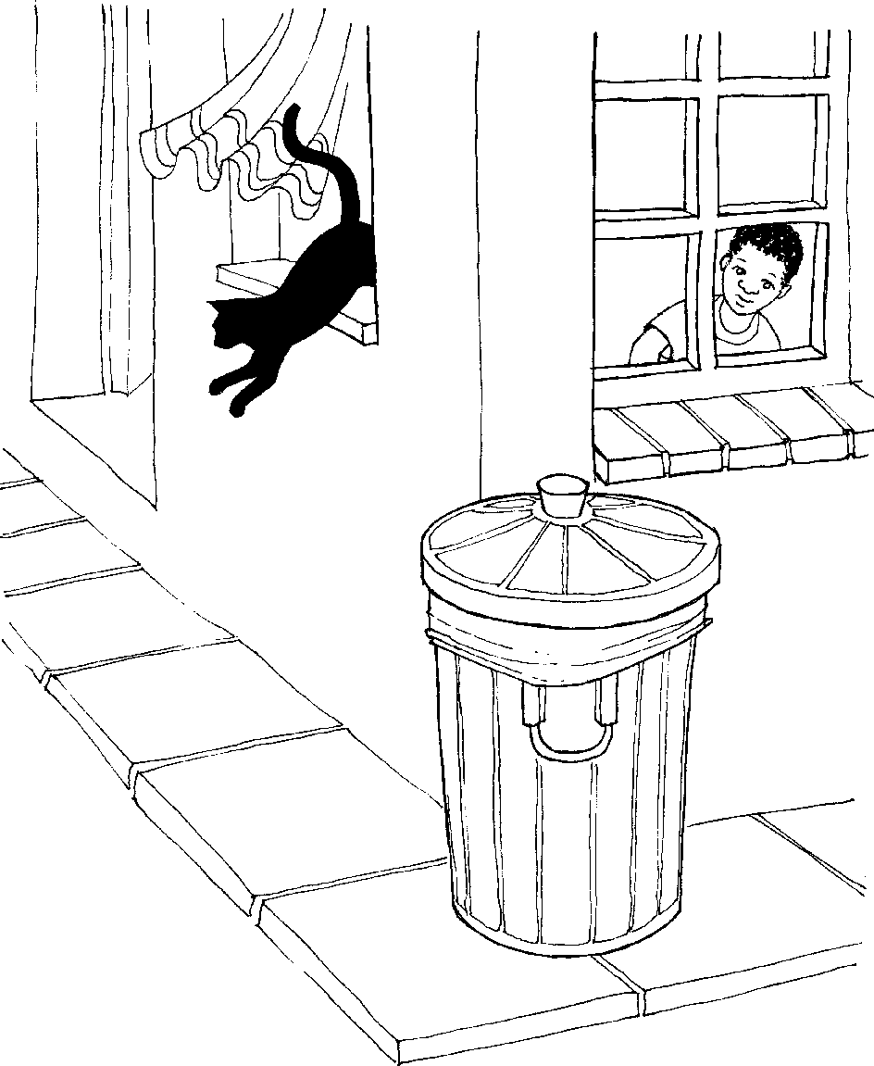
Kungabe liseduze
kombhede?
Is it next to the bed?

Slide 7
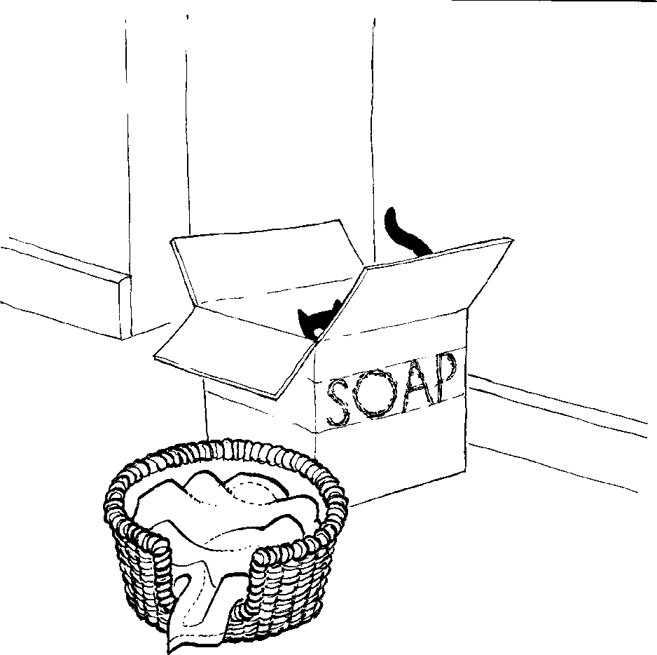
Kungabe liphakathi
kubhasikidi?
Is it inside the basket?

Slide 8
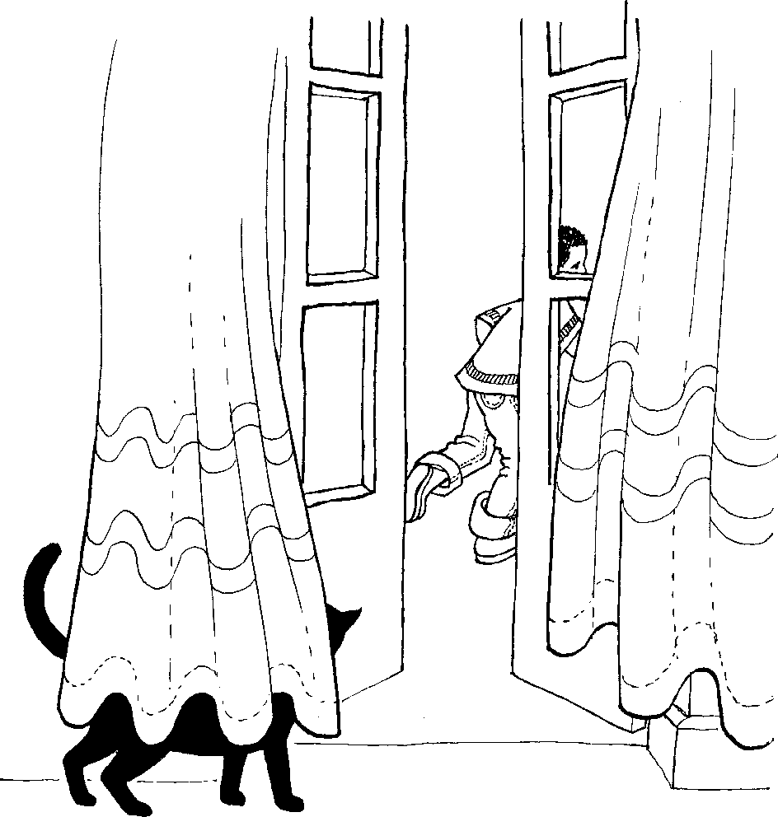
Kungabe lingaphandle kwendlu?
Is it outside the house?

Slide 9
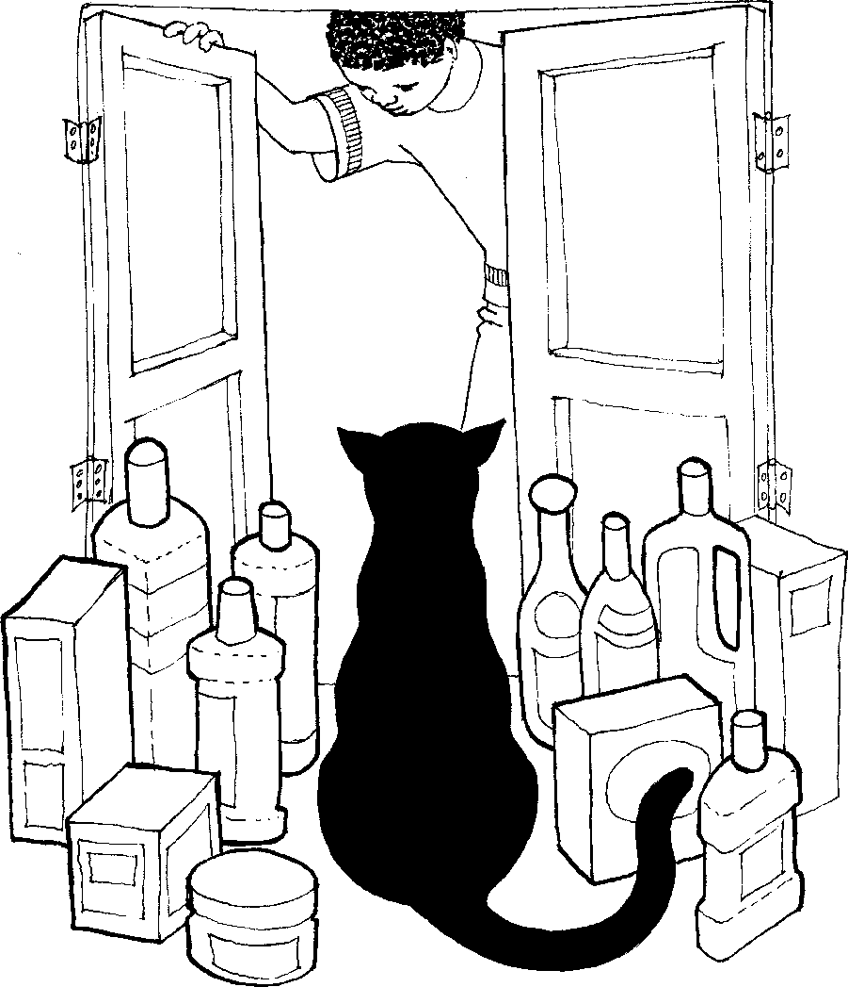
Nanti la!
Here it is!

Slide 10
Liphi ikati lami? Where is my cat?
© 2007 School of Education and
Development (Centre for Adult Education), University of KwaZulu-Natal.
This book may be copied, and used for teaching and learning free of charge.
It may not be sold for profit.
Story in isiZulu by Clare Verbeek, Thembani Dladla, Zanele Buthelezi
Jinny Heath

