Slide 1
My naam is Galiema hoe!
A Skipping Song
From My Drum
(Johannesburg, Abecedarius Books, 1988)

Slide 2
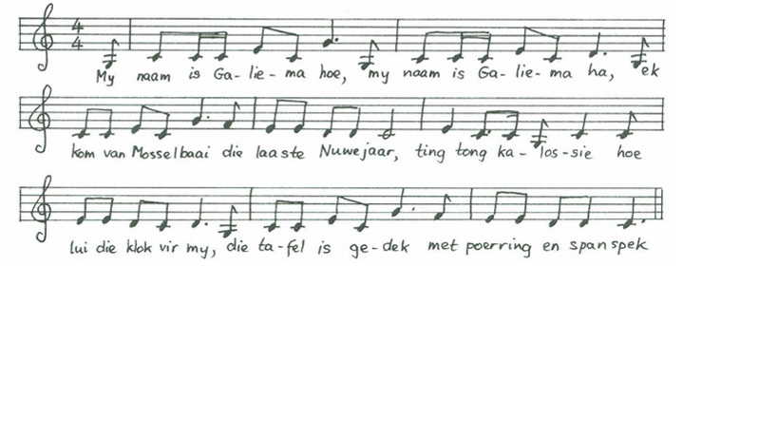
Afrikaans
My naam is Galiema hoe!
My naam is Galiema ha!
Ek kom van Mosselbaai die laaste Nuwejaar
Ting tong kalossie, hoe lui die klok vir my
Die tafel is gedek, met poerring en spanspek
Jy vra ‘n stukkie brood, hy het nie botter nie
Ek vra ‘n bietjie tee, hy het nie suiker nie
Ting tong kalossie, hoe lui die klok vir my
Die tafel is gedek, met poerring en spanspek
English
My name is Galiema hoo!
My name is Galiema ha!
I came from Mossel Bay on last New Year’s Day
Ding dong kalossie, the bell is ringing for me
The table is laid with pudding and sweet melon
You ask for a piece of break, he hasn’t any butter
I ask for a little tea, he hasn’t any sugar
Ding dong kalossie, the bell is ringing for me The table is laid with pudding and sweet melon
You can listen to children singing this song here …

Slide 3
My naam is Galiema hoe is a traditional African song sung during a game of skipping rope.
It is known and used cross-culturally in South Africa and is also sung in multiple languages.

Slide 4
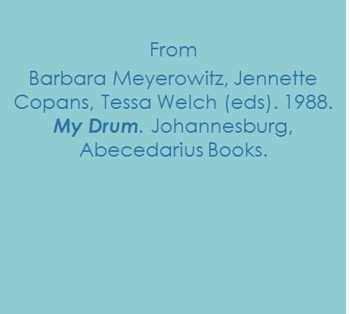
My naam is Galiema hoe!
© Meyerowitz B, Copans J, and Welch T
1991
For the Sesotho version of this song, see ‘Antoni ke bo mang bale’

