Slide 1
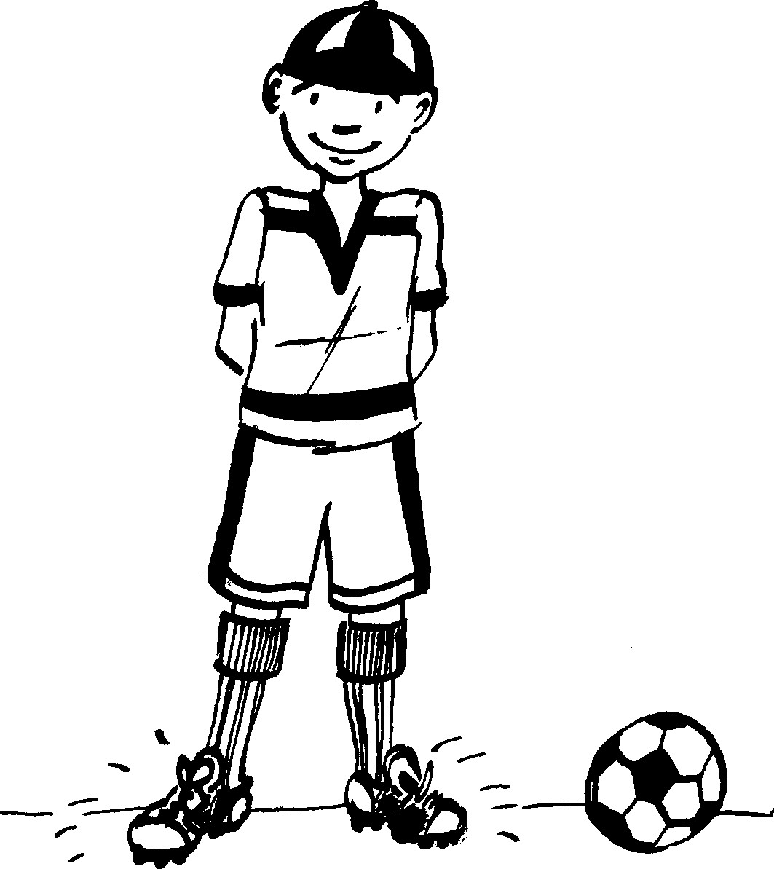
Izicathulo ezintsha New shoes
Story in isiZulu by Clare Verbeek, Thembani Dladla, Zanele Buthelezi
Illustrated by Cathy Feek

Slide 2
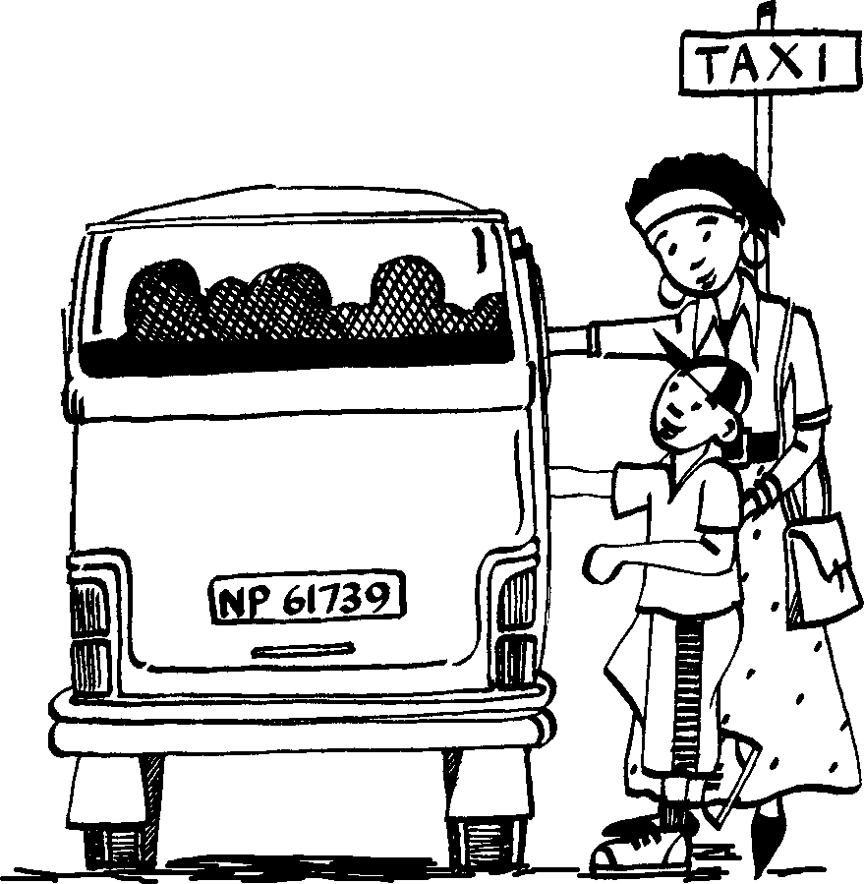
USipho uya edolobheni nodadewabo.
Sipho goes to town with his sister.

Slide 3
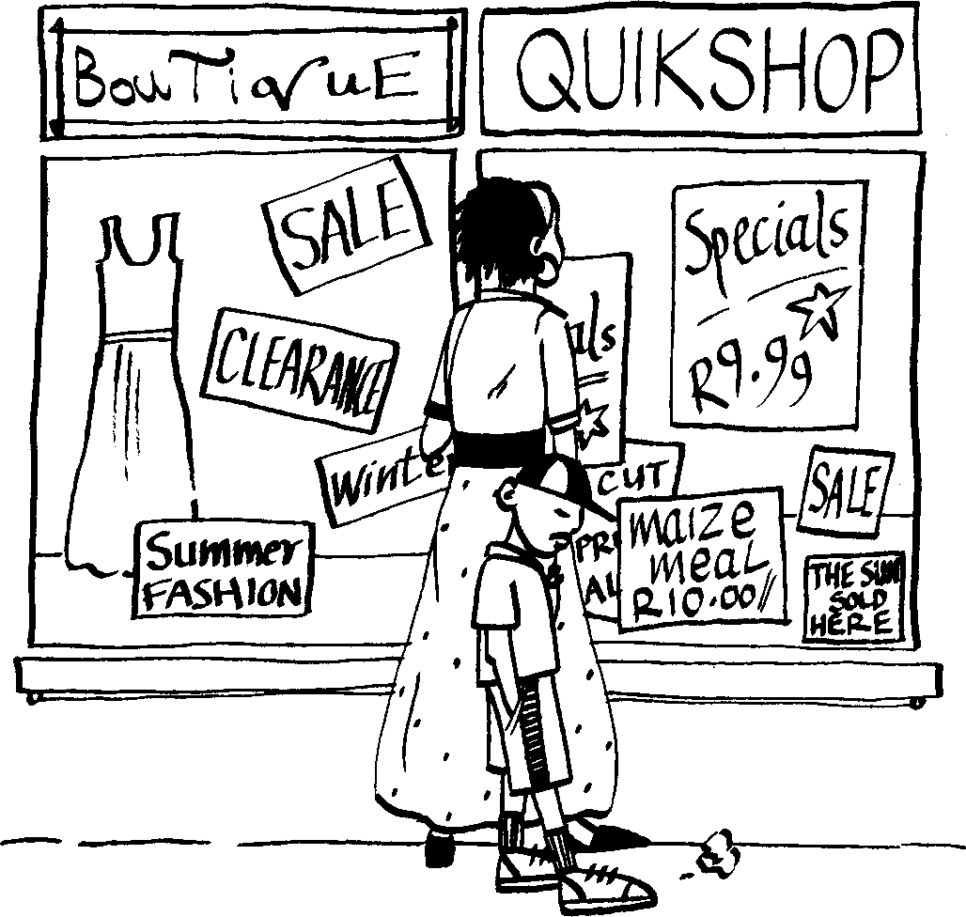
Udadewabo uhamba ebuka izimpahla ezitolo. USipho
ucikekile.
His sister is looking at the clothes in shops. Sipho is bored.

Slide 4
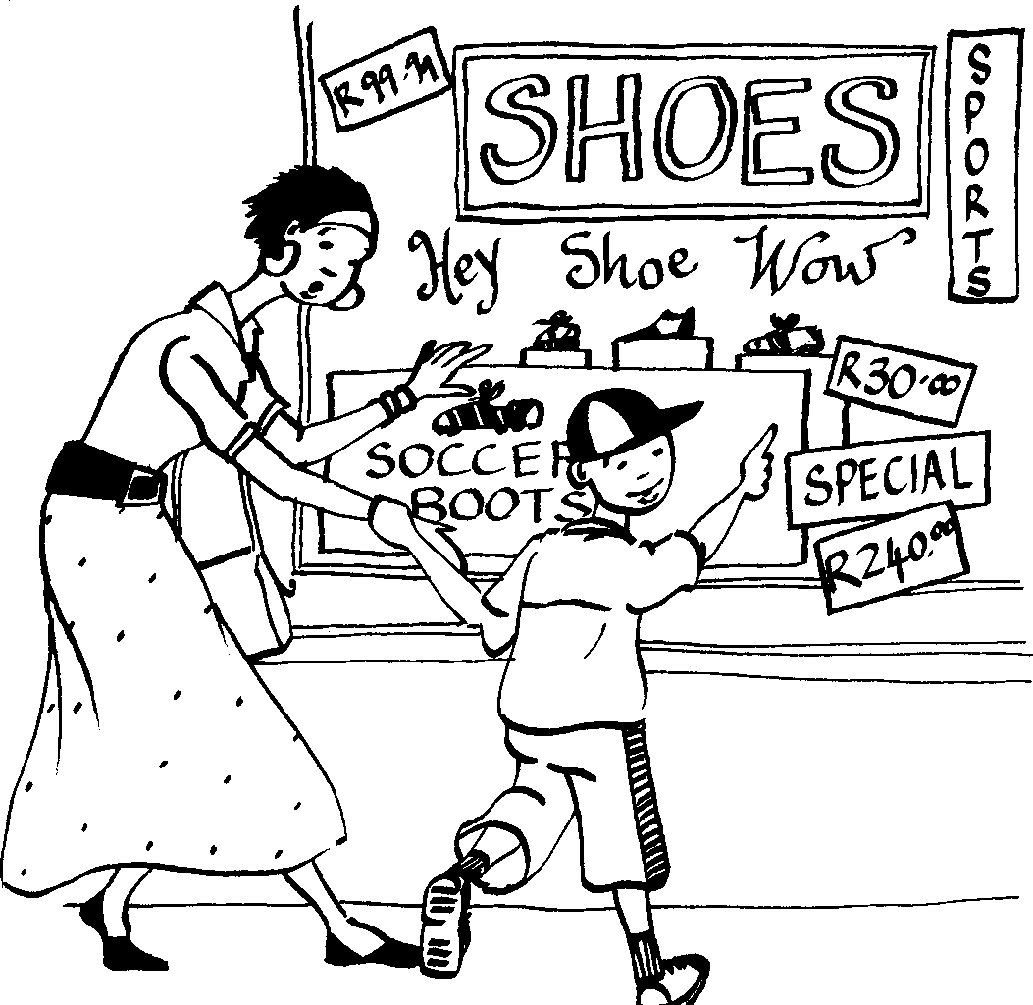
USipho ubona okufanele yena.
Sipho sees something he likes.

Slide 5
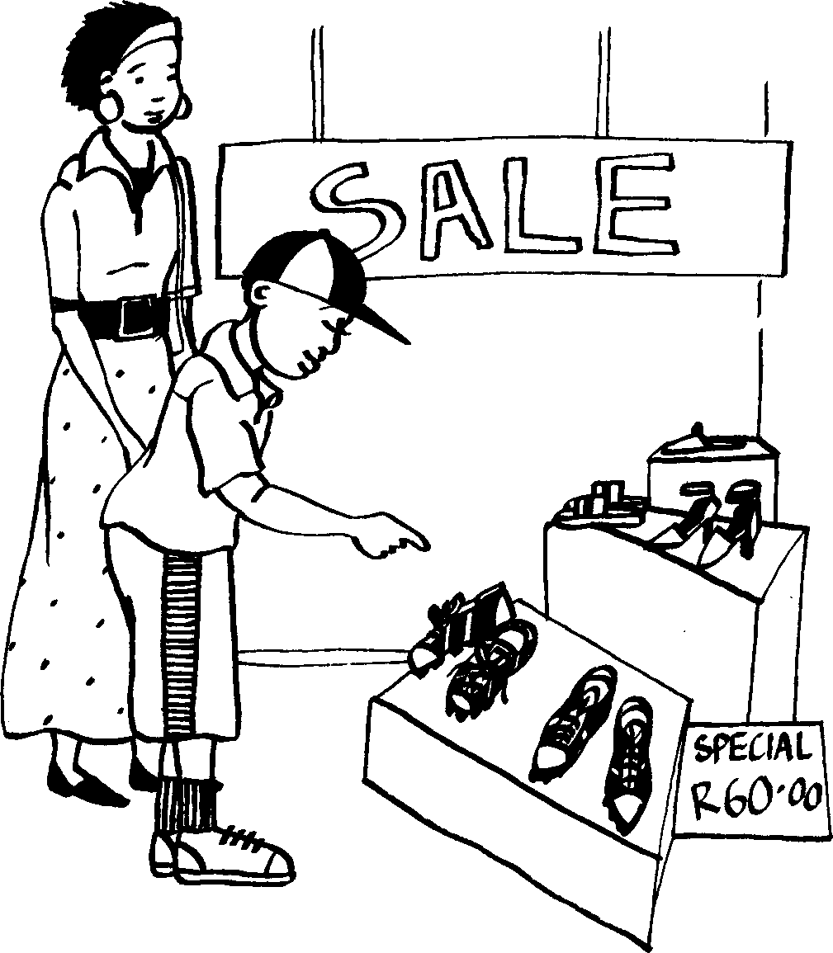
Amanani ezicathulo ehlisiwe.
The shoes are on sale.

Slide 6
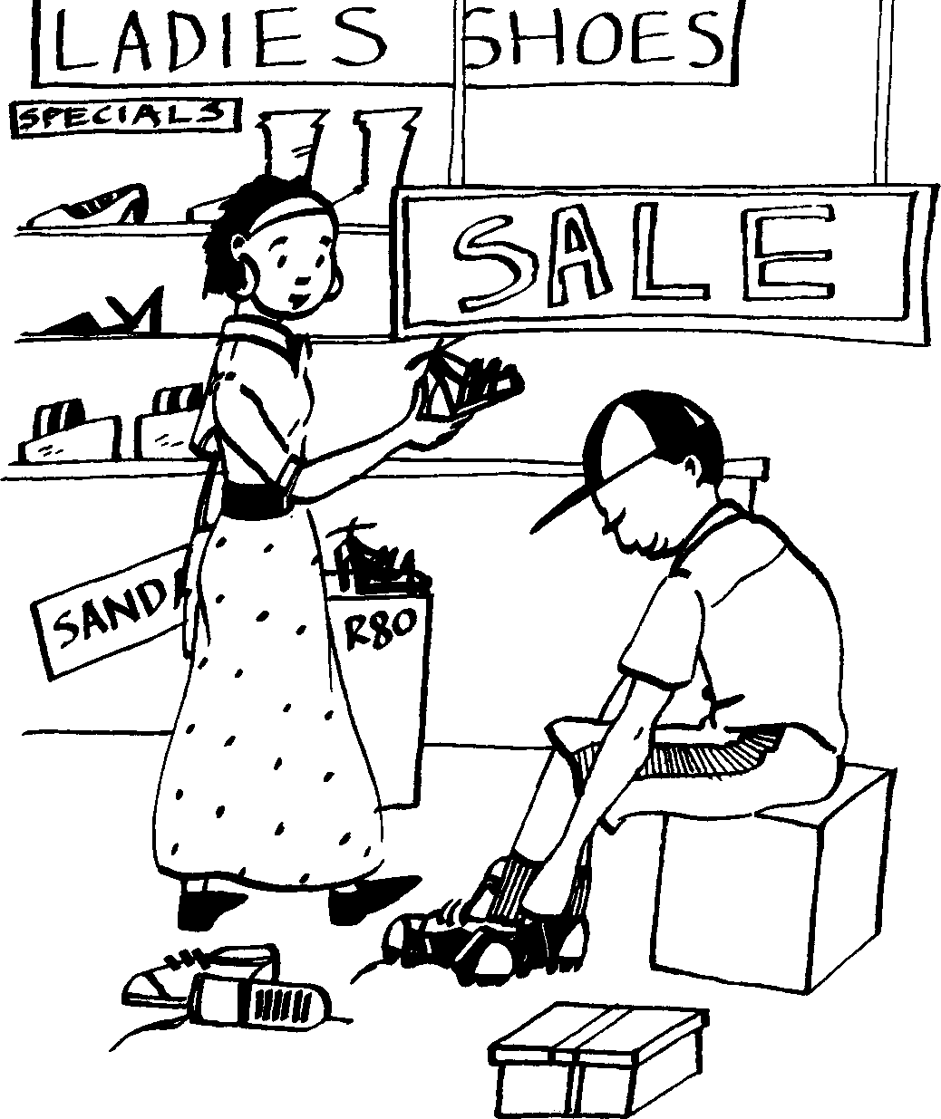
Uyazilinganisa zonke.
He tries them all on.

Slide 7
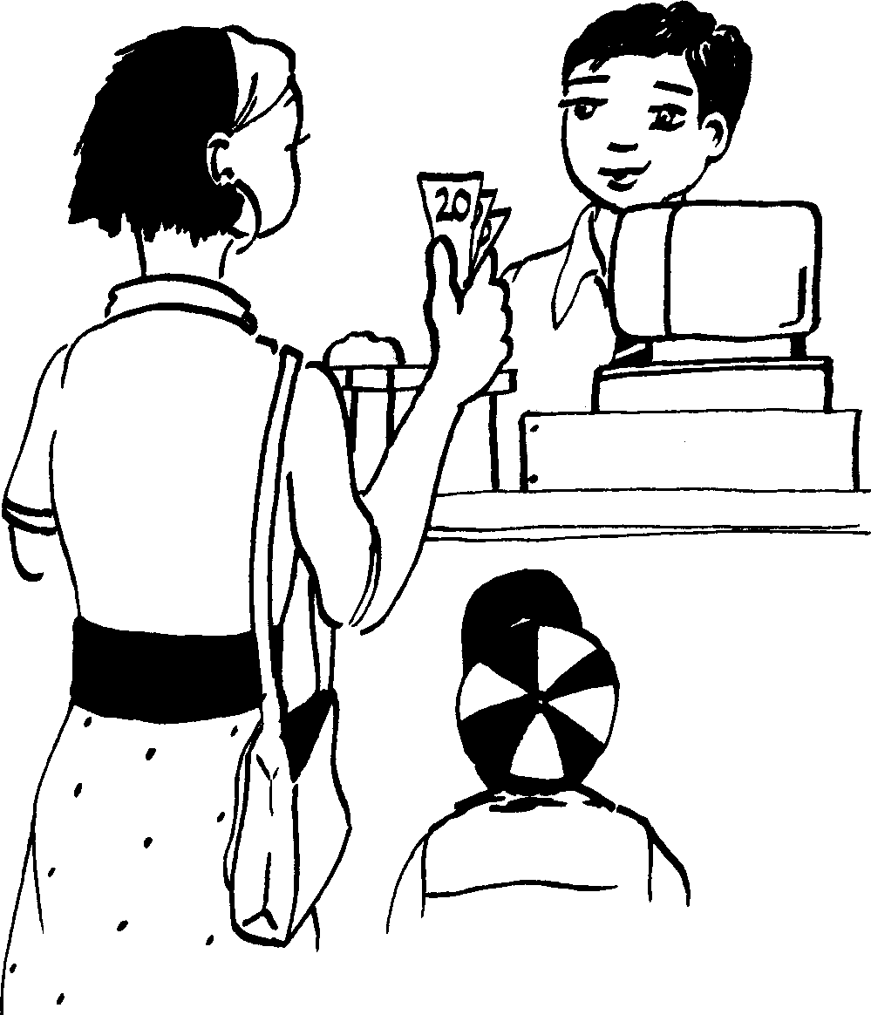
Udadewabo umthengela izicathulo zokudlala ibhola.
His sister buys him soccer shoes.

Slide 8
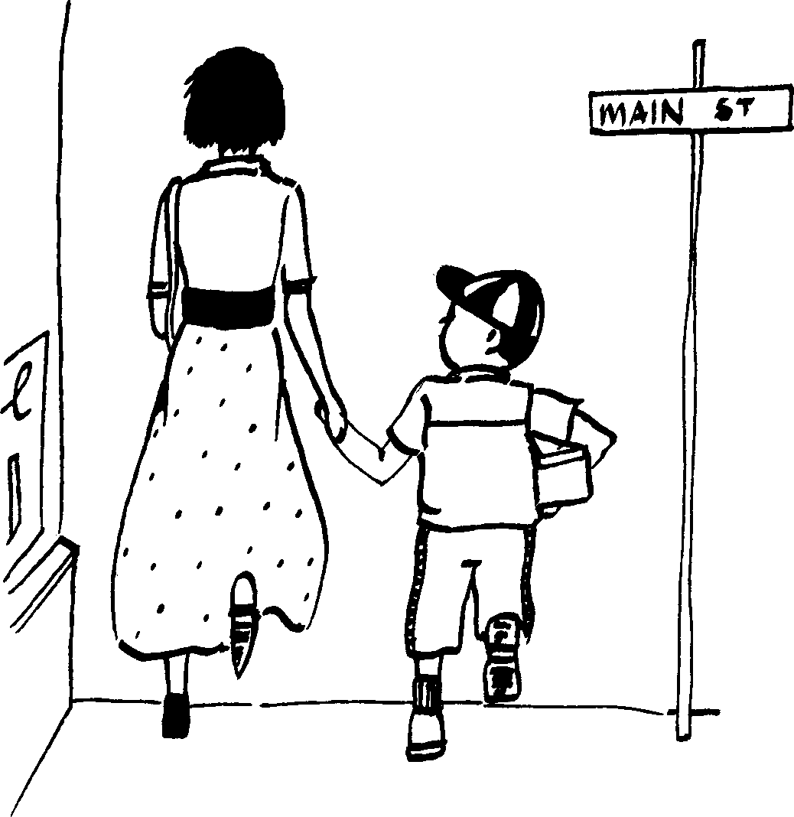
Kungani bejahe kangaka ukufika ekhaya?
Why are they in such a hurry to get home?

Slide 9
Ngenhlanhla, ufike ngesikhathi enkundleni yebhola! Ugqoke izicathulo zebhola ezintsha.
Luckily he got to the soccer filed on time! He is wearing his new soccer shoes.

Slide 10
Izicathulo ezintsha New shoes
© 2007 School of Education and
Development (Centre for Adult Education), University of KwaZulu-Natal.
This book may be copied, and used for teaching and learning free of charge.
It may not be sold for profit.
Story in isiZulu by Clare Verbeek, Thembani Dladla, Zanele Buthelezi
Cathy Feek

