Slide 1
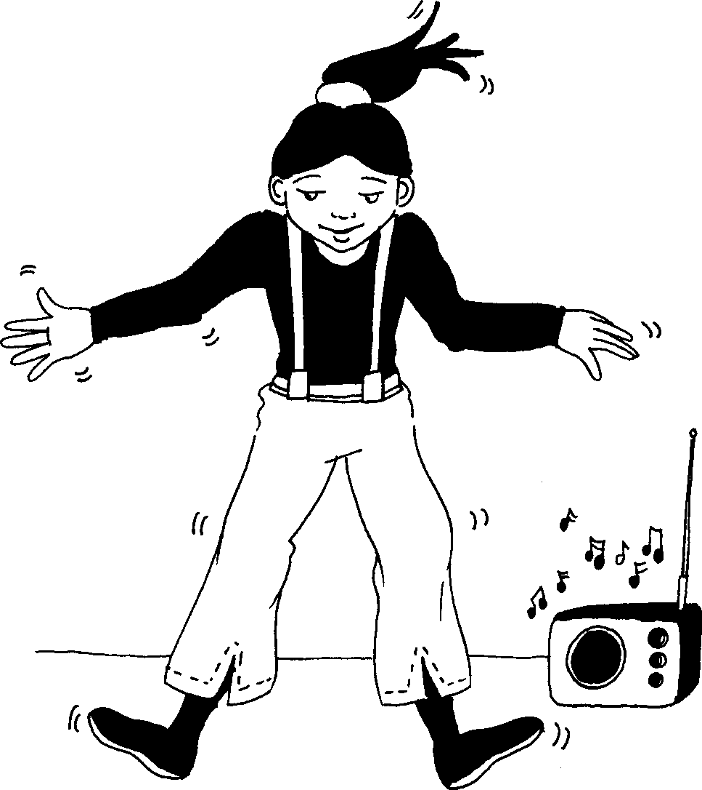
Ngingakwenza lokhu I can do this
Story in isiZulu by Clare Verbeek, Thembani Dladla, Zanele Buthelezi
Illustrated by Cathy Feek

Slide 2
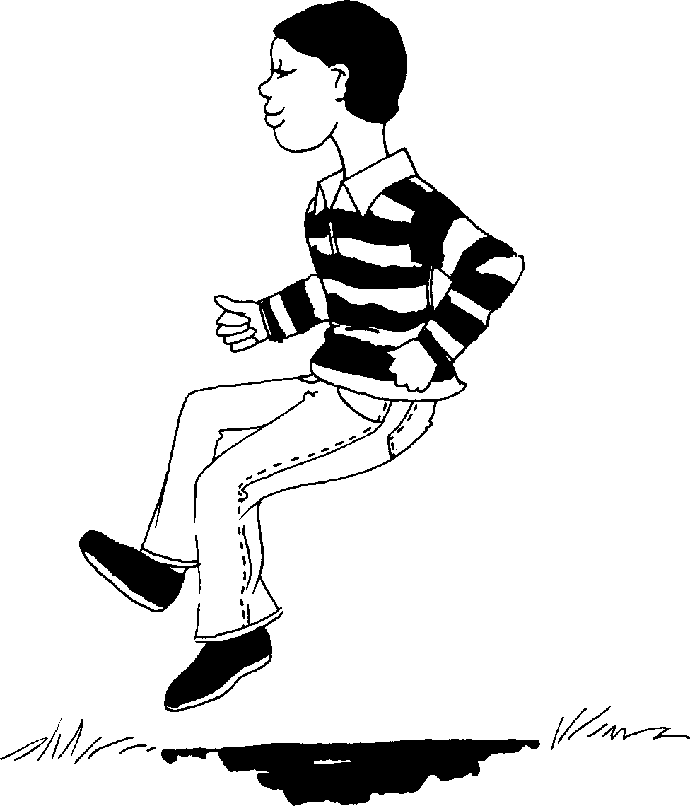

Slide 3
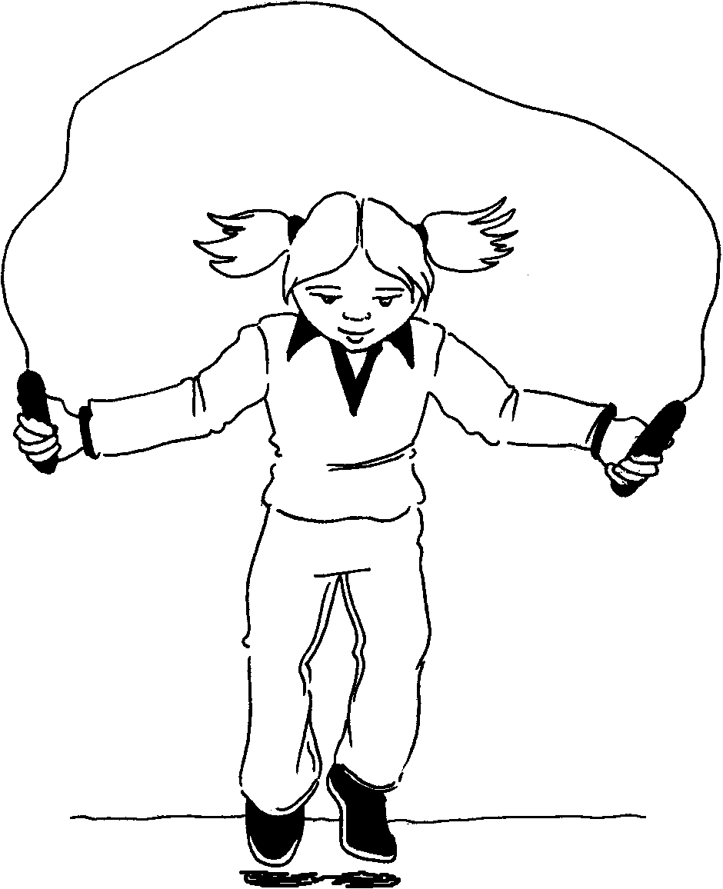

Slide 4
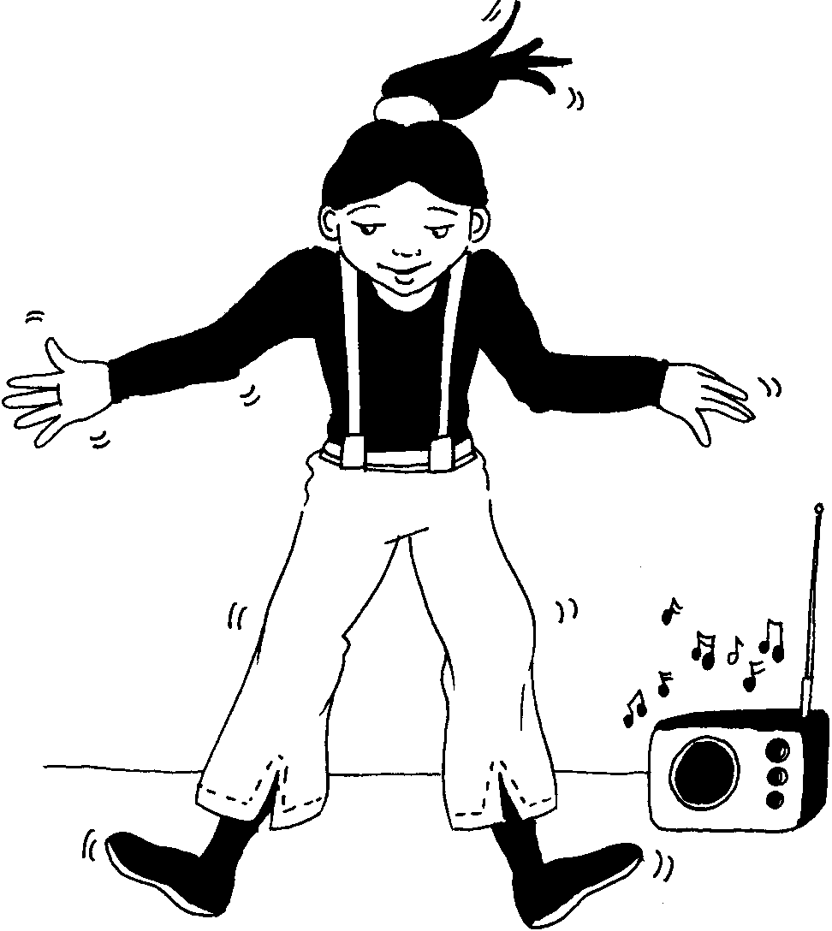

Slide 5
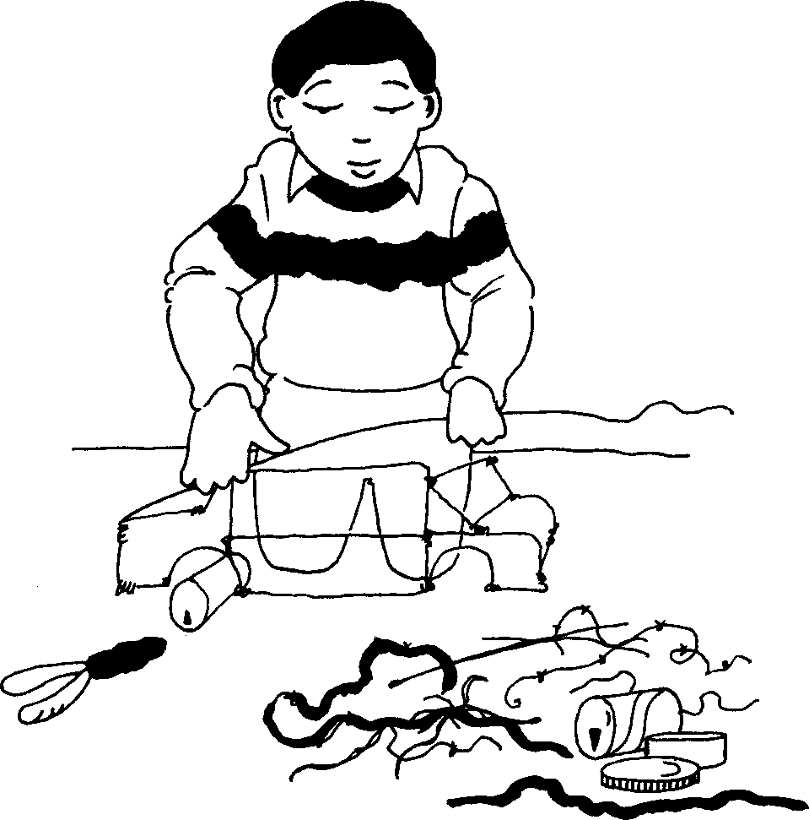

Slide 6
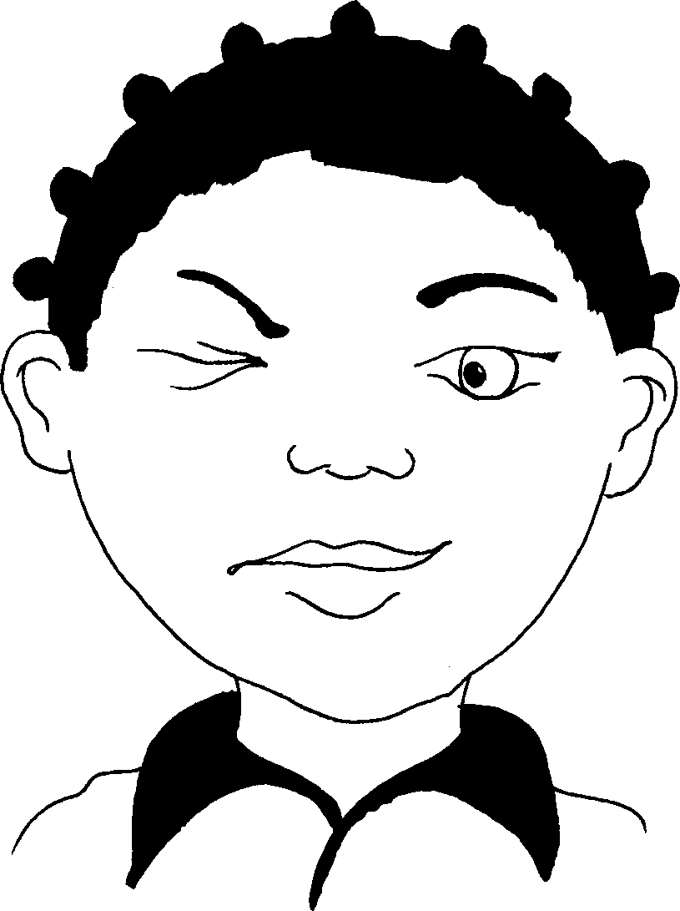

Slide 7
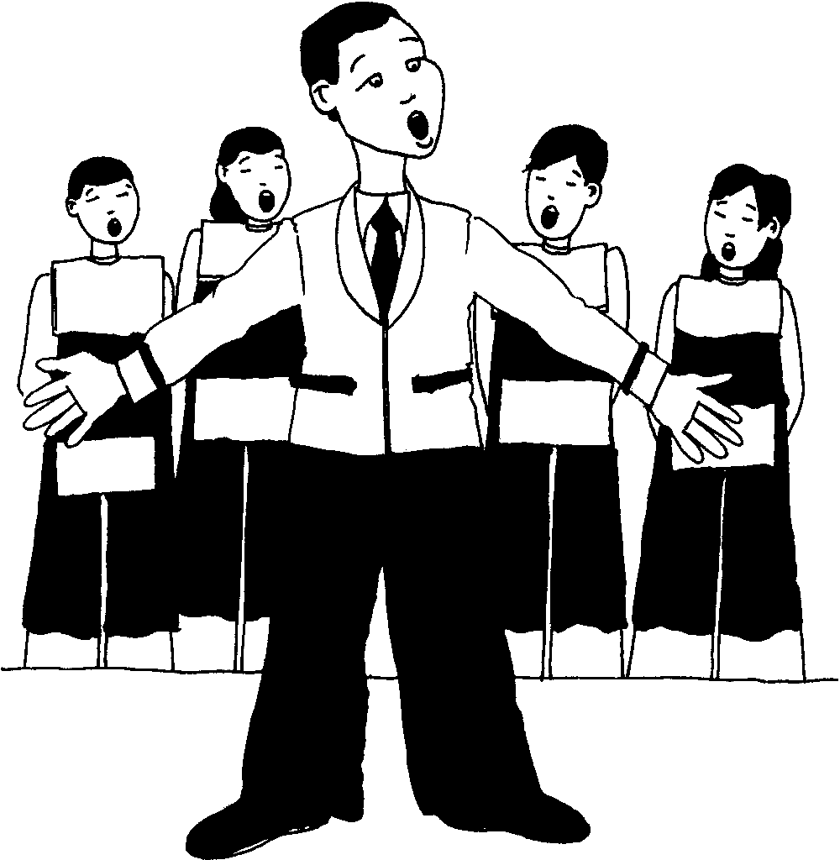

Slide 8
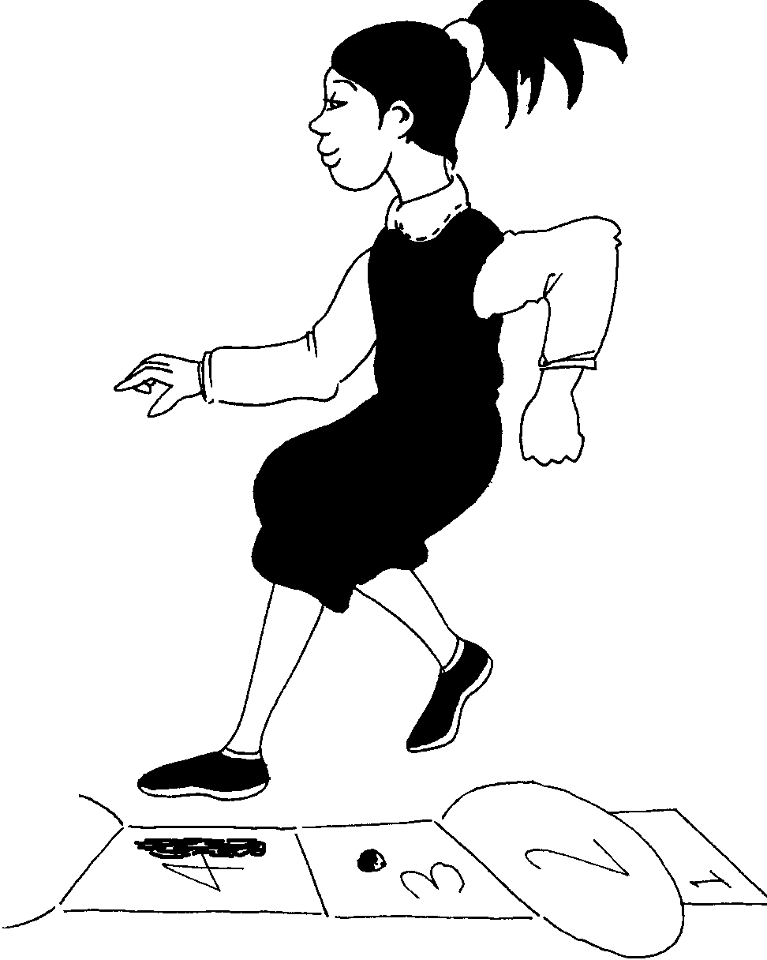

Slide 9
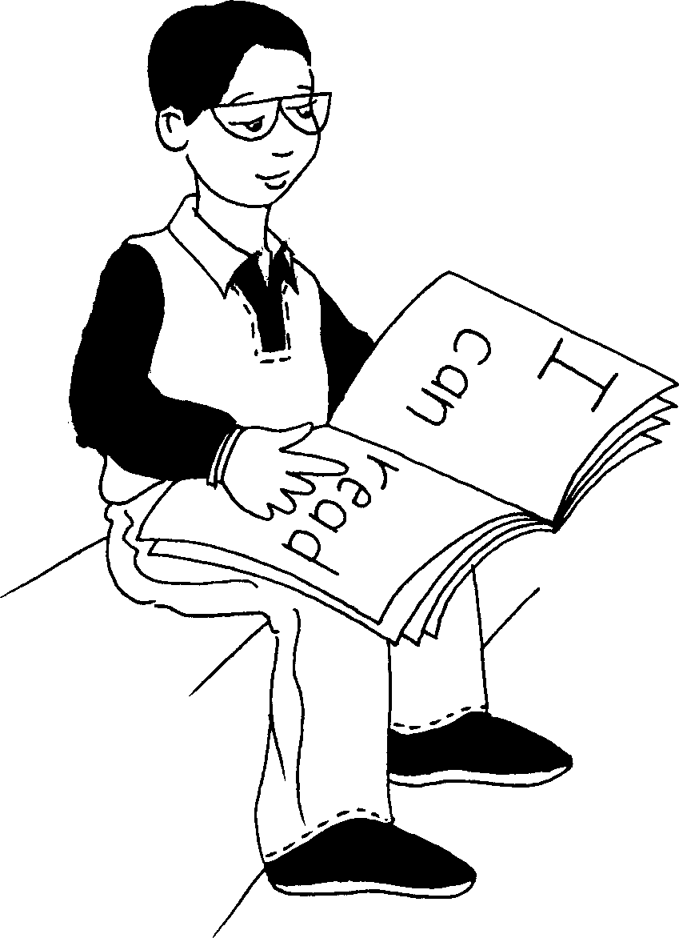
Ngingafunda.
I can read.

Slide 10
Ngingakwenza lokhu I can do this
© 2007 School of Education and
Development (Centre for Adult Education), University of KwaZulu-Natal.
This book may be copied, and used for teaching and learning free of charge.
It may not be sold for profit.
Story in isiZulu by Clare Verbeek, Thembani Dladla, Zanele Buthelezi
Cathy Feek

