Slide 1
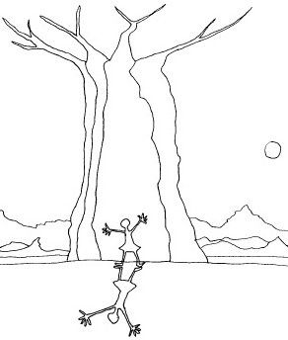

The Tree that saved the Village of Ombalantu
Karen von Wiese, Beryl Salt, Muhdni Grimwood, Barbara Meyerowitz
You can listen to the story being read here …

Slide 2
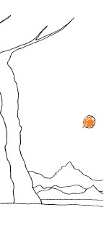
"Shhhu!" says Grandmother. "It's so hot! And this pot is so heavy. Let's sit in the shade of the tree and rest a bit."
She wipes the sweat from her face and makes herself comfortable among the arms of the roots. Selma stands with her hand on the smooth skin of the baobab while her brother, Toivo, walks round the trunk to see how wide it is. "This tree is very old, isn't it, Grandmother?"
"Yes, Selma, it is. But it is not as old, or as big as the tree at the village of Ombalantu!" "Ombalantu? The village near here?" asks Selma.
"Please tell us about the tree there," begs Toivo.
"Then sit and listen," says Grandmother and she begins her story.

Slide 3
There was once a girl called Thaimi who lived in the village of Ombalantu. One day she went with her brother, Angula, to fetch water. While Thaimi was filling her pot Angula saw a hare. He ran after it. He ran and ran and ran - but do you think he could catch that hare? He could not. The hare was too quick for him.
Thaimi's pot was full and she was ready to go home. She looked around but she could not see Angula. She did not know where he had gone. But, she did know that she couldn't go home without her little brother. So she set out to look for him. She walked and she walked and she walked. At last she found him lying in the grass behind a large anthill. As she came close he held his finger to his lips. Why did he want her to be quiet? Close by a group of strange men were resting. The men had bows and arrows ... and spears! Thaimi could hear their voices.
"Angula," she whispered, after she had listened for a bit. "Those men are raiders. They have come to steal our cattle and burn our village. Come quickly. We must run home and warn the village." So very quietly Thaimi and Angula crept away from that place. And ran towards their village.

Slide 4
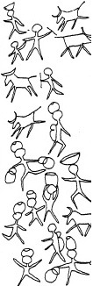
When they were near their village they met their uncle. He was taking his cow to the water. Thaimi called out, "Run, uncle, run! Men are coming to steal our cattle and burn our village.“
The man shouted at his cow and made her run towards the village.
Further on Thaimi saw her aunt working in the field and she called out, "Run, aunt, run! Men are coming to steal our cattle and burn our village!"
And the woman took her hoe, picked up her sleeping baby and ran towards the village.
Further on Thaimi saw her grandfather. He was limping along the road beside a donkey loaded with grain.
And she called out, "Run, grandfather, run! Men are coming to steal our cattle and burn our village!"
Her grandfather lifted his stick and chased the donkey until it ran towards the village.

Slide 5
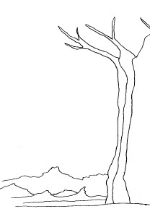
And so Thaimi and her brother reached the village. And she called out to everyone, "Run, run. Men are coming to steal our cattle and burn our village!"
The villagers were scared. They ran backwards and forwards like ants when a heap is trodden on by a cow.
They did not know where to hide or what to do.
Where could they hide their cattle?
Where could they hide their grain?
Where could they hide themselves?
Thaimi was very frightened. Then she remembered something. She remembered the place where she and Angula sometimes went to play.
A safe place.
A secret place.

Slide 6
"I have a place!" she cried. "1 know a place where we will all be safe!"
But the villagers could not hear her. They were making too much noise. How could she make the villagers listen to her? What do you think Thaimi did?
She picked up a drum and began to hit it as hard as she could.
Bam Bam Bam Boom Boom Boom
All the villagers stopped.
Thaimi called out, "I have a place to hide. Follow me."
She took Angula by the arm.

Slide 7
"Come, we'll take everyone to our tree. We will all be safe there!" Her brother shook his head.
"No, Thaimi. That is our secret. You said we must never tell anyone." "Yes", she said. "It was a secret. But now we are all in danger." Thaimi and Angula led the way to a baobab tree which stood nearby. Nobody could understand why.
"Why have you brought us here? We cannot hide here," they said.
Then Thaimi said to her father, "Come. I'll show you." They climbed to the top of the tree. There was a small opening.
Thaimi and her father slid down into the big trunk. It was hollow. It was huge. "But all the people can't come in through such a small hole", said her father.
"No," said Thaimi. "Bring axes and we will make an opening in the trunk." And that is what they
did. They cut an opening in the side of the tree. Some villagers collected the grain and the pots.
Others collected the goats, the sheep and the cattle. They all made their way through the opening into the great hollow inside the baobab tree.
And the strange thing was that there was room for everyone.

Slide 8
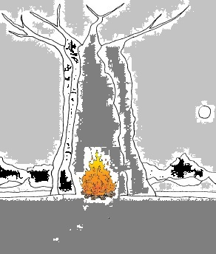
The sun went down. It grew dark and the night was quiet and cold.
The raiders crept up towards the village. It was dark. "Everyone must be asleep," they said.
Inside the great tree the villagers waited.
What was going to happen?
They were cold. They were hungry. And they were afraid.
Then Thaimi said, "It's cold. Let's make a fire." And she took two stones and struck them together. The sparks caught the grass and small flames flared.
Soon a bright warm fire was burning.

Slide 9
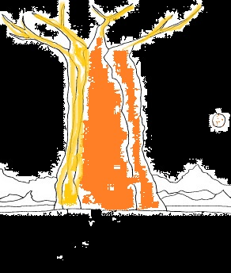
Outside the raiders crept closer and closer.
Then suddenly one of them gave a cry and pointed to the tree. Light flamed from the tree. Fiery eyes shone from the trunk. Bright tongues licked the branches. Smoke curled into the sky.
"It's a great spirit!" they cried in fear. First one raider turned and ran. Then another - and another. Until they had all run away. The people of the village of Ombalantu were saved.

Slide 10

Grandmother is silent.
Selma touches the smooth skin of the baobab.
"So it was the tree that saved them all," she says.

Slide 11
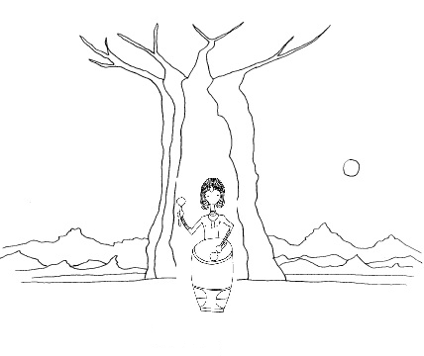

The tree that saved the village of Ombalantu
Karen von Wiese, Beryl Salt, Muhdni Grimwood,
Barbara Meyerowitz
Julia te Water Naude
© Karen von Wiese, Beryl Salt, Muhdni Grimwood,
Barbara Meyerowitz

