Slide 1
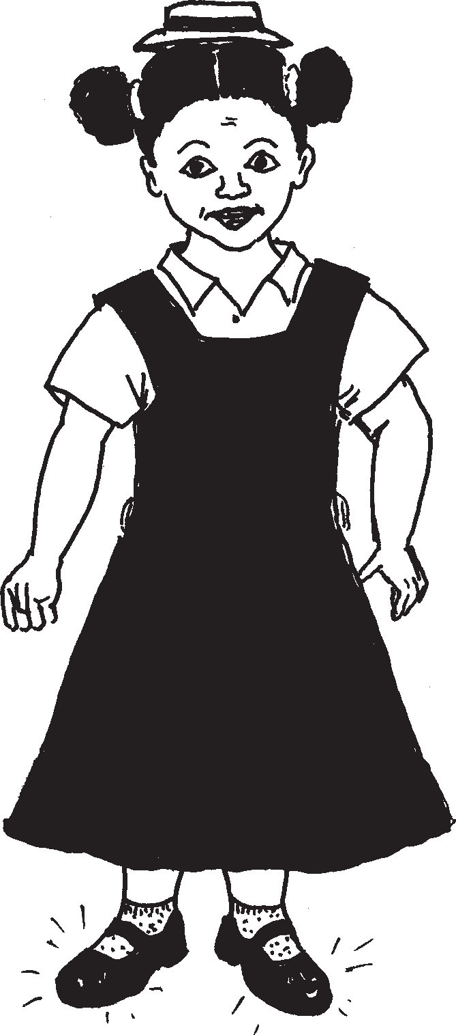
Izimapahla zesikole School clothes
Story in isiZulu by Clare Verbeek, Thembani Dladla, Zanele Buthelezi
Illustrated by Mlungisi Dlamini

Slide 2
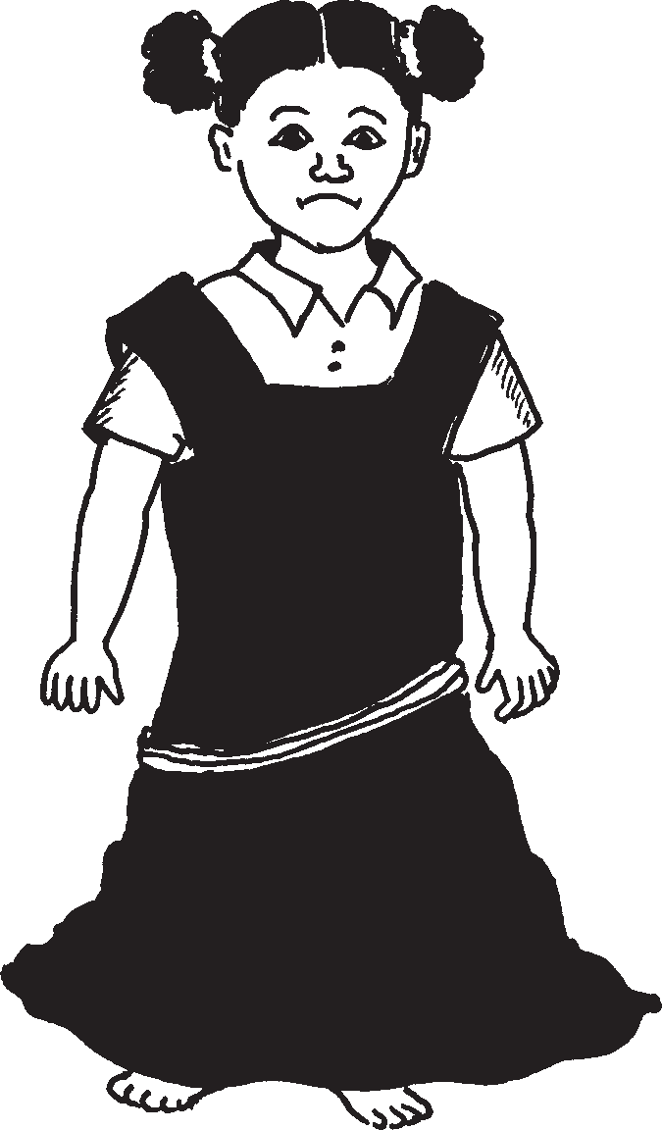
Le ngubo yinde.
This dress is long.

Slide 3
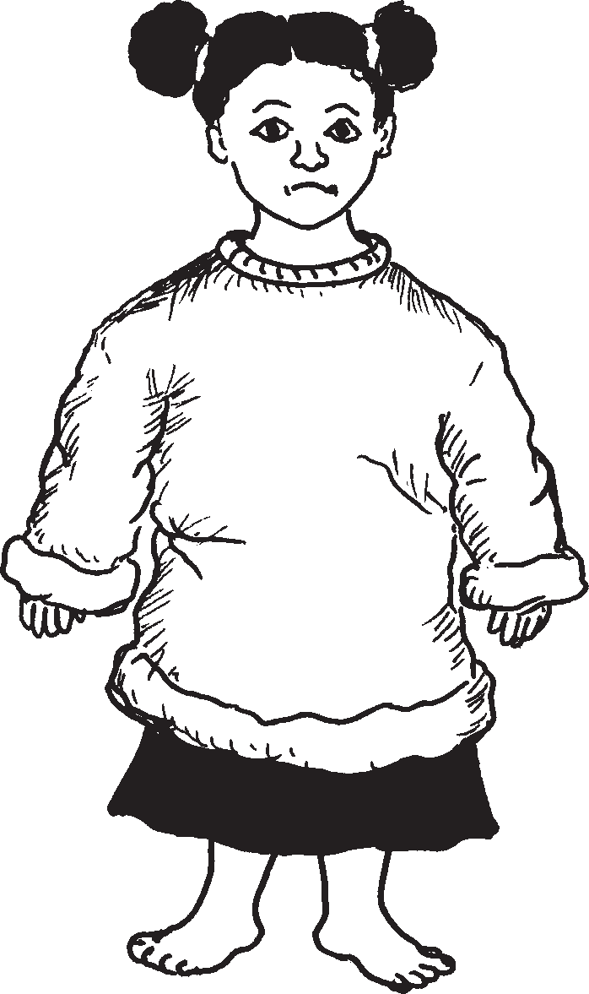
Leli jezi likhulu.
This jersey is big.

Slide 4
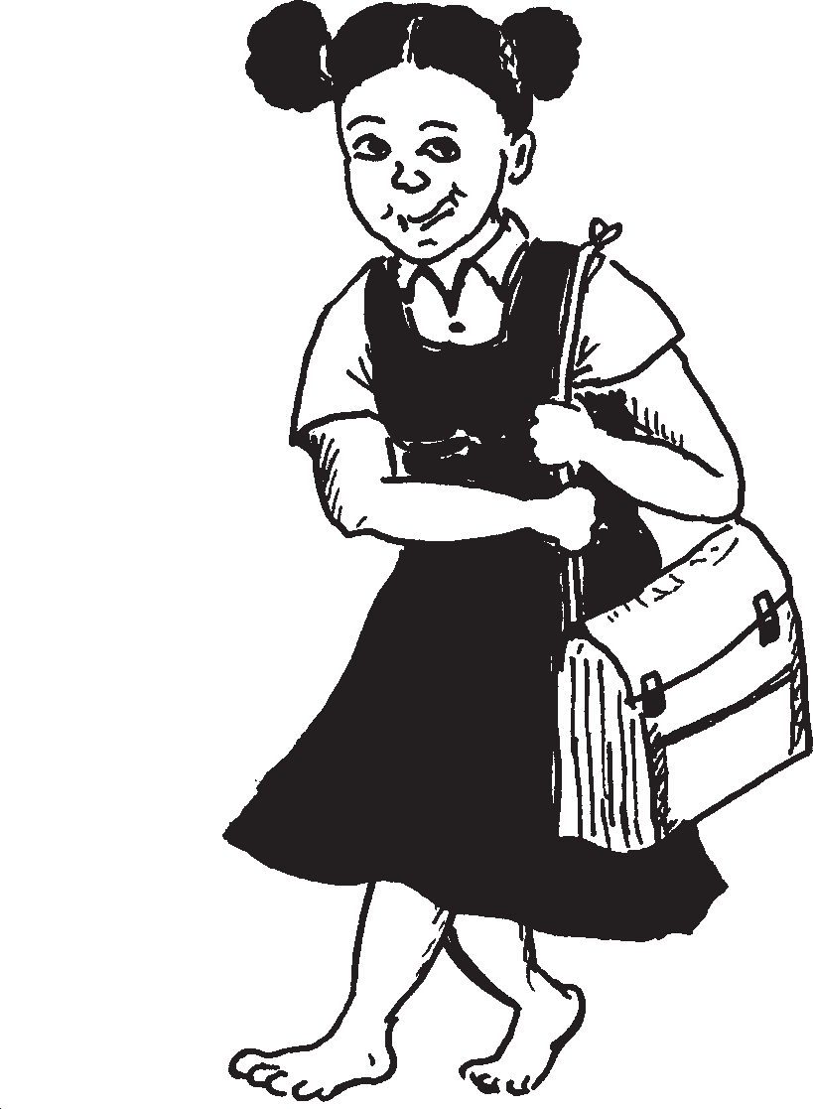
Lesi khwama siyesinda.
This bag is big.

Slide 5
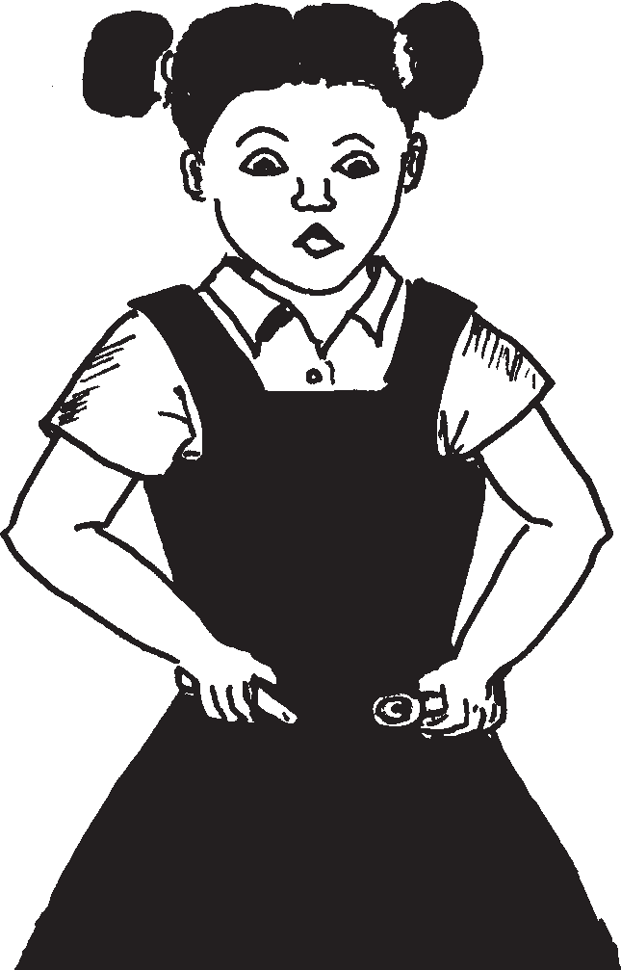
Leli bhande liyansinya.
This belt . ……..

Slide 6
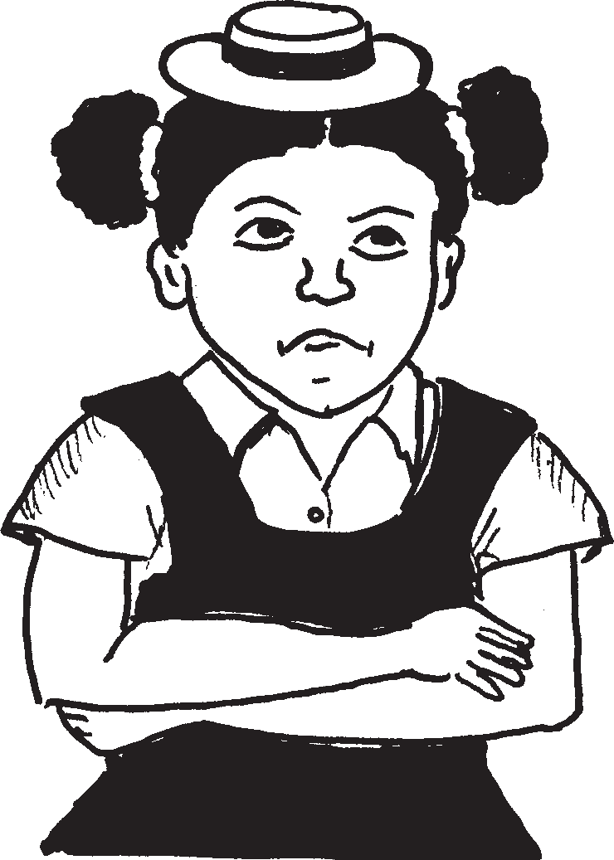
Lesi sigqoko sincane.
This hat is small.

Slide 7
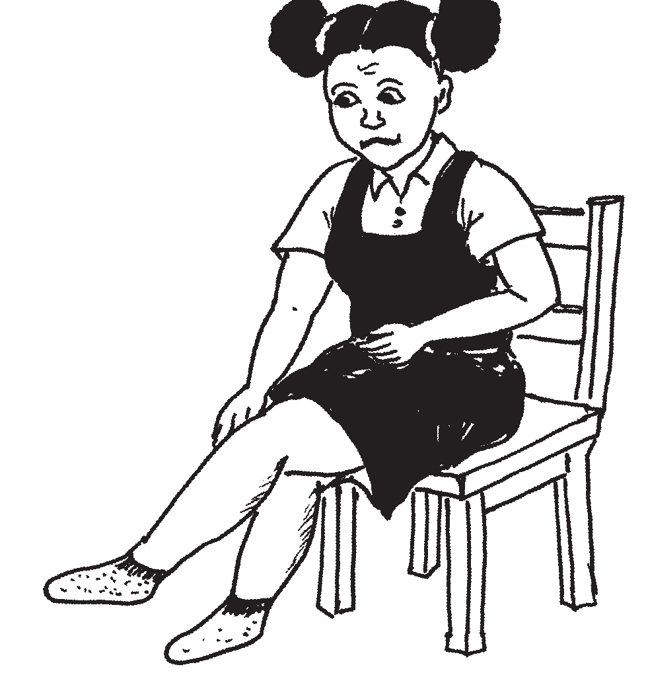
Amasokisi mafishane.
The socks are short.

Slide 8
Kodwa lezi zicathulo zintsha.
But these shoes are new.

Slide 9
…zingena kahle.
….they fit well.

Slide 10
Izimapahla zesikole School clothes
© 2007 School of Education and
Development (Centre for Adult Education), University of KwaZulu-Natal.
This book may be copied, and used for teaching and learning free of charge.
It may not be sold for profit.
Story in isiZulu by Clare Verbeek, Thembani Dladla, Zanele Buthelezi
Mlungisi Dlamini

