Slide 1
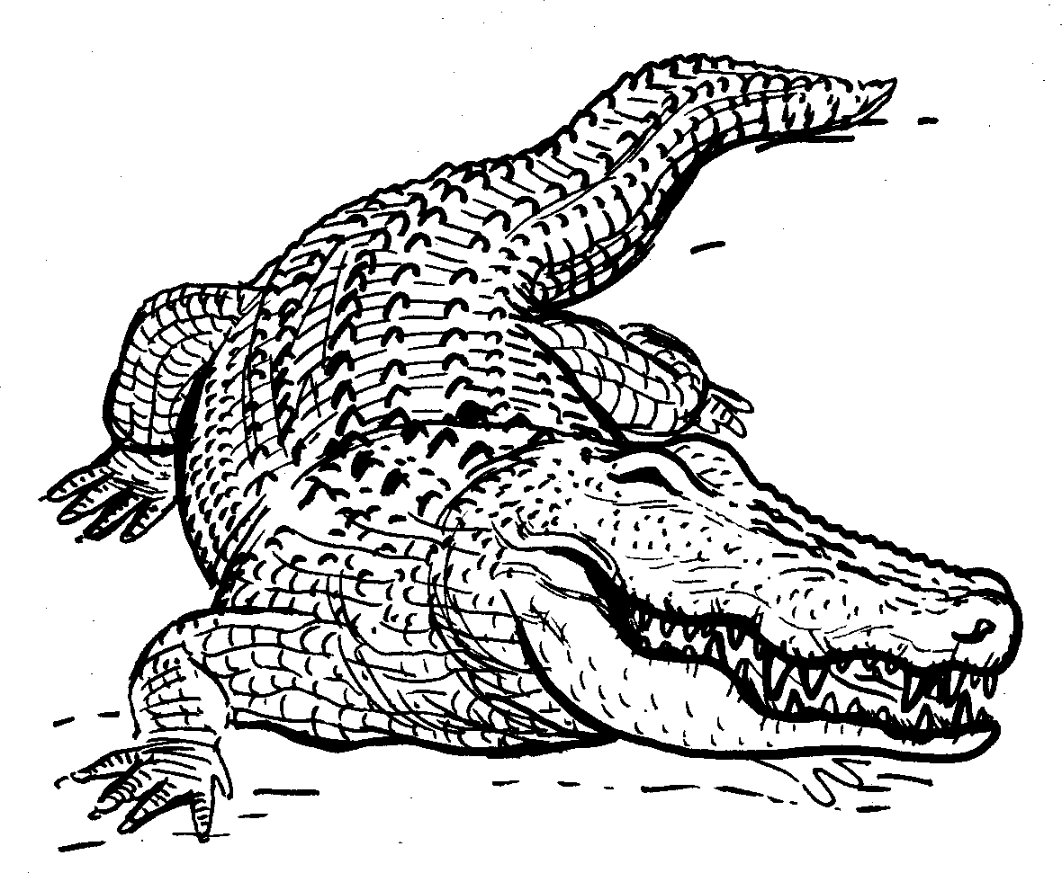
Amazinyo Teeth
Story in isiZulu by Clare Verbeek, Thembani Dladla, Zanele Buthelezi
Illustrated by Kathy Arbuckle

Slide 2
Ingwenya inamazinyo amakhulu.
A crocodile has big teeth.

Slide 3
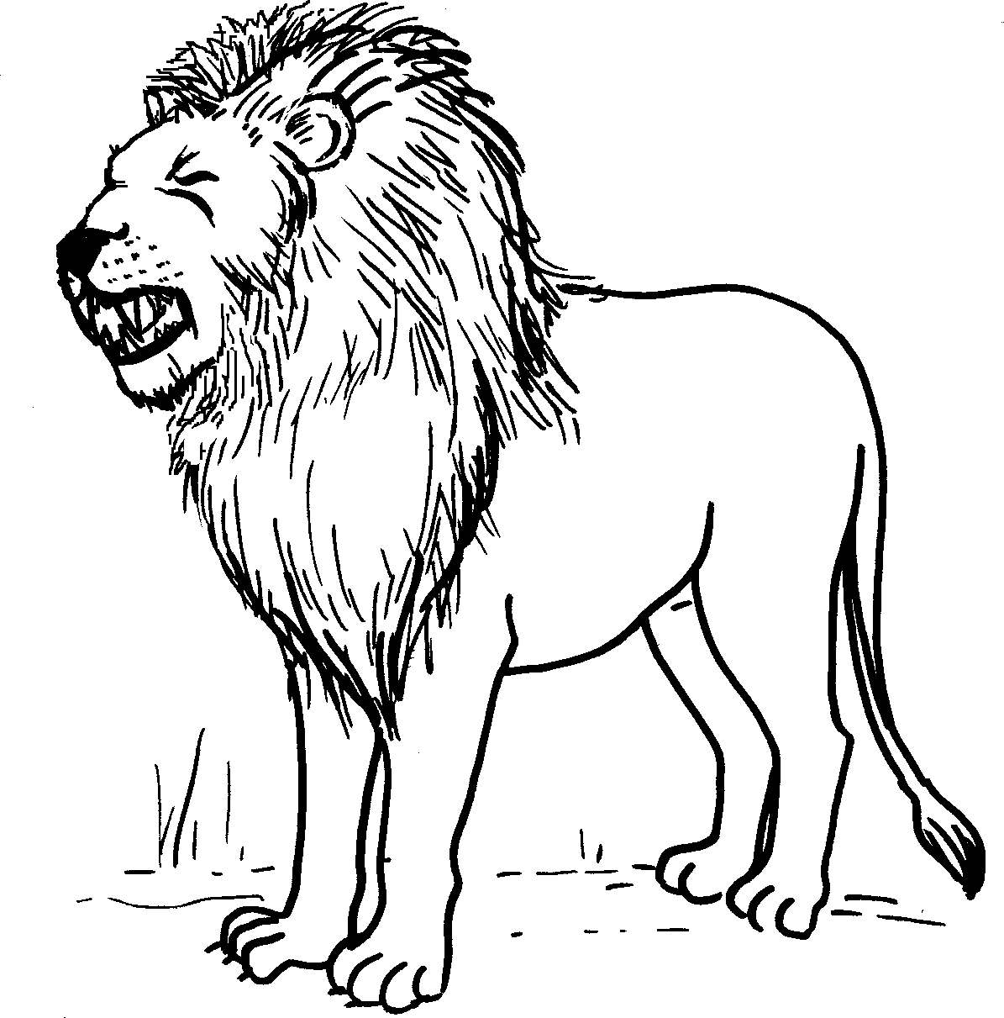
Ngokunjalo nebhubesi linamazinyo amakhulu.
A lion has big teeth as well.

Slide 4
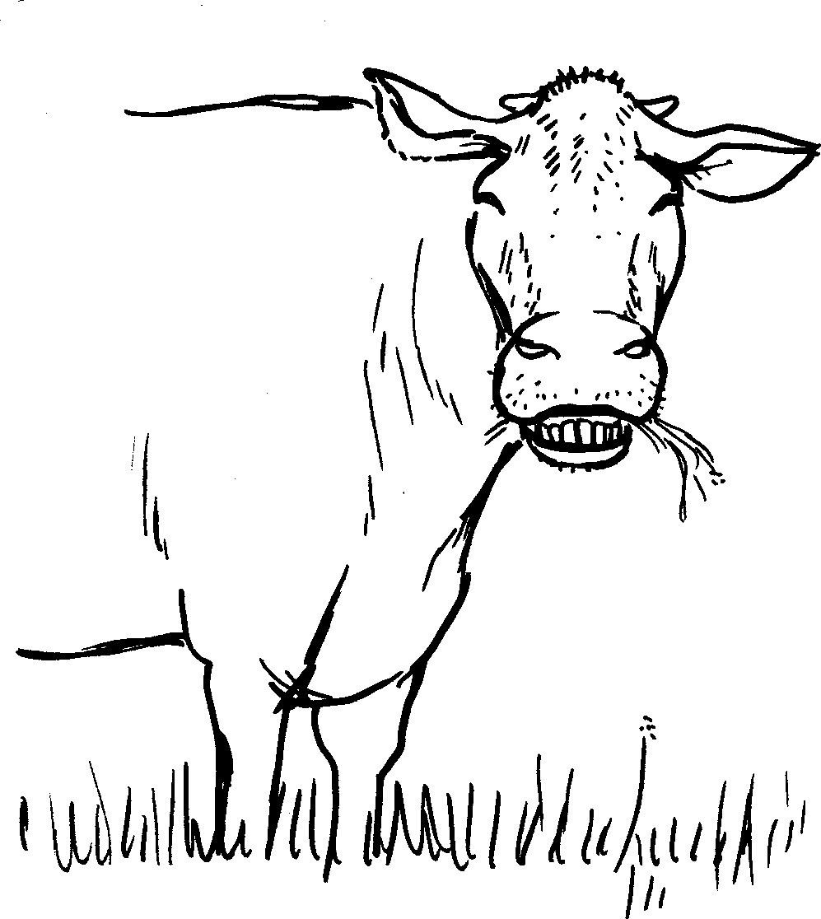
Inkomo inamazinyo ayizicaba.
A cow has ??? teeth.

Slide 5
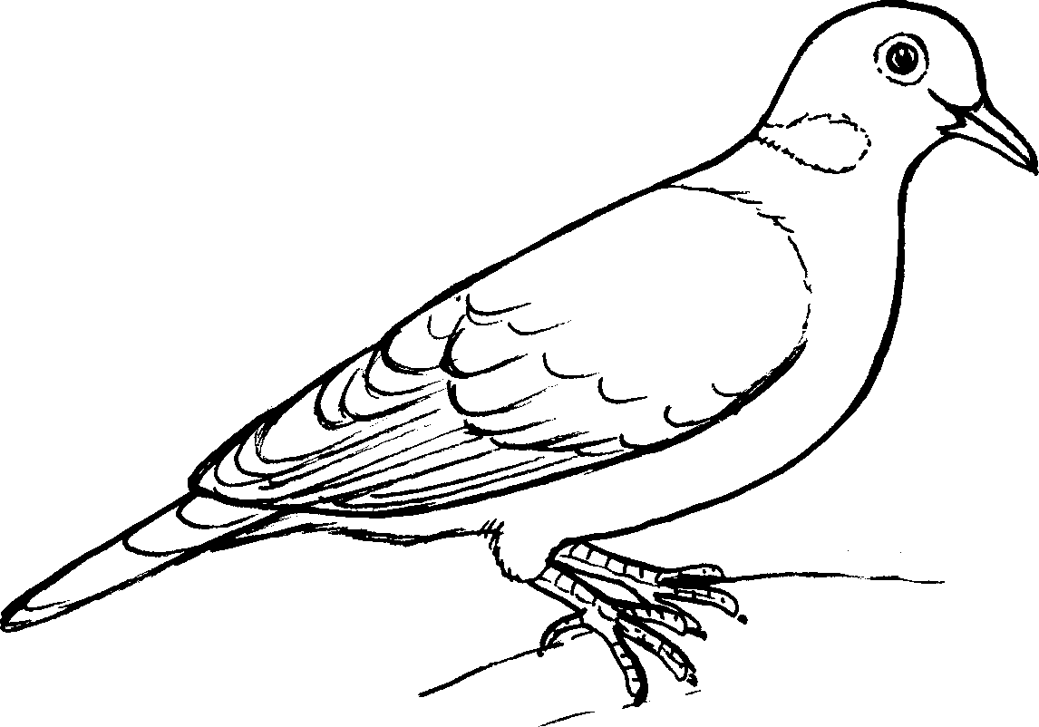
Izinyoni azinawo amazinyo.
Birds do not have teeth.

Slide 6
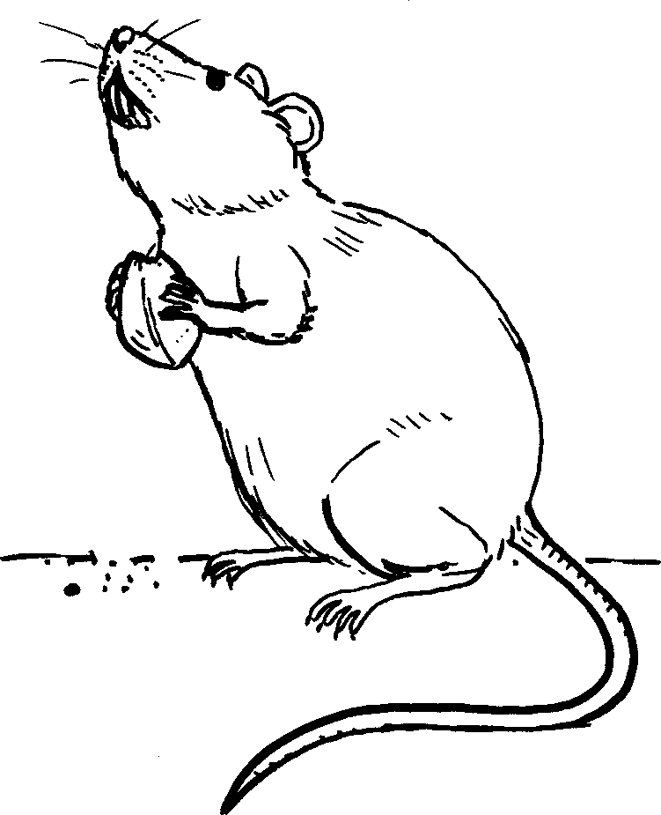
Amagundane anamazinyo amakhulu angaphambili.
Rats have big front teeth.

Slide 7
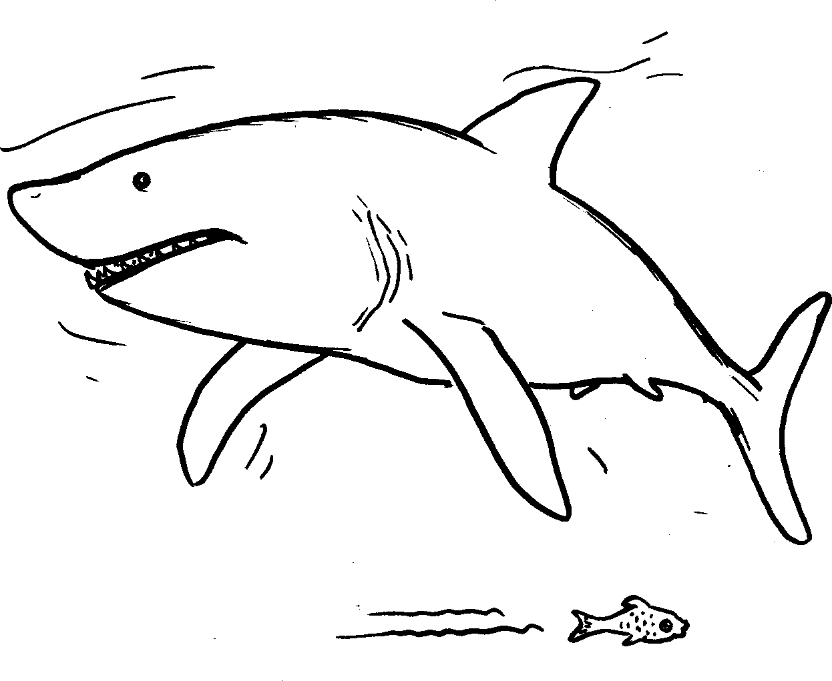
Oshaka banamazinyo acijile.
Sharks have sharp teeth.

Slide 8
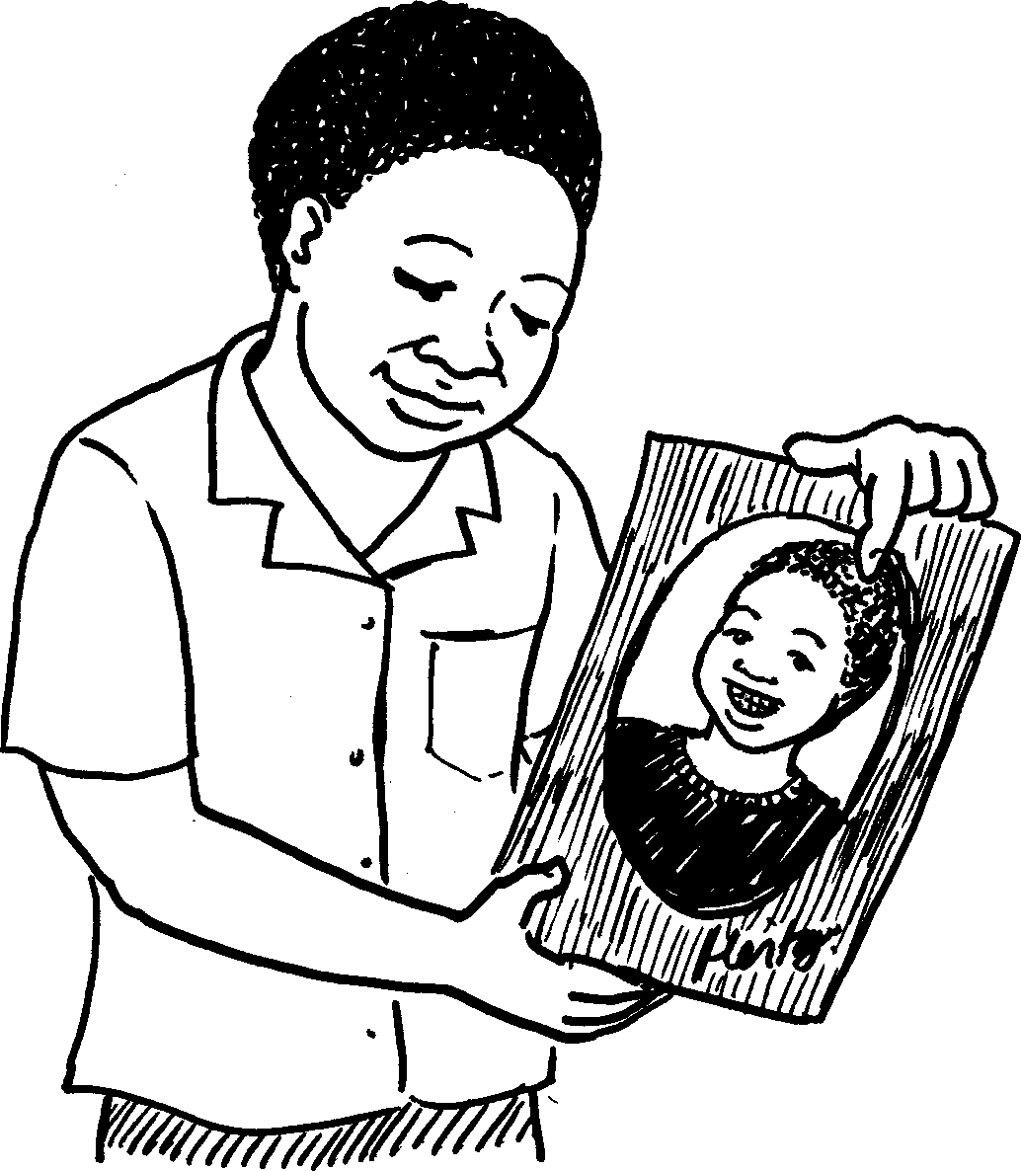
Nganginamazinyo amaningi.
I used to have a lot of teeth.

Slide 9
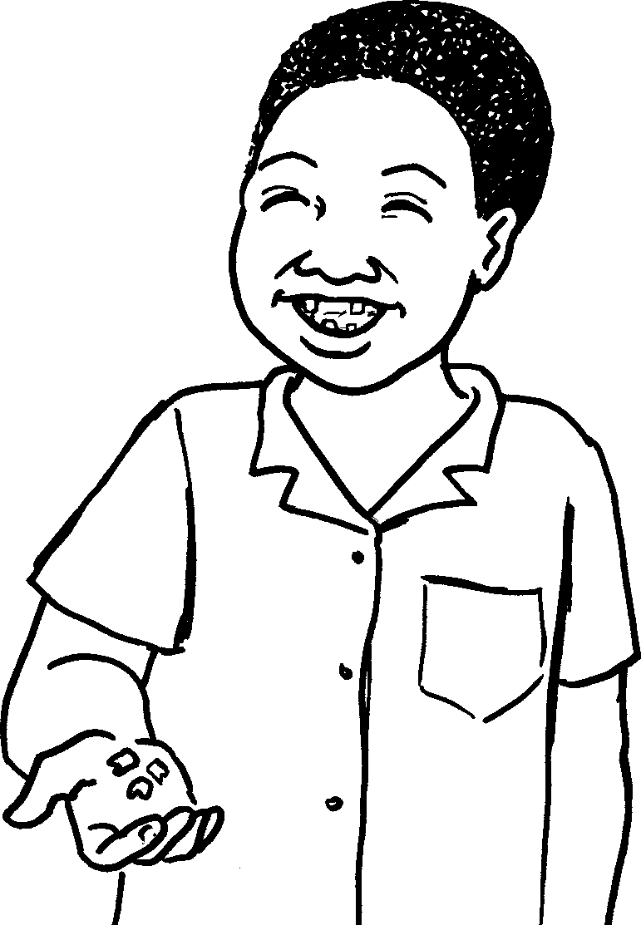
Kodwa manje angisenawo.
But now I do have as many teeth.

Slide 10
Amazinyo Teeth
© 2007 School of Education and
Development (Centre for Adult Education), University of KwaZulu-Natal.
This book may be copied, and used for teaching and learning free of charge.
It may not be sold for profit.
Story in isiZulu by Clare Verbeek, Thembani Dladla, Zanele Buthelezi
Kathy Arbuckle

