Slide 1
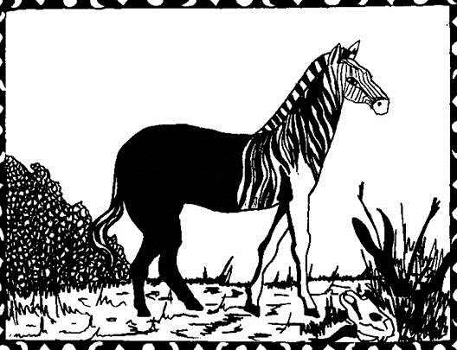

The Quagga’s Secret
Hamilton Wende
You can hear this story being read aloud here …

Slide 2
Not so very long ago, there lived an animal called the Quagga. The Quagga was half- zebra and half-horse. It had stripes on its head and neck, but the rest of its body was a light chestnut colour. In the old days, Quaggas would gallop all across the veld from the Tugela river to Griqualand and beyond. The Quagga had his own special secret of happiness, and other animals would often ask the Quagga for his secret. When this happened, he smiled:
“Will you also tell me the secret of your happiness”? he would ask. But the other animals didn’t know what to say. And the Quagga became very quiet because he knew that secrets must always be shared – they must never just be given away.

Slide 3
One day, the Quagga came across a man called Dai-Kwain. The Quagga had never seen such a strange creature before, standing on two legs like an ostrich, but without any feathers! And the man had never seen such an odd-looking horse. But the two liked each other immediately and soon became good friends. They often used to roam the veld together with the herd to which the Quagga belonged.
One day in the veld the Quagga said, “Dai-Kwain, you are so wise and happy. Tell me, what is the secret of your happiness?” “I don’t have a particular secret,” said Dai-Kwain. “I am just me.” The Quagga looked very puzzled when he heard this.

Slide 4
“It’s easy, Quagga,” said Dai-Kwain. “I have a secret of happiness, but I thought it was plain to see. My secret lies in the song of the earth; in the dance of the sun and in the whisper of the stars at night. My secret is spoken in every moment that exists, and all those who have ears can hear it.” “Dai-Kwain,” the Quagga said. “At last, I am truly happy. I have found someone who understands his own life. Now I can share the secret of my happiness with you.”
The Quagga bent his head forward to tell Dai-Kwain his secret…
BAM!!

Slide 5
There was a huge noise like the sky falling in. The Quagga’s mate standing just next to the Quagga fell down dead, blood pouring from her neck. Dai-Kwain was terrified, and he ran into the hills to hide from the loud noise that had killed the Quagga’s mate. Everywhere he went, it was the same. Men with guns were shooting Quaggas. The Quaggas were chased and shot until there were no more left in all of Africa.
Many years passed and no one saw another Quagga alive. Then there came a runour that deep in the Kaokoveld, beyond where the welwitschia plants grew, there was one old Quagga left alive. Dai-Kwain was now old too, but he began to hope that it was his friend. And so he set out to see if he could find him. What Dai-Kwain didn’t know, was that a hunter was following him, hoping to find the last living Quagga, and to bring his skin back in triumph.

Slide 6
Sure enough, one day when Dai-Kwain was looking for water in a donga, he found his old friend. The Quagga was all alone, except for a cloud of mosquitoes that flew around his head to keep him company.
“It’s been a long time, my friend,” said the Quagga.
“It has indeed, “said Dai-Kwain.
Neither of them heard the hunter creeping up from behind.
“You have waited so long to hear my secret,” said the Quagga. “Where shall I begin?”
The hunter came closer and closer.
“At the very beginning,” said Dai-Kwain.
The Quagga opened his mouth to speak.

Slide 7
The hunter fired. Again there was the loud noise. A cloud of mosquitoes flew up from around the Quagga’s head. This time Dai-Kwain knew what the sound was. He ran down the bank of the donga to his friend’s side. But the hunter’s gun had been too powerful.
Dai-Kwain put his ear to the Quagga’s mouth, but he could hear only a faint dying whisper. The last Quagga had died, and the secret of his happiness was lost forever. Dai-Kwain rested his head on his friend’s and cried and cried. The hunter saw what a terrible mistake it had been to kill the last Quagga. He wished with all his heart he could undo what he had done, but it was too late.

Slide 8
Through his crying, Dai-Kwain heard a tiny humming sound in his ear. It was a single mosquito hovering above him. Angrily, Dai-Kwain waved the mosquito away. But the mosquito flew around his hand, and kept humming. Dai-Kwain was furious. He put both his hands in the air and was about to swat the mosquito inside them. Suddenly, Dai-Kwain understood. That tiny mosquito had not flown away when all the others had. He had heard the Quagga’s final words. The mosquito, alone of all the animals in Africa, knew the precious secret of the Quagga’s happiness.
Dai-Kwan looked up at the hunter standing on the edge of the donga. “What you have done can never be changed,” said Dai-Kwain. “But, from now on, whenever a mosquito wakes you up by buzzing in your ear, do not be angry with him. Listen to him instead. He may be trying to tell you the precious secret of happiness that was lost to us all when the last Quagga was killed.”

Slide 9
The Quagga was a real animal once. It was actually a cousin of both horse and zebra and its scientific name was Equus Quagga. Quaggas were hunted all over Southern Africa for their meat and skin.
The last Quagga was shot in the wild in 1861 near King Williamstown in the Eastern Cape. A very few remained in zoos in Europe but, in the end, the last two remaining Quaggas were female and so no attempt could be made to breed them. In 1883, in the Amsterdam Zoo, the very last Quagga died.
There were reports of Quagga sightings in the remote Koaokoveld of Namibia after that, the last one being in the 1940’s. But none of the sightings were ever confirmed.
Did you know?

Slide 10

The Quagga’s Secret
Hamilton Wende
From: My Drum (Johannesburg, Abecedarius Books, 1988)
Daniella Orkin
© Meyerowitz B, Copans J, and Welch T

