Slide 1
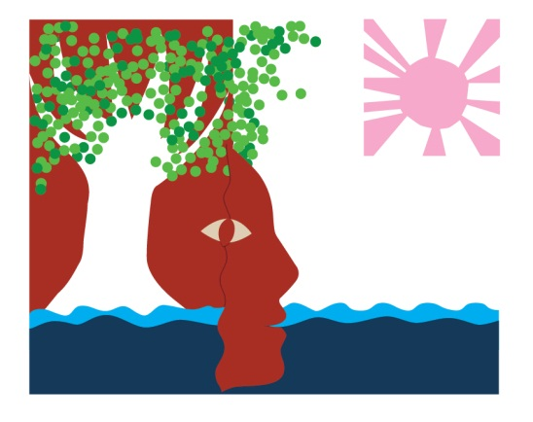
The Tree Wife
Adapted by Tessa Welch from the Xhosa folktale, Kamiyo of the River
Illustrations by Jemma Kahn

Slide 2
Once upon a time, there lived a man who had plenty of everything – a large fertile farm, with cattle, sheep, and goats.
But, as he grew old, he grew sad, because one thing was missing. He did not have a wife.

Slide 3
Standing under a tree one day, he had a brilliant idea.
If he couldn’t find a wife, perhaps he could make one?

Slide 4
So he set to work to shape a beautiful woman from a strong branch of the tree.
When he had finished making the statue, he touched her eyes, and they opened.
He blew gently on her, and she came alive.

Slide 5
She was truly the most beautiful woman he had ever seen.
He knelt before her, and asked her to be his wife.

Slide 6
He gave her a colourful apron, beads, and a head ring, the sign of a married woman. And he built her a house with the mud and grass that used to lie at the foot of her trunk.
“Only one thing I beg of you,” he said to his wife. “Never tell anyone where you come from.”

Slide 7
But before long, the young men from a neighbouring village began talking among themselves.
“How can such an old man have such a beautiful young wife?”
So they decided to steal her and take her to their own kraal.

Slide 8
The old man was heartbroken. He felt he could not live without her.
But then he thought, “Perhaps if I have something of hers, I would not feel so sad?”
So he sent his doves to find her, to sing to her, and to bring back something of hers to him.

Slide 9
When they found her, they sang to her in the language of birds:
Tree woman, tree woman
More beautiful than any other
Your husband has sent us
To bring back your apron!

Slide 10
She gave them her apron, and they flew over the hill, over the river, back to her husband.
He held the apron to his face, and was comforted for a little while.

Slide 11
But his longing did not go away.
So again he sent his doves to sing to her:
Tree woman, tree woman
More beautiful than any other
Your husband has sent us
To bring back your head ring!
And back they flew with the head ring, the sign of a married woman.

Slide 12
He held the head ring and sighed for his wife, far away in the kraal of other people.
After a while, he called his doves again.
Go to her and sing,
Tree woman, tree woman
More beautiful than any other
Your husband has sent us
To bring back your Life!

Slide 13
So away they went the third time.
They perched on her shoulders. As they sang, each bird pecked out an eye.
Immediately she turned again into a statue.
Her feet and arms fell away. Then her head.
And she fell to the ground.

Slide 14
Her husband slowly rolled her wooden trunk to the river.
He stood her up with her roots in the water.
Nourished by sun and soil, she grew leaves again.

Slide 15
And when the wind blows, the leaves sigh.
Just as a woman does when she longs for her husband.

Slide 16
The Tree Wife
© African Storybook Initiative, 2013
This work is licensed under a Creative Commons Attribution (CC-BY) Version 3.0 Unported License.
You are free to download, copy and adapt this story and use the illustrations as long as you attribute the original authors and illustrators
Adapted by Tessa Welch from the Xhosa folktale, Kamiyo of the River
Jemma Kahn
Listen on YouTube to another version of this story – Kamiyo of the River
http://www.youtube.com/watch?v=li8tklIflMs

