Slide 1
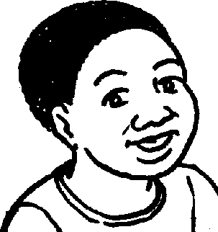
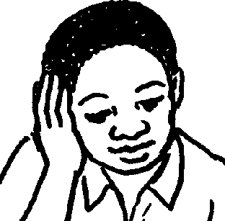
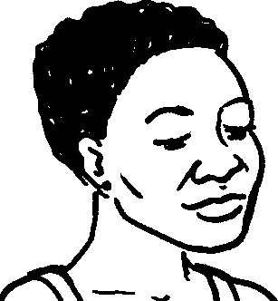
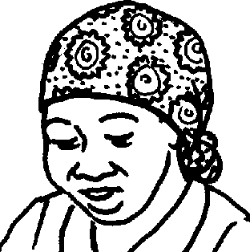
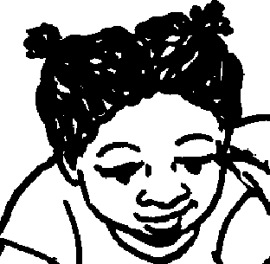
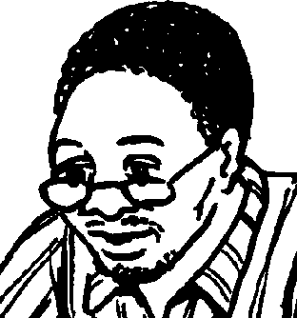
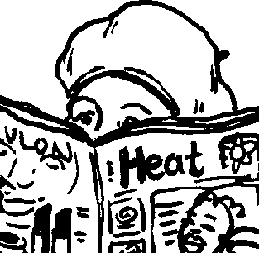
Umndeni wami My family
Story in isiZulu by Clare Verbeek, Thembani Dladla, Zanele Buthelezi
Illustrated by Kathy Arbuckle

Slide 2
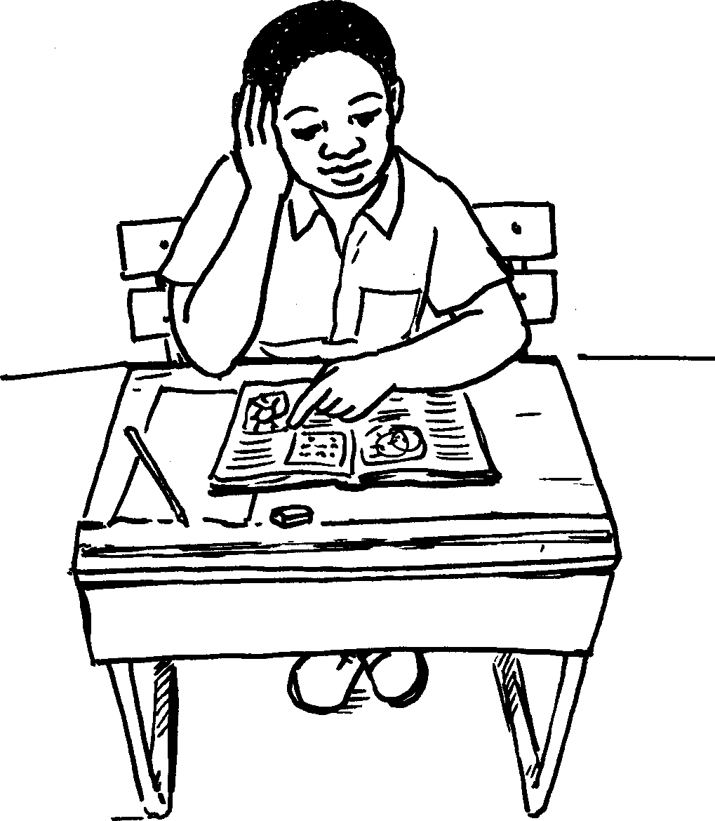
Umfowethu ufunda incwadi yesikole.
My brother is reading a school book.

Slide 3
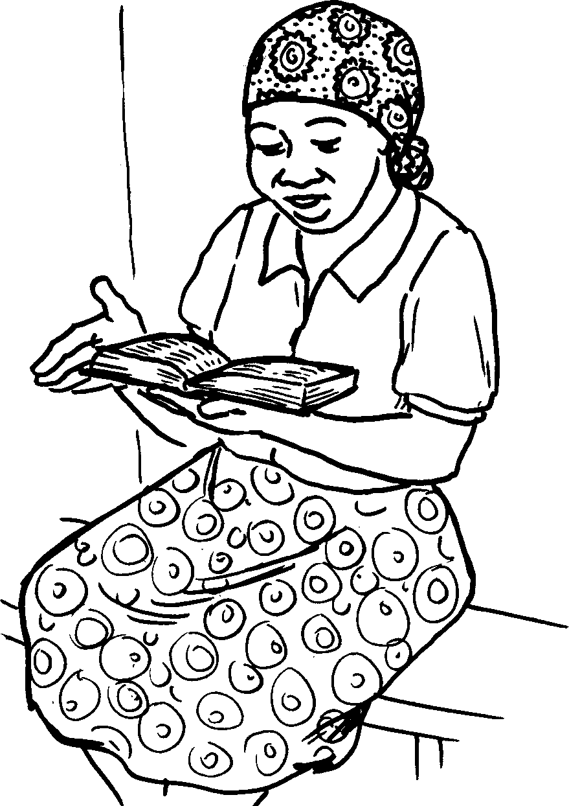
Umama ufunda iBhayibheli.
My mother is reading a Bible.

Slide 4
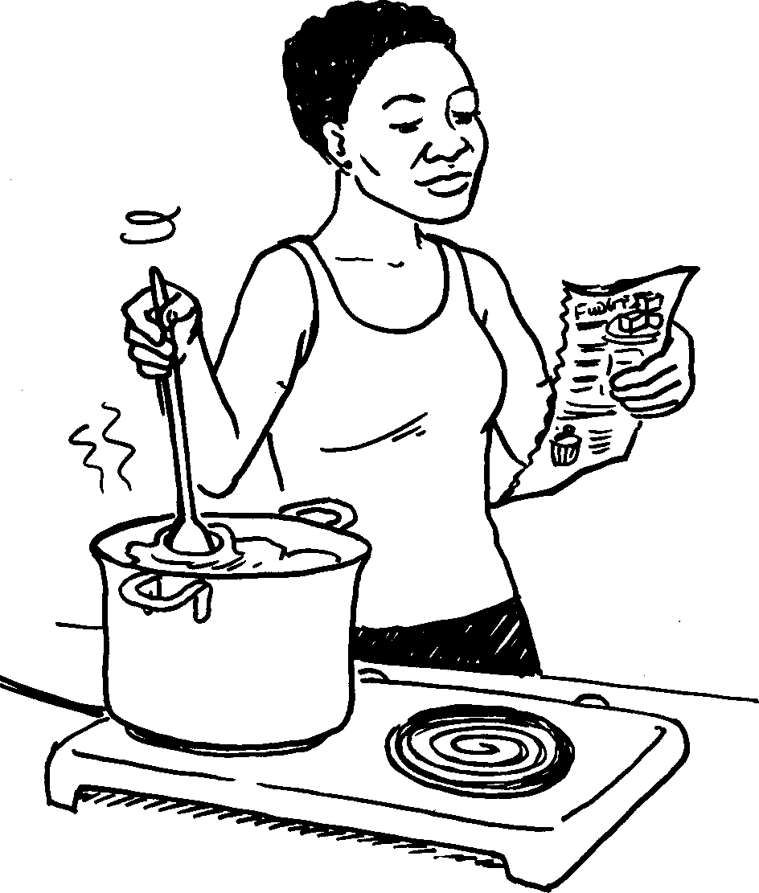
Udadewethu yena ufunda
incwadi yokupheka.
My sister is reading a recipe book.

Slide 5
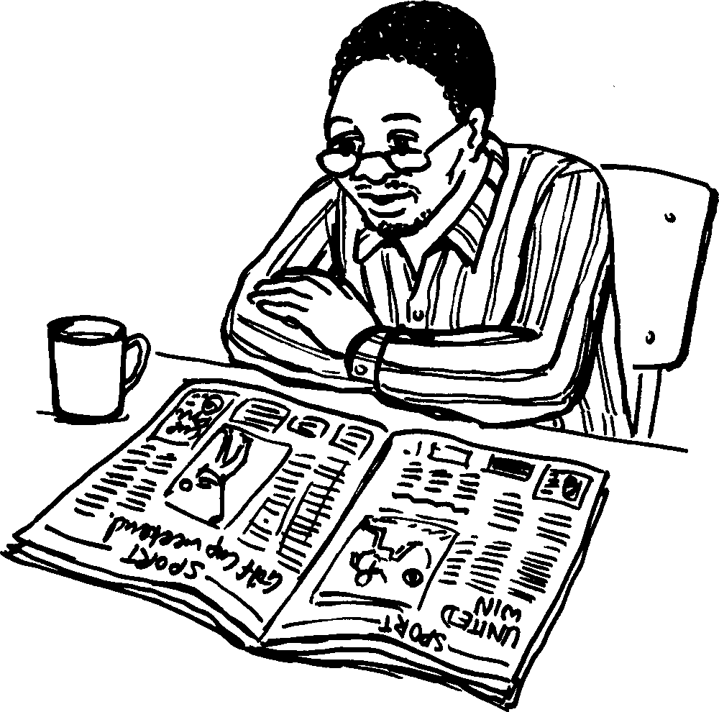
Umalume ufunda
iphephandaba.
My uncle is reading a newspaper.

Slide 6
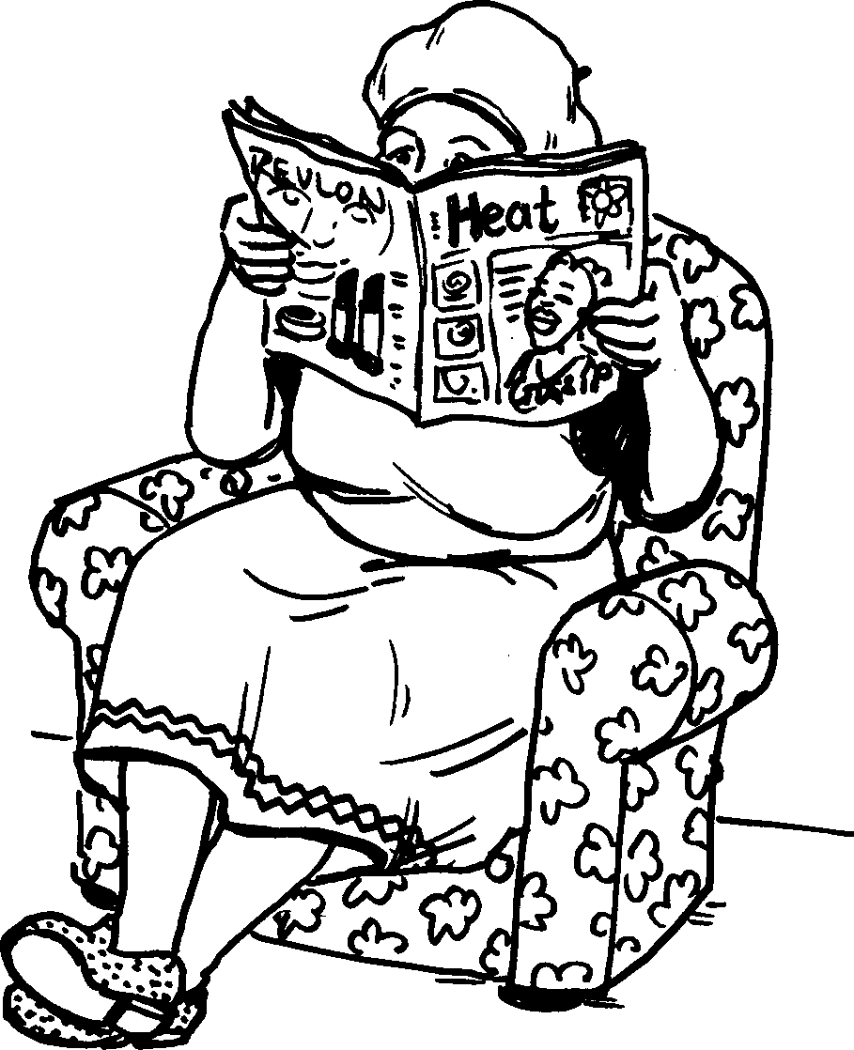
Ugogo yena ufunda ibhuku.
Granny is reading a magazine.

Slide 7
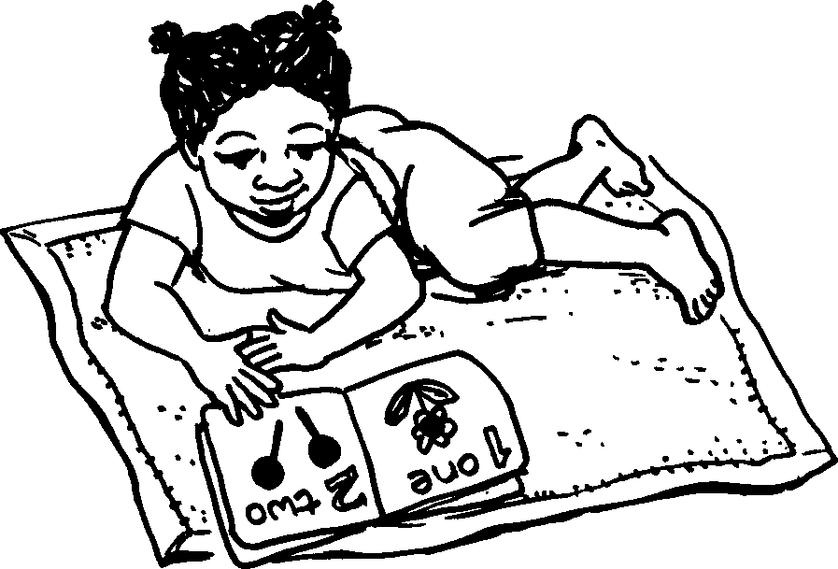
Udadewethu omncane
ufunda incwadi
enezithombe.
My little sister is reading a picture book.

Slide 8
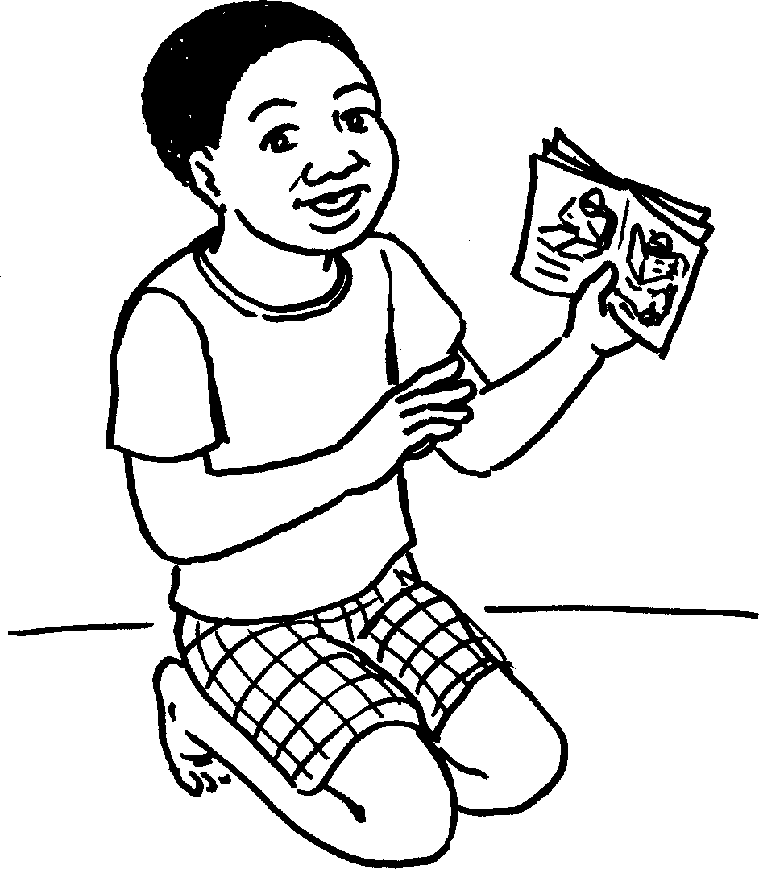
Mina ngifunda le ncwadi.
I am reading this book.

Slide 9
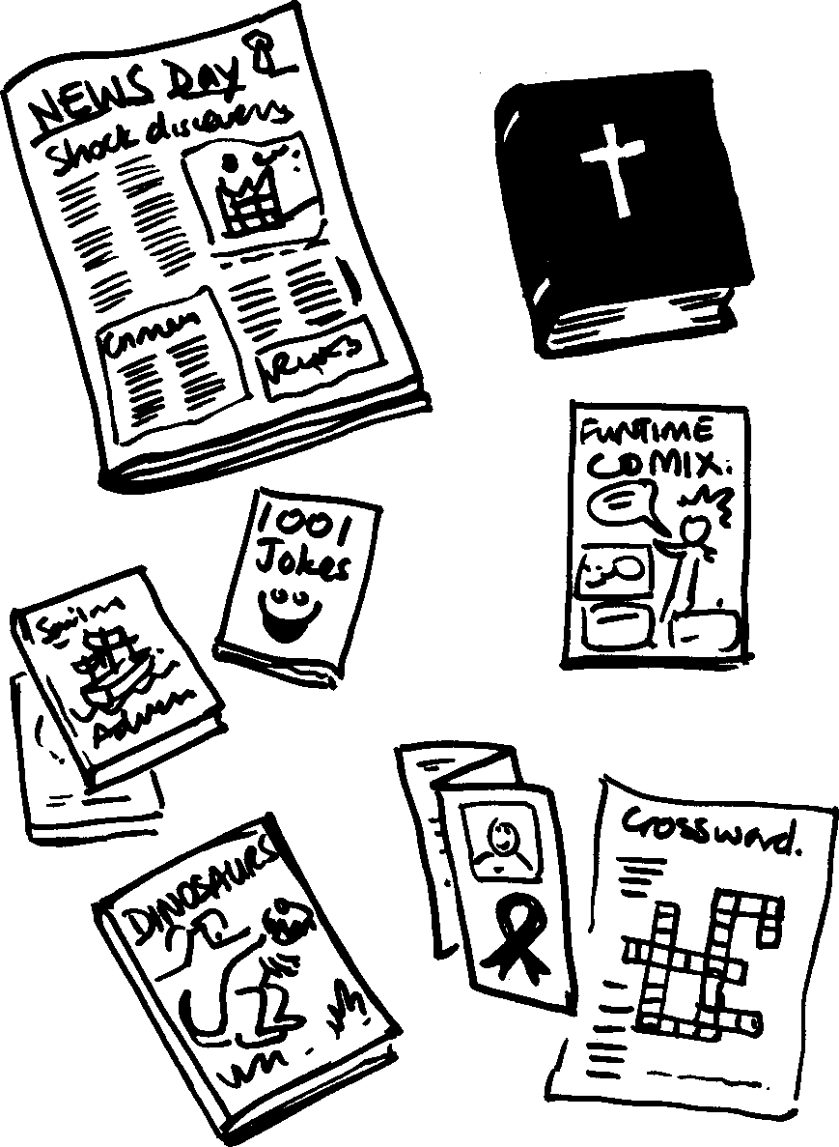
Maduze nje ngizobe ngikwazi ukufunda konke!
Soon I will be able to read everything.

Slide 10
Umndeni wami My family
© 2007 School of Education and
Development (Centre for Adult Education), University of KwaZulu-Natal.
This book may be copied, and used for teaching and learning free of charge.
It may not be sold for profit.
Story in isiZulu by Clare Verbeek, Thembani Dladla, Zanele Buthelezi
Kathy Arbuckle

