Slide 1
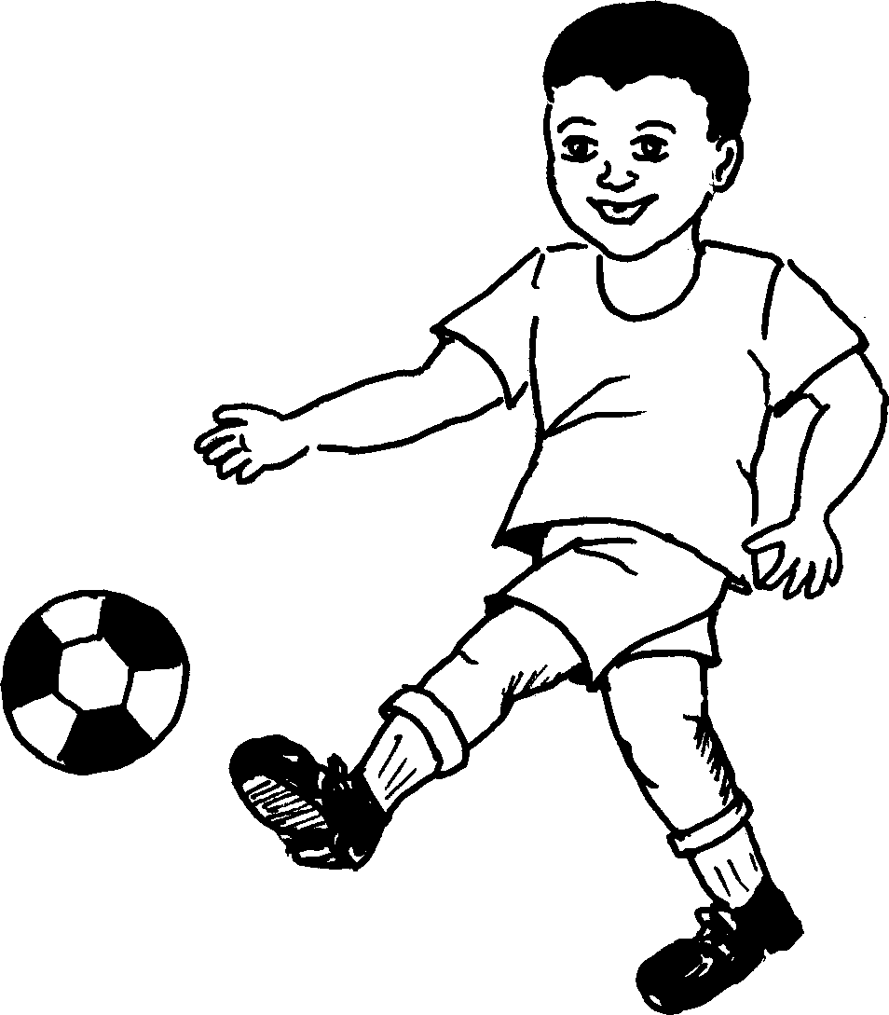
Umzimba wami My body
Story in isiZulu by Clare Verbeek, Thembani Dladla, Zanele Buthelezi
Illustrated by Mlungisi Dlamini

Slide 2
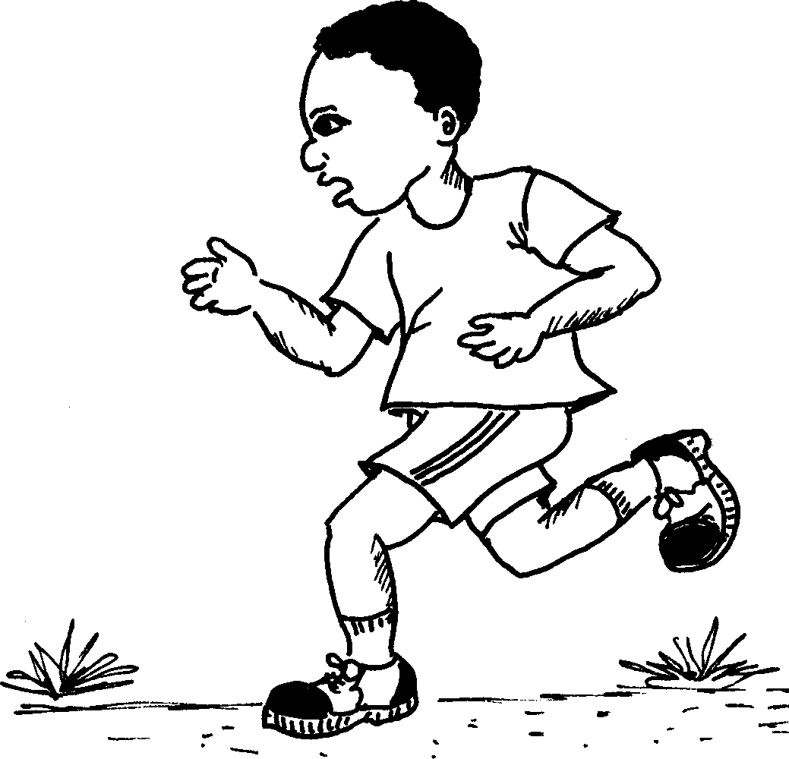
Ngingagijima ngawo.
I can run with it.

Slide 3
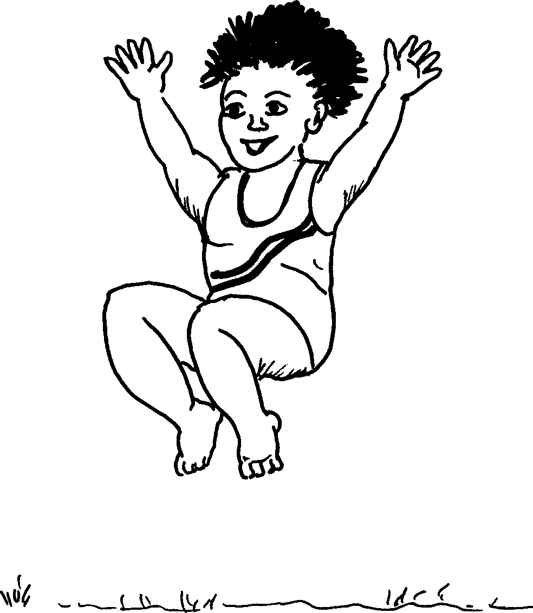
Ngingagxuma ngawo.
I can jump with it.

Slide 4
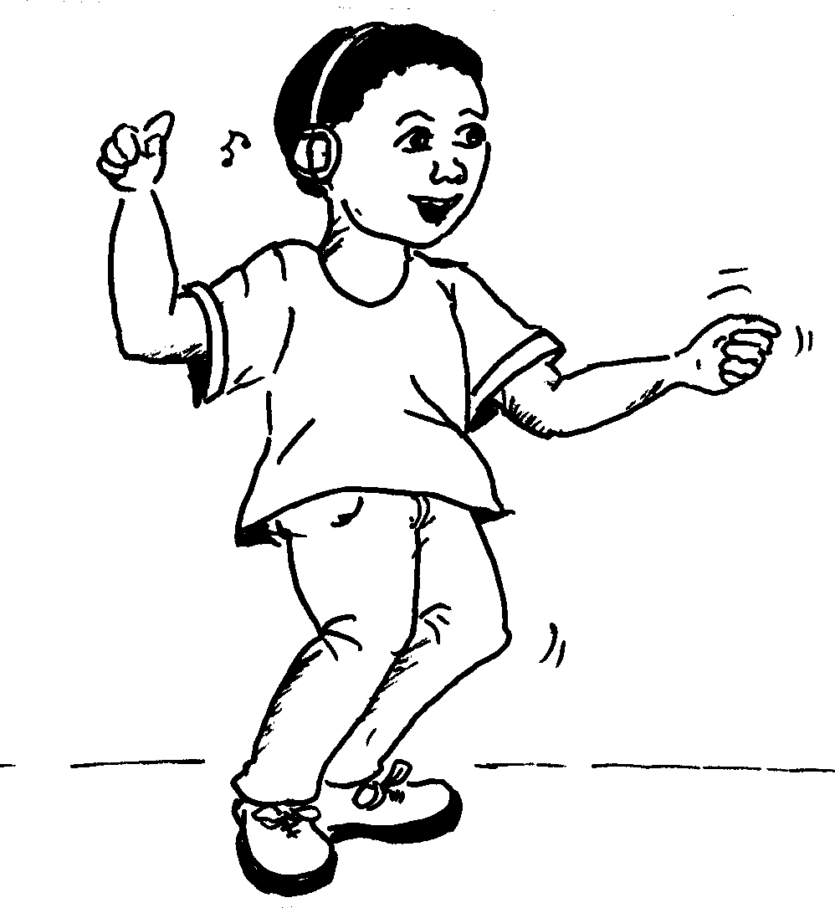
Ngingadansa ngawo.
I can dance with it.

Slide 5
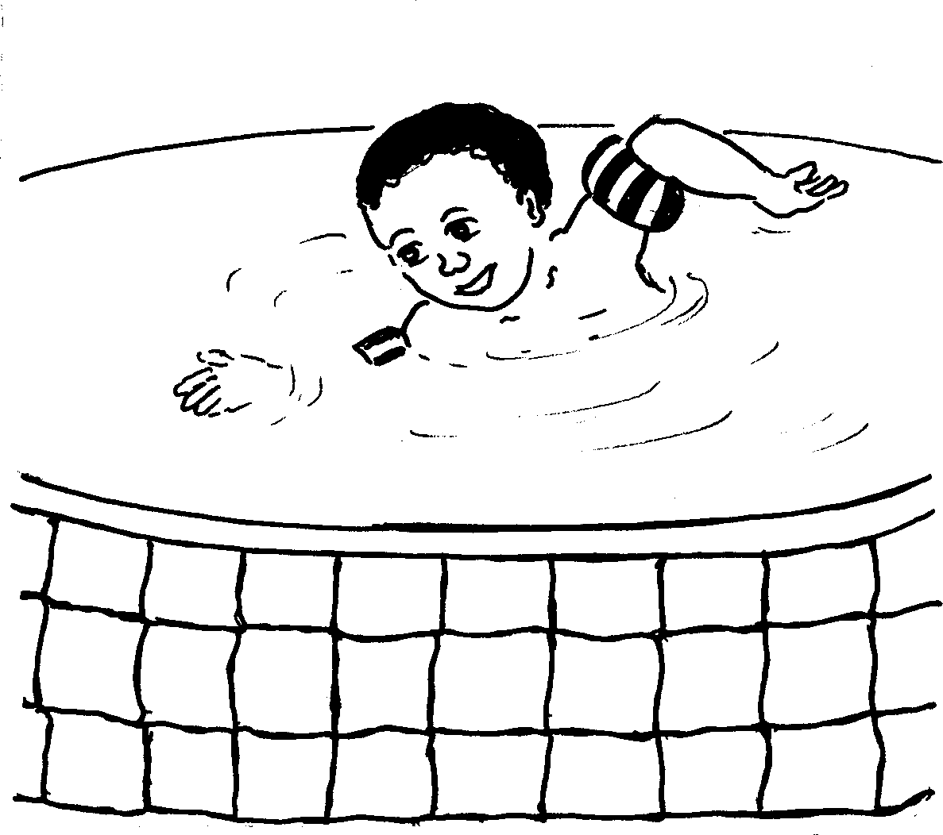
Ngingabhukuda ngawo.
I can swim with it.

Slide 6
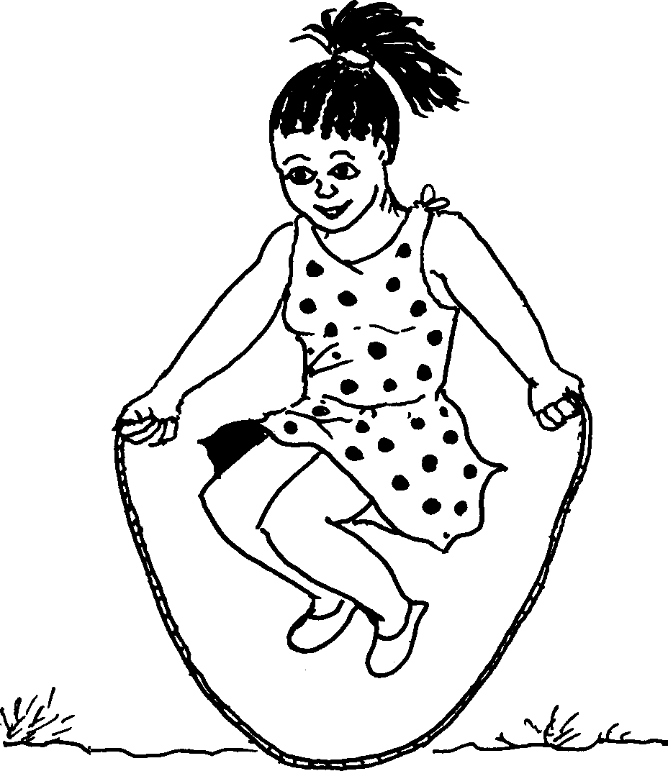
Ngingajomba ngawo.
I can skip with it.

Slide 7
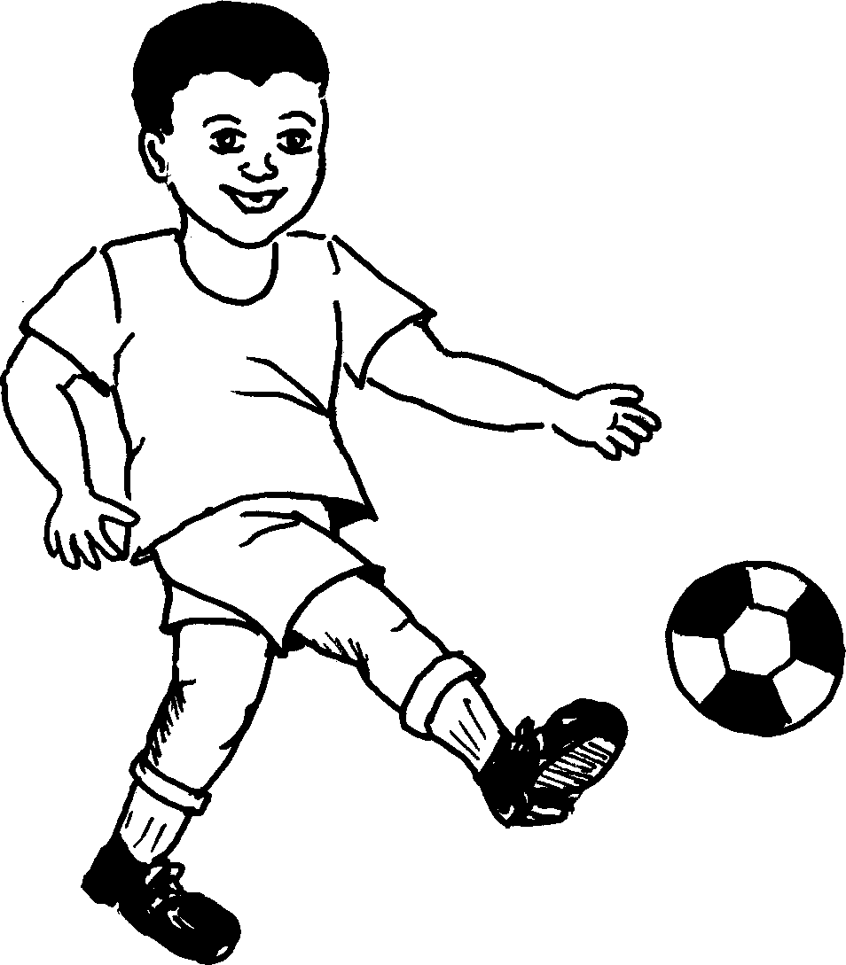
Ngingakahlela ngawo.
I can kick with it.

Slide 8
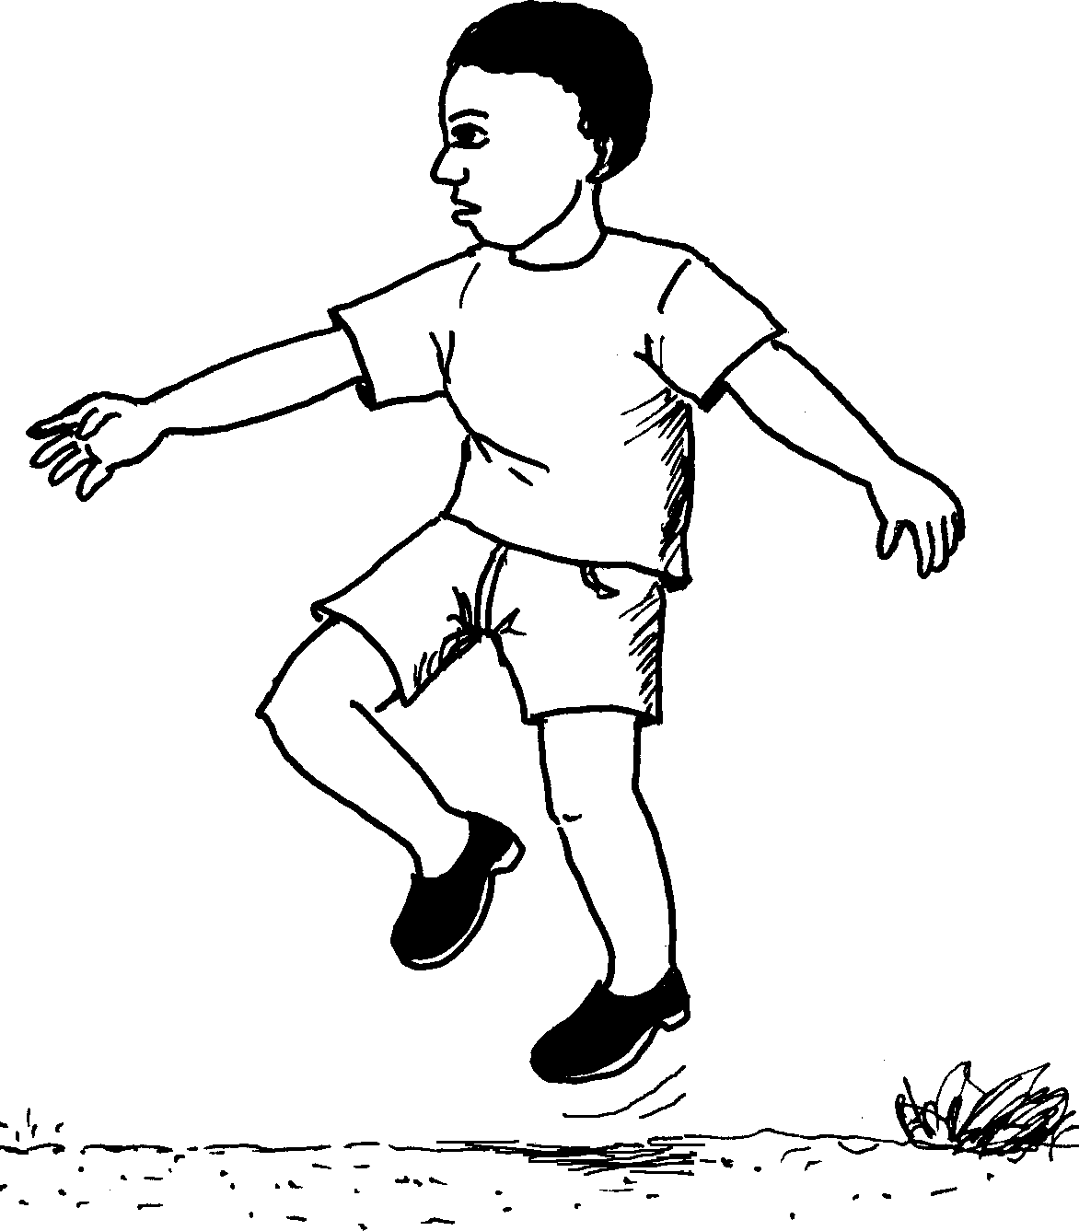
Ngingeqa ngawo.
I can escape with it.

Slide 9
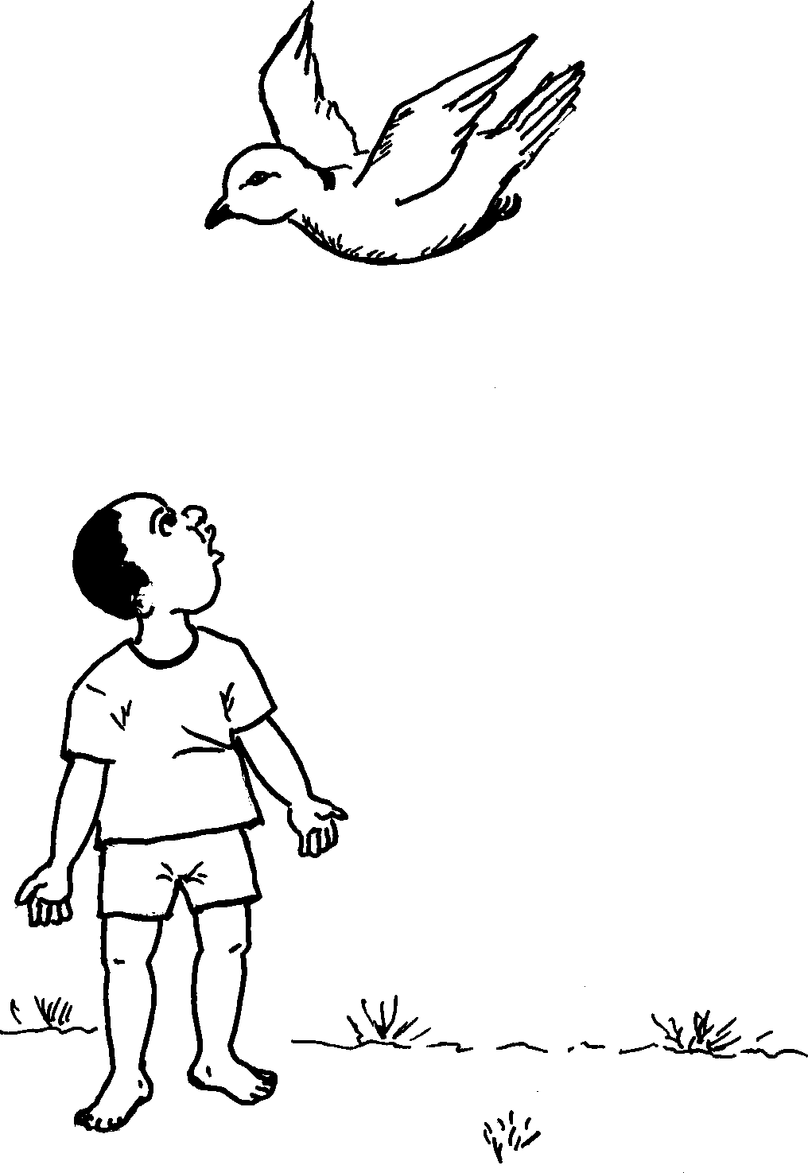
Kodwa ngeke ngindize ngawo.
But I can never fly with it.

Slide 10
Umzimba wami My body
© 2007 School of Education and
Development (Centre for Adult Education), University of KwaZulu-Natal.
This book may be copied, and used for teaching and learning free of charge.
It may not be sold for profit.
Story in isiZulu by Clare Verbeek, Thembani Dladla, Zanele Buthelezi
Mlungisi Dlamini

