Slide 1
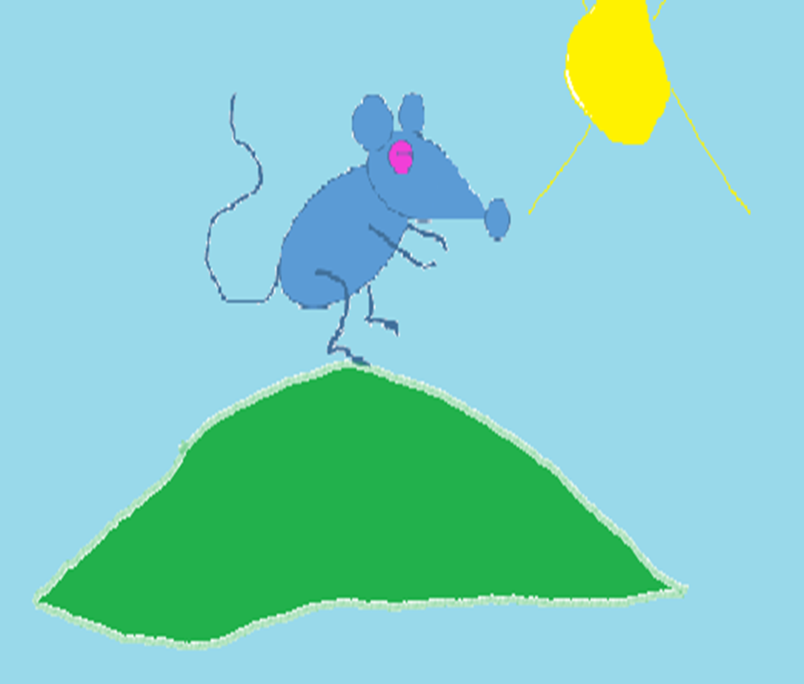
Whisker’s adventures
Written and illustrated by
Liandri de Beer

Slide 2
Long ago there lived a mouse on a grassy hill. His name was Whiskers.

Slide 3
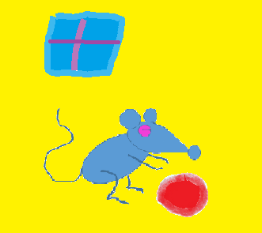
Whiskers loved playing with his bright red ball.

Slide 4
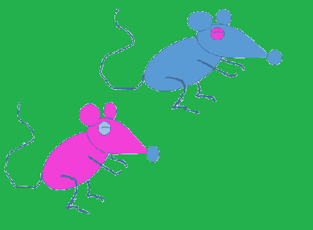
One day, his best friend Minnie came to visit.

Slide 5
Whiskers said, “Would you like to play with my bright red ball?”

Slide 6
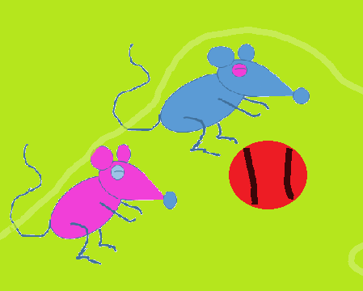
“Yes, please!” said Minnie. “Let’s go play outside!”

Slide 7
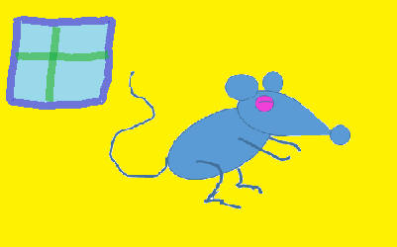
But Whiskers was a lazy mouse, he wanted to stay in the house.

Slide 8
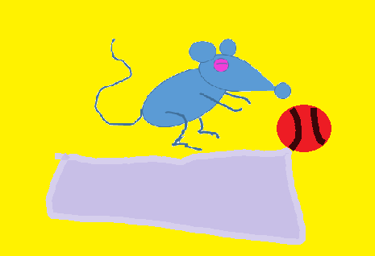
Minnie asked, “Are you allowed to play with the ball in the house?”

Slide 9
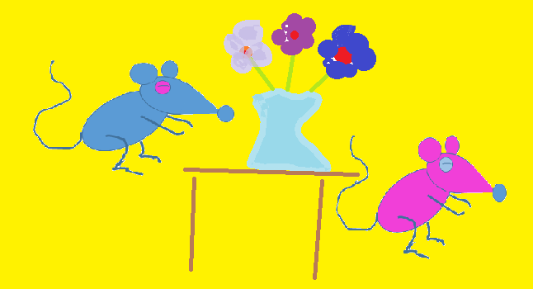
Whiskers said, “there is nothing bad that can happen if I play with my ball in the house.”

Slide 10
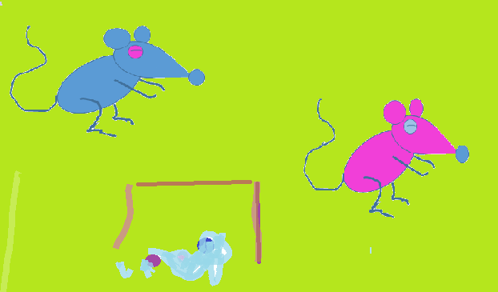
Whiskers kicked the ball. Kaboem! His mom’s vase broke into tiny little pieces!

Slide 11
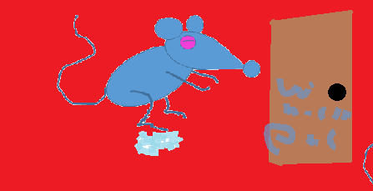
He ran to his room, but on his way he stepped into a piece of broken glass.

Slide 12
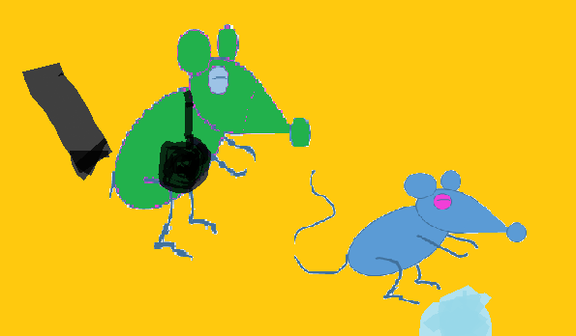
He cried and cried until his mom came. There was blood all over the floor!

Slide 13
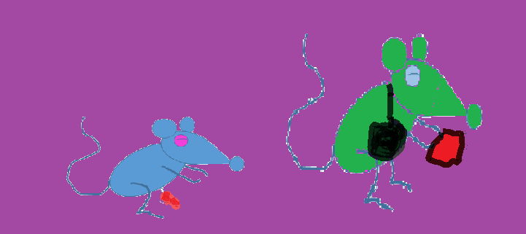
His mom wiped away his tears and cleaned off all the blood, she put a plaster on his tiny foot.

Slide 14
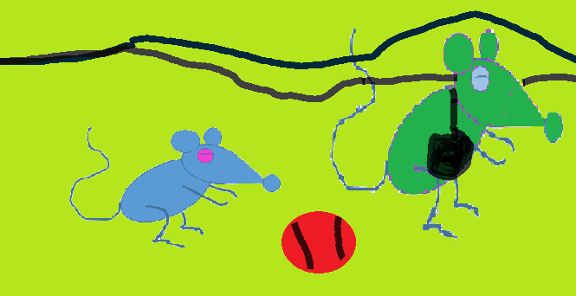
Whiskers said: “I’m so sorry I broke your pretty vase mommy.” From that day on, he never played with his ball in the house again.
THE END

Slide 15
Whiskers is a lazy mouse. He learns a valuable lesson about being careful in and around the house.
Presented and illustrated by Liandri de Beer

