Slide 1
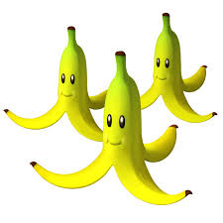
Wafumba akatooke You prepare bananas
A Lugwere children’s game collected by Shakira Bodio
Image from
http://jumboempanadas.blogspot.com/2010/09/bananas-ice-cream-and-mariokart.html

Slide 2
Wafumba akatooke
Watwala kungira
Omukaire yakalya
Yasesa mukenda
Omukyala wefune
Akagele kano
Akalimu obudondo
Obweikere
Instructions
Sit in a circle with legs stretched out into the center.
Start singing the song.
When the song stops, fold the leg on which the song stops.
The play goes on until the last person to fold his/her leg has been found.
That one chooses the rest until he/she gets at least three of them.
The game is repeated.
You prepare bananas
You take to the road
An old woman eats
She fills her intestines
Woman fold this leg
It has dirt like that of a frog

Slide 3
Wafumba akatooke You prepare bananas
A Lugwere children’s game collected by Shakira Bodio
© African Storybook Initiative, 2013
Image from: http://jumboempanadas.blogspot.com/2010/09/bananas-ice-cream-and-mariokart.html

