Slide 1
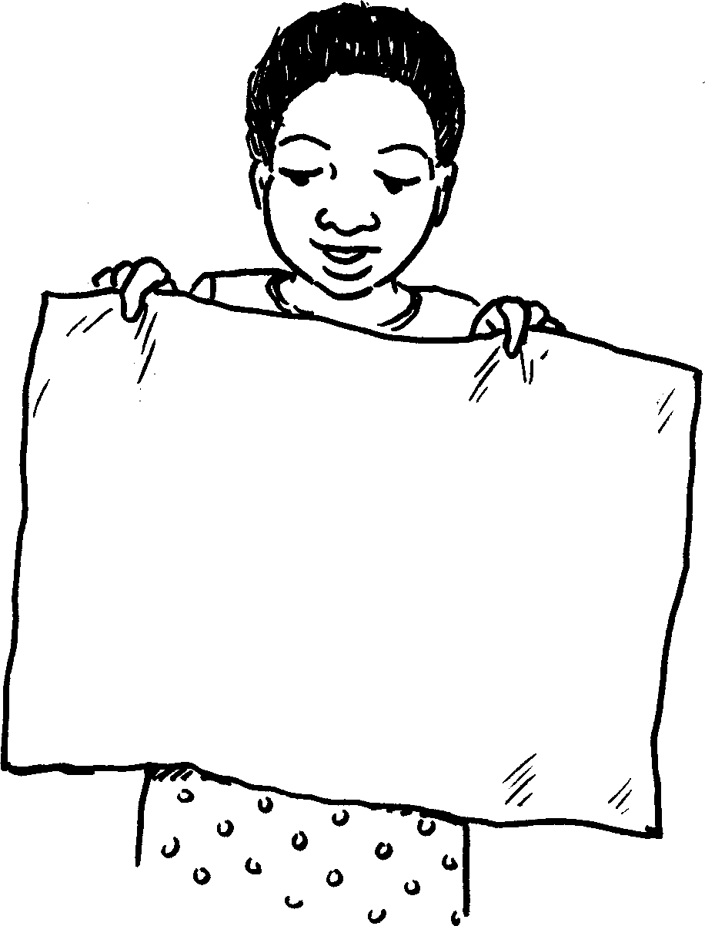
Yimina lona This is me
Story in isiZulu by Clare Verbeek, Thembani Dladla, Zanele Buthelezi
Illustrated by Kathy Arbuckle
Yimina lona This is me

Slide 2
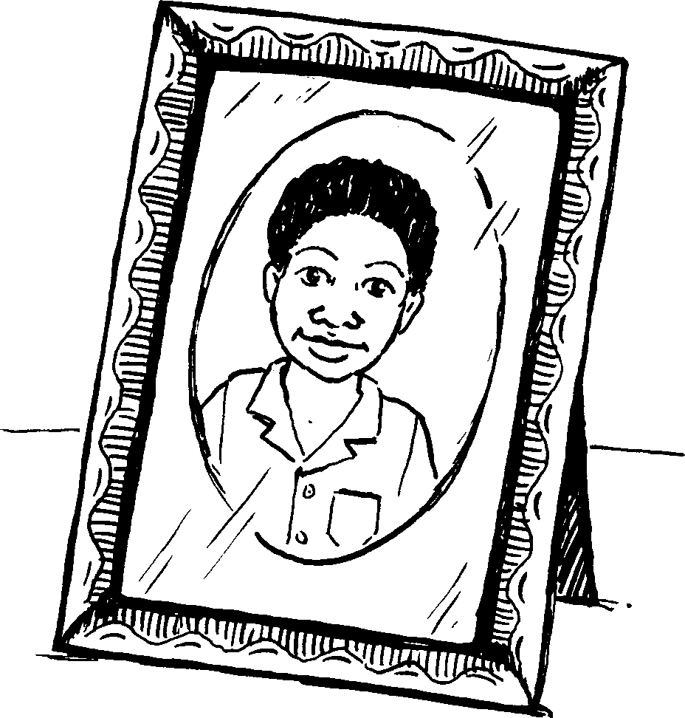
Lesi yisithombe sami.
This is my picture.

Slide 3
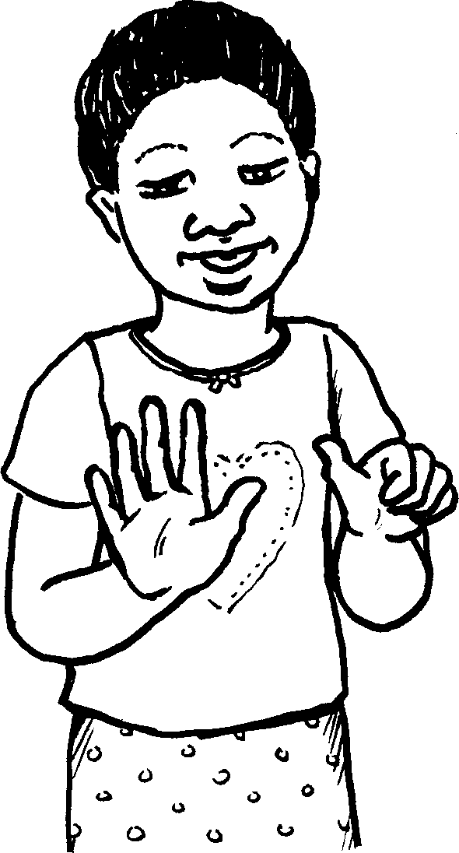
Ngineminyaka eyisithupha.
I am six years old.

Slide 4
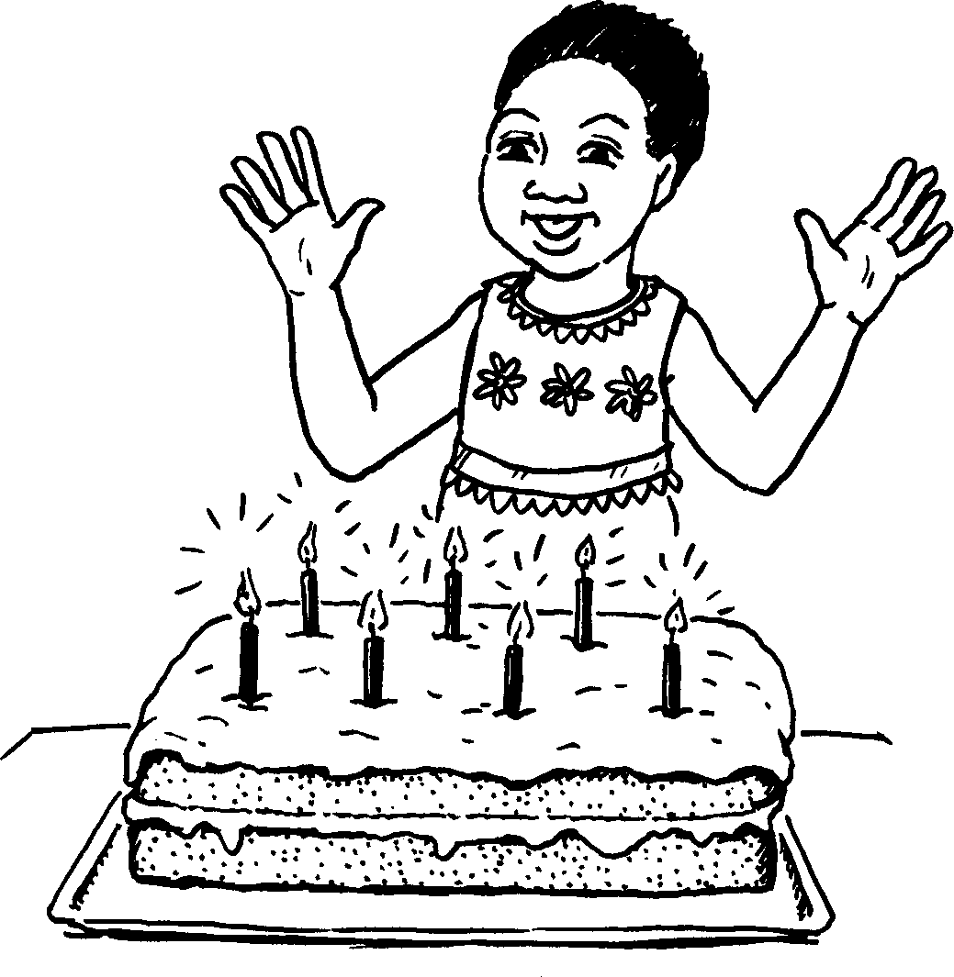
Usuku lwami lokuzalwa lungoMashi.
I was born in March.

Slide 5
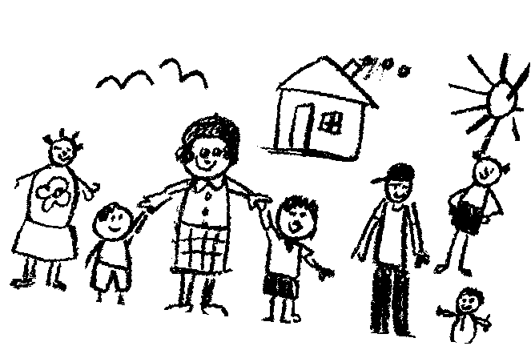
Lesi yisithombe somndeni wami.
This is a picture of my family.

Slide 6
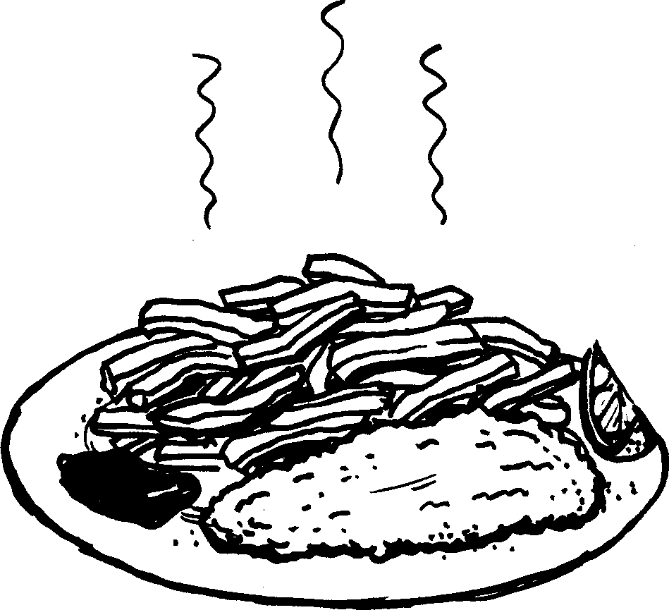
Ukudla engikuthandayo yinhlanzi namazambane athosiwe.
My favourite food is fried fish and chips.

Slide 7
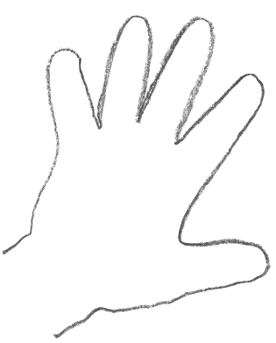
Ngingasidweba isandla sami.
I can draw my hand.

Slide 8
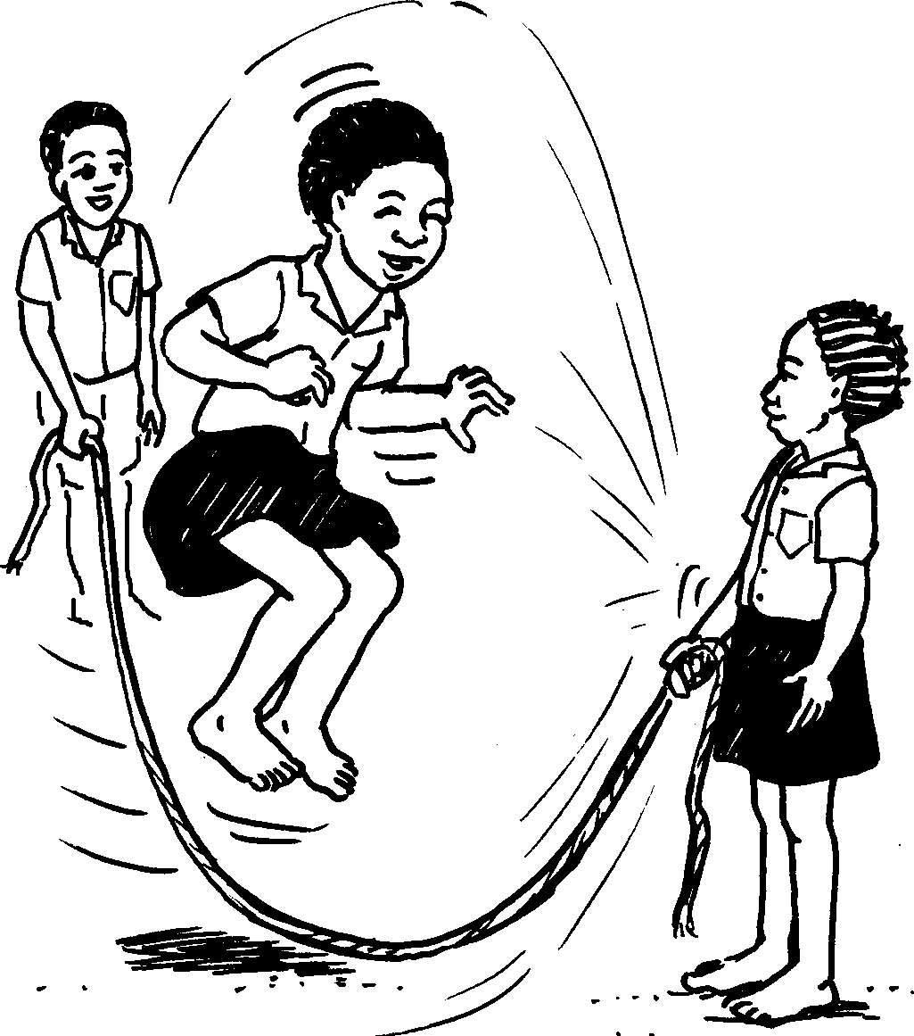
Ngineminyaka eyisithupha.
I am ………… years old.

Slide 9
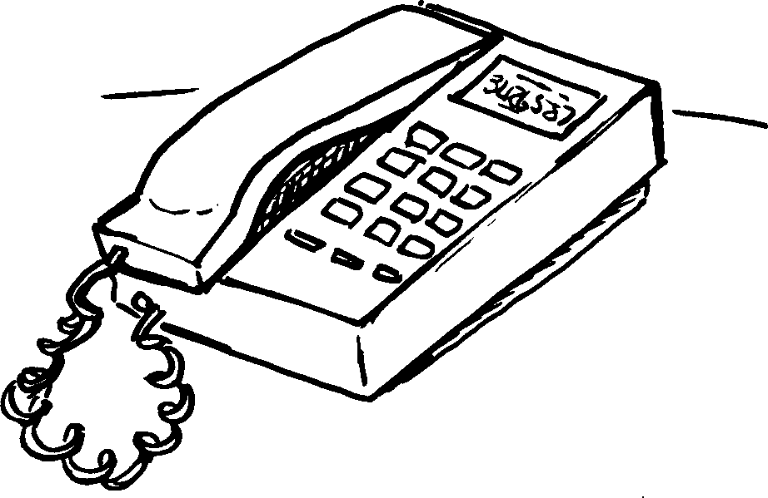
Inombolo yami yocingo yilena 033 – 3426587
Ungalenza ibhuku elifana naleli?
My telephone number is
033 – 3426587
Ungalenza ibhuku elifana naleli?

Slide 10
Yimina lona This is me
© 2007 School of Education and
Development (Centre for Adult Education), University of KwaZulu-Natal.
This book may be copied, and used for teaching and learning free of charge.
It may not be sold for profit.
Story in isiZulu by Clare Verbeek, Thembani Dladla, Zanele Buthelezi
Kathy Arbuckle

