Slide 1
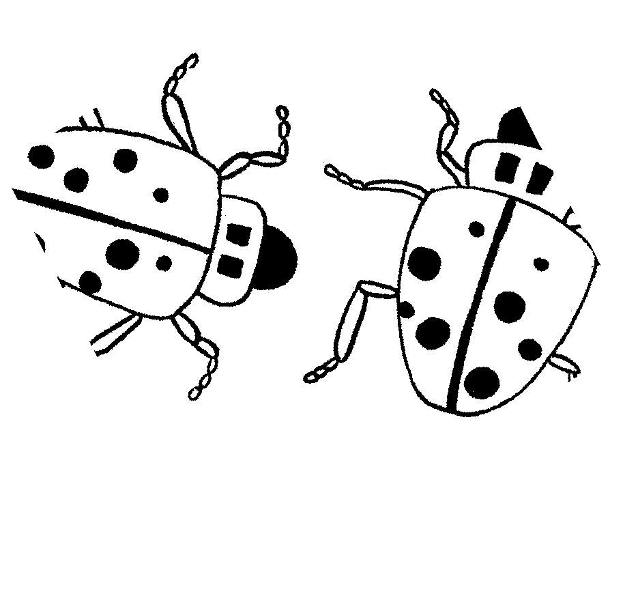
Kungaki? How many?
Story in isiZulu by Clare Verbeek, Thembani Dladla, Zanele Buthelezi
Illustrated by Sandra Mc Dougall

Slide 2
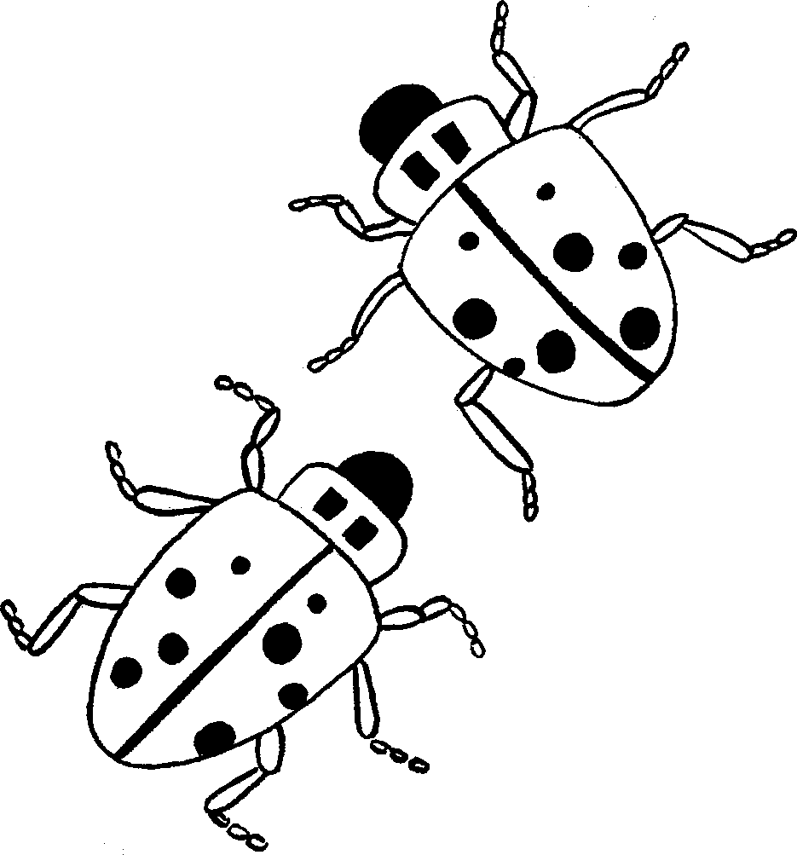
Mingaki imilenze yamabhungezi amabili?
How many legs do two ladybirds have?

Slide 3
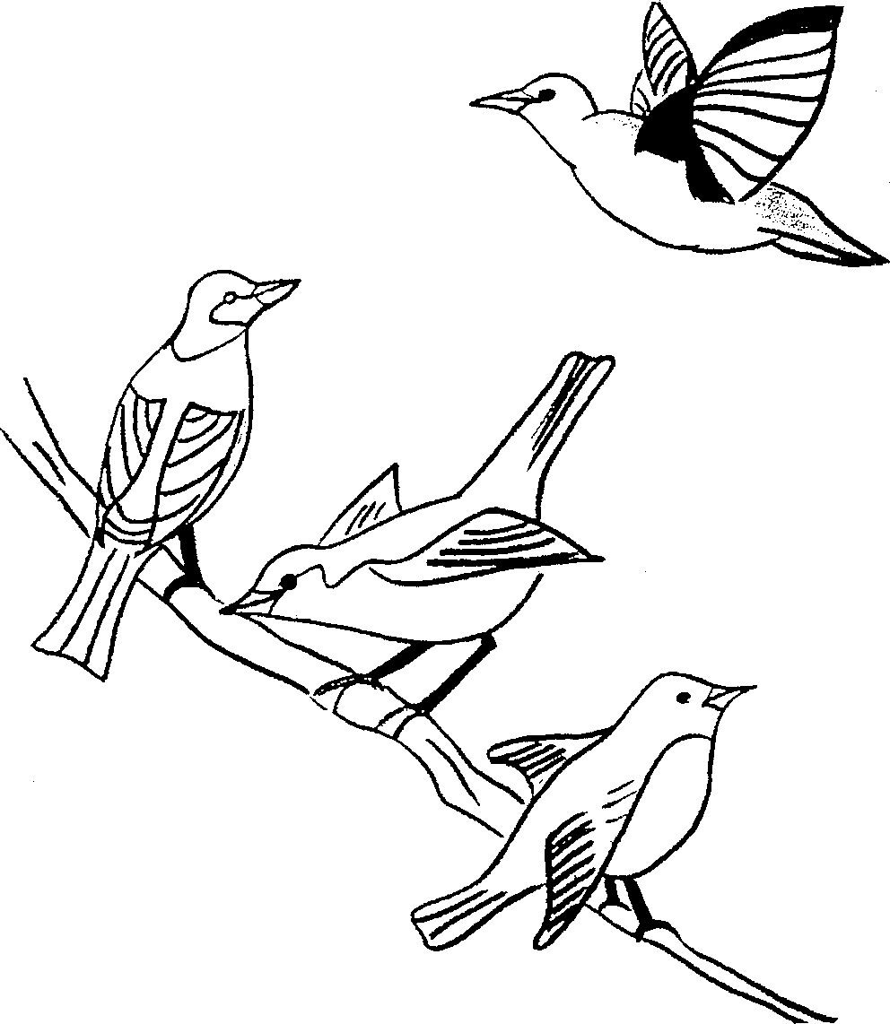
Zingaki izimpiko zezinyoni ezine?
How many wings do four birds have?

Slide 4
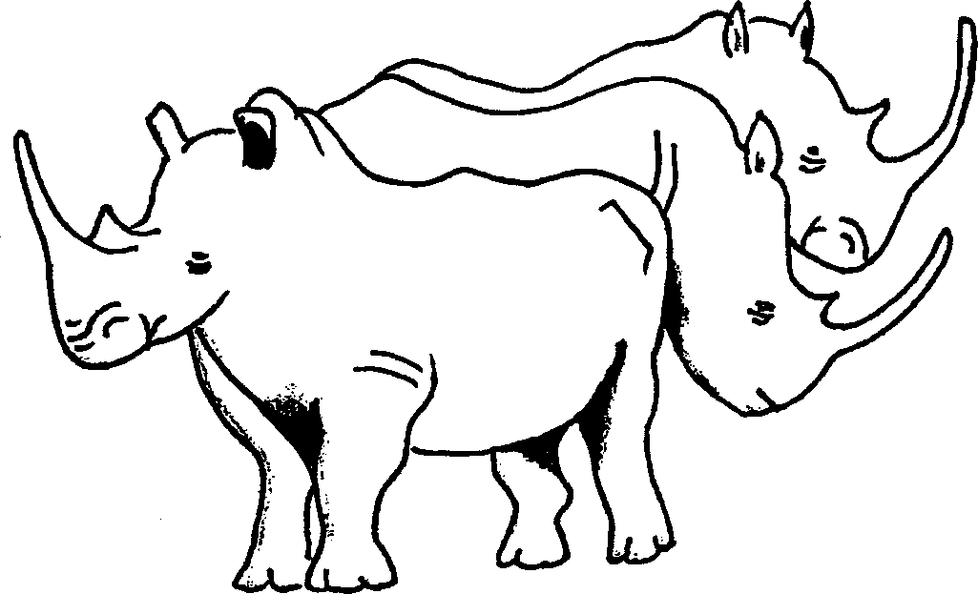
Zingaki izimpondo
zobhejane abathathu?
How many do three rhinos have?

Slide 5
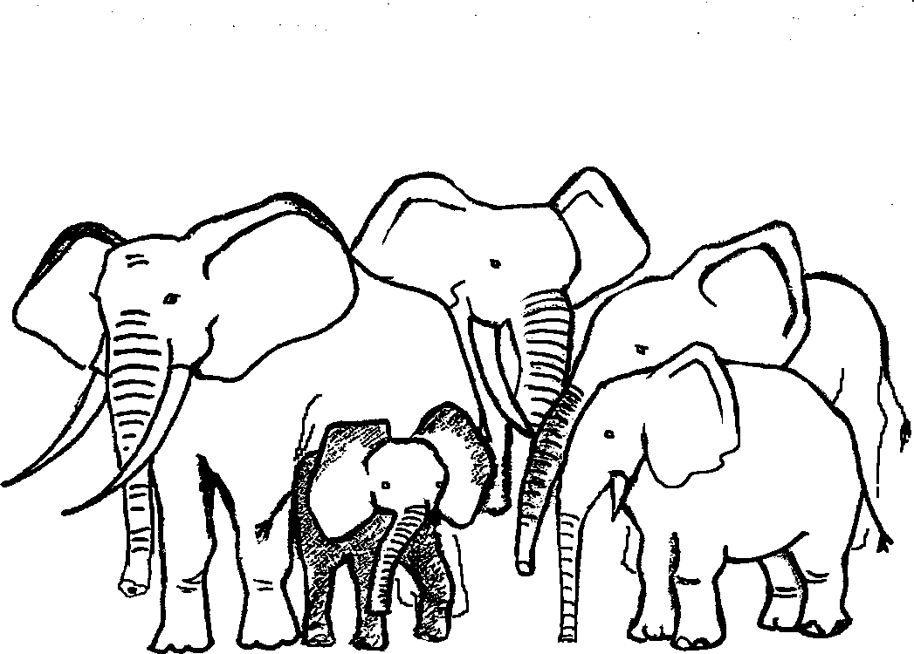
Mingaki imiboko yezindlovu ezinhlanu?
How many trunks do five elephants have?

Slide 6
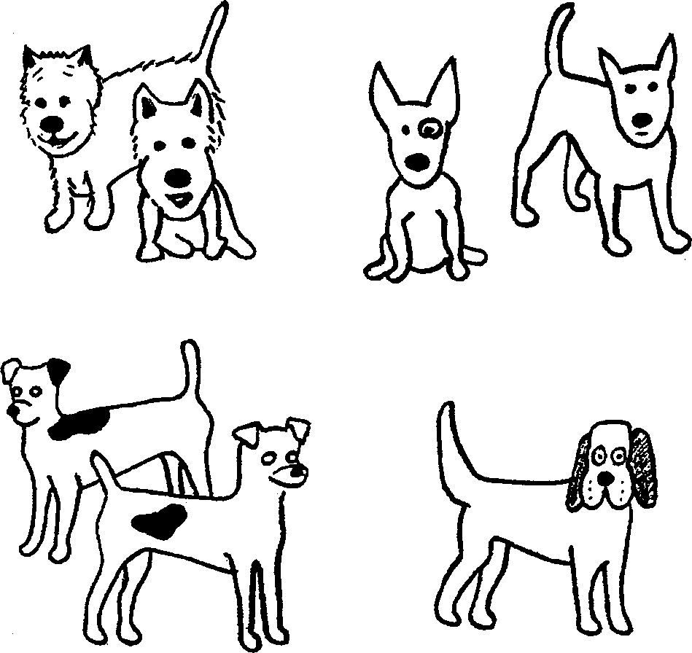
Mangaki amadlebe ezinja
eziyisikhombisa?
How many ears do seven dogs have?

Slide 7
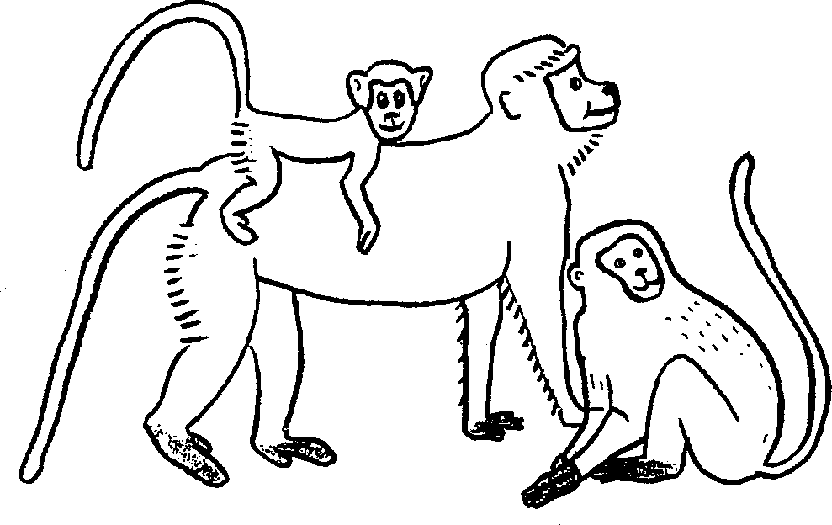
Mingaki imisila yezinkawu
ezintathu?
How many tails do three monkeys have?

Slide 8
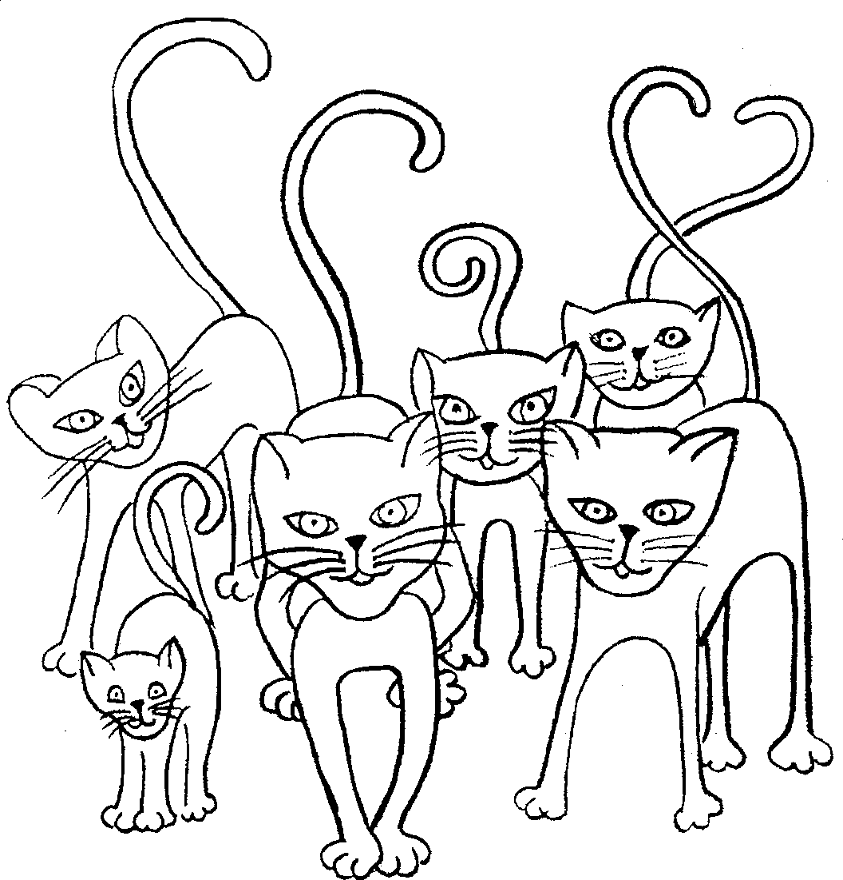
Mangaki amehlo amakati ayisithupha?
How many eyes do six cats have?

Slide 9
Mingaki imilenze
yesongololo elilodwa?
How many legs does one worm have?

Slide 10
Kungaki? How many?
© 2007 School of Education and
Development (Centre for Adult Education), University of KwaZulu-Natal.
This book may be copied, and used for teaching and learning free of charge.
It may not be sold for profit.
Story in isiZulu by Clare Verbeek, Thembani Dladla, Zanele Buthelezi
Sandra McDougall

